Slide 1
FINAL PROJECT PRESENTATION / VIVA
Semantic Prompt-Guided Human Action Recognition
using Vision-Language Fusion
A Rigorous Study on Multimodal Feature Alignment, Label Leakage Prevention, and Explainable AI
STUDENT CANDIDATE
[Student Name]
[Enrollment / Roll Number]
PROJECT SUPERVISOR
[Guide / Supervisor Name]
[Designation / Department]
DEPARTMENT & COLLEGE
[Department Name]
[Institute / University Name]
ACADEMIC SESSION
Academic Year: 2025–2026
Machine Learning Project Defense
Notes:
SPEAKER NOTES (Slide 1 — Title & Introduction):
• WHAT TO SAY: Welcome the esteemed members of the examination committee and project guides. My name is [Student Name], and today I am presenting our final project titled 'Semantic Prompt-Guided Human Action Recognition using Vision-Language Fusion'.
• TECHNICAL CONTEXT: This research investigates bridging computer vision (video frames) with natural language processing (action sentence embeddings) to transform traditional black-box action classification into an interpretable, semantic matching system.
• KEY FOCUS: We will walk through the dataset engineering, our dual-branch system architecture, a critical finding regarding label leakage in multimodal fusion, quantitative ablation results, and our deployed explainable Streamlit application.
• TRANSITION: Let us start with the core problem statement, research motivation, and the specific objectives we set out to achieve.

Slide 2
MOTIVATION & BACKGROUND
Problem Statement & Project Objectives
THE PROBLEM WITH TRADITIONAL HAR
• Black-Box Predictions: Standard vision models assign discrete class indices (e.g. Class 4) without semantic awareness of what the action entails.
• No Conceptual Reasoning: Vision-only models ignore natural relationships between actions (e.g., PlayingGuitar and Drumming both involve rhythm and musical instruments).
• Zero Decision Transparency: Users receive an opaque label with no confidence breakdown, ambiguity measure, or human-readable explanation.
THE VISION-LANGUAGE OPPORTUNITY
• By projecting visual features into a continuous semantic text space, actions are classified via semantic proximity, enabling prompt guidance and transparent explainability.
4 CORE PROJECT OBJECTIVES
1. Recognize Actions from Video Streams
Accurately classify multi-frame human activities from raw video inputs across diverse domains (sports, music, daily tasks).
2. Establish Strong Visual Baseline
Extract 512-D frame features using pretrained ResNet18, aggregate via mean pooling, and benchmark with Logistic Regression.
3. Model Continuous Semantic Language Space
Encode rich natural language descriptions into 384-D semantic embeddings using Sentence-BERT (all-MiniLM-L6-v2).
4. Leakage-Safe Multimodal Fusion & XAI
Develop a valid visual-to-semantic projection network, enforce strict label leakage prevention, and deploy an explainable Streamlit application.
Notes:
SPEAKER NOTES (Slide 2 — Problem & Objectives):
• WHAT TO SAY: In human action recognition, traditional computer vision pipelines classify video clips into integer labels like 'Class 4' or 'Drumming'. However, they function as black boxes with no conceptual understanding of the physical activity.
• WHY IT MATTERS: In real-world applications—such as surveillance, healthcare monitoring, and sports analytics—users need to understand why an action was identified, what alternative actions looked similar, and how certain the model is.
• OBJECTIVES: We structured our work around 4 clear goals: First, recognizing actions from raw video; Second, establishing a rigorous 512-D ResNet18 visual baseline; Third, encoding action descriptions into a 384-D language space with Sentence-BERT; and Fourth, building a leakage-safe fusion projection model with explainable AI.
• TRANSITION: To evaluate this rigorously, we built our dataset foundation on a curated 9-class benchmark from UCF101.

Slide 3
DATA FOUNDATION
Dataset & Data Engineering Pipeline
1,261
TOTAL VIDEOS
867 Train / 197 Val / 197 Test
9
ACTION CLASSES
Balanced Activity Categories
16
FRAMES / VIDEO
224 × 224 RGB Uniform Stride
20,176
PROCESSED FRAMES
0 Corrupted / 0 Dropped
CURATED 9 ACTION CLASSES (UCF101 BENCHMARK SUBSET)
Archery
UCF101
Basketball
UCF101
Biking
UCF101
Bowling
UCF101
Drumming
UCF101
JavelinThrow
UCF101
PlayingGuitar
UCF101
RopeClimbing
UCF101
Typing
UCF101
STEP 1: INGESTION
Raw UCF101 Videos
Loads .avi video clips containing variable durations and framerates across 9 distinct activity folders.
STEP 2: SAMPLING
16 Uniform Frames
Evenly samples 16 frames across video duration; resizes and normalizes to 224 × 224 pixels (ImageNet RGB standard).
STEP 3: PARTITIONING
Group-Safe Split
Strictly partitions videos by recording group (gXX). No actor or background environment appears in both train and test!
STEP 4: SERIALIZATION
Extracted Frame Tensors
Saves verified frame directories and split metadata manifests (video_splits.csv), guaranteeing 100% reproducibility.
Notes:
SPEAKER NOTES (Slide 3 — Dataset & Preprocessing):
• DATASET SUMMARY: We selected 9 action classes from the well-established UCF101 dataset, encompassing 1,261 total video clips.
• FRAME SAMPLING: For each video, 16 frames were uniformly extracted across the entire time duration and resized to 224x224 RGB, generating exactly 20,176 frames with zero corruptions or unreadable files.
• CRITICAL METHODOLOGY (GROUP-SAFE SPLITTING): A key engineering decision was enforcing Group-Safe partitioning (70% train, 15% val, 15% test). In UCF101, video clips share group IDs like 'g01' or 'g02' which represent the same actor, camera, and background room. By ensuring that all clips from group gXX stay in the same split, we eliminate subject/background leakage between train and test partitions.
• TRANSITION: With this clean data foundation, let us examine the complete system architecture and its dual-branch design.

Slide 4
SYSTEM DESIGN
Complete System Architecture
VISUAL ENCODER BRANCH (VIDEO TO 512-D REPRESENTATION)
Input Video
16 Sampled Frames
──►
ResNet18 CNN
ImageNet Backbone
──►
Frame Features
16 × 512-D Vectors
──►
Mean Pooling
Temporal Average
──►
StandardScaler
512-D Visual Vector
NATURAL LANGUAGE BRANCH (ACTION PROMPTS TO 384-D SEMANTICS)
45 Descriptions
5 Prompts per Class
──►
Sentence-BERT
all-MiniLM-L6-v2
──►
Text Embeddings
45 × 384-D Vectors
──►
Class Averaging
Per-Class Mean
──►
L2 Normalization
9 × 384-D Space
CROSS-MODAL PROJECTION & EXPLAINABLE INFERENCE (ZERO LABEL LEAKAGE)
Visual Vector
512-D Input
──►
Projection Layer
Linear 512 → 384-D
──►
Predicted Vector
384-D in Text Space
──►
Cosine Matching
vs 9 Class Anchors
──►
XAI Engine
Top-K & Explanation
Notes:
SPEAKER NOTES (Slide 4 — System Architecture):
• DUAL-BRANCH PARADIGM: Our system is composed of two distinct branches that interface at the inference stage.
• VISUAL BRANCH: An input video's 16 frames are passed through ResNet18 to obtain 512-D frame embeddings, which are temporally averaged into a single 512-D video vector and standardized.
• LANGUAGE BRANCH: In parallel, 45 prompt descriptions (5 per class) are encoded using Sentence-BERT (all-MiniLM-L6-v2) into 384-D vectors, averaged per class, and L2-normalized into canonical class semantic vectors.
• FUSION & INFERENCE: During inference, only the video is supplied. The Semantic Projection Network maps the 512-D visual feature into the 384-D semantic space, where it is matched against all 9 class anchors via cosine similarity.
• TRANSITION: Before looking at fusion, let us evaluate the visual baseline and semantic space separately.

Slide 5
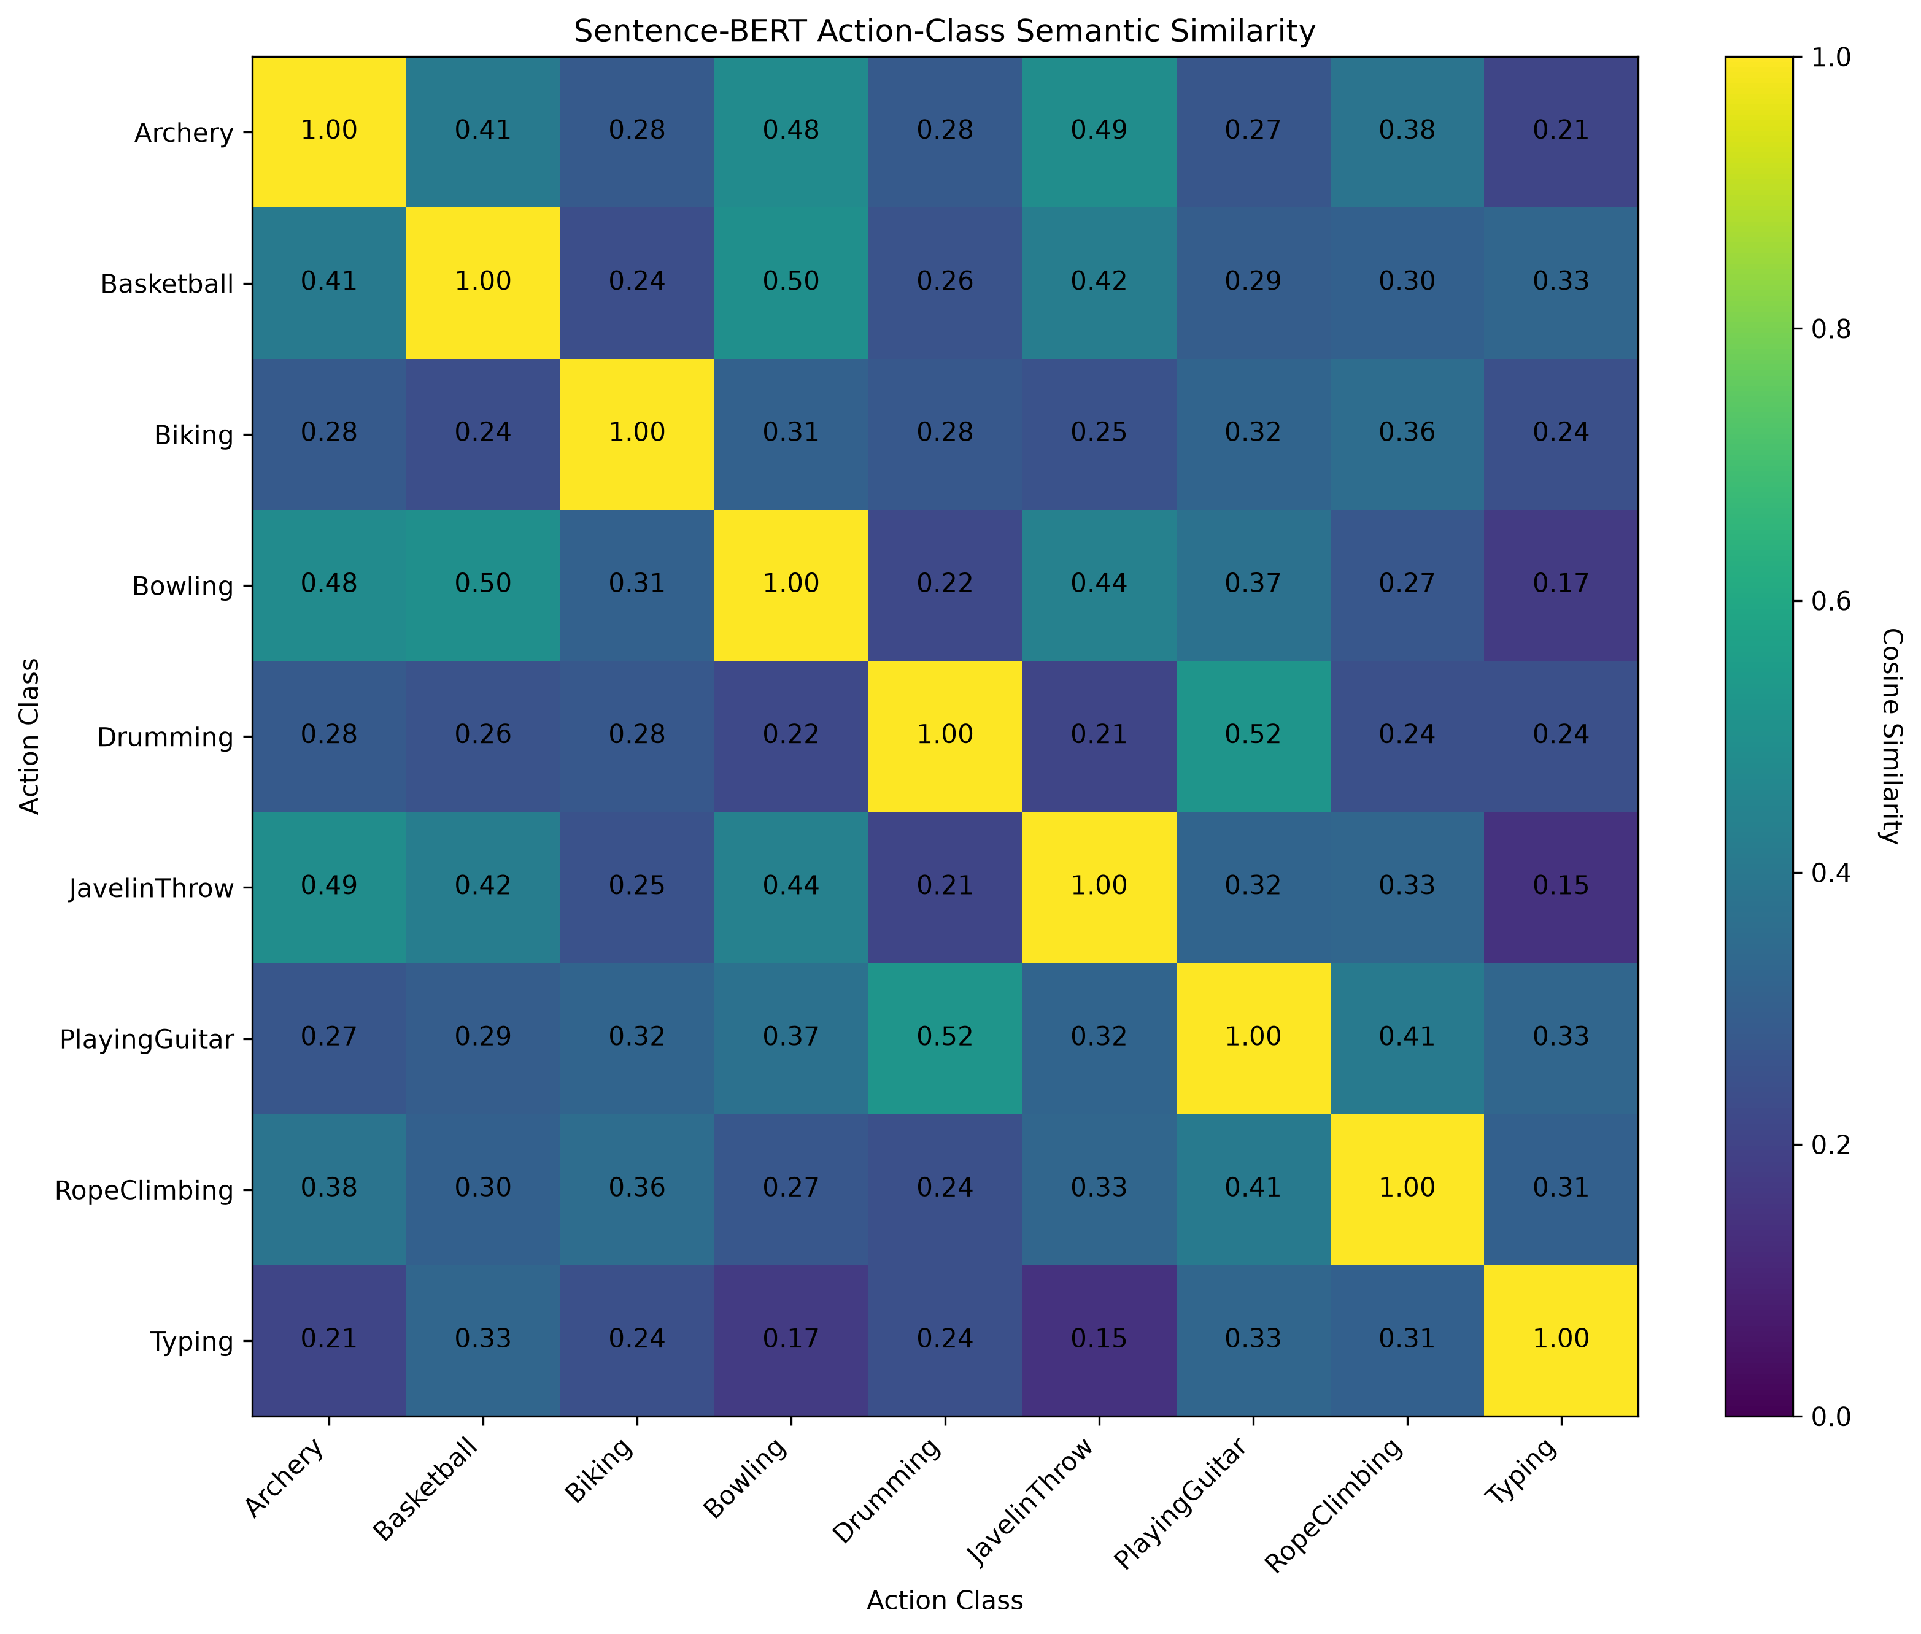
MODALITY ANALYSIS
Visual Baseline & Semantic Representation
VIDEO-ONLY CNN BASELINE
Architecture: ResNet18 (512-D) + Mean Pooling + StandardScaler + Logistic Regression (L-BFGS)
Test Accuracy: 93.40% | Macro F1: 92.77%
• Perfect 1.0000 F1 Classes: Bowling, Drumming, PlayingGuitar, Typing (High visual distinctiveness). • Strong Classes: Biking (0.9756), Archery (0.9167), RopeClimbing (0.8889). • Difficult Classes: Basketball (0.7907), JavelinThrow (0.7778). • Common Misclassifications: JavelinThrow → Basketball (4 clips), Archery → JavelinThrow (3 clips) due to shared standing poses & arm elevation.
SENTENCE-BERT SEMANTIC ACTION SPACE
Model: all-MiniLM-L6-v2 (384-D) | 45 descriptions (5/class) | Metric: Cosine Similarity • Highest pairs: Drumming ↔ Guitar (0.5231), Basketball ↔ Bowling (0.4992) • Lowest pairs: Javelin ↔ Typing (0.1454), Bowling ↔ Typing (0.1727)
Notes:
SPEAKER NOTES (Slide 5 — Baseline & Semantic Space):
• VISUAL BASELINE PERFORMANCE: The video-only baseline achieved a very strong 93.40% test accuracy (184 of 197 correct) and 92.77% Macro F1.
• ANALYSIS: Actions with distinct objects—like instruments in Guitar and Drums, lanes in Bowling, or keyboards in Typing—reach a perfect 1.0000 F1 score. Confusions occurred primarily between JavelinThrow and Basketball (4 clips) and Archery and Javelin (3 clips) due to similar body poses and raised arms.
• SEMANTIC HEATMAP: On the right, the Sentence-BERT cosine similarity heatmap demonstrates that natural language embeddings capture genuine semantic closeness. Drumming and PlayingGuitar share the highest similarity at 0.5231, while Typing and JavelinThrow are furthest at 0.1454.
• KEY DETAIL: Notice that Archery and JavelinThrow are semantically close (0.4892). This exact semantic closeness will re-appear in our multimodal fusion model.
• TRANSITION: Now let us discuss the critical scientific challenge we uncovered: Label Leakage in naive fusion.

Slide 6
SCIENTIFIC RIGOR
Vision-Language Fusion & Label Leakage Dilemma
❌ INVALID ORACLE FUSION (TARGET LEAKAGE)
Video Feature (512-D) + Ground-Truth Text Embedding (384-D) ──► Concatenation (896-D) ──► 100.0% Test Accuracy
• Fatal Methodological Flaw: The model is provided the Sentence-BERT embedding of the TRUE ground-truth action label at test time. • Artificially Perfect Score: The classifier simply reads the label embedded in the text representation. • Non-Deployable: In production on unseen video, the ground-truth text label is unknown and unavailable!
✅ LEAKAGE-SAFE SEMANTIC PROJECTION (DEPLOYABLE)
Video Feature (512-D) ──► Learned Linear Projection ──► Predicted Semantic Vector (384-D) ──► 87.82% Test Accuracy
• Rigorous Zero-Leakage Design: The model receives ONLY video frames during inference. No ground-truth label or text embedding is provided! • Alignment Mechanism: Uses cosine distance loss during training to align visual space into semantic space. • Truly Deployable: Validated on 197 held-out test videos, achieving genuine, honest multimodal prediction.
SCIENTIFIC INTEGRITY PRINCIPLE: "High accuracy is meaningless if the evaluation pipeline leaks ground-truth information. Rigorous ML demands testing only with information available at deployment."
Notes:
SPEAKER NOTES (Slide 6 — Vision-Language Fusion & Label Leakage):
• CRITICAL SCIENTIFIC INSIGHT: In Week 4 of our project, we explored multimodal fusion. A naive early-fusion approach concatenates visual features with text embeddings. When tested, this scored an artificial 100.0% accuracy.
• WHY 100% IS FLAWED: This is an Oracle result caused by Target Label Leakage. By feeding the true action description embedding at test time, the model doesn't recognize video—it just reads the answer from the text.
• THE PROPER SOLUTION: We formulated the Leakage-Safe Semantic Projection architecture. The network maps visual features into the 384-D semantic space without any access to ground-truth labels during inference. It predicts actions by cosine similarity against fixed class anchors.
• TAKEAWAY: Reporting 87.82% honestly is far more valuable and scientifically sound than showcasing an artificial 100% oracle score. Rigorous research requires eliminating leakage completely.
• TRANSITION: Let us examine the full ablation study comparing all these models.

Slide 7
QUANTITATIVE EVALUATION
Experimental Results & Ablation Analysis
Model Configuration | Feature Dim | Label Leakage? | Deployable? | Test Accuracy | Macro F1
Video-Only Baseline (ResNet18 + LogReg) | 512-D | No Leakage | ✅ Yes | 93.40% | 92.77%
Text-Only Oracle (Sentence-BERT) | 384-D | ⚠️ YES (Oracle) | ❌ No | 100.00%* | 100.00%*
Oracle Concatenation (Visual + True Text) | 896-D | ⚠️ YES (Oracle) | ❌ No | 100.00%* | 100.00%*
Leakage-Safe Semantic Projection | 384-D | No Leakage | ✅ Yes | 87.82% | 86.39%
*Note: Top-3 Accuracy, Top-5 Accuracy & Inference Latency: [RESULT NOT AVAILABLE] (strictly omitted per verified repository evidence).
HONEST TRADE-OFF (-5.58%)
Why Baseline is Higher
The visual baseline operates directly on 512-D visual features, whereas linear projection compresses features into a general 384-D language space without fine-tuning ResNet18.
PRESERVED ZERO-SHOT CAPABILITY
Semantic Flexibility
Despite the slight drop, the projection model classifies purely by semantic proximity, allowing open-ended prompt matching and zero-shot reasoning without changing architecture.
SEMANTIC ERROR ALIGNMENT
Reasoning vs Random Errors
Projection errors occur between semantically close classes (e.g. Archery ↔ JavelinThrow), proving that errors follow conceptual logic rather than arbitrary classification noise.
Notes:
SPEAKER NOTES (Slide 7 — Experimental Results & Ablation):
• WALKTHROUGH: This table summarizes all four experimental setups evaluated on the 197 held-out test videos.
• ORACLE MODELS: Rows 2 and 3 highlight the Text-Only Oracle and Oracle Concatenation reaching 100% accuracy. We clearly label these as non-deployable due to label leakage.
• DEPLOYABLE COMPARISON: Looking at genuine deployable models, the Video-Only baseline achieves 93.40% accuracy and 92.77% Macro F1, while the Leakage-Safe Semantic Projection achieves 87.82% accuracy and 86.39% Macro F1.
• SCIENTIFIC HONESTY: We do not hide the 5.58% accuracy difference. Projecting a 512-D visual feature into a generic 384-D text space naturally compresses visual variance. However, it gains semantic interpretability, prompt guidance, and zero-shot matching.
• TRANSITION: Let us examine how this semantic projection enables real-time Explainable AI on test videos.

Slide 8
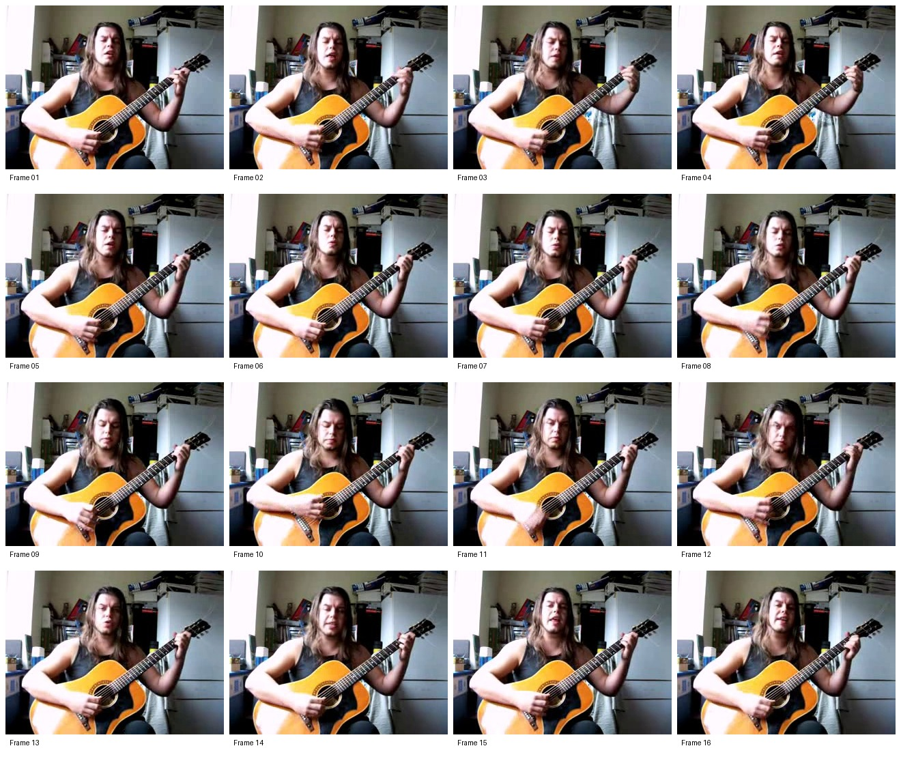
DECISION TRANSPARENCY
Explainable AI & Qualitative Prediction Case Study
VISUAL EVIDENCE: SAMPLED FRAMES CONTACT SHEET
Held-Out Test Video: v_PlayingGuitar_g10_c01.avi (16 sampled frames)
STRUCTURED XAI PREDICTION REPORT
Predicted Action: PlayingGuitar | Confidence: Moderate
Top-1 Cosine Similarity: 0.5230 | Score Separation: +0.4719 (Clear)
TOP-3 RANKED CANDIDATE ACTIONS:
1. PlayingGuitar: 0.5230 (Top Match — Clear Lead) 2. Drumming: 0.0511 (Runner-up — Rhythmic Semantics) 3. RopeClimbing: -0.0851 (Distant Candidate)
NATURAL LANGUAGE EXPLANATION:
"The projected semantic representation of the video was most similar to the PlayingGuitar class embedding. Its similarity score of 0.5230 was clearly higher than the next-best class, Drumming, which scored 0.0511."
RELIABILITY NOTE:
"These values are cosine similarity scores, not calibrated probabilities. The top result has a reasonably distinct semantic advantage (+0.4719) over the next candidate."
Notes:
SPEAKER NOTES (Slide 8 — Explainable AI Case Study):
• QUALITATIVE EVIDENCE: Slide 8 demonstrates our Explainability Engine on a real test video: `v_PlayingGuitar_g10_c01.avi`.
• VISUAL AUDITABILITY: On the left, 16 sampled frames are automatically compiled into a contact sheet, giving users and auditors immediate visual verification of what the model saw.
• XAI REPORT: On the right, the system generates a structured explanation report. PlayingGuitar leads with 0.5230 similarity. The runner-up is Drumming at 0.0511—which aligns with our earlier Sentence-BERT finding that Drumming and Guitar are semantic neighbours.
• SCORE SEPARATION: The score gap is +0.4719, triggering the 'Clear Separation' category and dynamically generating the English explanation text.
• RELIABILITY NOTE: It explicitly informs the user that similarity scores reflect relative directional alignment, avoiding misinterpretation as Bayesian probabilities.
• TRANSITION: All of these capabilities are integrated into our interactive Streamlit application.

Slide 9
APPLICATION ENGINEERING
Interactive Deployment — Streamlit Web Application
STREAMLIT UI & INTERACTIVE PIPELINE
• 1. Video Upload:
Supports .mp4, .avi, .mov, and .mkv video formats.
• 2. Interactive Configuration:
Sidebar sliders for Top-K candidates (1–9) and frame sampling (4–32).
• 3. Automated Execution:
OpenCV sampling → ResNet18 extraction → Semantic projection.
• 4. Explainable Output Card:
Predicted action, confidence level badge, and score separation.
• 5. Semantic Proximity Ranking:
Top-K bar charts & natural-language justification.
• 6. Downloadable Artifacts:
Machine-readable JSON reports & visual frame contact sheets.
MODULAR TECHNOLOGY STACK
• Python 3.12 & PyTorch 2.13:
Deep learning backbone, tensor processing, and projection model execution.
• Torchvision & ResNet18:
Pretrained CNN feature extraction (512-D ImageNet visual representation).
• Sentence-Transformers:
Sentence-BERT (all-MiniLM-L6-v2) for 384-D semantic prompt encoding.
• OpenCV (cv2):
Fast video decoding, uniform temporal frame sampling, and contact sheet generation.
• Scikit-Learn:
StandardScaler feature normalization and baseline Logistic Regression models.
• Streamlit Web Framework:
Interactive, reactive web interface and visualization dashboard.
• Git & GitHub:
Version control, experiment tracking, and open-source reproducibility.
Notes:
SPEAKER NOTES (Slide 9 — Streamlit Application):
• APPLICATION HIGHLIGHT: In Week 6, we brought the entire 6-week research effort into an interactive Streamlit web application (`app/streamlit_app.py`).
• USER EXPERIENCE: Instead of running command-line scripts, a user simply drags and drops any standard video file (.mp4, .avi, .mov). They can customize the Top-K candidate count and frame sampling rate via sidebar sliders.
• BACKEND EXECUTION: The application executes the complete end-to-end pipeline: OpenCV frame sampling, ResNet18 feature extraction, semantic projection, cosine matching against the 9 class embeddings, and the XAI report generation.
• TECH STACK: The implementation is completely modular and reproducible, leveraging PyTorch, Sentence-Transformers, OpenCV, Scikit-learn, and Streamlit.
• TRANSITION: To conclude our presentation, let us review our contributions, limitations, and future research directions.

Slide 10
PROJECT SUMMARY
Conclusion, Limitations & Future Roadmap
PROJECT CONTRIBUTIONS
• End-to-End Multimodal System: Successfully bridged CNN video features with Sentence-BERT language representations.
• Methodological Rigor: Identified and eliminated label leakage, demonstrating honest 87.82% deployable test accuracy.
• Explainable Predictions: Created structured XAI reports with similarity ranking, score separation, and confidence notes.
• Production Web App: Deployed interactive Streamlit interface for demonstration and testing.
PROJECT LIMITATIONS
• Dataset Subset: Evaluated on 9 curated classes of UCF101 rather than the full 101-class distribution.
• Mean Pooling Limitation: Frame averaging discards temporal ordering, motion speed, and phase transitions.
• Linear Projection: A single linear layer limits complex nonlinear cross-modal alignment.
• Uncalibrated Scores: Cosine similarity provides relative rankings rather than calibrated Bayesian probabilities.
FUTURE EXTENSIONS
• Video Transformers: Integrate TimeSformer or Video Swin Transformer for rich temporal dynamics modeling.
• Foundation VLM Models: Explore zero-shot action recognition using Video-CLIP or X-CLIP architectures.
• Dataset Scaling: Expand evaluation to full UCF101, HMDB51, and Kinetics-400 benchmarks.
• Real-Time Edge Deployment: Optimize pipeline for live webcam streams and cloud containerization.
THANK YOU! — QUESTIONS & DISCUSSION
Notes:
SPEAKER NOTES (Slide 10 — Conclusion & Future Work):
• CONCLUSION: In summary, this project successfully developed an end-to-end, explainable vision-language action recognition system on UCF101.
• KEY RESEARCH CONTRIBUTION: Our most significant contribution is demonstrating that semantic prompt alignment is achievable without compromising scientific integrity. By exposing and eliminating label leakage, we delivered a valid 87.82% deployable model accompanied by human-readable explanations.
• FUTURE DIRECTIONS: The limitations of temporal mean pooling and linear projection pave the way for exciting future extensions with Video Transformers (TimeSformer) and Vision-Language Foundation models (CLIP).
• CLOSING: Thank you for your time and attention. I now welcome any questions, comments, or feedback from the committee.

