Slide 1
Decentralizing Decentralization
Victoria Li @Lickyvi
Author: Victoria Li
License: CC BY-SA 4.0
https://github.com/vkli/BTC2019

Slide 2
Disclaimer
These ideas are not necessarily mine, nor do I necessarily endorse them, but they are the result of discussions with various organizations and individuals.
I am just a teacher.
Author: Victoria Li
License: CC BY-SA 4.0
https://github.com/vkli/BTC2019

Slide 3
What is decentralization?
Author: Victoria Li
License: CC BY-SA 4.0
https://github.com/vkli/BTC2019
Notes:
First of all, what is decentralization?

Slide 4
Lack of centralized whatever
i.e. No single point of failure
Author: Victoria Li
License: CC BY-SA 4.0
https://github.com/vkli/BTC2019
Notes:
basically

Slide 5
“
Politically decentralized: no one controls it
Architecturally decentralized: no infrastructural central point of failure
Logically decentralized: no one commonly agreed state and the system doesn’t behave like a single computer
”
https://opolis.co/off-white-paper/
Author: Victoria Li
License: CC BY-SA 4.0
https://github.com/vkli/BTC2019
Notes:
specifically lack of centralized politics, architecture, logic…
by “no” we mean every
Are blockchains 1) politically 2) architecturally 3) logically decentralized?
(answer is in the Opolis off-white-paper)

Slide 6
DAOs
i.e. Decentralized funding and decision-making
Author: Victoria Li
License: CC BY-SA 4.0
https://github.com/vkli/BTC2019
Notes:
manifested as

Slide 7
“
A decentralized autonomous organization (DAO)…is an organization represented by rules encoded as a computer program that is transparent, controlled by shareholders and not influenced by a central government.
A DAO's financial transaction record and program rules are maintained on a blockchain.
”
https://opolis.co/off-white-paper/
Author: Victoria Li
License: CC BY-SA 4.0
https://github.com/vkli/BTC2019
Notes:
DAICOs are something between a DAO and an ICO

Slide 8
Bitcoin
Open Source | Decentralized
Anyone can view, PR, fork projects | Decisions are made by distributed consensus
Anyone can propose BIPs: https://github.com/bitcoin/bitcoin/blob/master/CONTRIBUTING.md#decision-making-process | Anyone can make soft forks, hard forks. Everyone chooses for themselves which to use. 9/2010 1MB block size soft fork 8/2017 Bitcoin Cash hard fork
https://bitcoin.org/bitcoin.pdf
Author: Victoria Li
License: CC BY-SA 4.0
https://github.com/vkli/BTC2019
Notes:
the blockchain that started it all: Bitcoin (2009)
(cryptocurrency started in 1998)
open source != decentralized
Is Bitcoin a DAO?
What makes Bitcoin (including all its soft/hard forks) fully decentralized is: users decide which version to use
You can think of all the blockchains as hard forks of each other (cryptocurrency as a hard fork of fiat)

Slide 9

The Dao that is spoken is not the true Dao. The name that is named is not the true name.
張路 - http://tech2.npm.gov.tw/cheschool/zh-tw/index.aspx?content=e_1_58, Public Domain, https://commons.wikimedia.org/w/index.php?curid=9846913
Author: Victoria Li
License: CC BY-SA 4.0
https://github.com/vkli/BTC2019
Notes:
1st line of the Tao Te Ching

Slide 10
Token Engineering
Author: Victoria Li
License: CC BY-SA 4.0
https://github.com/vkli/BTC2019
Notes:
Was started in response to the organization problem among blockchain orgs

Slide 11
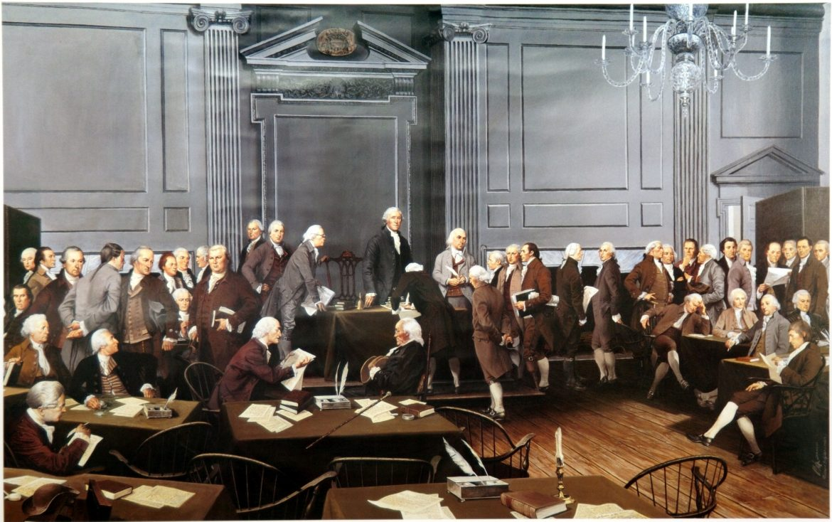
https://allthingsliberty.com/2018/09/who-picked-the-committees-at-the-constitutional-convention/
Author: Victoria Li
License: CC BY-SA 4.0
https://github.com/vkli/BTC2019
Notes:
How do we decide how we make decisions?
Democracy is ~300 years old, we’re still using today
What’s wrong with this picture
Tyranny of the majority
Liken to Web1.0 (Netscape, commercial only)

Slide 12
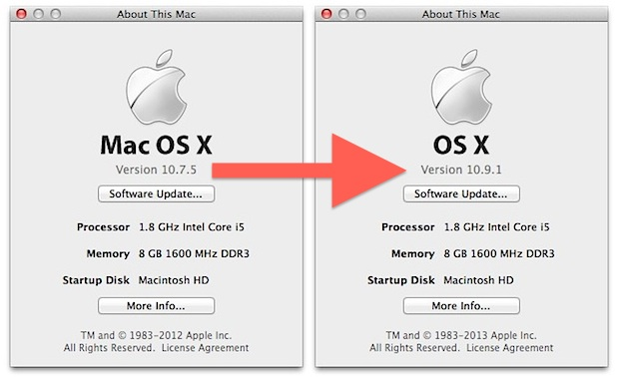
http://osxdaily.com/2014/02/18/still-running-old-os-x-upgrade-to-mavericks/
Author: Victoria Li
License: CC BY-SA 4.0
https://github.com/vkli/BTC2019
Notes:
Upgrade to digital democracy
Web2.0 is about individuals, social media, startups, etc.

Slide 13
UBI
dApps
web3
meritocracy
consensus
encryption
distributed
blockchain
P2P
?
FLOSS
zero-knowledge
anonymous
bonding curve
transparency
decentralized
smart contract
mechanism design
DAO
immutable ledger
trustless
Author: Victoria Li
License: CC BY-SA 4.0
https://github.com/vkli/BTC2019
Notes:
Web3
What’s it gonna look like? So far…

Slide 14
Voting
Author: Victoria Li
License: CC BY-SA 4.0
https://github.com/vkli/BTC2019

Slide 15
Gibbard’s Theorem
“Every deterministic voting scheme with at least three outcomes is either dictatorial or manipulable.”
https://www.eecs.harvard.edu/cs286r/courses/fall11/papers/Gibbard73.pdf
Author: Victoria Li
License: CC BY-SA 4.0
https://github.com/vkli/BTC2019
Notes:
The mathematical proof is not so important as the fact that deterministic voting schemes 1) aren’t continuous: require voting at set time set location 2) can’t satisfy all types of voters: ties in preferences, want all proposals to proceed simultaneously, none of the above, changing preferences, etc. 3) require enforcement by physical means

Slide 16
2-Outcome Vote
Doesn’t exist.
Proof:
There is always an additional choice, none of the above (or all of the above).
https://hackmd.io/@themathematicianisin/SyLhKHCWS
Author: Victoria Li
License: CC BY-SA 4.0
https://github.com/vkli/BTC2019

Slide 17
Approval Voting
1 vote per candidate you approve of
Approve as many candidates as you like
Manipulable: depending what you know about the current votes, you might benefit by voting differently
 | 1st choice | 2nd choice | 3rd choice
Current votes | 1 | 1 | 1
 | 1 | 4 | 4
→ 100
→ 110
https://www.electionscience.org/library/approval-voting/
Author: Victoria Li
License: CC BY-SA 4.0
https://github.com/vkli/BTC2019
Notes:
1p1v (1 person 1 vote), rank voting, are similar

Slide 18
Quadratic Voting
“Individuals pay for as many votes as they wish using a number of ‘voice credits’ quadratic in the votes they buy.”
https://ssrn.com/abstract=2003531
Author: Victoria Li
License: CC BY-SA 4.0
https://github.com/vkli/BTC2019
Notes:
Each person gets equal number of voice tokens
For each proposal: N^2 voice tokens = N votes
100 tokens = (10,0,0,0) or (5,5,5,5) or (1,1,…,1)…
Is this manipulable?

Slide 19

Futarchy/Signaling Markets
Trade “I pay you $1 if V wins” assets (V assets)
price = E[pay] = P(V wins)
Vote on welfare = W$∈$ [0,1] measurement method
Trade “I pay you $W/(current price of B assets) if B wins” assets
Calculate W
price = E[pay] = P(B)E[W|B]/P(B) = E[W|B]
“Vote on Values, Bet on Beliefs”
“When speculative markets clearly estimate that a proposed policy would increase national welfare, that policy becomes law.”
http://hanson.gmu.edu/futarchy2013.pdf
Author: Victoria Li
License: CC BY-SA 4.0
https://github.com/vkli/BTC2019
Notes:
When do policies become law and payments happen?

Slide 20
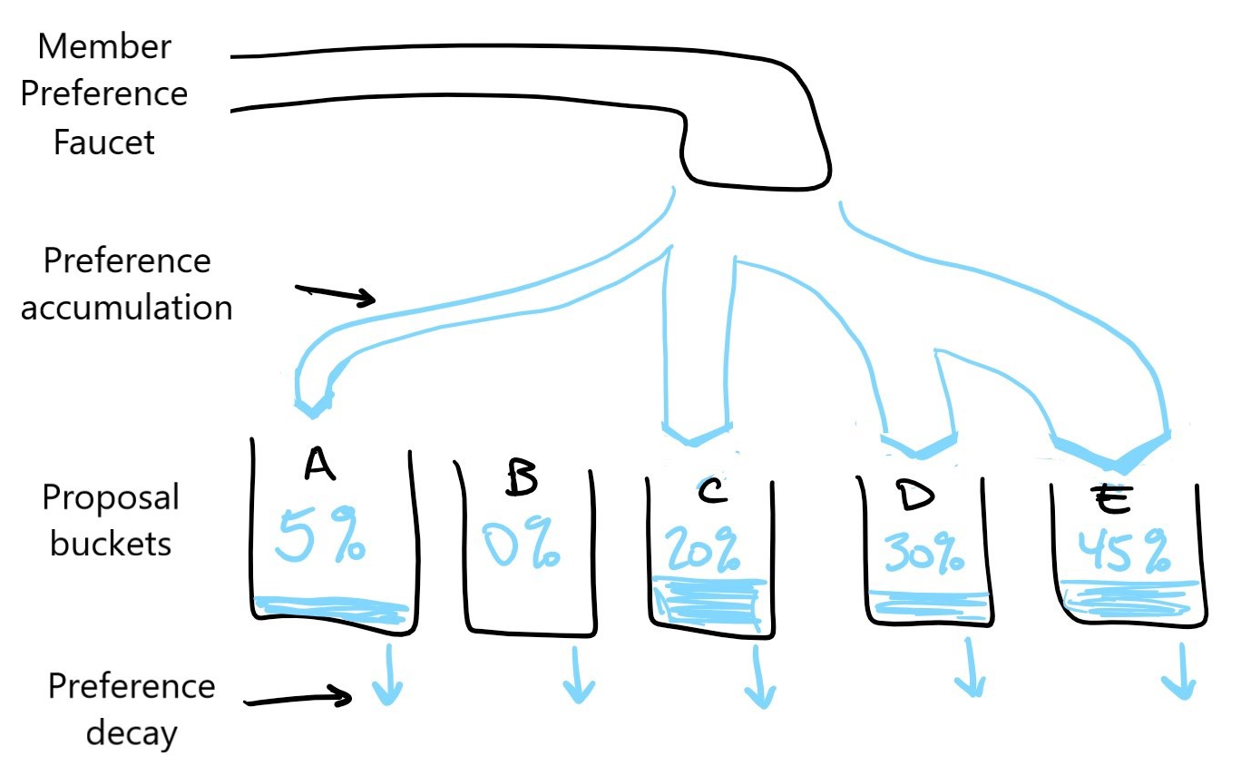
Continuous Voting
Voting by Contributing
Basically, do what you want, but bear the consequences
Create whatever projects you want, support whatever projects you want
What if projects conflict?
See Ownership
Conviction Voting
In progress as of 8/24/2019
See Merit Signaling
https://github.com/disclosure-exchange/whitepaper/wiki/R&D#voting-by-contributing
https://medium.com/giveth/conviction-voting-a-novel-continuous-decision-making-alternative-to-governance-aa746cfb9475
Author: Victoria Li
License: CC BY-SA 4.0
https://github.com/vkli/BTC2019
Notes:
To achieve non-manipulability, we must think outside the definition of deterministic voting schemes as defined by Gibbard.
Inspired by approval voting/quadratic voting/futarchy, these solutions: 1) are continuous 2) satisfy all voters 3) don’t require enforcement.
Can combine with Merit Signaling resource allocation for decision-making and funding.

Slide 21
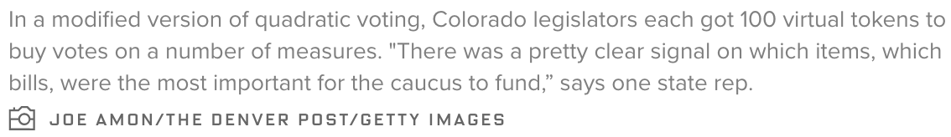
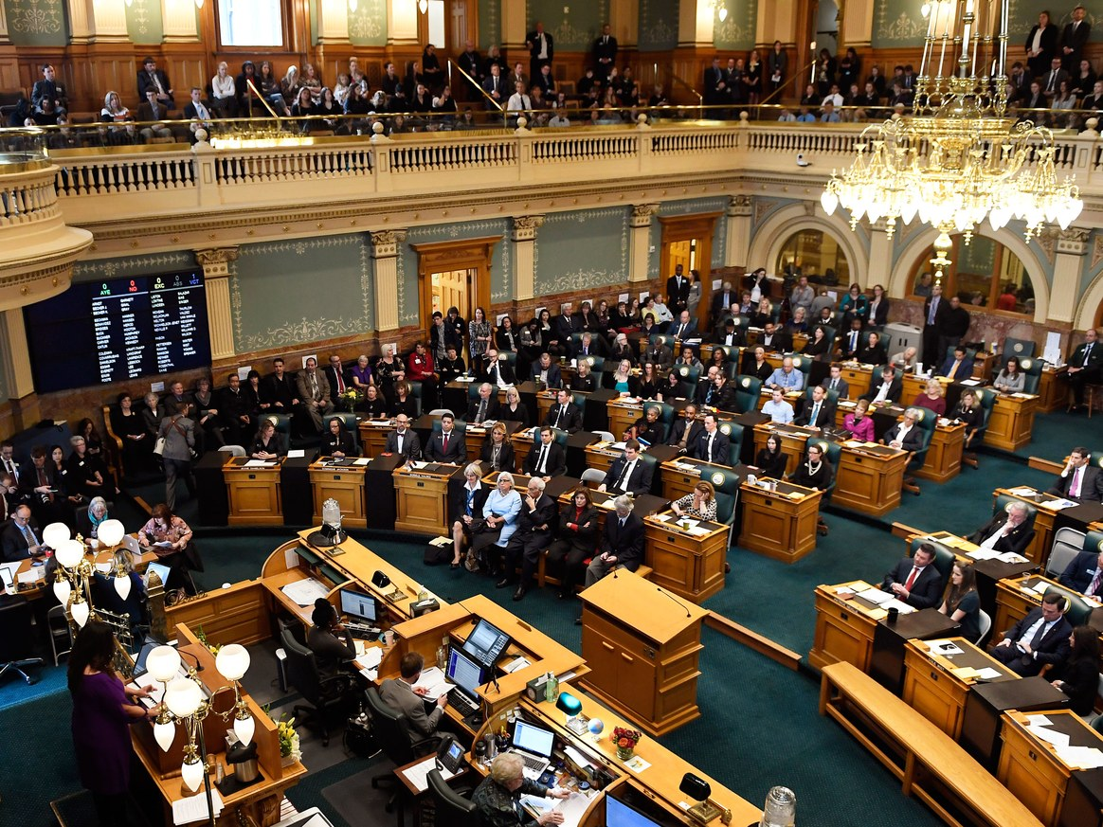
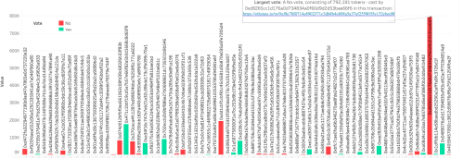
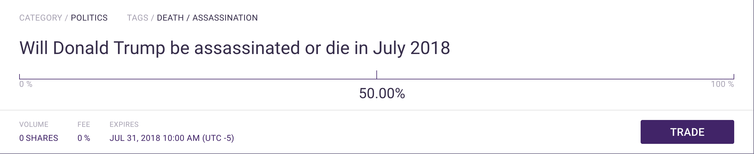
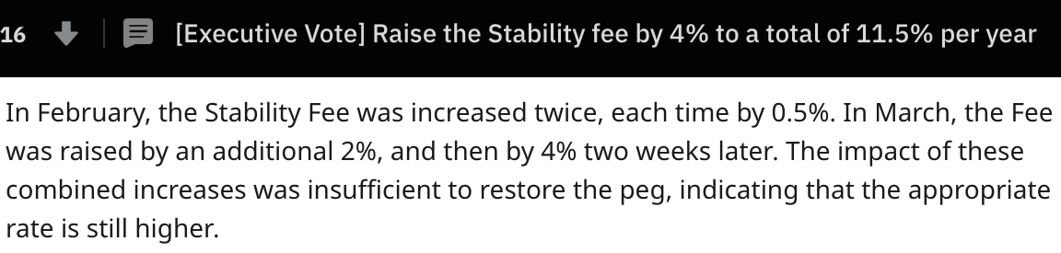
Experiments
Quadratic Voting – CO House Dem Caucus 2019
https://www.wired.com/story/colorado-quadratic-voting-experiment/
Plutocracy – AGP42
Signaling Markets - Augur
https://www.evanvanness.com/post/184616403861/aragon-vote-shows-the-perils-of-onchain-governance
https://www.reddit.com/r/mkrgov/comments/bcfx9x/executive_vote_raise_the_stability_fee_by_4_to_a/
Continuous Approval Voting (by MKR holders) – MakerDAO
https://www.reddit.com/r/mkrgov/comments/bcfx9x/executive_vote_raise_the_stability_fee_by_4_to_a/
Author: Victoria Li
License: CC BY-SA 4.0
https://github.com/vkli/BTC2019
Notes:
Ideas are great in theory, but you can’t know for sure until you test them. Currently working on implementation for Disclosure Exchange.

Slide 22
Cryptoeconomics
Author: Victoria Li
License: CC BY-SA 4.0
https://github.com/vkli/BTC2019
Notes:
the financing of decentralization

Slide 23
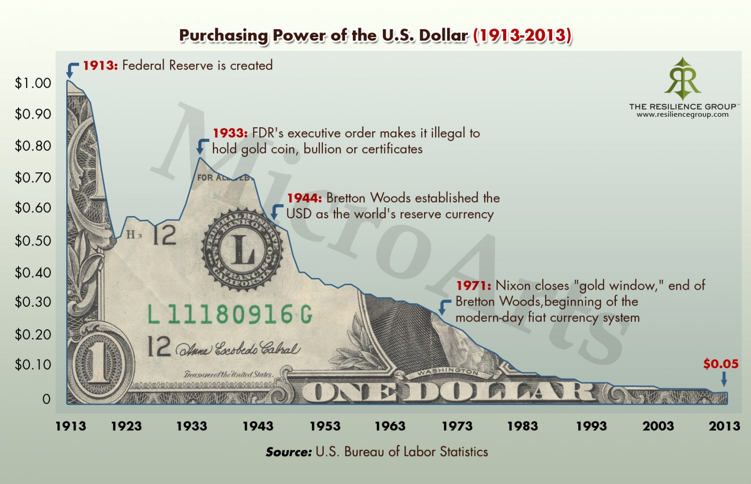
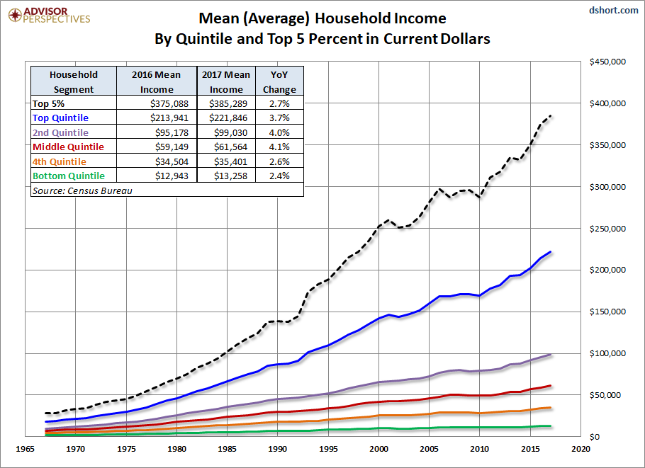
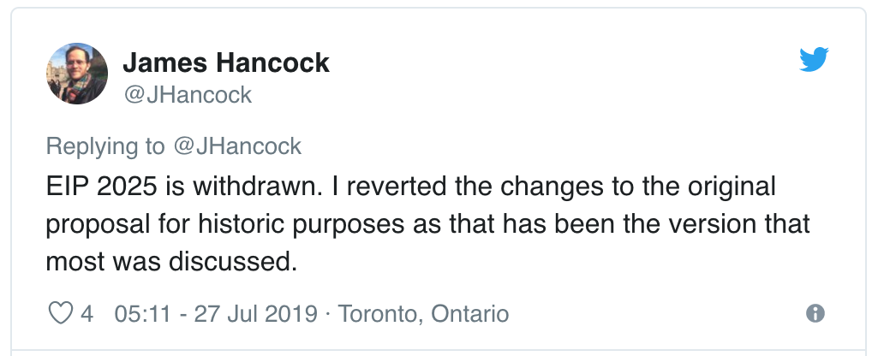
On Inflation
goods/$
$/goods
Inflation Funding
– EIP2025
https://www.cryptoglobe.com/latest/2019/08/circle-research-examines-the-debate-around-ethereums-funding-model/
Author: Victoria Li
License: CC BY-SA 4.0
https://github.com/vkli/BTC2019
Notes:
It is totally possible to have an economy without inflation if goods/$ = 1/ ($/goods)
Current: not sustainable

Slide 24
On Sustainability
Transparency
Decentralized
Trustless
Peer-to-Peer (no middle-men)
Meritocracy
Meritocracies maximize merit
Nature maximizes efficiency
How do we achieve both?
https://hackernoon.com/the-history-of-money-the-future-of-bitcoin-and-the-cryptocurrency-economy-5cc25e808275
https://hackmd.io/@themathematicianisin/SyLhKHCWS
Author: Victoria Li
License: CC BY-SA 4.0
https://github.com/vkli/BTC2019
Notes:
Goal: sustainability
What makes crypto different from fiat is…
Thanks to the work of various individuals and institutions, we are living in an increasingly transparent world ☺
Merit: at any given time, any given individual has different merit in different areas

Slide 25
Funding
Author: Victoria Li
License: CC BY-SA 4.0
https://github.com/vkli/BTC2019

Slide 26
Augmented Token Bonding Curves
A continuous, self-sustaining, fully-backed, native currency:
R(C) = token bonding curve
R = funds in reserve
C = tokens in circulation
Purchase price determined by reserve funds: P(R) = dR/dC
Redemption value backed by reserve funds: S(R)=R/C(R)
Proved: R < C(R)dR/dC so R=aC^{k} for k > 1, a = 1/V₀
Value increases as Reserve funds increase
https://storage.googleapis.com/website-bancor/2018/04/01ba8253-bancor_protocol_whitepaper_en.pdf
https://medium.com/giveth/deep-dive-augmented-bonding-curves-3f1f7c1fa751
https://hackmd.io/@themathematicianisin/BkikbN2kr
Author: Victoria Li
License: CC BY-SA 4.0
https://github.com/vkli/BTC2019
Notes:
Aragon implemented

Slide 27
Investment Model
Anyone contributes at any time:
Reserve Fund by purchasing tokens
Project Fund via 1−λ% transaction or service fee
Work on projects
Contributors are rewarded respectively by:
Tokens whose value is tied to a good/service
Development of said good/service
Paid by Resource Allocation
Transaction fee is determined by the market (Merit Signaling)
Tokens are used as Currency:
Store of Value - redeemed for the underlying asset
Medium of Exchange - exchanged for other tokens
Unit of Accounting - purchase goods/services
https://github.com/disclosure-exchange/whitepaper/wiki/R&D#funding
Author: Victoria Li
License: CC BY-SA 4.0
https://github.com/vkli/BTC2019

Slide 28
Resource Allocation
Author: Victoria Li
License: CC BY-SA 4.0
https://github.com/vkli/BTC2019

Slide 29
Mechanism Design
 | Progressive Auction | Dutch Auction
Mechanism | Increase price to last bid | Decrease price to 1st bid
Homogeneous |  | Lower variance
Non homogeneous |  | Manipulable Not always Pareto-optimal
Both | E[price] = 2nd highest bid Pareto-optimal | E[price] = 2nd highest bid
Sealed-bid auction to highest bidder at 2nd highest price achieves optimal resource allocation
https://www.cs.columbia.edu/coms6998-3/lecture1-auctions.pdf
https://hackmd.io/@themathematicianisin/Sk-hh3Zgr
Author: Victoria Li
License: CC BY-SA 4.0
https://github.com/vkli/BTC2019
Notes:
Homogeneous: bidders’ values are i.i.d.
sealed-bid second-price auction optimizes resource allocation:
Pareto-optimal: the winner is the highest valuer
Maximize earnings by bidding exactly the value of the object to oneself
No costly (time, resources) market appraisal and manipulation
As long as the highest bidder and 2nd highest price are published transparently, and the seller and top bidder and 2nd highest bidder don’t collude to set the price to the 3rd highest bid

Slide 30
Merit Signaling
For each project:
Step 1
Contributors continuously use their tokens to signal % conviction (merit) of subprojects
Step 2
This equals the % of incoming project funds received by the subprojects
Apply recursively to subprojects/…/tasks/subtasks/contributors.
https://github.com/disclosure-exchange/whitepaper/wiki/R&D#meritocracy
Author: Victoria Li
License: CC BY-SA 4.0
https://github.com/vkli/BTC2019
Notes:
Inspired by mechanism design and conviction voting

Slide 31
Ownership
Author: Victoria Li
License: CC BY-SA 4.0
https://github.com/vkli/BTC2019

Slide 32
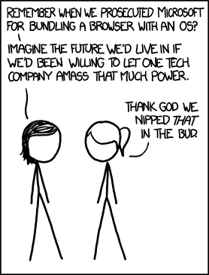
https://www.explainxkcd.com/wiki/index.php/1118:_Microsoft
Author: Victoria Li
License: CC BY-SA 4.0
https://github.com/vkli/BTC2019
Notes:
Microsoft bundled IE during the browser wars, which the US govt deemed monopolistic and unsuccessfully tried to prohibit
Compare to today’s copyright and monopoly disputes, and what they’ve actually done for rights and innovation

Slide 33
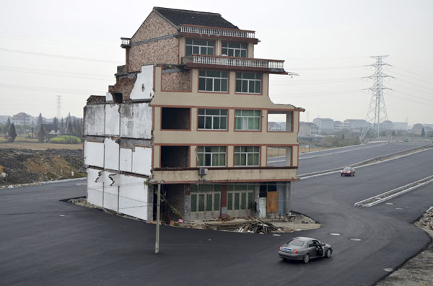
http://blogs.reuters.com/photographers-blog/2012/11/26/house-in-the-middle-of-the-road/
Author: Victoria Li
License: CC BY-SA 4.0
https://github.com/vkli/BTC2019
Notes:
Q: What if projects conflict?

Slide 34
Harberger Taxes
Owner <--> Pay Tax
“Even if the revenue from such taxes are completely ignored, the cost of keeping works proprietary as opposed to releasing them open source would incent users of the license to include their derivative works in the commons rather than keeping the work proprietary.”
https://medium.com/hive-commons/harberger-taxation-and-open-source-58dcdbab140d
Author: Victoria Li
License: CC BY-SA 4.0
https://github.com/vkli/BTC2019
Notes:
applies to software licenses
not for land usage

Slide 35

Ownership <--> Competence
“Investors (through token bonding curve) fund competence of the team building the product, not the product itself. This will take us to the Future of Ideas.”
https://hackmd.io/@themathematicianisin/SyLhKHCWS
https://en.wikipedia.org/wiki/Gate_Tower_Building
Author: Victoria Li
License: CC BY-SA 4.0
https://github.com/vkli/BTC2019
Notes:
A: There is always a 3rd choice (1. house only 2. highway only 3. house in highway, highway in house, none of the above)

Slide 36
In Summary
Decentralization and DAOs:
Voting
Funding
Resource Allocation
Ownership
Author: Victoria Li
License: CC BY-SA 4.0
https://github.com/vkli/BTC2019
Notes:
We covered

Slide 37
A Long Long List
Too many people to fit here, so…
Author: Victoria Li
License: CC BY-SA 4.0
https://github.com/vkli/BTC2019

Slide 38
Thank You Everyone!
Bitcoin Training Conference (C4)
Opolis
AragonProject
Giveth
Native
Council for the Advancement of Blockchain Technology Use
Securities and Exchange Commission
Disclosure Exchange
Colorado Blockchain (Various meetups)
You
Author: Victoria Li
License: CC BY-SA 4.0
https://github.com/vkli/BTC2019

