Slide 1
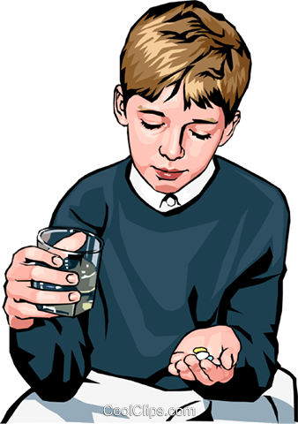
A Person take some medicine daily.

Slide 2

One day he decide to go other city.

Slide 3
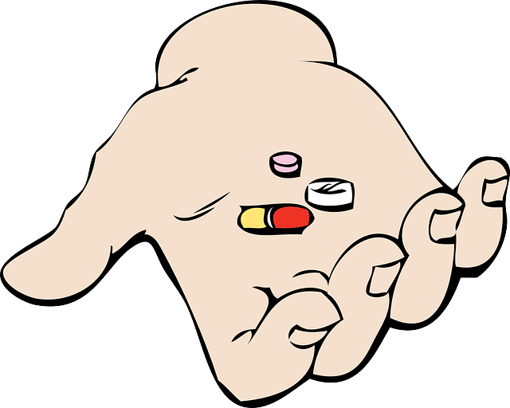
And he forgot his medicine!

Slide 4
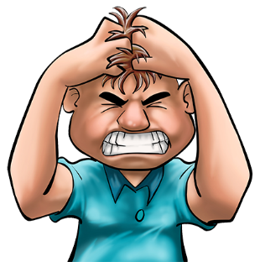
He go to a medical store and that medicine is not available there…
Oh No..!!!!

Slide 5

He got an idea. He has an application that can help him to find SIMILAR medicine he required.

Slide 6
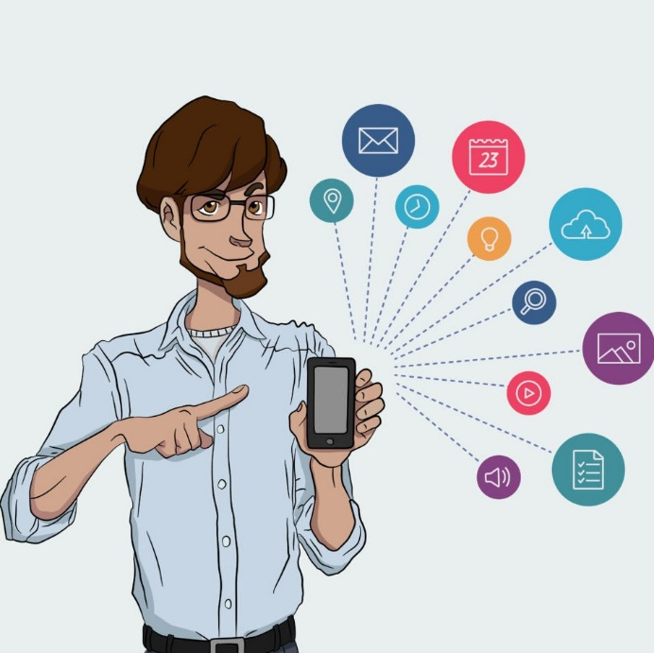
He open the application, find similar medicine, And Problem is solved…!

