Slide 1
Chapter 5 EA Documentation Process

Slide 2
Chapter objectives
Learning Objectives:
Understand how current views relate to the EA implementation methodology.
Understand how current views relate to the EA documentation framework.
See examples of current views of EA components and artifacts.
Understand how future views relate to the EA documentation framework.
Understand how future views relate to the EA implementation methodology.
Understand how scenario planning helps the development of future views.
See examples of future views of EA components and artifacts.

Slide 3
Introduction
Current EA views are important to an enterprise in that they establish or verify what resources (including IT) are being used in lines of business to support the achievement of strategic goals.
This becomes a reference baseline much like an inventory that then supports planning and decision-making regarding the future architecture.
Gives a view of the enterprise emerges that reveals associations, dependencies, and performance gaps between the enterprise’s business requirements and current capabilities.

Slide 4
Introduction
The current view of the EA is intended to show the IT resources that are presently active in the enterprise’s IT operating environment.
This is also known as the “as-is” view of the EA.
Depending on the amount of prior EA planning, these IT resources may or may not be aligned with the enterprise’s strategic goals and business services

Slide 5
Strategic Level EA Artifacts – Current View
The current view of strategic level artifacts should be updated only as changes to the Strategic Plan and/or E-Commerce/E-Government Plan are formally published.
Strategic Level Artifact – Current Strategic Scenario:
current view of the EA, the desired artifact related to scenario planning is the scenario that has become the current planning context for the enterprise and contains the current planning assumptions.
Notes:
x

Slide 6
Strategic Level EA Artifacts – Current View
Strategic Goals:
IT-related goals must meet several criteria to be of strategic value:
achieve some element of the enterprise’s purpose,
result in an outcome within a scenario that is evidentable and measurable,
not reduce the enterprise’s flexibility so much that other scenarios cannot be pursued and/or threats to enterprise survival cannot be addressed,
have enterprise support for implementation.
“Improve global communications availability, quality, and cost.” (The IT element is the voice, data, and video infrastructure).
Notes:
x

Slide 7
Strategic Level EA Artifacts – Current View
Strategic Initiatives
Each strategic goal that the enterprise identifies is pursued though strategic initiatives.
Progress in achieving strategic initiatives must be measurable so that the enterprise can manage the resources given to that initiative and know whether success has been achieved.
IT-related strategic initiatives are those which relate to strategic goals in a way that enhances information flows, improves/integrates supporting systems, services, and/or applications, or optimizes the network infrastructure
Strategic Goal #1: Improve marketing and sales information.
Strategic Initiative #1-1: Begin sales data mart within six months
Strategic Initiative #1-2: Consolidate marketing systems in two years.
Strategic Initiative #1-3: Increase customers by eight percent in a year.
Notes:
x

Slide 8
Strategic Level EA Artifacts – Current View
Performance Measures
Each strategic goal should be stated in a form that includes a measurable and meaningful outcome.
Each supporting strategic initiative should include measurable and meaningful outcome and output measures. Outcome measures describe an intended future state. Output measures describe levels of activities/items that contribute to achieving an outcome.
Example Outcome Measure: “Improve competitiveness by being no lower than #3 in national market share across all product lines within one year.”
Example Output Measure: “Increase the availability of products in retail outlets by ten percent within six months.”
Notes:
xx

Slide 9
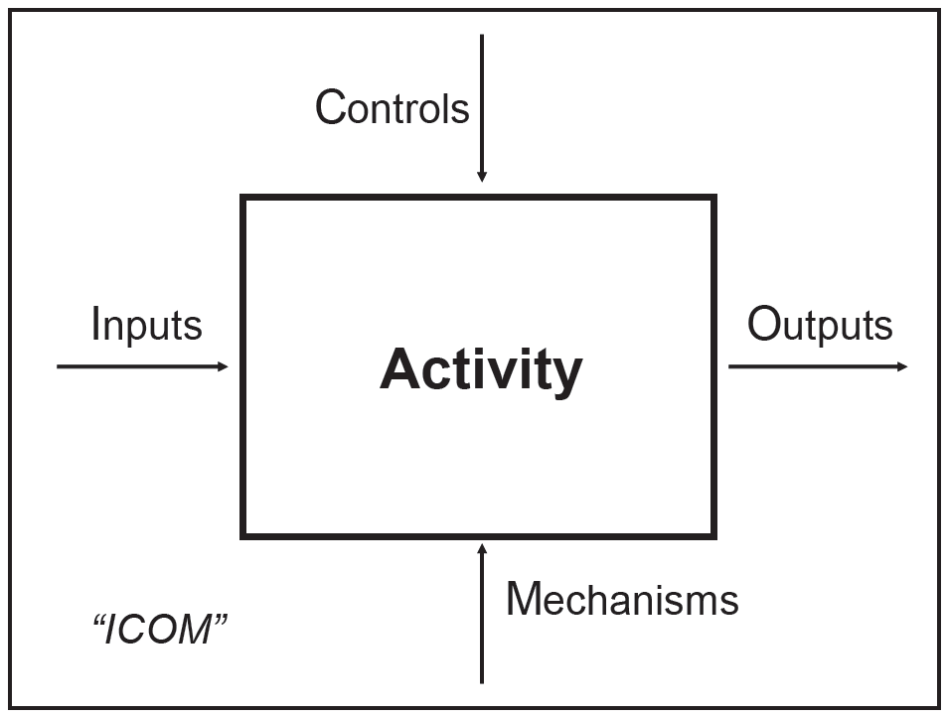
Business Level EA Artifacts – Current View
Process Documentation   
Methods for modeling business processes:
the Integration Definition for Function (IDEF) technique.
IDEF-0 modeling is useful in showing linkages between steps in a process as well as internal external influences, but does not indicate a particular time sequence for the overall set of activities

Slide 10
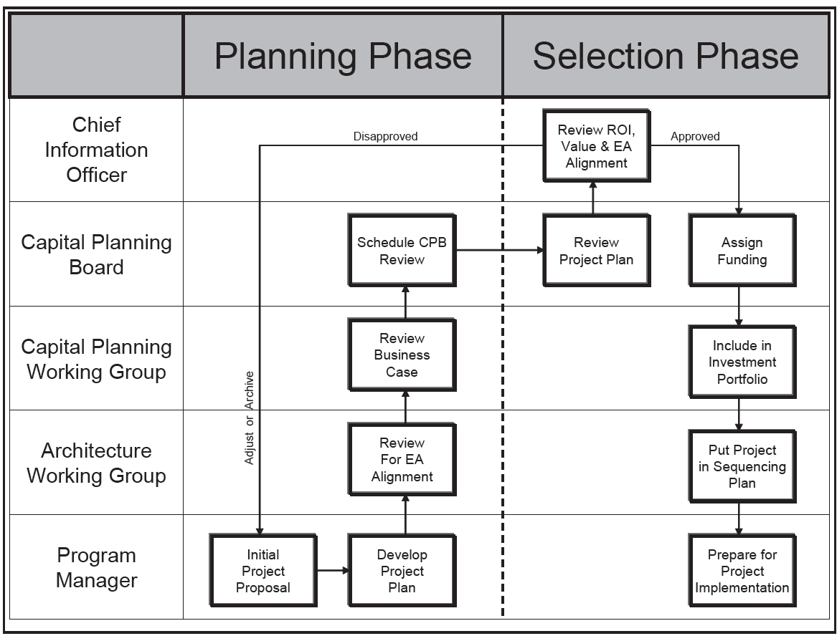
Business Level EA Artifacts – Current View
“swim lane” diagram that shows activities in horizontal rows, so as to identify areas of responsibility for those activities.

Slide 11
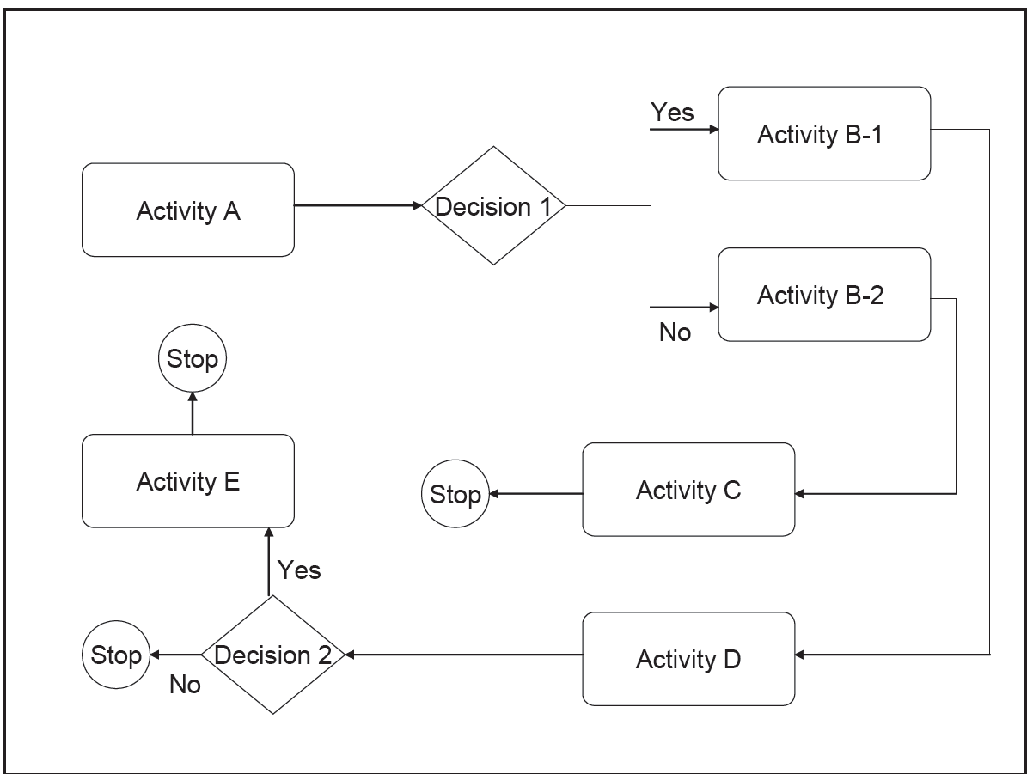
Business Level EA Artifacts – Current View
traditional flow diagram that includes events, decision-points, and sequenced flows of the activities and decision points in a business process

Slide 12
Information Level EA Artifacts – Current View
Documenting information flows involves the development of data models that show the structure and flow of data in the enterprise’s business services and supporting IT systems/services. 
Data can be modeled and analyzed using “traditional” and/or “object-oriented“ methods, depending on how the resulting documentation is intended to be used.

Slide 13
Information Level EA Artifacts – Current View
Data Structure and Data Flow Diagrams:  
Modeling Information Structure:
ERD
Modeling Information Flows:  
Data Flow Diagrams (DFDs)
Uniform Modeling Language (UML):
(1) Use-Case Diagram;
(2) Class/Object Diagram;
(3) Object Sequence Diagram;
(4) Object State-Transition Diagram.

Slide 14
Information Level EA Artifacts – Current View
Data Dictionary / Object Library 
Data Dictionaries are repositories for the data entities and attributes that an enterprise collects and stores in databases.
Object Libraries are repositories for reusable objects. From a technical perspective, it is the discrete pieces of programming code that actually make up an object, and that are being stored in the Object Library as a complete reusable unit.

Slide 15
System & Service Level EA Artifacts – Current View 
The completed current view of the support applications level of the framework may show:
(1) a lack of integration in areas with requirements for exchanges of information,
(2) duplications of function,
(3) little or lots of vendor diversity, and/or
(4) where business requirements are not being met.

Slide 16
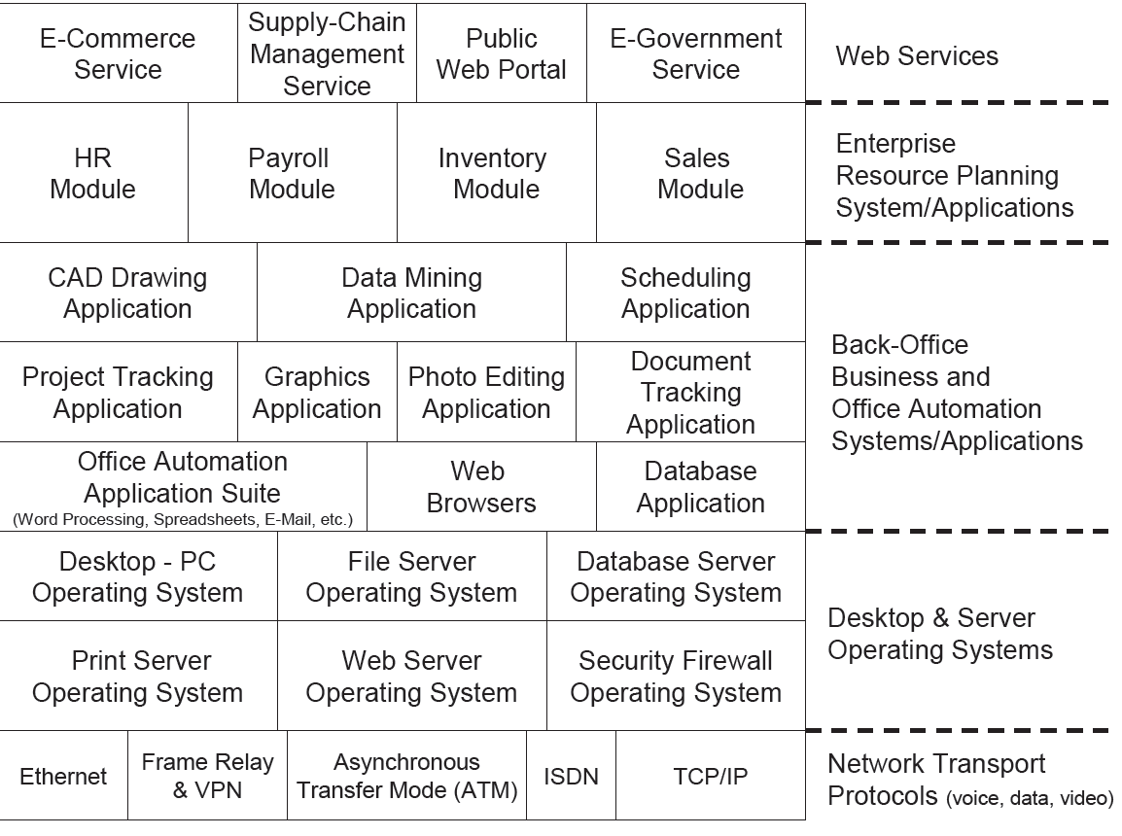
System & Service Level EA Artifacts – Current View
Application Programs:
It can show an overview of the enterprise’s current “suite” of systems, applications, and supporting network protocols.

Slide 17
System & Service Level EA Artifacts – Current View
Technical Standards 
IT applications should be selected based on technical standards and protocols from industry, national, or international bodies which have no bias toward particular vendors or products.
Standards for APIs, service functionality, and software/hardware integratability should be documented to assist in decision-making regarding the selection of new applications and the operations and maintenance of existing applications.
Notes:
x

Slide 18
Infrastructure Level EA Artifacts – Current View
Network Documentation
Technical Standards
Security Documentation 
IT resources must be tested and certified for security vulnerabilities.
The related EA artifacts include:
the development of system/network security plans,
vulnerability test reports,
disaster recovery
continuity of operations plans,
certification and accreditation review results
Notes:
At the infrastructure level of the EA:
Networks, backbone routers/switches/hubs, equipment rooms, wiring closets, and cable plants should be described in detail using both text documents and diagrams that show logical and physical design. Each of the enterprise’s voice, data, and video networks should be documented such that analysis and decision making regarding current operations and maintenance is supported.
Technical standards for voice, data, and video networks should be identified to provide a reference for the analysis and support of current infrastructure resources as well as the planning for future resources

Slide 19
Developing Future Architecture Views

Slide 20
Introduction
The future views of the EA are important to the enterprise because they capture one or more possible business and technology operating scenarios, which supports planning and decision-making
The creation of future view artifacts is accomplished by using the planning assumptions in the scenarios and the same documentation and modeling techniques as were used to develop the current view artifacts.
This is also known as the “to-be” view of the EA.

Slide 21
Developing Future CONOPS Scenarios
to envision several potential courses of action is key to winning many types of recreational games.
Developing several scenarios that capture a variety of good and bad operating environments helps the enterprise to think through its probable responses (defensive moves) and initiatives (offensive moves) in advance.
It also helps to identify the resources and capabilities that will be needed for those responses/initiatives.

Slide 22
Updating Future EA Views – Version Control
By ‘freezing’ the current and future views of the EA at regular periods (e.g., twice each year).
Without this type of version control, the EA repository becomes a free-for-all whereby no one is sure when and where changes will appear, and this will detract from the perceived value of EA information

Slide 23
Strategic Level EA Artifacts –Future View
The documentation of drivers at the Strategic Level often centers on those influencing factors that originate in the external operating environment
Strategic Scenarios
Strategic scenarios can be added or deleted from the Strategic Plan’s future view in response to changes in the internal and external operating environment.
Strategic Goals
New strategic goals also serve to direct the development of future operating scenarios, which should capture the priorities and direction of those new goals
Strategic Initiatives
The future view of IT-related strategic initiatives is intended to show the changes that are being planned to existing initiatives as well as new initiatives that will be introduced in coming years. This is valuable to enterprises that have highly structured planning and budget processes.
Performance Measures

Slide 24
Business Level EA Artifacts – Future View
the documentation of Business Level drivers often focuses on influencing factors that originate in the internal operating environment.
There are four general types of changes to business services that occur:
(1) the introduction of a completely new process,
(2) elimination of an existing process,
(3) major reengineering of an existing process,
(4) minor improvement of an existing process.

Slide 25
Business Level EA Artifacts – Future View
Process Documentation
Documenting approved changes to business services helps to maintain “upward alignment” and “downward alignment” in the EA³ Cube Framework.
Project Plans
development of EA components may benefit from having a future view of the PMP to show the implementation of system modules that are envisioned at some future time.
Business Cases
The business case is unique in that it ties directly to the enterprise’s budget and financial planning process, and as such usually requires a review at least annually

Slide 26
Information Level EA Artifacts – Future View
Data Models:
Modeling Information Structure:
ERD and Data Flow Diagrams (DFDs)
CRUD Matrix
Uniform Modeling Language (UML):
future system activities (Use Cases),
data process/structure (Class and Object Diagrams),
data transformation (State Transition Diagrams),
information flows (Sequence Diagrams)
Developing future views of how information in the form of objects will be stored differently helps analysts, programmers, and architects to produce better logical and physical data models, promotes application interoperability, and supports plug-and-play EA components that are based on open standards or a particular vendor product line.

Slide 27
Information Level EA Artifacts – Current View
Data Dictionary / Object Library
Data Dictionary: The future view of a Data Dictionary would show the changes in data standards and formats that are anticipated to be needed as a result of system/application/database changes.
Object Libraries

Slide 28
System & Service Level EA Artifacts – future View
Application Interface Descriptions
Descriptions of application software programs and their interfaces in the future view provide an understanding of what will change from what is currently in operation as well as what new functional capabilities will have to be integrated.
Application Interface Diagrams
Interface diagrams in the future view show the changes to existing system, service, and application interface points.
Standards
Technical standards documentation in the future view shows the international, national, local, and industry standards that changes to commercial and custom-developed services, systems, and applications must meet.

Slide 29
Infrastructure Level EA Artifacts – Future View
Network Documentation
Technical Standards
Security Documentation
Configuration Change Requests
Hardware/Software Inventories

