Slide 1

Evaluating Risk Bounds for AdaBoost on Real Datasets
This work explores AdaBoost ensembles created by different algorithms. The AdaBoost ensemble is as follows:
The task of constructing an AdaBoost ensemble is to obtain a linear combination of hk classifiers from hypothesis set H in such a way as to reduce generalisation error. The hypothesis set H consists of “weak” classifiers such as decision stumps or hyper-planes into two classes.

Slide 2


Problems explored in this thesis: the influence of L1-geometric margin on the error on test set
Suppose AdaBoost ensemble is defined in a vector form:
Then, L1-geometric margin for the ensemble is as follows:
For a hyper-plane perpendicular to vector a, the geometric margin is a minimum among norm-1 distances from h(xt) vectors to the hyper-plane. Thus, the geometric margin reflects the classifier's confidence in the train data set, and the question is whether a greater L1-geometric margin provides less generalisation error on test data.

Slide 3
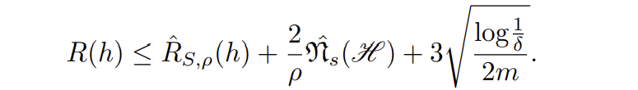

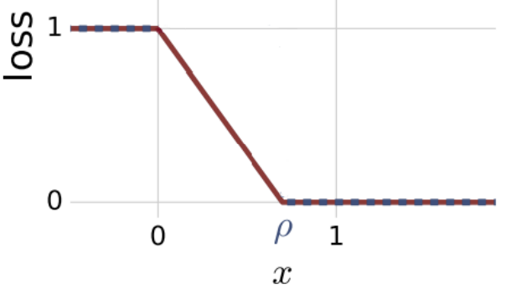
Problems explored in this thesis: studying of risk estimation based on the empirical loss function
Suppose, H is a set of real-valued functions and the non-negative value ρ of the margin is fixed. Then, for any δ > 0, with a probability at least 1 − δ, the risk estimation for any h ∈ H is as follows:
The empirical loss function RS,ρ is defined as follows:
Фρ has the following graph:

Slide 4
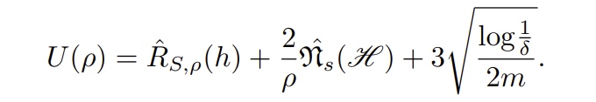
Problems explored in this thesis: studying of error estimation based on the empirical loss function
From the above definitions, it can be seen that in order to estimate the risk of a classifier, the following function must be examined for a minimum:
From the above definitions, it can be seen that in order to estimate the risk of a classifier, the following function must be examined for a minimum:
It may be noted that U(ρ) contains differently directed terms: RS,ρ(h) is a growing function of ρ while (2/ρ)*Rs(H) is decreasing. Thus, some minimum of U(ρ) is expected. It is difficult to solve this optimising task analytically because of the undifferentiated RS,ρ as function of ρ, thus in the following experiments the value U(ρ) is estimating empirically by varying the variable ρ.

Slide 5
Experiments with L1-geometric margin
Originally, AdaBoost was implemented as an iterative process. In each boosting round a weak classifier is selected in order to minimise the error on some specially designed distribution. Alternatively, the L1-geometric margin in the separable case for the training set can be defined and maximised explicitly, e.g. using linear programming. Thus, we obtain two methods for the classifier ensemble implementation and moreover, the second version is a margin maximiser. If it is true that maximising the margin yields less risk, the second version classifier should give better results. This statement is checked in the following experiments.

Slide 6
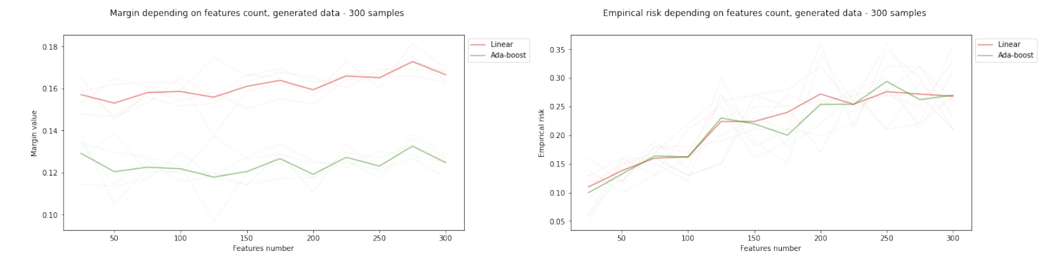
Experiments with L1-geometric margin: synthetic data sets with a varying number of features
As can be seen from the graphs, the geometrical margin for the linear algorithm is higher, which is explained by the different principles of the algorithms. At the same time, the empirical risk on the test set does not di_x001b_er signi_x001c_cantly between the versions of the classi_x001c_ers, as can be seen from the right-hand graph.

Slide 7
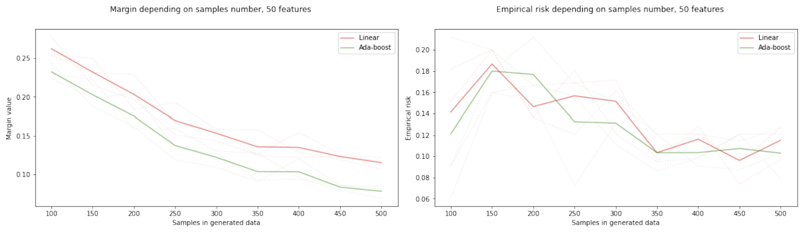
Experiments with L1-geometric margin: synthetic data sets with a varying number of samples
Again, the significant difference in margin values can be seen, which does not, however, affect the empirical risk values. Conversely, the linear algorithm’s risk turns out to be significantly bigger.

Slide 8
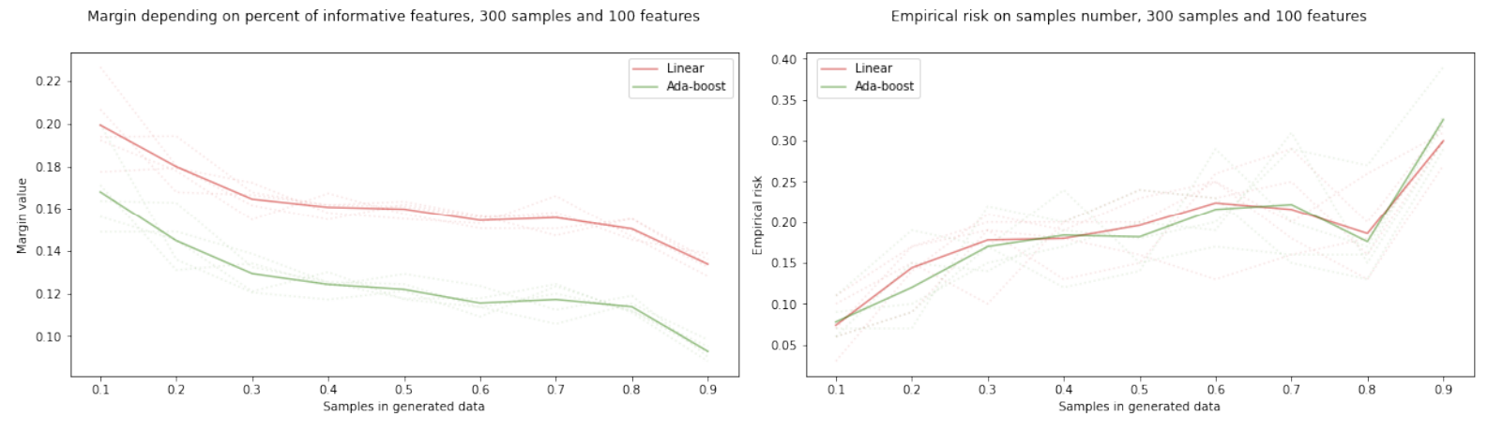
Experiments with L1-geometric margin: synthetic data sets with a varying per cent of informative features
The ratio of the data is similar to previous experiments, the difference in margin does not lead to better empirical risk.

Slide 9
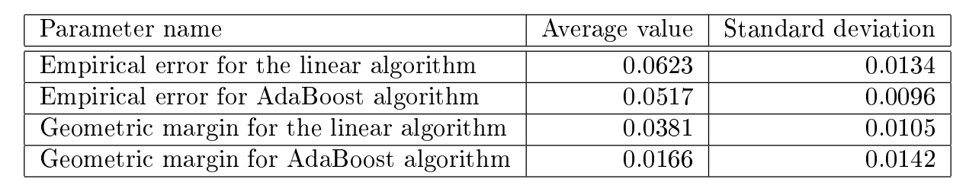
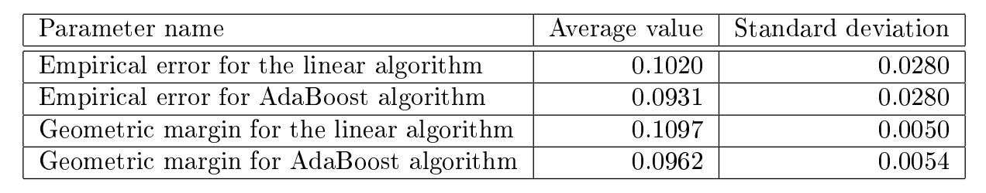
Experiments with L1-geometric margin: tests on real data sets
Set of experiments on breast cancer data set give results as follow:
Set of experiments on ionosphere data set give results as follow:
On both data sets the linear algorithm gives the larger geometric margin and the larger error simultaneously. Together with results on synthetic data sets this shows that the larger geometric margin does not ensure the smaller error. To summarise, L1-geometric margin cannot be a reliable indicator of classifier quality.

Slide 10
Risk estimation based on the empirical loss function
To find the value of the upper estimate of the generalisation error U(ρ), a data set is generated and split into training and test samples. Then, varying value ρ from 0 to 1 with step 0.05, the value of U(ρ) is calculated. For clarity, the graphs show the values of functions U(ρ) and separately the empirical margin loss RS,ρ since the latter actually determines the difference in estimation between the versions of the classifier. For the experiment the data set is generated, then five different splittings are performed with test size equal to 1/3 of all rows and results are averaged.

Slide 11
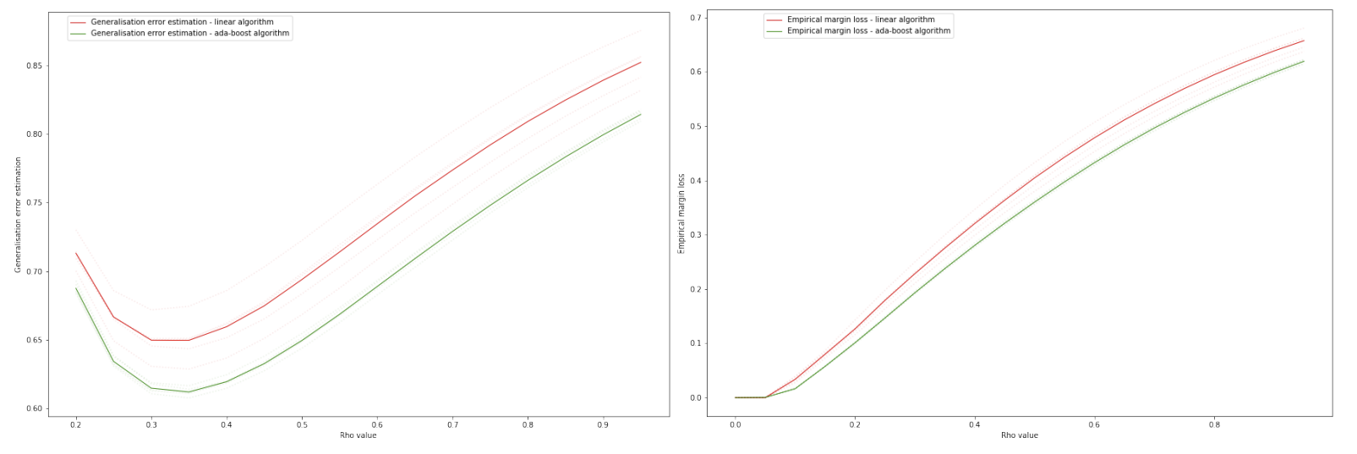
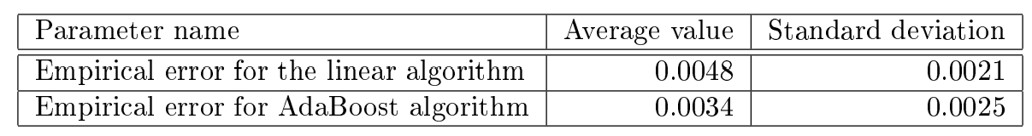
Risk estimation based on the empirical loss function: normally distributed data, 2 features and 3000 samples
Generalisation error estimations U(ρ) on the left-hand graph for AdaBoost and the linear classifier are much larger than their empirical errors: U(ρ) has minimum about 0.6, while the empirical error of the classifiers is 0.0048 and 0.0034 on average. Also, the linear algorithm gives a consistently higher value for empirical margin loss as can be observed from the right-hand graph.

Slide 12
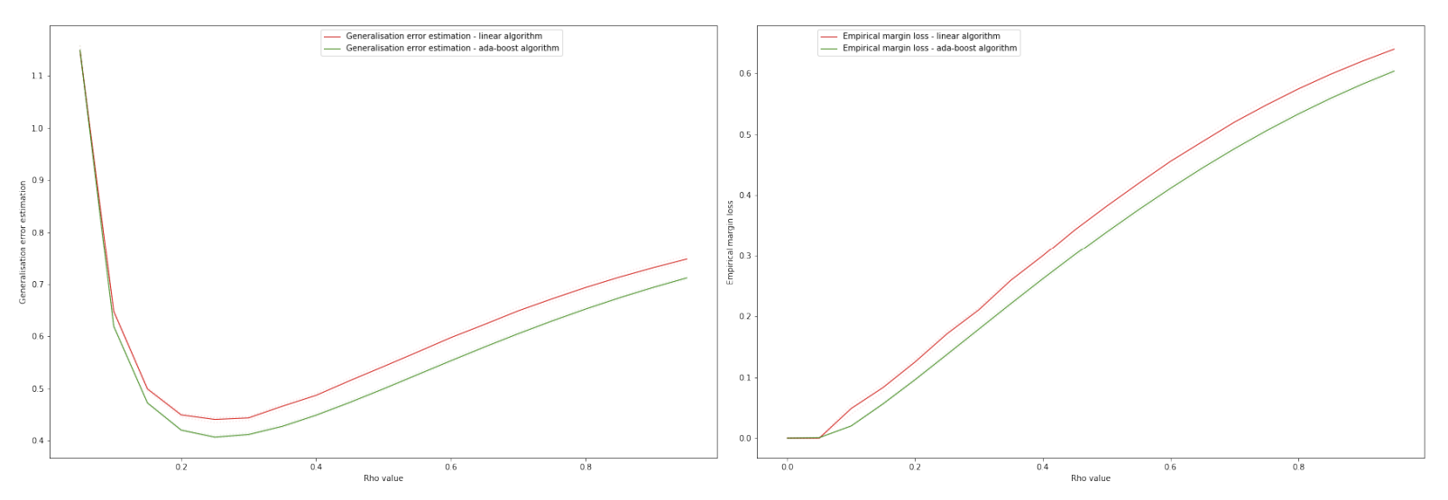
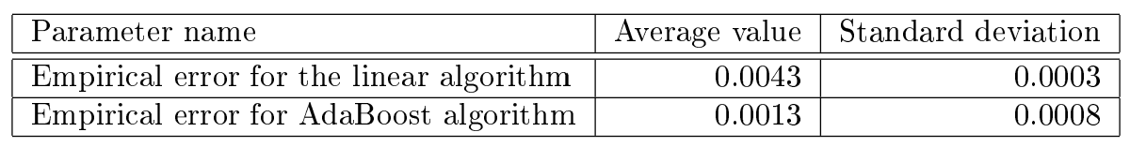
Risk estimation based on the empirical loss function: normally distributed data, 2 features and 10000 samples
The generalisation error estimate has decreased to approximately a value 0.4 but is still several times larger than the empirical error from the experiments. Thus, it can be assumed that as the number of samples in the training set increases, the estimate of generalisation error given by U(ρ) will be more accurate.

Slide 13
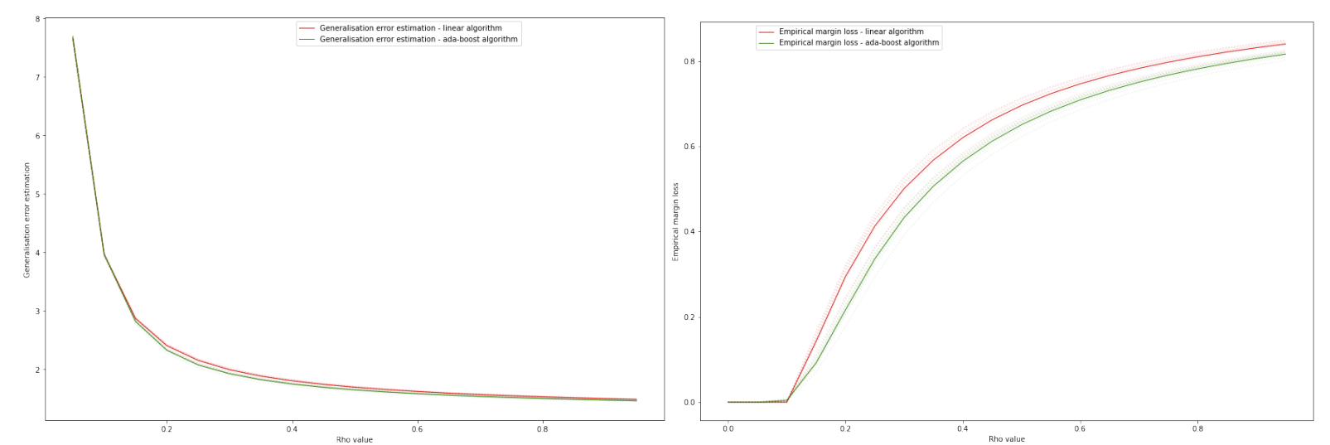
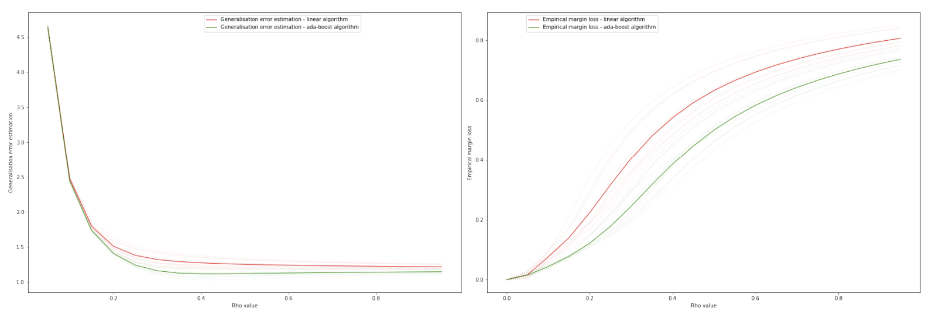
Experiments on real data sets
Ionosphere data set:
Breast cancer data set:
As the left-hand graphs shows, the generalisation error estimation curve does not even reach a value of 1 and thus this estimation U(ρ) is not suitable for practical application.

Slide 14
Conclusions
Although AdaBoost has a lower L1-margin, it exhibits mostly better empirical error on synthetic and real data sets.
All experiments show that the minimum of U(ρ) is several time larger than the empirical error of both classi_x001c_ers, which makes this approach to error estimation practically inapplicable.
Along with this, U(ρ) and empirical margin loss values for the classifier versions correlate with the empirical errors for them in the experiments: AdaBoost has a smaller U(ρ)/empirical margin loss and at the same time gives a smaller error in the experiments. This fact supports the hypothesis that it is possible to qualitatively estimate the classifier using the formula U(ρ).

