Slide 1
Faculty of Computer Science
Programme
'Master of Data Science'
Moscow
2022
Evaluating Risk Bounds for AdaBoost on Real Datasets
Student: Krivodub Viacheslav
Supervisor: PhD, Associate Professor, Bruno Frederik Bauwens

Slide 2

Faculty of Computer Science
Programme
'Master of Data Science'
Evaluating Risk Bounds for
AdaBoost on Real Datasets
Evaluating Risk Bounds for AdaBoost on Real Datasets
This work explores AdaBoost ensembles created by two different algorithms. The AdaBoost ensemble is as follows:
The goal of constructing an AdaBoost ensemble is to obtain a linear combination of h_{k} classifiers from hypothesis set H with a small error. The hypothesis set H consists of “weak” classifiers, which typically give an error of just under 0.5.

Slide 3

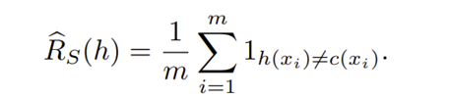

Faculty of Computer Science
Programme
'Master of Data Science'
Evaluating Risk Bounds for
AdaBoost on Real Datasets
Definition: empirical and generalisation risk
Risk or generalisation error of a classifier:
where c(x) is true classifier, 1 - the indicator function.
Empirical risk or empirical error of a classifier:
Empirical risk is an unbiased estimation of generalisation risk:

Slide 4
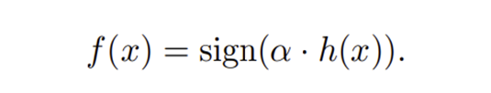

Faculty of Computer Science
Programme
'Master of Data Science'
Evaluating Risk Bounds for
AdaBoost on Real Datasets
Definition: L₁-geometric margin
Suppose AdaBoost ensemble is defined in a vector form:
Then, L₁-geometric margin for the ensemble is as follows:
For a hyper-plane perpendicular to vector α, the geometric margin is a minimum among norm-1 distances from h(x_{t}) vectors to the hyper-plane. Thus, the geometric margin reflects the classifier's confidence in the train data set, and the question is whether a greater L₁-geometric margin provides less risk on test data.

Slide 5
Faculty of Computer Science
Programme
'Master of Data Science'
Evaluating Risk Bounds for
AdaBoost on Real Datasets
Experiments with L₁-geometric margin
Initially, AdaBoost was implemented as an iterative process. In each boosting round, a weak classifier is selected in order to minimise the error of previously selected classifiers. Alternatively, the L₁-geometric margin in the separable case for the training set can be maximised explicitly, e.g. using linear programming. Thus, there are two methods for the classifier ensemble implementation, and moreover, the second version is a margin maximiser. If it is true that maximising the margin yields less risk, the second version classifier should give better results. This statement is checked in the following experiments.

Slide 6
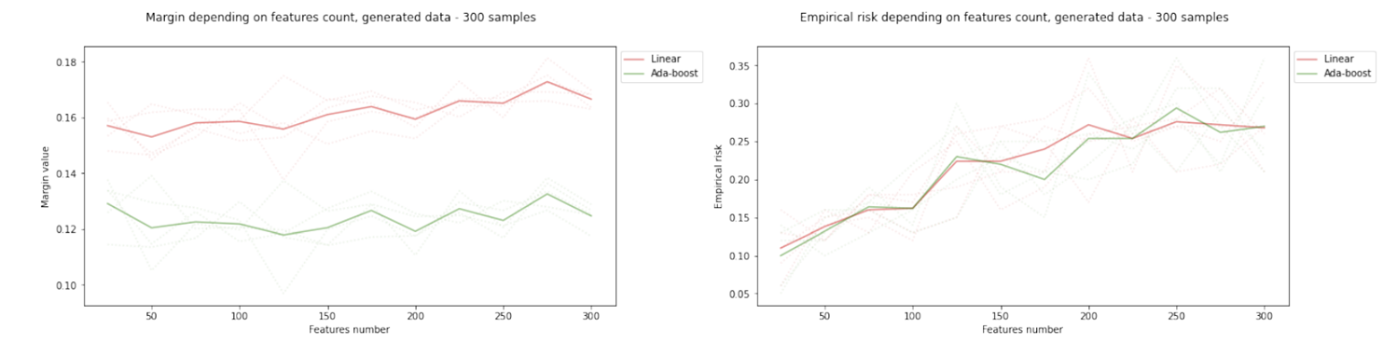
Faculty of Computer Science
Programme
'Master of Data Science'
Evaluating Risk Bounds for
AdaBoost on Real Datasets
Experiments with L₁-geometric margin: synthetic data sets with a varying number of features
The geometric margin on the left-hand graph for the linear programming version is higher. At the same time, the risk on the test set does not differ significantly between the versions of the classifiers, as seen from the right-hand graph.

Slide 7
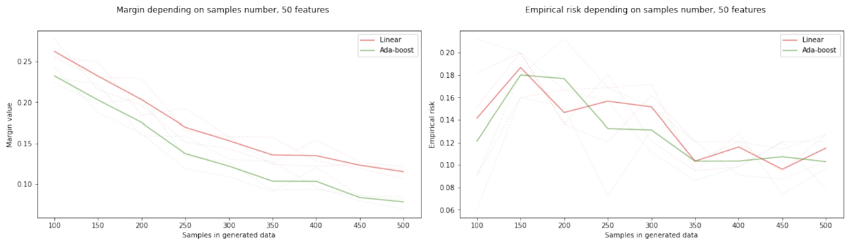
Faculty of Computer Science
Programme
'Master of Data Science'
Evaluating Risk Bounds for
AdaBoost on Real Datasets
Experiments with L₁-geometric margin: synthetic data sets with a varying number of samples
Again, the significant difference in margin values can be seen, which does not, however, leads to less empirical risk for the linear algorithm. Conversely, the linear algorithm’s risk turns out to be significantly larger.

Slide 8
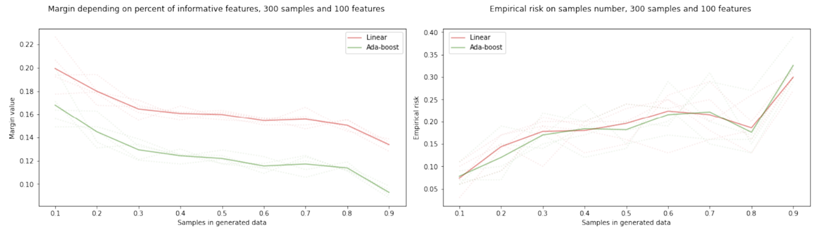
Faculty of Computer Science
Programme
'Master of Data Science'
Evaluating Risk Bounds for
AdaBoost on Real Datasets
Experiments with L₁-geometric margin: synthetic data sets with a varying per cent of informative features
The ratio of the data is similar to previous experiments; the difference in margin does not lead to better empirical risk.

Slide 9
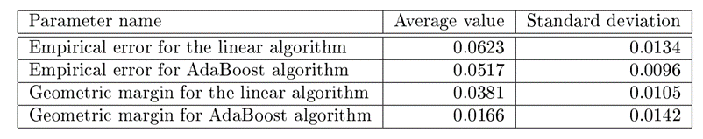
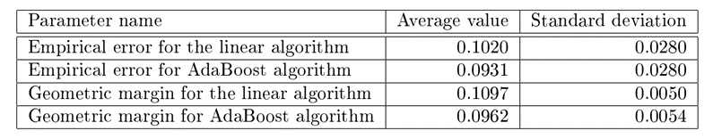
Faculty of Computer Science
Programme
'Master of Data Science'
Evaluating Risk Bounds for
AdaBoost on Real Datasets
Experiments with L₁-geometric margin: tests on real data sets
Set of experiments on breast cancer data set¹ gives the following results:
Set of experiments on ionosphere data set¹ gives the following results:
On both data sets, the linear programming version simultaneously gives the larger geometric margin and the larger error. Together with results on synthetic data sets, this shows that the larger margin does not ensure the smaller error. To summarise, L₁-geometric margin cannot be a reliable indicator of classifier quality.
1 – real data sets can be found in UCI Machine learning repository: https://archive.ics.uci.edu/ml

Slide 10


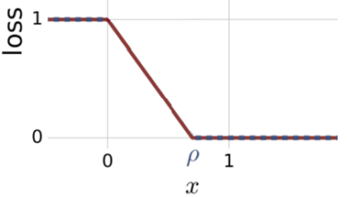
Faculty of Computer Science
Programme
'Master of Data Science'
Evaluating Risk Bounds for
AdaBoost on Real Datasets
Definition: risk estimation based on the empirical loss function
Suppose, H is a set of real-valued functions and the non-negative value ρ of the margin is fixed. Then, for any δ > 0, with a probability at least 1 − δ, the risk estimation for any h ∈ H is as follows:
The empirical loss function R_{S,ρ} is defined as follows:
Ф_{ρ} has the following graph:

Slide 11


Faculty of Computer Science
Programme
'Master of Data Science'
Evaluating Risk Bounds for
AdaBoost on Real Datasets
Definition: empirical Rademacher complexity
Impirical Rademacher complexity is defined as follows:
In the formula above σ = (σ₁, ..., σ_{m}), where σ_{t}, t = 1..m are independent uniform random variables taking values in {-1, +1}. According to the theory, either a set of weak classifiers or their AdaBoost ensembles can be used equally in this calculation. Thus, for the train set with m samples and n features there are at most 2·m·n different decision stump weak classifiers. Finally, the set of all possible σ can be replaced by a subset with the following error:

Slide 12
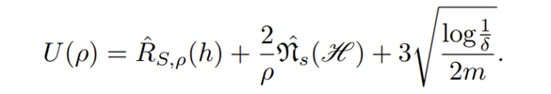
Faculty of Computer Science
Programme
'Master of Data Science'
Evaluating Risk Bounds for
AdaBoost on Real Datasets
Definition: risk estimation based on the empirical loss function
To estimate the risk of an AdaBoost classifier, the following function must be examined for a minimum:
U(ρ) contains two differently directed terms: R_{S,ρ}(h) is a growing function of ρ while (2/ρ)*R_{s}(H) is decreasing. Thus, a minimum of U(ρ) for some ρ is expected. In the following experiments, the value U(ρ) is estimated empirically by varying the variable ρ.
To find the value of the upper estimate of the generalisation error U(ρ), a data set is generated and split into training and test samples. Then, varying the value ρ from 0 to 1 with step 0.05, the value of U(ρ) is calculated. For clarity, the graphs show the values of functions U(ρ) and separately the empirical margin loss R_{S,ρ} since the latter actually determines the difference in estimation between the versions of the classifier. For the experiment, the data set is generated, then five different splittings are performed with a test size equal to 1/3 of all rows, and the results are averaged.

Slide 13
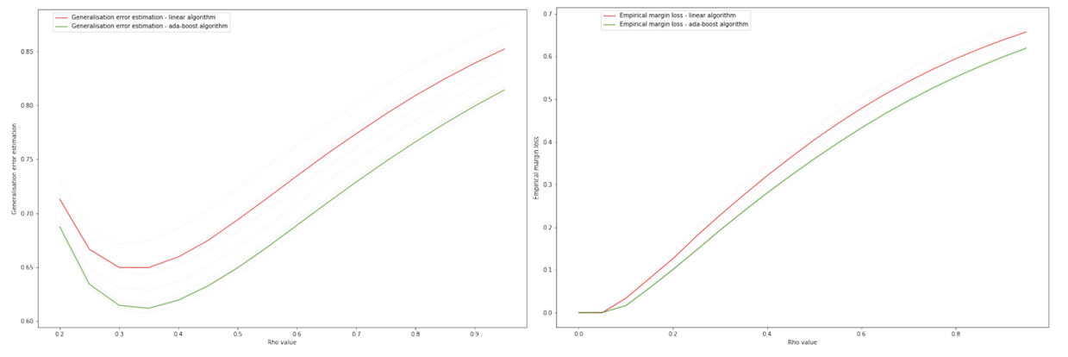

Faculty of Computer Science
Programme
'Master of Data Science'
Evaluating Risk Bounds for
AdaBoost on Real Datasets
Risk estimation based on the empirical loss function: normally distributed data, 2 features and 3000 samples
Generalisation error estimations U(ρ) on the left-hand graph for AdaBoost and the linear classifier are much larger than their empirical errors: U(ρ) has a minimum of about 0.6, while the empirical error of the classifiers is 0.0048 and 0.0034 on average. Also, the linear algorithm gives a consistently higher value for empirical margin loss as can be observed from the right-hand graph.

Slide 14
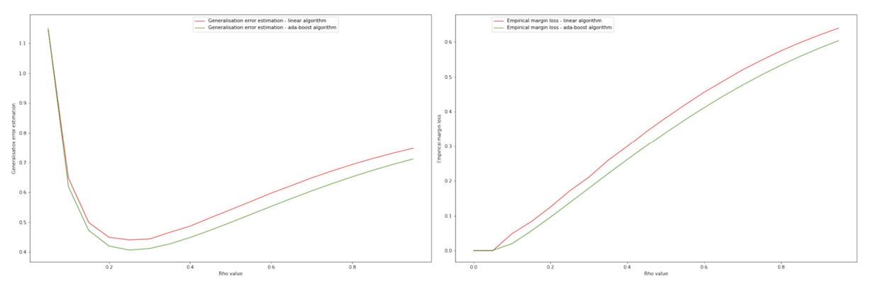

Faculty of Computer Science
Programme
'Master of Data Science'
Evaluating Risk Bounds for
AdaBoost on Real Datasets
Risk estimation based on the empirical loss function: normally distributed data, 2 features and 10000 samples
The generalisation error estimate has decreased to approximately a value of 0.4 but is still several times larger than the empirical error from the experiments. Thus, it can be assumed that as the number of samples in the training set increases, the estimate of generalisation error given by U(ρ) will be more accurate.

Slide 15
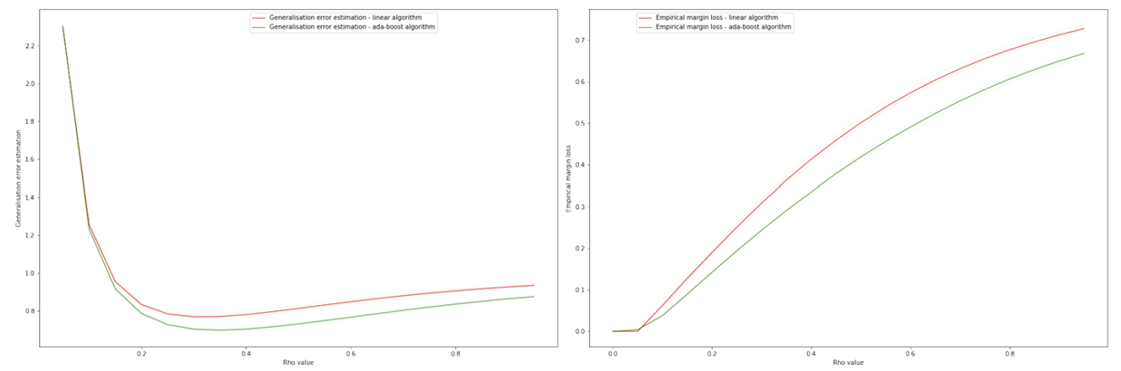

Faculty of Computer Science
Programme
'Master of Data Science'
Evaluating Risk Bounds for
AdaBoost on Real Datasets
Risk estimation based on the empirical loss function: Gaussian mixture with 5 features and 3000 samples
In comparison with the analogous experiment with 2 features, now the minimum on the curve U(ρ) is less pronounced, and the estimation itself has deteriorated significantly to around 0.8. Thus, the estimation of U(ρ) is not robust to increasing data complexity in the training set.

Slide 16
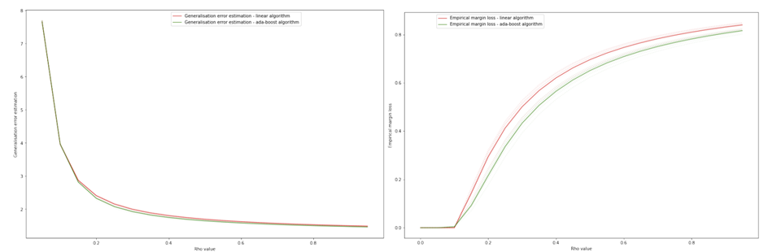
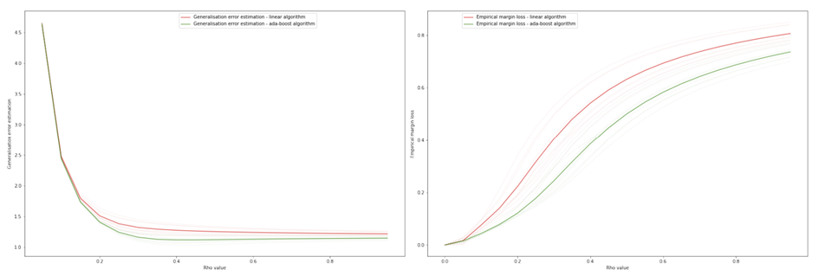
Faculty of Computer Science
Programme
'Master of Data Science'
Evaluating Risk Bounds for
AdaBoost on Real Datasets
Experiments on real data sets
Ionosphere data set:
Breast cancer data set:
As the left-hand graphs show, the generalisation error estimation curve does not even reach a value of one, and thus, this estimation U(ρ) is not suitable for practical application.

Slide 17
Faculty of Computer Science
Programme
'Master of Data Science'
Evaluating Risk Bounds for
AdaBoost on Real Datasets
Conclusions
L₁-margin is not a reliable indicator of classifier quality: although AdaBoost has a lower L₁-margin, it exhibits mostly better empirical error on synthetic and real data sets.
All experiments show that the minimum of U(ρ) is several times larger than the empirical error of both classifiers, making this error estimation approach practically inapplicable.
Along with this, empirical margin loss values for the classifier versions correlate with the empirical errors in the experiments: AdaBoost has a smaller empirical margin loss and, at the same time, gives a smaller error in the experiments. This fact supports the hypothesis that it is possible to qualitatively estimate the classifier using the formula U(ρ).

