Slide 1


Faculty of Computer Science Bachelor's Program in Software Engineering
Project Proposal
Client-Server Mobile Application for Synthesizing Arrangements for Musical Compositions
Project Proposal
Supervisor: Dmitry Vladimirovich Alexandrov, professor
Moscow, 2024
Melnik Vsevolod

Slide 2
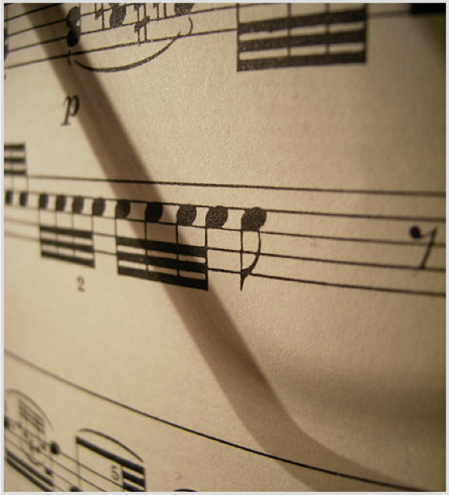
The Subject Area
In recent years, there is the increase of popularity of music as a hobby, as instruments and educational content on this topic have become more accessible. A large number of people study music with the goal of composing their own music. Often, a composer, who came up with some musical ideas, struggles to develop them into more complex composition.
The main goal of this program is to synthesize parts of the arrangements based on provided by the user melodies, in order for the user to get inspiration from.
фото
фото
FCS, Software Engineering
Высшая школа экономики, Москва, 2020

Slide 3


The Purpose and Objectives of The Project
Purpose The proposed program will use a variety of different technologies to provide the user a set of tools for synthesizing different parts of musical arrangements.
Tasks
Analysis of existing solutions;
Defining functional requirements;
Development of the user interface;
Design of generational algorithms.
Implementation of the server and the mobile parts of the application;
Testing the system.
FCS, Software Engineering

Slide 4
Functional Requirements
Recognition of the melody with the phone microphone;
Synthesizing variations of the given melody;
Synthesizing harmony for the given melody;
Synthesizing rhythmic variations of the given melody;
Synthesizing other melodies, which will compliment the given melody;
Transposing to different modes;
Editing of the given and generated notes;
Playback of the generated music;
Exporting project in MIDI format.
FCS, Software Engineering

Slide 5
Analysis of Existing Solutions
 | Autochords | Chord Suggester | Cthulhu | AIVA | Amadeus Code
Chord generation | + | + | + | + | + | +
Rhythm generation | - | - | +- | + | + | +
Arrangement generation | - | - | - | + | - | +
Result is readable by human without additional software | + | + | + | - | + | +
Melody recognition | - | - | - | - | - | +
Export to MIDI | - | + | + | + | + | +
Synthesis is based on given melody | - | - | + | - | - | +
Playback of the result | + | + | + | + | + | +
FCS, Software Engineering

Slide 6





Technologies and Implementation Tools
Expected development tools:
Integrated development environment: XCode, Visual Studio Code
Programming languages: Swift, Python
UIKit - user interface implementation
Music Notation Library, Beethoven – input and output of the notes
Flask - server implementation
Pytorch, Pandas, Numpy - calculations
Docker – container application development
FCS, Software Engineering

Slide 7
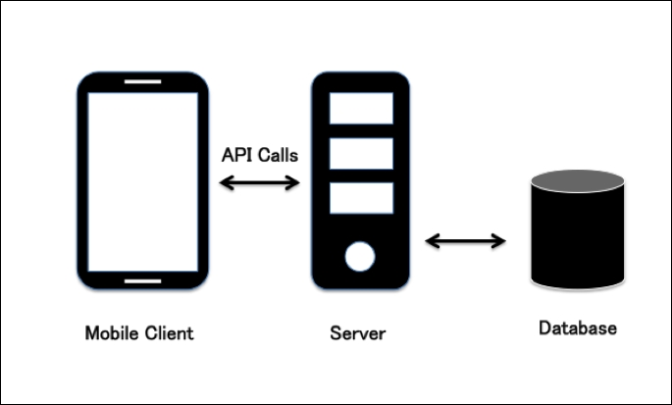
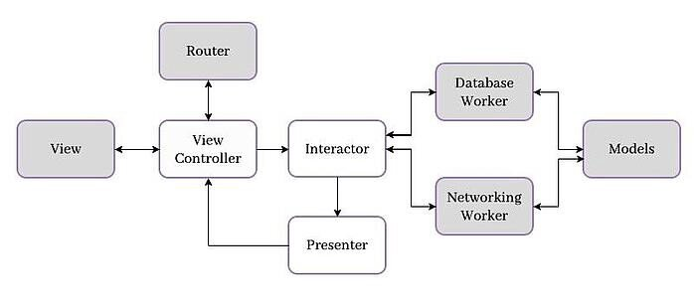
Architecture
FCS, Software Engineering

Slide 8

Expected Results
Analysis of existing solutions has been conducted;
Generational algorithms has been designed;
The architecture of the application has been designed;
Server and a mobile application have been developed;
The system has been tested;
FCS, Software Engineering

Slide 9
References
AutoChords. URL: https://autochords.com/ (Accessed - 17 ноября 2023)
Suggester URL: https://apps.apple.com/us/app/suggester-chords-and-scales/id504740787 (Accessed - 17 ноября 2023)
Cthulhu URL: https://xferrecords.com/products/cthulhu (Accessed - 17 ноября 2023)
AIVA URL: https://www.aiva.ai/ (Accessed - 17 ноября 2023)
Amadeus Code URL: https://amadeuscode.com/en/ (Accessed - 17 ноября 2023)
Apple Developer Documentation URL: https://developer.apple.com/documentation/ (Accessed - 20 ноября 2023)
Music Notation URL: https://github.com/music-notation-swift/music-notation (Accessed - 17 ноября 2023)
Beethoven URL: https://github.com/vadymmarkov/Beethoven/tree/master (Accessed - 17 ноября 2023)
Python URL: https://docs.python.org/3/ (Accessed - 17 ноября 2023)
Flask URL: https://flask.palletsprojects.com/en/3.0.x/ (Accessed - 17 ноября 2023)
PyTorch URL: https://pytorch.org/ (Accessed - 20 ноября 2023)\
Pandas URL: https://pandas.pydata.org/ (Accessed - 17 ноября 2023)
Numpy URL: https://numpy.org/ (Accessed - 17 ноября 2023)
MIDI URL: https://ru.wikipedia.org/wiki/MIDI (Accessed - 17 ноября 2023)
FCS, Software Engineering

Slide 10
Thank you for your attention!
FCS, Software Engineering

