Slide 1
DATA ANALYTICS PORTFOLIO PROJECT
IBM HR Attrition Analysis
Why people leave — and where the company should look first.
Python
SQL
Power BI
Venkata Modem
1,470 employees · 16.12% attrition · end-to-end analysis
Notes:
Title slide. Open with the one-line framing: this project asks who is leaving IBM and whether there's a pattern HR can act on. Mention the three tools used.

Slide 2



THE BUSINESS PROBLEM
Every resignation costs the company twice
When someone leaves, there's the visible cost of hiring and training a replacement — and the quieter loss of knowledge, relationships and momentum that walk out with them.
For an employer the size of IBM, even a small share of avoidable departures becomes a serious annual bill.
So the question driving this project was simple:
Who
Which people and roles are most likely to go
Why
What traits the leavers share
“Who is leaving — and is there a pattern behind it that HR can actually act on?”
So what
Where HR should focus limited effort
IBM HR Attrition Analysis
02
Notes:
Frame attrition as a cost, not bad luck. The three cards are the spine of the whole deck: who, why, so what.

Slide 3



HOW I APPROACHED IT
Three stages, from raw file to a story HR can read
01
02
03
Clean & explore
Question the data
Communicate
Python
SQL · MySQL
Power BI
Dropped dead columns, checked correlations, profiled who leaves with pandas and seaborn.
Loaded the clean table into MySQL and answered nine business questions with grouped queries and window functions.
Built one interactive page with KPIs, slicers and breakdowns so HR can explore it without writing code.
IBM HR Attrition Analysis
03
Notes:
Walk the pipeline left to right. Emphasise that the SQL ran against a real MySQL database, not a flat file — closer to a real team setup.

Slide 4





THE DATA AT A GLANCE
A fictional but realistic snapshot of 1,470 employees
1,470
237
16.12%
employees in the sample
have left the company
overall attrition rate
$6.5K
7.01 yrs
37
average monthly income
average tenure
average age
IBM HR Attrition Analysis
04
Notes:
These six numbers anchor everything. Stress that 16% is an average that hides much higher pockets — that's the hook into the findings.

Slide 5
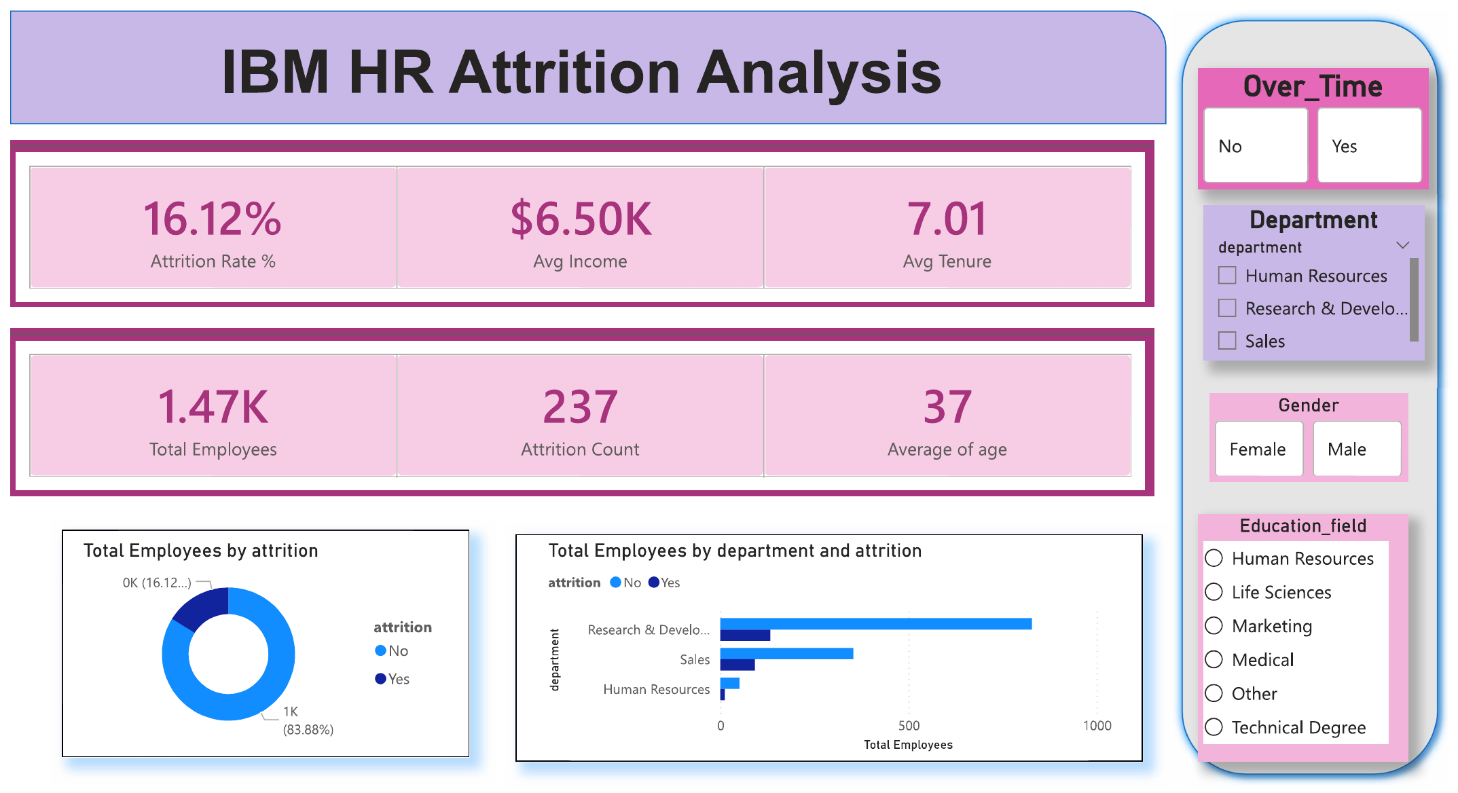
THE DELIVERABLE
One page that answers most questions in five seconds
Filter by overtime, department, gender or education field — no SQL required.
Notes:
The dashboard itself. Point out the slicers on the right — anyone in HR can slice the numbers live.

Slide 6
FINDING 1 — DEPARTMENT
Sales loses people fastest, even if R&D loses more bodies
Why it matters
Raw counts point at R&D simply because it's the biggest team.
But by rate, Sales is the real outlier at ~21% — well above the 16% average.
Looking at counts alone would have aimed attention at the wrong department.
IBM HR Attrition Analysis
06
Notes:
The count-vs-rate distinction is the analytical point here. R&D has the most leavers in absolute terms, but Sales has the highest rate.

Slide 7

FINDING 2 — JOB ROLE
One role stands apart: Sales Representatives leave at ~40%
The headline
Sales Representative — a junior, high-pressure, lower-paid role — churns at nearly 2.5x the company average.
If HR could fix only one thing, this is where to point them.
IBM HR Attrition Analysis
07
Notes:
This single bar is arguably the most important result in the project. Junior, pressured, lower-paid role churns hardest.

Slide 8
FINDING 3 — BEHAVIOUR & LIFE STAGE
Overtime is the cleanest signal of who walks
Works overtime vs not
By marital status
Overtime employees leave ~3x more often. Single staff leave more too — mostly a reflection of age and life stage, not marital status itself.
IBM HR Attrition Analysis
08
Notes:
Overtime is the single cleanest split between leavers and stayers. The marital-status pattern is really an age/life-stage signal.

Slide 9


PUTTING IT TOGETHER
The findings stack into one at-risk profile
Younger
Single
Junior / sales role
Lower paid
Works overtime
earlier in their careers
more mobile, fewer anchors
Sales Reps above all
easiest to tempt away
the clearest red flag
None of these traits is alarming alone. When several land on the same person — a young Sales Rep on overtime — the risk compounds.
Notes:
This is the synthesis slide. The power is in the stacking — the textbook at-risk employee is a young Sales Rep working overtime.

Slide 10
SO WHAT?
Three things I'd suggest HR do about it
1. Start with Sales Representatives
A 40% loss rate in one role is a focused problem, not a company-wide one. Exit interviews plus a review of pay, targets and workload for that group would likely pay for itself.
2. Treat overtime as an early-warning flag
It splits leavers from stayers more cleanly than almost anything else. Tracking who is consistently over hours gives managers a checklist before people reach the door.
3. Protect the lower pay bands
Low income paired with a junior role is where retention spending goes furthest — these people are both the most likely to leave and the most movable by a modest intervention.
IBM HR Attrition Analysis
10
Notes:
Read the findings as a to-do list. Each recommendation maps directly back to a finding.

Slide 11
HONESTY & NEXT STEPS
What this shows — and what it doesn't
Where it stops short
Where I'd take it next
It's a fictional, point-in-time dataset — so it shows association, not proof of cause.
Overtime lining up with attrition is a strong signal to investigate, not a closed case.
The numbers describe the past; they aren't a forecast on their own.
Build a classification model (logistic regression or gradient boosting) to score each employee's attrition risk.
Add time-based data to move from “who left” to “who's about to.”
Validate the overtime and Sales findings against real exit-interview notes.
Thanks for reading · Venkata Modem · Python · SQL · Power BI
IBM HR Attrition Analysis
11
Notes:
Close on intellectual honesty: associations, not causation, plus a clear roadmap. This signals analytical maturity.

