Slide 1
CART:Classification and Regression Trees
Presented by;
Pavla Smetanova
Lütfiye Arslan
Stefan Lhachimi
Based on the book “Classification and Regression Trees”
by L. Breiman, J. Friedman, R. Olshen, and C. Stone (1984).

Slide 2
Outline
1- INTRODUCTION
What is CART?
An example
Terminology
Strengths
2- METHOD:3 steps in CART:
Tree building
Pruning
The final tree

Slide 3
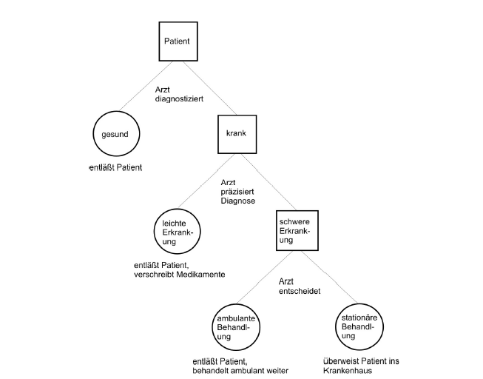

Slide 4
What is CART?
A non-parametric technique,using the methodology of tree building.
Classifies objects or predicts outcomes by selecting from a large number of variables the most important ones in determining the outcome variable.
CART analysis is a form of binary recursive partitioning.

Slide 5
An example from Clinical research
Development of a reliable clinical decision rule to classify new patients into categories
19 measurements(age, blood pressure, etc.)are taken from each heart-attack patients during the first 24 hours of their admittance to San Diego Hospital.
The goal: identify high-risk patients

Slide 6
Classification of Patients as High or No risk groups
Is the minimum systolic blod pressure
over the initial 24 hour> 91?
yes no
Is age>62.5?
yes no
Is sinus tachycardia
present?
yes no
G
F
G
F

Slide 7
Terminology
The classification problem: A systematic way of predicting the class of an object based on measurements.
C={1,...,J}: classes
x: measurement vector
d(x): a classifying function assigning every x to one of the classes 1,...,J.

Slide 8
Terminology
s: split
learning sample (L): measurement data on N cases observed in the past together with their actual classification.
R*(d): true misclassification rate R*(d)=P(d(x)=Y), Y∈ C

Slide 9
Strengths
No distributional assumptions are required.
No assumption of homogeneity.
The explanatory variables can be a mixture of categorical, interval and continuous.
Especially good for high-dimensional and large data sets. Produce useful results by using a few important variables.

Slide 10
Strengths
Sophisticated methods for dealing with missing variables.
Unaffected by outliers, collinearities, heteroscedascity.
Not difficult to interpret.
An important weakness: Not based on a probabilistic model, no confidence interval.

Slide 11
Dealing with Missing values
CART does not drop cases with missing measurement values.
Surrogate Splits: Define a measurement of similarity between any two splits s, s´ of t.
If best split of t is s on varible x_{m}, find s´ on other variables that is most similar to s. Call it best surrogate of s. Find 2nd best, so on...
If a case has x_{m} missing, refer to surrogates.

Slide 12
3 Steps in CART
Tree building
Pruning
Optimal tree selection
If the dependent variable is categorical then a classification tree and if it is continuous regression trees are used.
Remark: Until the Regression part, we talk just about classification trees.

Slide 13
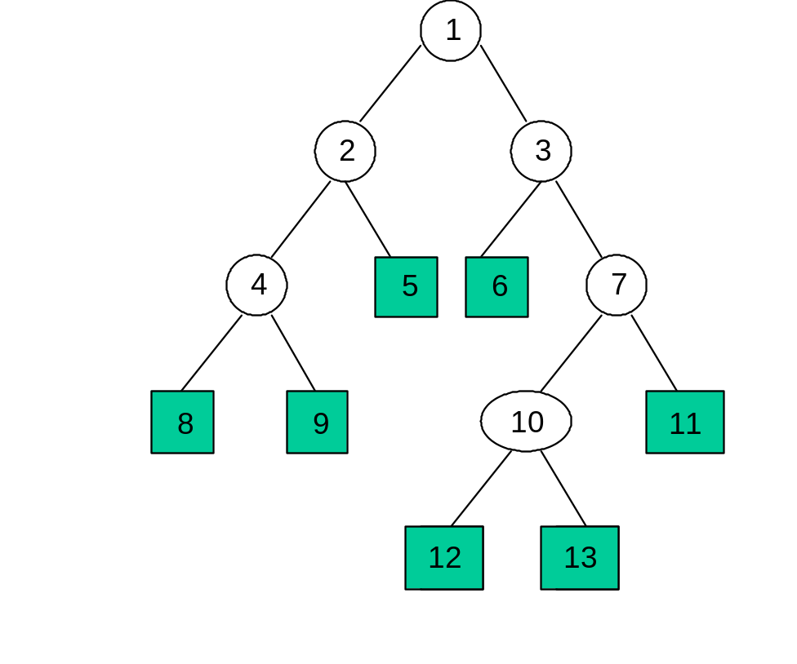
Example Tree
1 = root node
= terminal node
= non-terminal

Slide 14
Tree Building Process
What is a tree?
The collection of repeated splits of subsets of X into two descendant subsets.
A finite non-empty set T and two functions
left(.) and right(.) from t to T which satisfy;
For each t ∈T, either left(t)=right(t)=0,or left(t)>t and right(t)>t
For each t ∈T, other than the smallest integer in T, there is exactly one s ∈T s.t. either t=left(s) or t=right(s).

Slide 15
Terminology of tree
root of T: the minimum element of a tree
s: parent of T, if t=left(s) or t=right(s),
t: child
T*: set of terminal nodes: left(t)=right(t)=0.
T-T*: non-terminal nodes
A node s is ancestor of t if s=parent(t) or s=parent(parent(t)) or...

Slide 16
A node t is descendant of s, if s is an ancestor of t.
A branch of T_{t} of T with root node t ∈T consists of the node t and all descendants of t in T.
The main problem of tree building: how to use the data L to determine the splits, the terminal nodes and assignment of terminals to classes.

Slide 17
Steps of tree building
Start with splitting a variable at all of its split points. Sample splits into two binary nodes at each split point.
Select the best split in the variable in terms of the reduction in impurity (heterogeneity)
Repeat steps 1,2 for all variables at the root node.

Slide 18
Rank all of the best splits and select the variable that achieves the highest purity at root.
Assign classes to the nodes according to a rule that minimizes misclassification costs.
Repeat 1-5 for each non-terminal node
Grow a very large tree T_{max} until all terminal nodes are either small or pure or contain identical measurement vectors.
Prune and choose final tree using the cross validation.

Slide 19
1-2 Construction of the classifier
Goal: find a split, s , that divides L into so pure as possible subsets.
Goodness of split criteria is the decrease in impurity:
i(s,t)=i(t)-p_{L}i(t_{L})- p_{R}i(t_{R}).
where i(t):node impurity, p_{L},p_{R;}proportion of the cases that has been split to the left or right.

Slide 20
To extract the best split, choose the s* which fulfills;
 i(s*,t)=max_{s}  i(s,t)
Repeat the same till a node t is reached(optimization at each step) such that no significant decrease in purity is possible, declare it then as terminal node.

Slide 21
5-Estimating accuracy
Concept of R*(d): Construct d using L. Draw another sample from the same population as L. Observe the correct classification, find the predicted classification using d(x).
The proportion misclassified by d is the value of R*(d).

Slide 22
3 internal estimates of R*(d)
The resubstitution estimate(least accurate)
R(d)=1/N  _{n}I(d(x_{n}) j_{n}).
Test-sample estimate: (for large sample sizes)
R^{ts}(d)=1/N₂ _{(xn,jn)}I(d(x_{n})  j_{n}).
Cross-validation(preferred for smaller samples)
R^{ts}(d^{(v)})=1/N_{v} _{(xn,jn)}I(d^{(v)}(x_{n})  j_{n}).
R^{CV}(d)=1/V_{v}R^{ts}(d^{(v)}).

Slide 23
7-Before Pruning
Instead of finding appropriate stopping rules, grow a T_{max} and prune it to the root. Then use R*(T) to select the optimal tree among pruned subtrees.
Before pruning, for growing a sufficiently large initial tree T_{max} specifies N_{min} and split until each terminal node either is pure or N(t) N_{min}.
Generally N_{min} has been set at 5, occasionally at 1.

Slide 24
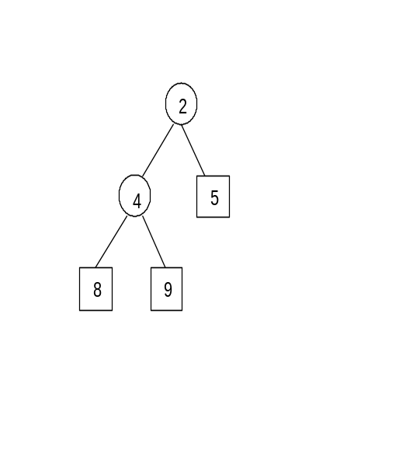
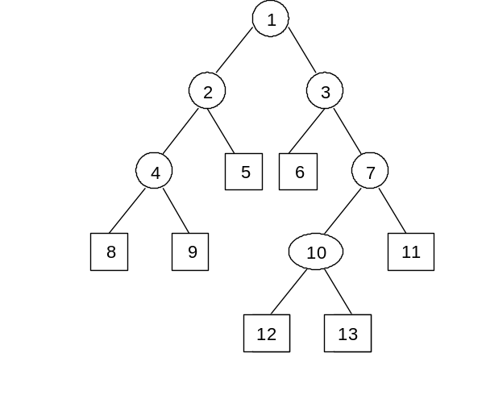
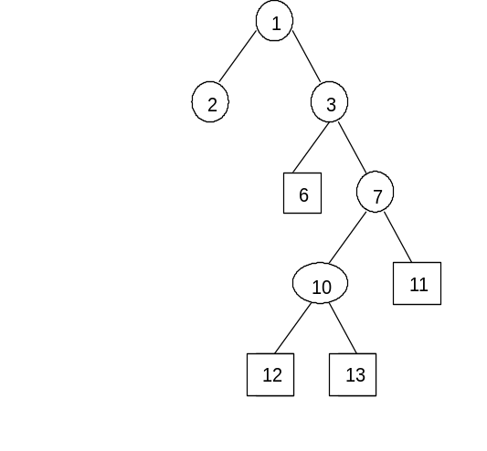
Tree T
Branch T₂
Tree T-T₂
Definition : Pruning a branch T_{t} from a tree T consists of deleting all descendants of t except its root node.
T- T_{t} is the pruned tree.

Slide 25
Minimal Cost-Complexity Pruning
For any subtree T  T_{max}, complexity |T| :the number of terminal nodes in T.
Let   0, be a real number called the complexity parameter, a measure of how much additional accuracy a split must add to the entire tree to warrant the additional complexity.
The cost-complexity measure R (T) is a linear combination of the cost of the tree and its complexity.
R (T)=R(T)+  |T| .

Slide 26
For each value of α, find the subtree T() which minimizes R (T),i.e.,
R (T())=min_{T} R (T).
For  =0, we have the T_{max}. As  increases the tree become smaller, reducing down to the root at the extreme.
Result is a finite sequence of subtrees T₁,
T₂, T₃ ,... T_{k} with progressively fewer terminal nodes.

Slide 27
Optimal Tree Selection
Task: find the correct complexity parameter  so that the information in L is fit, but not overfit.
This requires normally an independent set of data. If not available, use CROSS-Validation to pick out that subtree with the lowest estimated misclassification rate.

Slide 28
Cross-Validation
L randomly divided into V subsets, L₁,..., L_{V}.
For every v=1,...,V; apply the procedure using L- L_{V} as a learning sample and let d^{(v)}(x) be the resulting classifier. A test sample estimate for R*(d^{(v)}) is;
R^{ts}(d^{(v)})=1/N_{v} _{(xn,jn)}I(d^{(v)}(x_{n})  j_{n}).
where N_{v} is the number of cases in L_{V}.

Slide 29


Regression trees
The basic idea same with classification.
The regression estimator in the first step;
The regression estimator in the second step;

Slide 30

Split R into R₁ and R₂ such that sum of squared residuals of the estimator is minimized;
which is the counterpart of true misclassification rate in classification trees.

Slide 31
Comments
Mostly used in clinical research, air pollution, criminal justice, molecular structures,...
More accurate on nonlinear problems compared to linear regression.
look at the data from different viewpoints.

