Slide 1
Challenge 1: Lung Cancer Phenotyping

Slide 2
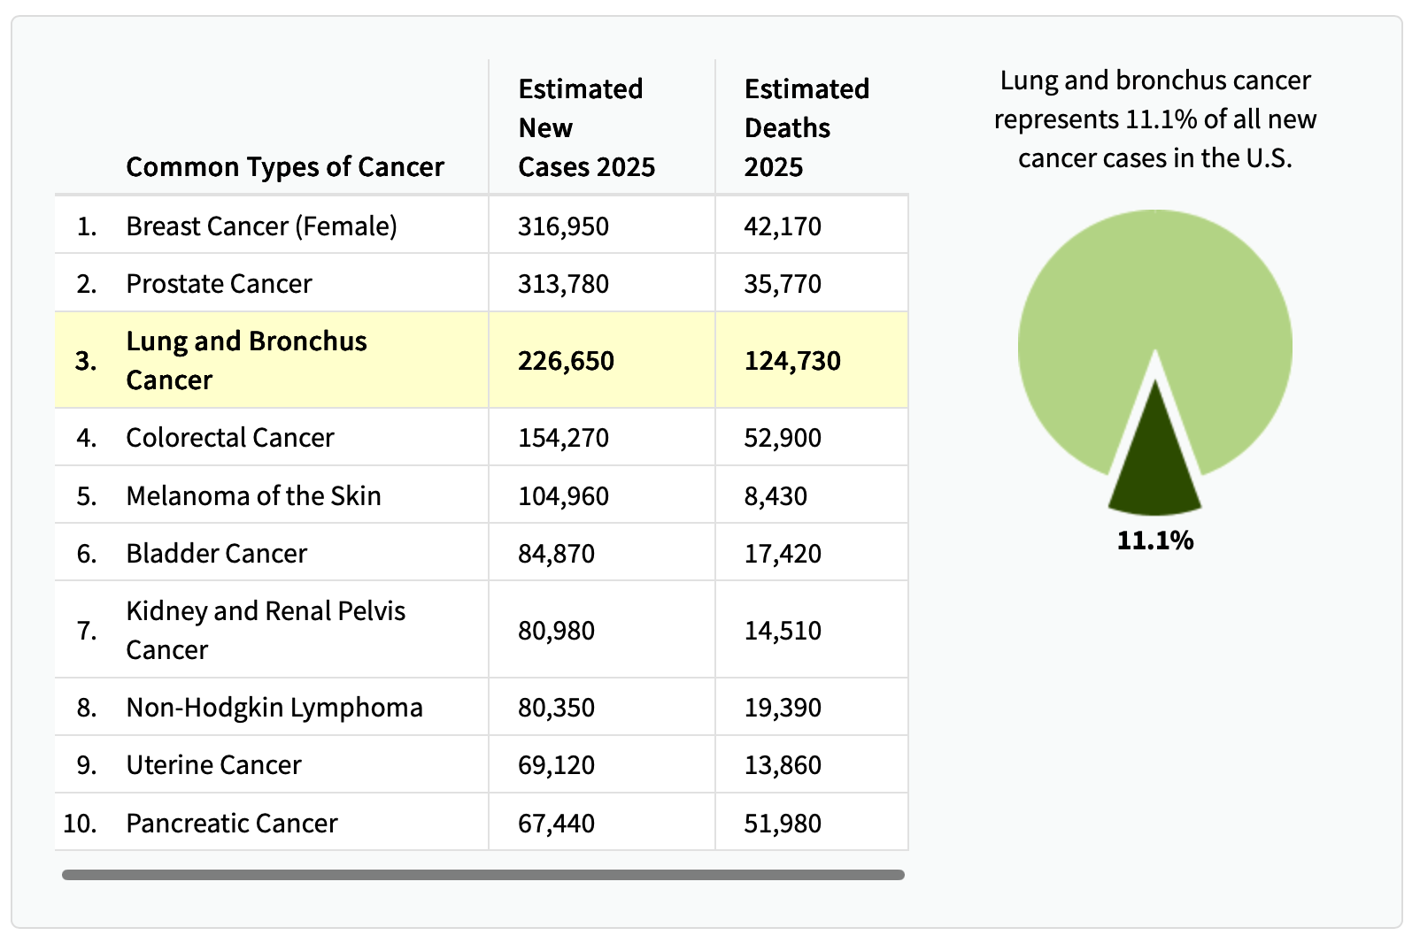
Lung cancer was still the leading cause of cancer death in 2025
NCI SEER Data
Notes:
Lung cancer is the leading cause of cancer death and represents 11.1% of all new cancer cases. Prior to this year, more people died of lung cancer than breast, prostate, and colorectal cancer combined. This is no longer true potentially as a result of increased lung cancer screening and new treatments.

Slide 3
Lung cancer stage at diagnosis relative to other common cancers
Long-established cancer screening recommendations
NCI SEER Data (2004 - 2022)
Notes:
Lung cancer is often detected at a later stage in comparison to breast, prostate, and colorectal cancer that have long-established screening programs. When lung cancer is detected early and is localized the 5-year survival is much higher compared to after it metastasizes to the lymph nodes or outside the lung.

Slide 4
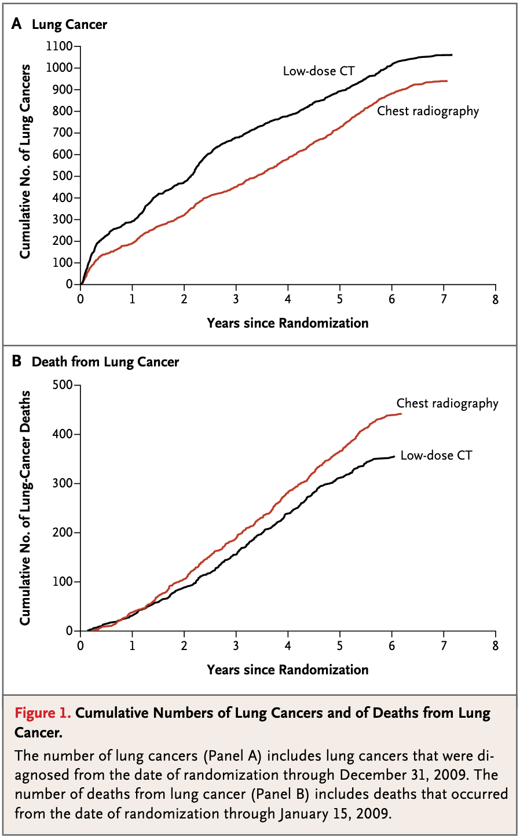

Notes:
The National Lung Cancer Screening trial was published in NEJM in 2011 and show that CT screening results in a 20% reduction in lung cancer mortality and paved the way for lung cancer screening programs to be implemented in the US.

Slide 5
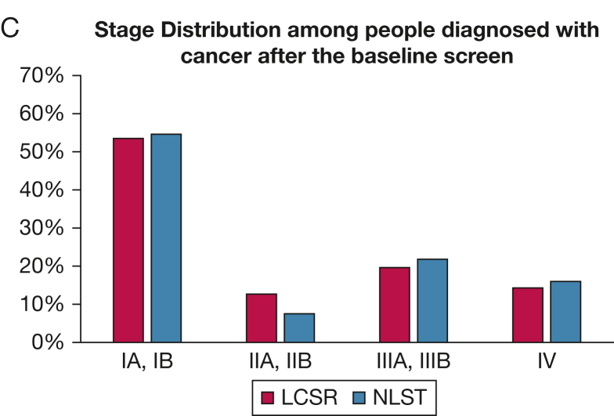
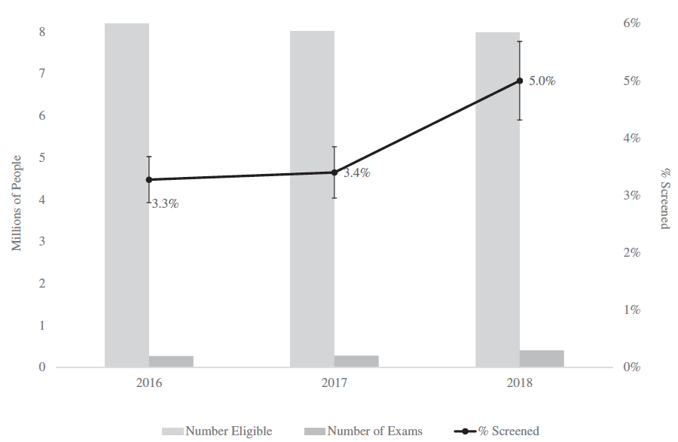
Detection of early-stage lung cancer is increasing
Fraction of eligible individuals screened
Fedewa et al. JNCI. 2021
Silvestri et al. Chest. 2023
Lung cancer treatment will increasingly be about treating early-stage disease and less about late-stage disease
Notes:
Most people eligible for lung cancer screening, do not get screened and so there is a lot of improvement to be made; however, screening is slowly increasing. As screening is implemented more broadly we expect to detect more early-stage lung cancers.

Slide 6
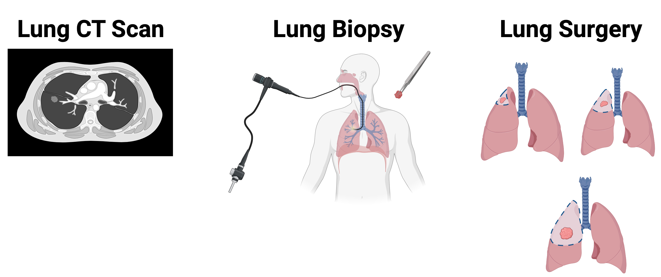
Central Hypotheses
Lung cancer screening has created an opportunity to decrease the burden of lung cancer by optimizing the treatment of early-stage disease: there is an opportunity to maximize survivorship while minimizing negative effects of treatment.
Pathologic features of lung cancer are associated with lung cancer aggressiveness and may be a better proxy of outcome than survival
?
?
Notes:
Since the number of early-stage lung cancers detected is rapidly increasing, it is very important to optimize treatment of to maximize survivorship. After a suspicious lung nodule is detected by CT scan, it is biopsied to confirm that it is cancer. If the cancer is very small and localized, it can undergo a tumor resection for potential cure. There are different types of lung cancer surgery that can be performed and they differ by the extent of lung tissue that is resected. About 10% of stage I lung adenocarcinomas recur after resection. Aggressive tumors that have a higher potential to occur can be identified by specific pathologic features. These pathologic features can be identified after resection to help determine optimal treatment. It would also be advantageous to identify these features in a pre-surgical biopsy so the type of lung cancer resection surgery could be tailored to tumor features.

Slide 7
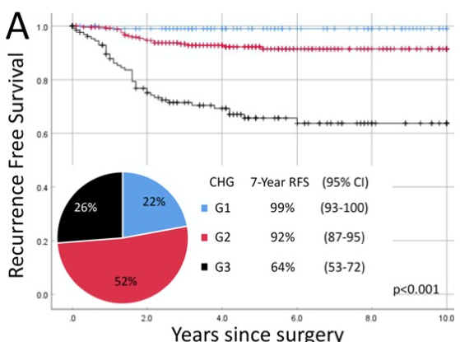
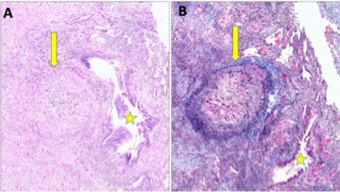
Microscopic vascular Invasion is an Aggressive Pathologic Feature
H&E
Trichrome Elastic Stain
VI
VI
VI
bronchiole
bronchiole
internal and external elastic lamina in black and collagen in blue
Yambayev et al. Lung Cancer. 2022
VI Foci are very small (<1mm), tumor is usually ~1.6cm
Notes:
Microscopic vascular invasion is an aggressive pathologic feature and is associated with poor prognosis (G3 in right picture). It can be visualized on H&E-stained tissue and more easily with a Trichrome Elastic Stain. It is challenging for pathologists to detect because it can be very small.

Slide 8
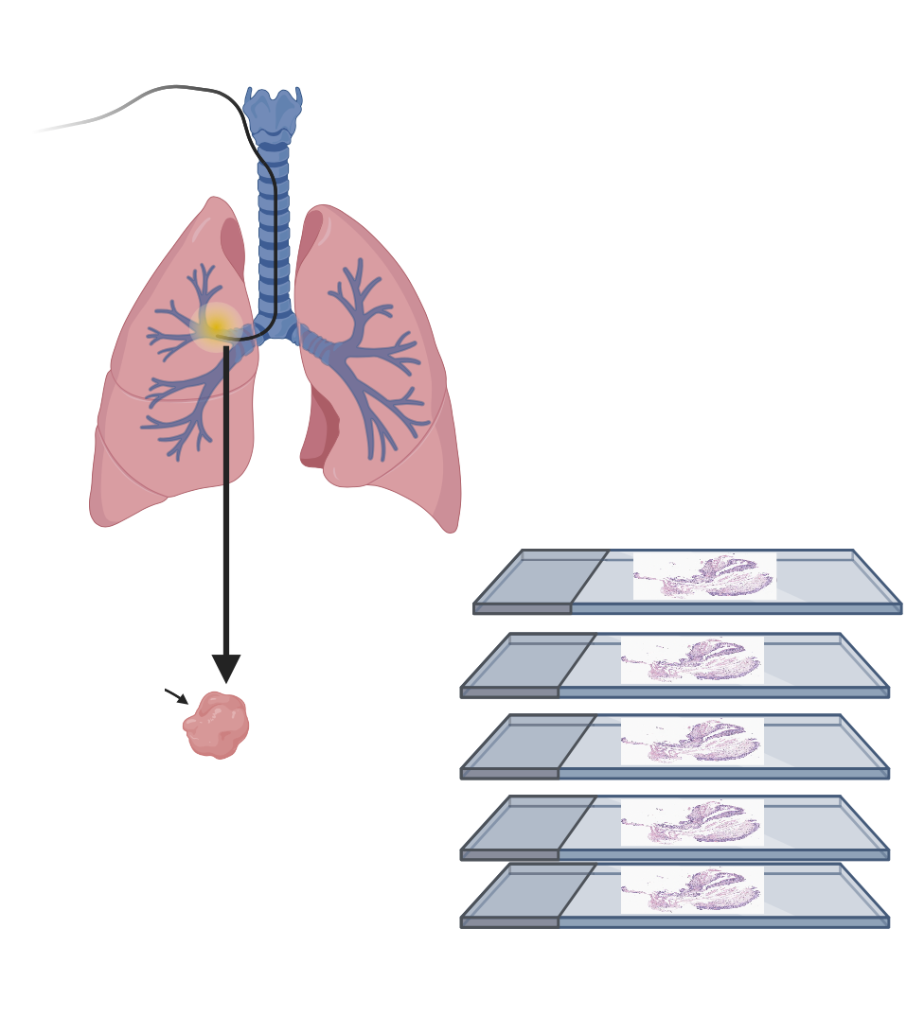
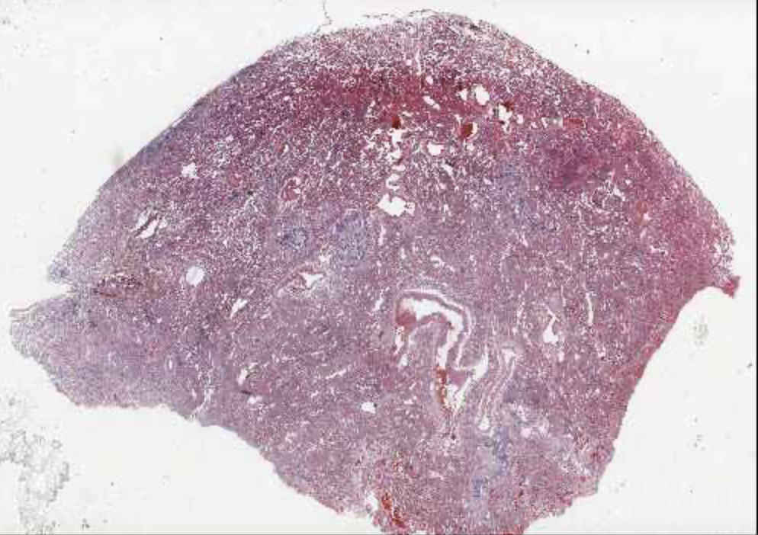
Challenge 1: Detect VI in H&E tissues from lung tumors
Stage I Lung Adenocarcinoma Patients
Each H&E is digitized at 20X
(WSI)
H&Es
Pre-computed
Patch level Features
And spatial coordiates
Model
Aperio slide scanner
(.svs format)
Tumor with or without VI
Avg. Size ~1.3GB
~24000*19000 pixels
Hematoxylin: stains nuclei blue/purple
Eosin: stains cytoplasm and extracellular matrix pink
Team with best log loss for VI status wins
Training Data - NLST
245 patients, 506 WSIs
291 NOVITUMOR, 215 VITUMOR
Patient-level Label
External Data – Inova/Lahey
158 patients, 314 WSIs
220 NOVITUMOR, 94 VITUMOR
Patient-level Label
Notes:
The challenge is to detect VI in H&E-stained lung resection tissues. VI is patient level label, but patients can have multiple slides, only some of which will contain a VI foci. It would be advantageous for the predictor to be able to detect VI across all slides because we would like to test it on pre-surgical biopsies. In this challenge the training slides are from lung adenocarcinoma cases from the NLST (National Lung Cancer Screening Trial) that have been reviewed by a pathologist for the presence/absence of VI. The predictor developed will be tested in similar slides from an external datasets collected at Inova and Lahey.

