Slide 1
ABSTRACTION

Slide 2
The meaning of the word “Abstraction”, in general words, is the process of working with ideas rather than their implementation.
Abstraction is the process of hiding certain details and showing only essential information to the user.
May also be defined as the process of identifying only the required characteristics of an object ignoring the irrelevant details. The properties and behaviors of an object differentiate it from other objects of similar type and also help in classifying/grouping the objects.

Slide 3
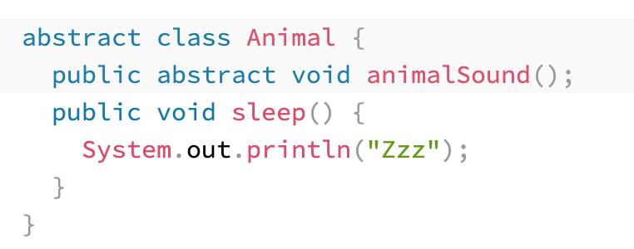
The abstract keyword is a non-access modifier, used for classes and methods:
Abstract class: is a restricted class that cannot be used to create objects (to access it, it must be inherited from another class).It is used to represent a concept.

Slide 4
An abstract class does not allow you to create objects of its type. In this case, we can only use the objects of its subclass. That is, an abstract class can not be directly instantiated with the NEW operator.
An abstract class can have both abstract and regular methods
The class has to be declared as abstract if it contains at least one abstract method.
An abstract class can have parameterized constructors and the default constructor is always present in an abstract class.

Slide 5
Abstract method: can only be used in an abstract class, and it does not have a body. The body is provided by the subclass (inherited from).
A method-defined abstract must always be redefined in the subclass.
It can not be private, final or static.

Slide 6
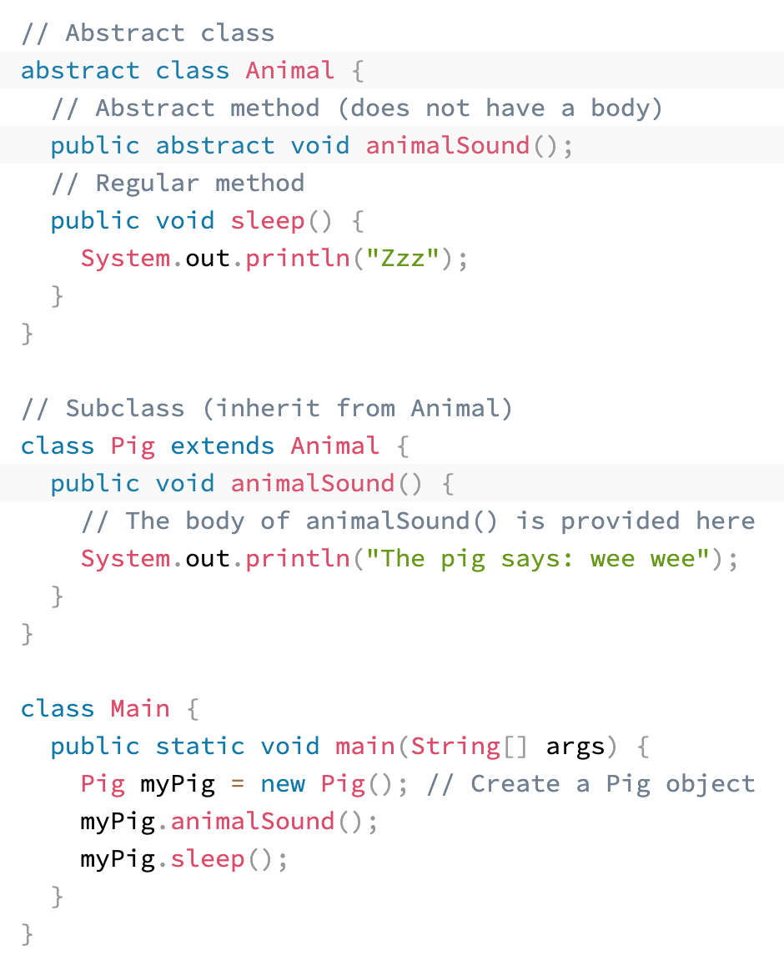

Slide 7
Advantages of Abstraction
It reduces the complexity of viewing things.
Avoids code duplication and increases reusability.
Helps to increase the security of an application or program as only essential details are provided to the user.
It improves the maintainability of the application.
It improves the modularity of the application. (removed, replaced, modified)

