Slide 1

La4j
Linear Algebra for Java
Arquitectura de Software

Slide 2
Description
Open-source library for manipulation of vectors and matrices
Started as a student project
Over 800 commits and 25 contributors
Written in Java
Object-oriented architecture
Destined for programmers
Junit test suite with approximately 90% coverage
Notes:
Object oriented architecture: All objects, like matrices and vectors, are self-contained, since can describe themselves from information that they contain, and have methods for their manipulation

Slide 3
Use cases

Slide 4
Logical View
Functionality provided to end-users – developers, in our case
We considered its classes as the services provided to developers
Most important classes that we chose to describe:
Matrix
Vector
Solvers
Inverter

Slide 5
Logical View
Notes:
LeastNormSolver, SquareRootSolver, SweepSolver, GaussianSolver, JacobiSolver, SeidelSolver, ForwardBackSubstitutionSolver, LeastSquaresSolver, têm uma *association* com Matrix – porque guardam um objecto do tipo Matrix dentro de si
LeastNormSolver, SquareRootSolver, SweepSolver, GaussianSolver, JacobiSolver, SeidelSolver, ForwardBackSubstitutionSolver, LeastSquaresSolver, têm uma *generalization* com AbstractSolver – estendem o AbstractSolver, herdam métodos dele
LeastNormSolver, SquareRootSolver, SweepSolver, GaussianSolver, JacobiSolver, SeidelSolver, ForwardBackSubstitutionSolver, LeastSquaresSolver, têm uma *realization* com LinearSystemSolver – implementam essa interface GaussJordanInverter, NoPivotGaussInverter, têm uma *association* com Matrix – porque guardam um objecto do tipo Matrix dentro de si GaussJordanInverter, NoPivotGaussInverter, têm uma *realization* com MatrixInverter – implementam essa interface

Slide 6
Logical View - Matrix
Too big to show here: https://raw.githubusercontent.com/randrade23/la4j/master/ArchSW-docs/uml/class_diagrams/matrix.png

Slide 7
Logical View - Vector
Too big to show here: https://raw.githubusercontent.com/randrade23/la4j/master/ArchSW-docs/uml/class_diagrams/vector.png

Slide 8
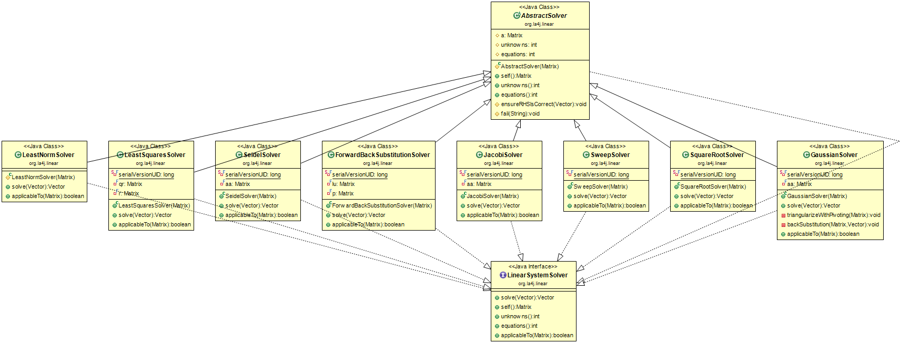
Logical View – Solvers
Notes:
AbstractSolver class is a generalization of the solvers
The solvers implement (realization) the LinearSystemSolver class You can instantiate the AbstractSolver class and then assign it a class from the others, to use any method for system solving

Slide 9
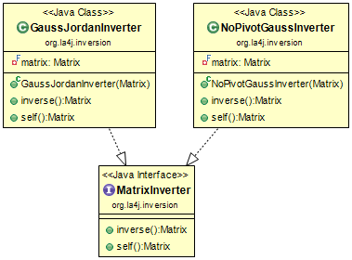
Logical View - Inverter
Notes:
The inverters implement (realization) the MatrixInverter interface
You can instantiate directly the GaussJordanInverter and NoPivotGaussInverter classes

Slide 10
Process View
How does the system do certain functionality?
We chose six exemples of essential functionality:
Creating a matrix and printing it
Creating two matrices, summing them and printing the sum
Creating a vector
Adding two vectors and printing the norm of the sum
Solving a Ax=B equation system with the Gaussian method
Inverting a matrix with the Gauss-Jordan method

Slide 11
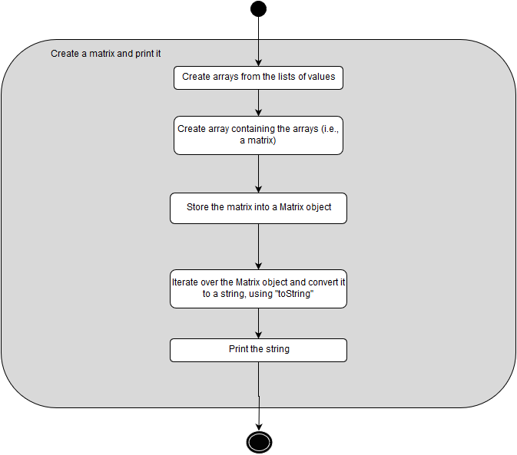
Process View – Creating a matrix and printing it
Notes:
Shows how to create a matrix, which is essential, and how to print it – this way of printing can be used in Vector object too

Slide 12
Process View – Creating two matrixes, summing them and printing the sum
Notes:
Shows how arithmetic with matrices is done

Slide 13
Process View – Creating a vector
Notes:
Very simple procedure – and similar to Matrix

Slide 14
Process View – Add two vectors and print the norm of the sum
Notes:
How arithmetic in Vectors is done – similar to matrices

Slide 15
Process View – Solving an Ax=B system with Gaussian method
Too big to show here: https://raw.githubusercontent.com/randrade23/la4j/master/ArchSW-docs/uml/process_view/Example5.png
Notes:
How one of the most important functionalities is done internally

Slide 16
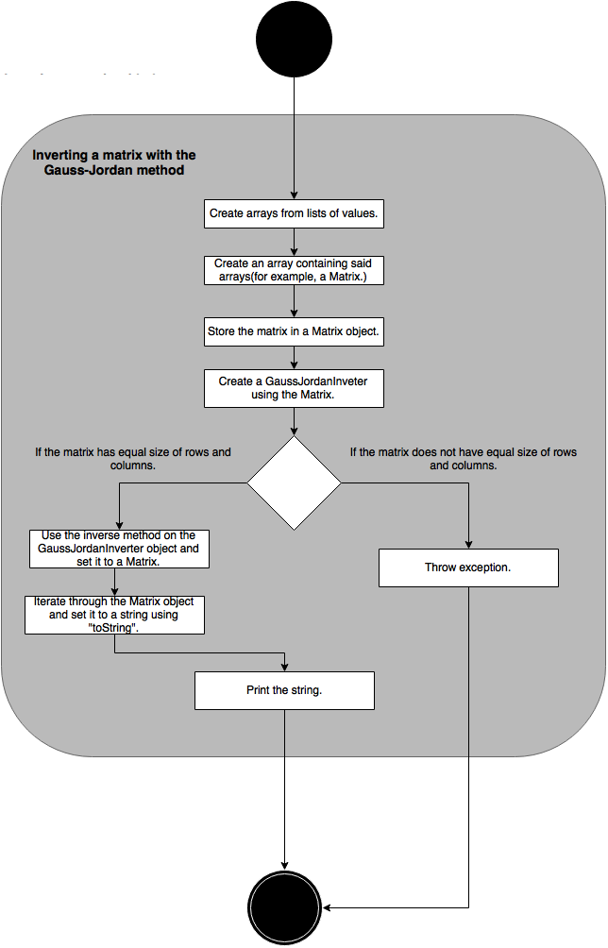
Process View – Inverting a matrix with the Gauss-Jordan method

Slide 17
Development View
How did the library developer visualize this?
Hard to separate this view from actual code, in our case
Code is divided in packages – we tried to make sense of them

Slide 18
Development View
Notes:
Matrixes and Vectors can be stored in two different ways – sparse or dense (memory storage: sparse if most elements == 0, dense otherwise)
Functors let you implement functions to run over Matrices and Vectors
Linear – equation solvers, require matrices and vectors to do that
Decomposition – lets you factor a matrix
Inversion – matrix inversion
Iterator – lets you iterate over elements that constitute Matrices and Vectors
Operation – arithmetic manipulation of vectors and matrixes – can be done in place (without cloning – modifies original object) or out of place

Slide 19
Physical View
Destined for system engineers
How can our system interface with others?
This is a Java library – it can be implemented in other projects

Slide 20
Physical View
Notes:
Any Java project, written in Java 6 or newer, can import the library

Slide 21
Conclusions
This project is developed in a very modular function
The code is kept sound due to the simplicity of linear algebra functions and its test suite
Easy to interface with existing projects or libraries
Test suite could be extended to full coverage

Slide 22
Contribution
Emanuel Barros: 23%
Ricardo Ferreira da Silva: 23%
Rui Andrade: 30%
Vanda Azevedo: 23%

