Slide 1
La4j
Linear Algebra for Java

Slide 2
Description
Open-source library for manipulation of vectors and matrices
Started as a student project
Over 800 commits and 25 contributors
Written in Java
Object-oriented architecture
Destined for programmers
Notes:
Object oriented architecture: All objects, like matrices and vectors, are self-contained, since can describe themselves from information that they contain, and have methods for their manipulation

Slide 3
Logical View
Functionality provided to end-users – developers, in our case
We considered its classes as the services provided to developers
Most important classes that we chose to describe:
Matrix
Vector
Solvers
Inverter

Slide 4
Logical View
Notes:
LeastNormSolver, SquareRootSolver, SweepSolver, GaussianSolver, JacobiSolver, SeidelSolver, ForwardBackSubstitutionSolver, LeastSquaresSolver, têm uma *association* com Matrix – porque guardam um objecto do tipo Matrix dentro de si
LeastNormSolver, SquareRootSolver, SweepSolver, GaussianSolver, JacobiSolver, SeidelSolver, ForwardBackSubstitutionSolver, LeastSquaresSolver, têm uma *generalization* com AbstractSolver – estendem o AbstractSolver, herdam métodos dele
LeastNormSolver, SquareRootSolver, SweepSolver, GaussianSolver, JacobiSolver, SeidelSolver, ForwardBackSubstitutionSolver, LeastSquaresSolver, têm uma *realization* com LinearSystemSolver – implementam essa interface GaussJordanInverter, NoPivotGaussInverter, têm uma *association* com Matrix – porque guardam um objecto do tipo Matrix dentro de si GaussJordanInverter, NoPivotGaussInverter, têm uma *realization* com MatrixInverter – implementam essa interface

Slide 5
Logical View - Matrix
Too big to show here: https://raw.githubusercontent.com/randrade23/la4j/master/ArchSW-docs/uml/class_diagrams/matrix.png

Slide 6
Logical View - Vector
Too big to show here: https://raw.githubusercontent.com/randrade23/la4j/master/ArchSW-docs/uml/class_diagrams/vector.png

Slide 7
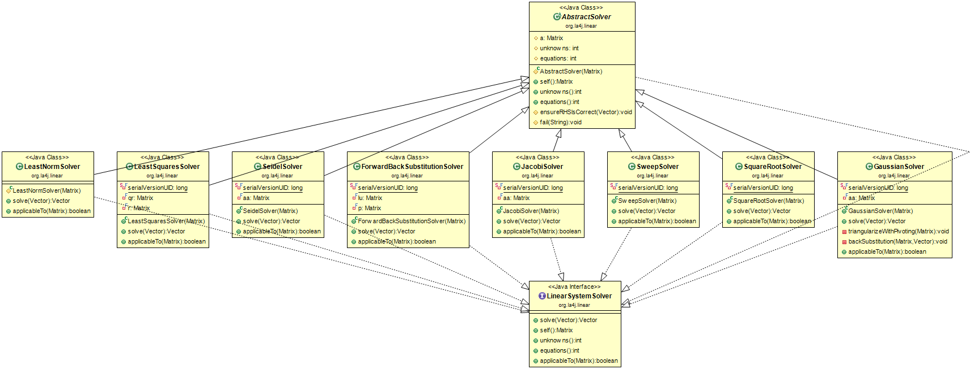
Logical View – Solvers
Notes:
AbstractSolver class is a generalization of the solvers
The solvers implement (realization) the LinearSystemSolver class You can instantiate the AbstractSolver class and then assign it a class from the others, to use any method for system solving

Slide 8
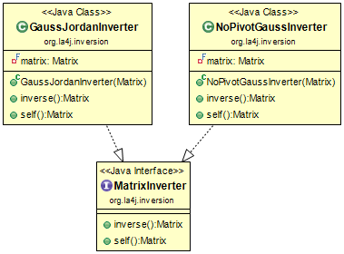
Logical View - Inverter
Notes:
The inverters implement (realization) the MatrixInverter interface
You can instantiate directly the GaussJordanInverter and NoPivotGaussInverter classes

Slide 9
Process View
How does the system do certain functionality?
We chose six exemples of essential functionality:
Creating a matrix and printing it
Creating two matrices, summing them and printing the sum
Creating a vector
Adding two vectors and printing the norm of the sum
Solving a Ax=B equation system with the Gaussian method
Inverting a matrix with the Gauss-Jordan method

Slide 10
Process View – Creating a matrix and printing it
Notes:
Shows how to create a matrix, which is essential, and how to print it – this way of printing can be used in Vector object too

Slide 11
Process View – Creating two matrixes, summing them and printing the sum
Notes:
Shows how arithmetic with matrices is done

Slide 12
Process View – Creating a vector
Notes:
Very simple procedure – and similar to Matrix

Slide 13
Process View – Add two vectors and print the norm of the sum
Notes:
How arithmetic in Vectors is done – similar to matrices

Slide 14
Process View – Solving an Ax=B system with Gaussian method
Too big to show here: https://raw.githubusercontent.com/randrade23/la4j/master/ArchSW-docs/uml/process_view/Example5.png
Notes:
How one of the most important functionalities is done internally

Slide 15
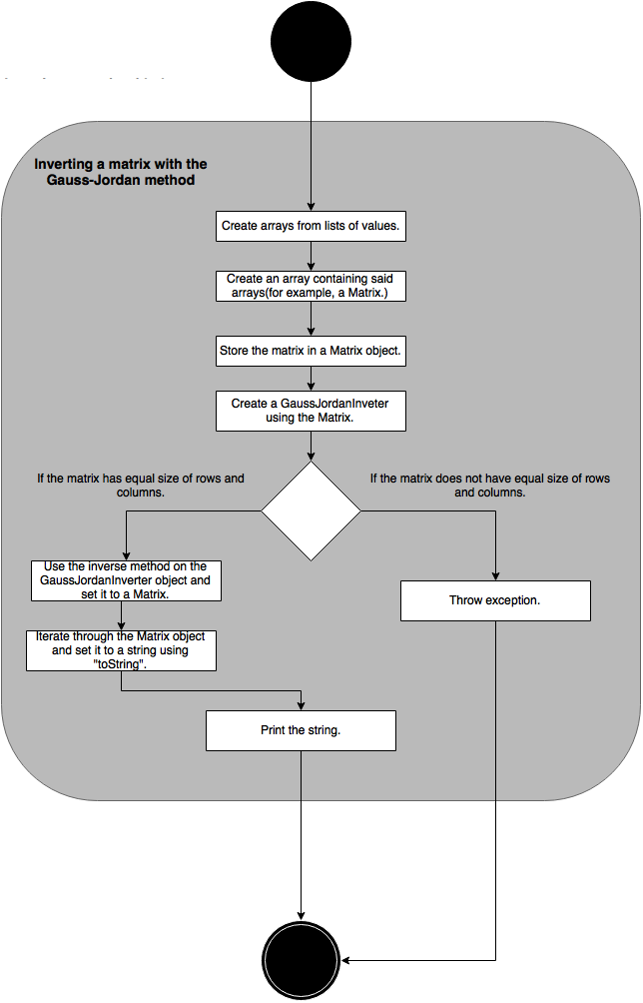
Process View – Inverting a matrix with the Gauss-Jordan method

Slide 16
Development View
How did the library developer visualize this?
Hard to separate this view from actual code, in our case
Code is divided in packages – we tried to make sense of them

Slide 17
Development View
Notes:
Matrixes and Vectors can be stored in two different ways – sparse or dense (memory storage: sparse if most elements == 0, dense otherwise)
Functors let you implement functions to run over Matrices and Vectors
Linear – equation solvers, require matrices and vectors to do that
Decomposition – lets you factor a matrix
Inversion – matrix inversion
Iterator – lets you iterate over elements that constitute Matrices and Vectors
Operation – arithmetic manipulation of vectors and matrixes – can be done in place (without cloning – modifies original object) or out of place

Slide 18
Physical View
Destined for system engineers
How can our system interface with others?
This is a Java library – it can be implemented in other projects

Slide 19
Physical View
Notes:
Any Java project, written in Java 6 or newer, can import the library

