Slide 1
La4j
Linear Algebra for Java

Slide 2
Description
Open-source library for manipulation of vectors and matrices
Started as a student project
Over 800 commits and 25 contributors
Written in Java
Object-oriented architecture
Destined for programmers

Slide 3
Logical View
Functionality provided to end-users – developers, in our case
We considered its classes as the services provided to developers
Most important classes that we chose to describe:
Matrix
Vector
Solvers
Inverter

Slide 4
Logical View
Notes:
LeastNormSolver, SquareRootSolver, SweepSolver, GaussianSolver, JacobiSolver, SeidelSolver, ForwardBackSubstitutionSolver, LeastSquaresSolver, têm uma *association* com Matrix – porque guardam um objecto do tipo Matrix dentro de si
LeastNormSolver, SquareRootSolver, SweepSolver, GaussianSolver, JacobiSolver, SeidelSolver, ForwardBackSubstitutionSolver, LeastSquaresSolver, têm uma *generalization* com AbstractSolver – estendem o AbstractSolver, herdam métodos dele
LeastNormSolver, SquareRootSolver, SweepSolver, GaussianSolver, JacobiSolver, SeidelSolver, ForwardBackSubstitutionSolver, LeastSquaresSolver, têm uma *realization* com LinearSystemSolver – implementam essa interface GaussJordanInverter, NoPivotGaussInverter, têm uma *association* com Matrix – porque guardam um objecto do tipo Matrix dentro de si GaussJordanInverter, NoPivotGaussInverter, têm uma *realization* com MatrixInverter – implementam essa interface

Slide 5
Logical View - Matrix
Too big to show here: https://raw.githubusercontent.com/randrade23/la4j/master/ArchSW-docs/uml/class_diagrams/matrix.png

Slide 6
Logical View - Vector
Too big to show here: https://raw.githubusercontent.com/randrade23/la4j/master/ArchSW-docs/uml/class_diagrams/vector.png

Slide 7
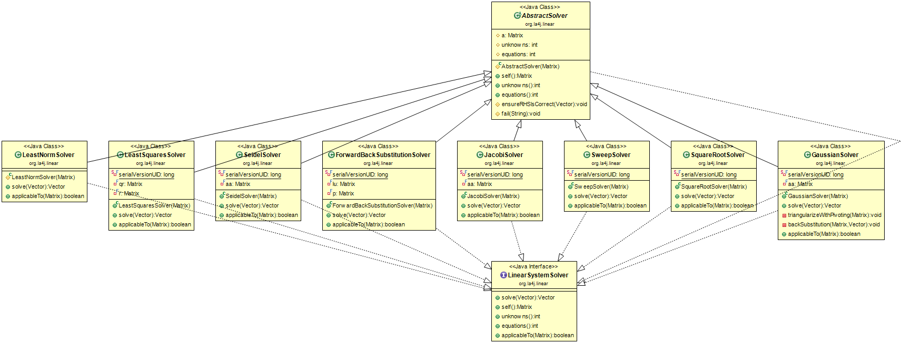
Logical View – Solvers
Notes:
AbstractSolver class is a generalization of the solvers
The solvers implement (realization) the LinearSystemSolver class You can instantiate the AbstractSolver class and then assign it a class from the others, to use any method for system solving

Slide 8
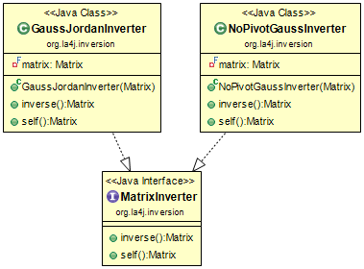
Logical View - Inverter
Notes:
The inverters implement (realization) the MatrixInverter interface
You can instantiate directly the GaussJordanInverter and NoPivotGaussInverter classes

