Slide 1

Security Enhancements Using Routers and Switches
Under The Guidance of
Mr. K. Chandrasekhar M.C.A,M.Tech

Slide 2
Abstract
Design and Implement different secure techniques in WAN & LAN Communications.
WAN technologies implemented by Routers and LAN Technologies are implement by Switches.
Routers and switches doesn’t provide any security.
Internet work operating system (IOS) is used to manage the routers and switches.
By enabling the secure technologies in routers and switches by using IOS to prevent attacks from intruders.

Slide 3
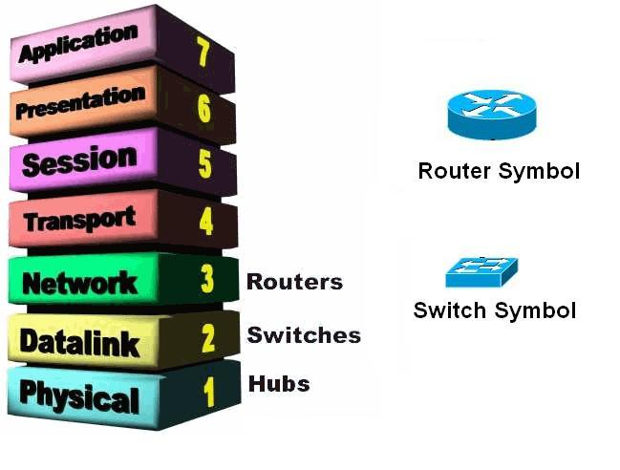
Introduction
Routers and Switches are the basic building blocks of networking.
Routers are Layer 3 devices and switches are Layer 2 devices.

Slide 4
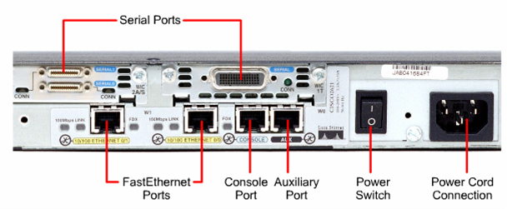
Introduction (Cont…)
Router
  It is a physical device used to communicate different geographical locations and routed packets.
  The Rear View of Cisco 2500 Series Router.

Slide 5
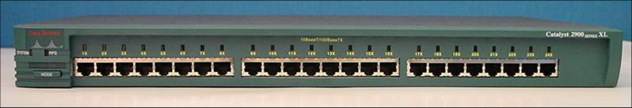
Introduction (Cont…)
Switch
  It is physical device, used to communicate the local area devices, and it forwards the frames.
  The rear view of Cisco 2900 series Switch

Slide 6
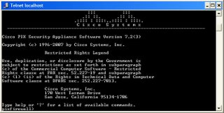
Introduction (Cont…)
Internet work Operating System (IOS)
  It is a Operating system used to manage the routers and switches
  Cisco IOS uses command line interface.
  Reliable and secure access the network and resources.
  Network scalability

Slide 7
Existing System
Categories network attacks
Reconnaissance Attacks
Access Attacks
Denial of Services Attack
Management Protocol Attacks
Virus, worms and trogons attacks

Slide 8
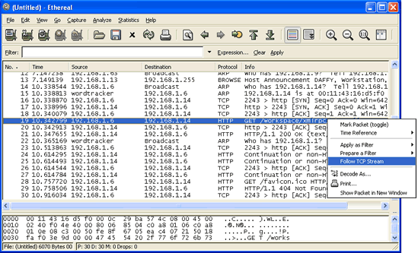
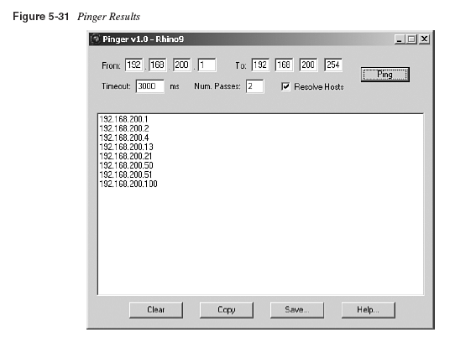
Existing System (Cont…)
Packets which are send by an network
Reconnaissance Attacks
  Packet Sniffer.
    Capturing the packets.
    Ethereal tool used to capture packets send my Ethernet.
  Ping Sweeps.
    Identify the host in a network.
    Angry IP scanner is a tool, used to identify the alive host.
Observers the IP address in a network
Ethereal tool

Slide 9

Existing System (Cont…)
Access Attacks
  Password attacks
  Man in the Middle attacks
Denial of service attacks
  IP spoofing
  Distributed DOS
Management Protocol Attacks
  Telnet
  TFTP

Slide 10

Existing System (Cont…)
Viruses, worms and Trojan horses
  Viruses
    Virus is a program, when it open it automatically attach code to another file.
  Worms
    Worm is a programs that replicate without infecting other programs. It is generally slowdown the processor
  Trojan horses
    It is a program that contain code, that make the file unrecognizable.

Slide 11

Proposed System
Reconnaissance Attacks
  Mitigation :
    Authentication.
    Switches.
    Cryptography.
Access Attacks
  Mitigation:
    Eliminate duplicate passwords.
    Disable accounts after failed authentication.
    Use strong authentication.

Slide 12

Proposed System (Cont…)
Denial of services
  Mitigation:
    Cryptography.
Viruses, Worms and Trojans horses
  Mitigation:
    Cryptography, Isolate the infected devices by VLAN.
Management Protocol Attacks
  Mitigation:
    SSH, ACL’s.

Slide 13
Requirements
Software Requirements
  Packet tracer simulator.
  Windows XP or higher.
  RAM 512.
Hardware Requirements
  4 Cisco Routers.
  5 Switches.
  IOS.

Slide 14
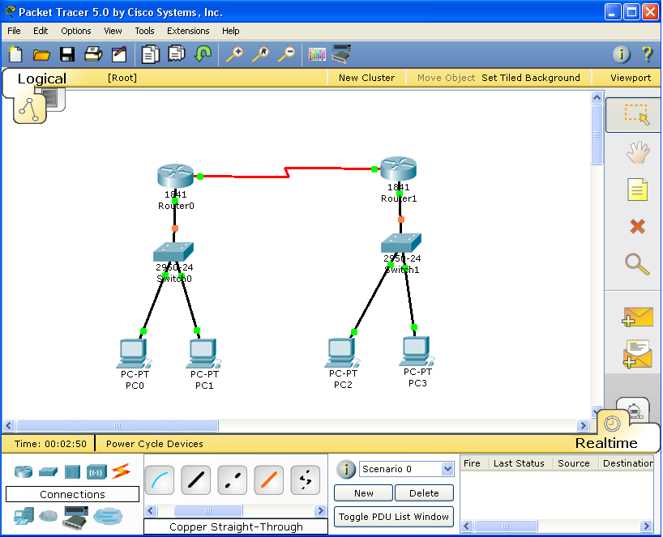
Simulator for Routers and Switches

Slide 15
Thank You
Mallikarjunarao

