Slide 1

REST-CONF
Mallikarjunarao Kosuri
Saturday, September 12, 2015

Slide 2

Topics
REST
JSON
REST-CONF
Resources
Operations
Messages
Query Parameters
Notifications
Error reporting
References

Slide 3
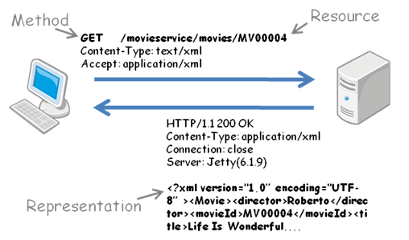
REST
REST stands for Representational State Transfer
The idea used to simple HTTP verbs are used to make calls between machines.
REST Components
Method
GET, POST, PUT, DELETE
URI
Resource
Headers
Representation
XML
JSON
URI
Headers
Return Headers
Notes:
HTTP – Hyper Text Transfer Protocol
Methods – GET, POST, PUT, DELETE (HTTP Verbs)

Slide 4



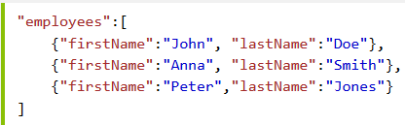
JSON is a lightweight data-interchange format
JSON is faster and easier than XML:
Using XML
Large message size
Slower deserialization
Fetch an XML document
Use the XML DOM to loop through the document
Extract values and store in variables
Using JSON
Smaller message size
Faster deserialization
Fetch a JSON string
JSON.Parse the JSON string
JSON Data
JSON Object
JSON Arrays
Notes:
Python JSON encoder and decoder https://docs.python.org/2/library/json.html
Serialization and Deserialization https://msdn.microsoft.com/en-us/library/ms731073%28v=vs.110%29.aspx

Slide 5





RESTCONF
Simple Subset of NETCONF Functionality
It is a standard mechanisms to allow WEB applications to access the configuration data
Reduce business costs
24/7 Availability
Zero install
RESTCONF is not intended to replace NETCONF
RESTCONF relies on TLS [RFC2246] to provide privacy and data integrity for its HTTP operations.
ADTRAN REST supported product are 1187040F1 SM, 1187503F1 AM, 1187010L1 SCM, TA1x48V (4th Gen)
RESTCONF components
HTTP
NETCONF
Data-Model
MIB Modules
YANG Modules
Notes:
https://tools.ietf.org/html/rfc2246
ADTRAN REST supported products 1187040F1 SM, 1187503F1 AM, 1187010L1 SCM, TA1x48V (4th Gen)
For more information http://yang.adtran.com/docs/virtual_dev/latest/virtualizing/index.html

Slide 6
REST-CONF Resources
The RESTCONF protocol operates on a hierarchy of resources
The RESTCONF resources are accessed via a set of URIs
A resource represented by the "Content-Type" header in the HTTP response message.
RESTCONF Resource Types
Resource | Media Type
API - API framework | application/yang.api
Data - YANG data definition | application/yang.data
Datastore - NETCONF datastore | application/yang.datastore
Operation - YANG rpc statement | application/yang.operation
Schema | application/yang
Notes:
Root Resource Discovery
GET /.well-known/host-meta users HTTP/1.1
Media-type: HTTP uses Internet media types [RFC2046] in the Content-Type and Accept header fields in order to provide open and extensible data typing and type negotiation.

Slide 7
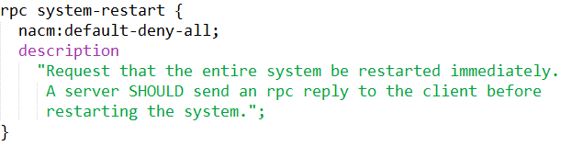
API Resources
API Resources
The API resource contains the state and access points for the RESTCONF features
Data
Operations
Data
configuration and operational data resources
Operations
operation defined with the YANG "rpc" statement

Slide 8

Datastore Resource
Is used to simplify resource editing for the client.
A datastore resource written using PATCH method.
datastore resource is saved to non-volatile storage
Collision Detections
Timestamp
Using "Last-Modified" and "Date" headers are returned in the response for a retrieval request
Entity Tag
"ETag" header is returned in the response for a retrieval request. The "If-Match" header can be used in edit operation requests to cause the server to reject the request if the resource entity tag does not match the specified value.
ADTRAN

Slide 9
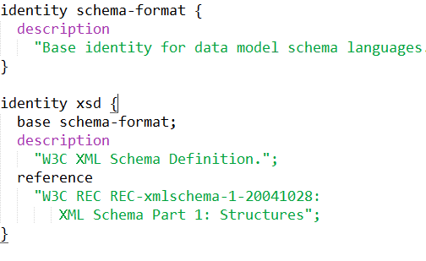
Resources (Conti…)
A data resource represents a YANG data node that is a descendant node of a datastore resource.
Containers, leafs, list entries and anyxml nodes are data resources.
The schema resource used get xml schema from model

Slide 10
Operations
RESTCONF | NETCONF
OPTIONS | None
HEAD | None
GET | <get-config>, <get>
POST | <edit-config> (operation="create")
PUT | <edit-config> (operation="create/replace")
PATCH | <edit-config> (operation="merge")
DELETE | <edit-config> (operation="delete")
OPTIONS*
The client to discover which methods are supported by the server for a specific resource
HEAD
The client to retrieve headers that would be returned for the comparable GET method
GET
The client to retrieve data and meta-data for a resource
POST
The POST method is sent by the client to create a data resource or invoke an operation resource
PUT:
Create or replace the target resource (fully not partially).
PATCH?
Apply partial modifications to a resource
Notes:
* Mandatory option
? Optional option
Patch RFC http://tools.ietf.org/html/rfc5789

Slide 11
Query Parameters
Name | Methods | Description
content | GET | Select config and/or non-config data resources
depth | GET | Request limited sub-tree depth in the reply content
fields | GET | Request a subset of the target resource contents
filter | GET | Boolean notification filter for event stream resources
insert | POST, PUT | Insertion mode for user-ordered data resources
point | POST, PUT | Insertion point for user-ordered data resources
start-time | GET | Replay buffer start time for event stream resources
stop-time | GET | Replay buffer stop time for event stream resources
with-defaults | GET | with-defaults Control retrieval of default values
Notes:
If vendors define additional query parameters, they SHOULD use a prefix (such as the enterprise or organization name) for query parameter names in order to avoid collisions with other parameters.

Slide 12

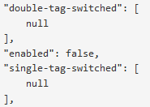

Other Query Features
Partial Returns
Some responses may be either very large or very time consuming
This is done by inserting a JSON array containing a single null in the output
List Pagination
Responses which return lists can be paginated so that large lists do not have to be transferred in a single response.
Retrieving Single List Items
A single item within a list can be retrieved by specifying “listname=key_1,key_2,...,key_n” within the URI:
Notes:
http://yang.adtran.com/docs/adtran_rest_api/latest/specification.html#other-api-features

Slide 13
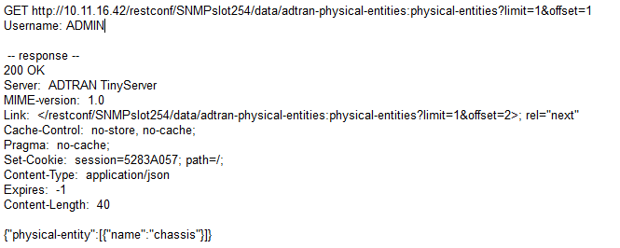
Messages
Method*
entry*
resource?
query?
Request URI Structure
Return Status
Message Caching
Message Encoding
Response body
Notes:
* - Mandatory param
? - Optional param
Request URI Structure
Message Headers : Definitions are adopted, but may not be implemented immediately
Message Encoding: Only JSON is supported
Return Status: Error information is not returned in the way RESTCONF specifies.
Message Caching: ETag and Last-Modified are not provided by the server.

Slide 14

Notifications
Notifications are similar to alarm in SNMP
Notifications are asynchronous messages
Notifications are events
An event is something that happens that may be of interest - a configuration change, a fault, a change in status, crossing a threshold, or an external input to the system
Client should subscribe to server to receive notifications
AOE
Query Parameters
Start-time
Stop-time
filter
Asynchronous
Synchronous
Notes:
Asynchronous messaging describes communications that takes place between two applications or systems, where the system places a message in a message queue (called an Event Queue in enterprise messaging systems) and does not need to wait for a reply to continue processing. Contrast with synchronous messaging.
http://yang.adtran.com/docs/adtran_rest_api/latest/specification.html#adtran-asynchronous-notifications

Slide 15
Error Reporting
Status-Line | Description
200 OK | Success with response body
201 Created | POST to create a resource success
204 No Content | Success without response body
304 Not Modified | Conditional operation not done
400 Bad Request | Content type unknown or URI malformed
401 Unauthorized
403 Forbidden | Base URI doesn’t match specified base URI
404 Not Found | Content doesn’t exist
413 Request Entity Too Large | too-big error
500 Internal Server Error | REST server has an error
501 Not Implemented | Command not implemented on server, not a PATCH, POST, GET or DELETE

Slide 16

References
https://tools.ietf.org/html/draft-ietf-netconf-restconf-05
http://yang.adtran.com/docs/adtran_rest_api/latest/
KIWI_TEAM <KIWITEAM@adtran.com>

