Slide 1
Robot Without RIDE
Mallikarjunarao Kosuri

Slide 2
Agenda
Robot syntax
Advantages without RIDE
Robot Text edit
Robot API
Programmatic modification of test data
Doc generators
References and Questions

Slide 3
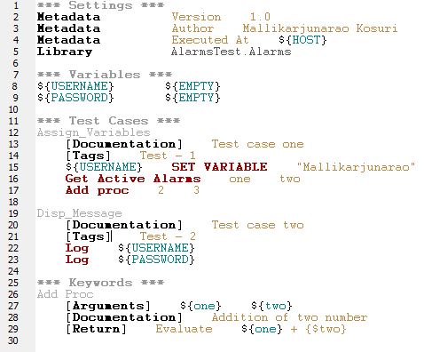
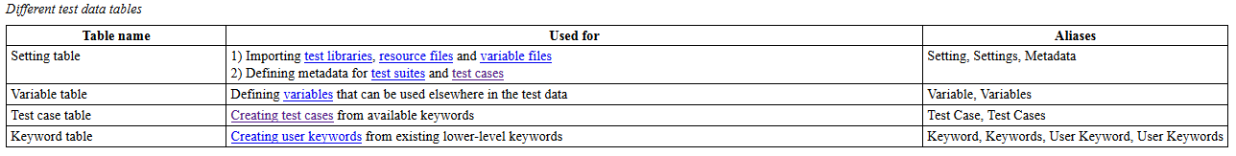
Robot syntax
Robot Framework test cases are created using a simple tabular syntax.
Supported Files are Html, TSV (Table separted values) and Text files
Test data tables are
Notes:
*** Settings ***
Metadata Version 1.0
Metadata Author Mallikarjunarao Kosuri
Metadata Executed At ${HOST}
Library AlarmsTest.Alarms
*** Variables ***
${USERNAME} ${EMPTY}
${PASSWORD} ${EMPTY}
*** Test Cases ***
Assign_Variables
[Documentation] Test case one
[Tags] Test - 1
${USERNAME} SET VARIABLE "Mallikarjunarao"
# Get Active Alarms one two
Add proc 2 3
Disp_Message
[Documentation] Test case two
[Tags] Test - 2
Log ${USERNAME}
Log ${PASSWORD}
*** Keywords ***
Add Proc
[Arguments] ${one} ${two}
[Documentation] Addition of two number
[Return] Evaluate ${one} + {$two}

Slide 4

Advantages without RIDE
Familiar with Syntax, keywords and libraries
ROBOT test case generator
Debugging test case in faster ways
RIDE doesn’t allow to user to use existing features like
  Keyword tagging,
  Creating other table headers
  prerebotmodifier
Many times Pdb debugger failed to execute from RIDE
Pybot has more options than RIDE execution options
Tester knew test body parameters rather dependent on RIDE

Slide 5

Robot Text edit
Use notepad++ or any other text editor to write robot test cases
Notepad++ Preferences
  Replace tab with spaces
    Go to Settings -> Preferences...-> Tab Settings
    Check Replace by space http://i.stack.imgur.com/Dnltf.png
  Select White space and tab option
  View -> Show Symbol -> Show White space and tab
  Make sure enable spell check
Use double tabs while writing statements in robot

Slide 6
Robot Text edit (Conti…)
Robot test case are in a tabular format (Rows and Columns)
Each column divided with a 4 space tab (Defaulted 2 spaces)
Statements are in any table are case insensitive
All headers start with 3 stars
  Fallowed name of headers
  Fallowed by test data
We can write table headers in any order in a test case or test suite
This trick works by knowing that robot will ignore any data in tables that are not one of the four recognized tables: keywords, tests, settings or variables.
  if you have some other table, anything under it up until the next table will be ignored.
  *** Header ***
  Tricky comment block

Slide 7
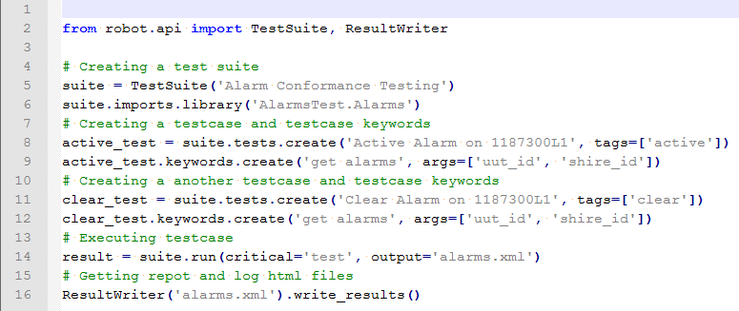
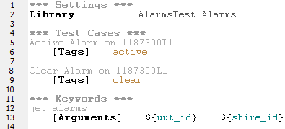
Robot API
TestCaseFile, TestDataDirectory, and ResourceFile classes for parsing test data files and directories.
TestSuite class for creating executable test suites programmatically and TestSuiteBuilder class for creating such suites based on existing test data on the file system.
SuiteVisitor abstract class for processing testdata before execution.
ExecutionResult() factory method for reading execution results from XML output files and ResultVisitor abstract class to ease further processing the results.
ResultWriter class for writing reports, logs, XML outputs, and XUnit files.
Notes:
from robot.api import TestSuite, ResultWriter
# Creating a test suite
suite = TestSuite('Alarm Conformance Testing')
suite.imports.library('AlarmsTest.Alarms')
# Creating a testcase and testcase keywords
active_test = suite.tests.create('Active Alarm on 1187300L1', tags=['active'])
active_test.keywords.create('get alarms', args=['uut_id', 'shire_id'])
# Creating a another testcase and testcase keywords
clear_test = suite.tests.create('Clear Alarm on 1187300L1', tags=['clear'])
clear_test.keywords.create('get alarms', args=['uut_id', 'shire_id'])
# Executing testcase
result = suite.run(critical='test', output='alarms.xml')
# Getting repot and log html files
ResultWriter('alarms.xml').write_results()

Slide 8
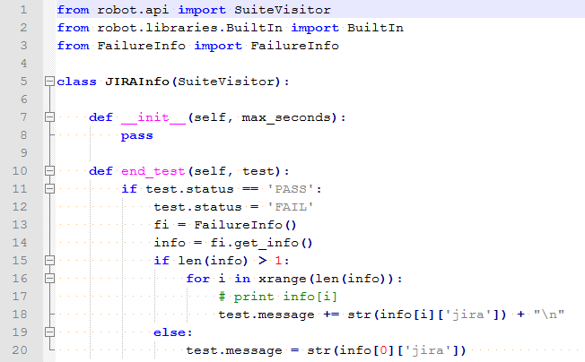
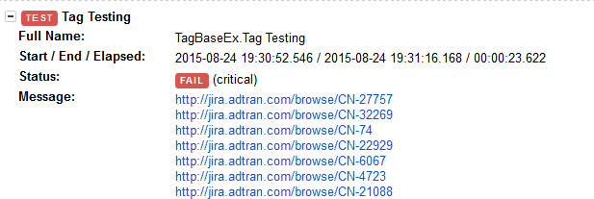
Programmatic modification of test data
Robot Framework 2.9 and newer provide a possible to do custom modifications programmatically
This is accomplished by creating a model modifier and activating it using the --prerunmodifier option.
Model modifiers should be implemented as visitors that can traverse through the executable test suite structure and modify it as needed.
    pybot --prerebotmodifier JIRAInfo.py:1 TagBaseEx.robot
Notes:
from robot.api import SuiteVisitor
from robot.libraries.BuiltIn import BuiltIn
from FailureInfo import FailureInfo
class JIRAInfo(SuiteVisitor):
def __init__(self, max_seconds):
pass
def end_test(self, test):
if test.status == 'PASS':
test.status = 'FAIL'
fi = FailureInfo()
info = fi.get_info()
if len(info) > 1:
for i in xrange(len(info)):
# print info[i]
test.message += str(info[i]['jira']) + "\n"
else:
test.message = str(info[0]['jira'])

Slide 9
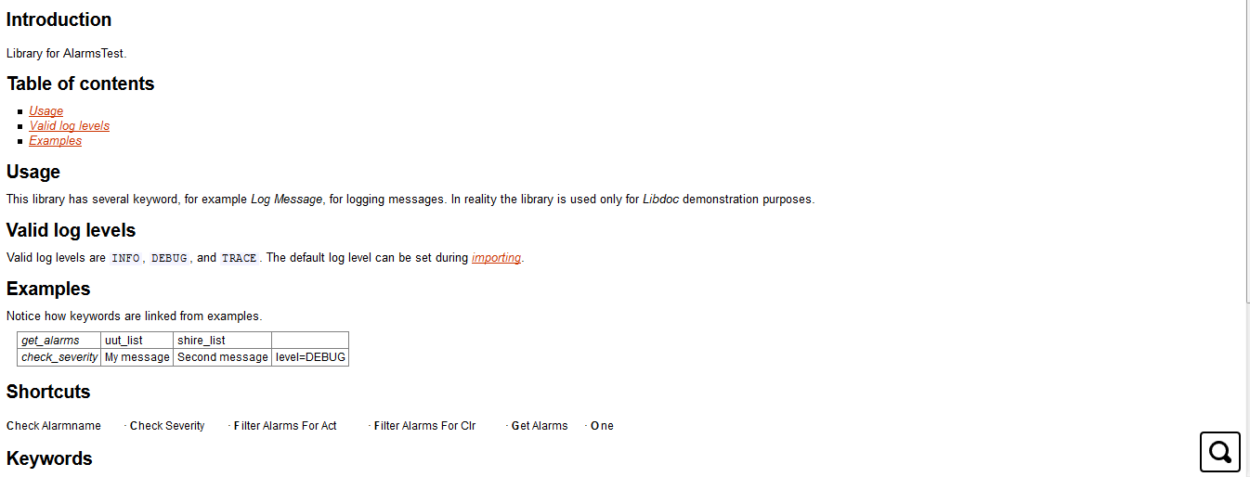
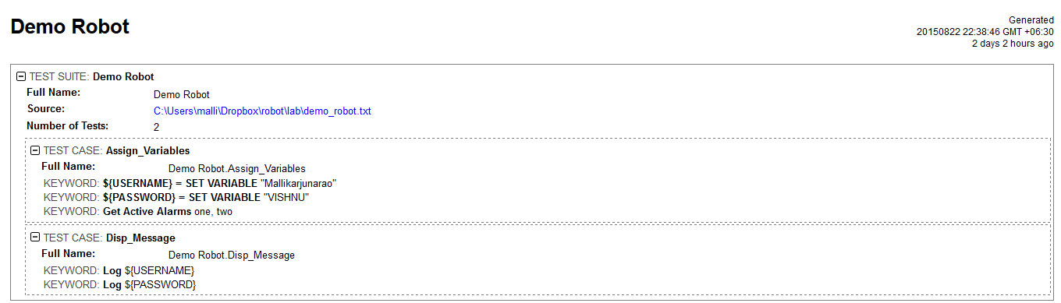
Doc generators
Documentation on Library files
  http://robotframework.org/robotframework/latest/RobotFrameworkUserGuide.html#writing-documentation
  python -m robot.libdoc AlarmsTest LibDoc4.html
Documentation on Test cases
  http://robotframework.org/robotframework/latest/RobotFrameworkUserGuide.html#id309
  python -m robot.testdoc my_test.robot testdoc.html

Slide 10

References and Questions
https://robot-framework.readthedocs.org/en/2.9/
http://robotframework.org/
http://robotframework.org/robotframework/latest/RobotFrameworkUserGuide.html
http://pythonhosted.org/jira/
http://confluence.adtran.com/display/~vkosuri/Robot+Tutorial
Questions?

