Slide 1
P-YANG Plugin
Mallikarjunarao KOSURI

Slide 2

Topics
YANG
Yang Layout
Why code generator
pyang
Important pyang classes
Writing a sample plugin
Pyang plugin debug
Reference and Questions

Slide 3
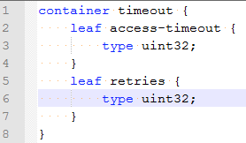

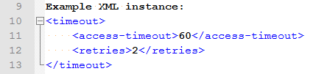
YANG
YANG is a language used to model data for the NETCONF protocol
The name is an acronym for "Yet Another Next Generation".
Data models are represented by definition hierarchies called schema tree
Instances of schema trees are called data trees and are encoded in any language
Protocol
The SNMP Protocol
NETCONF
Data-Model
MIB Modules
YANG Modules

Slide 4
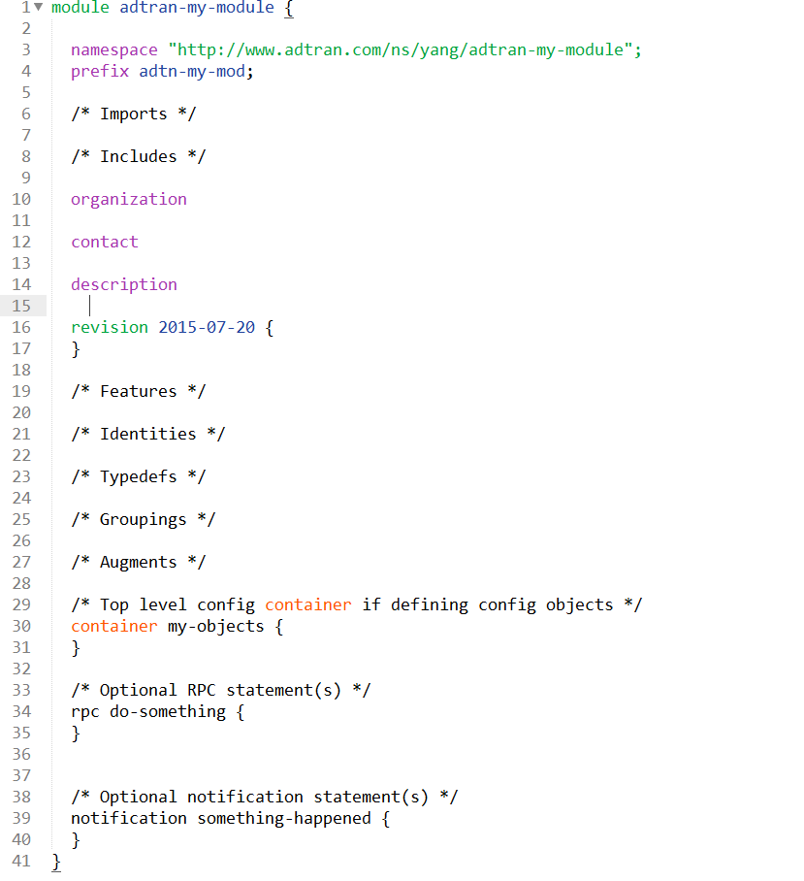
Yang Layout
All ADTRAN module names SHALL be named using dash (‘-‘) separated lowercase prefixed with “adtran”
All YANG definitions are specified within a module that is bound to a particular XML namespace, which is a globally unique URI
Each module has a prefix assigned to it. This prefix is used when importing from other modules.
Formatting
All objects that support the description substatement shall include it.
All revision statements must include both a description and a reference.
Lines should not exceed 70 characters. This include newlines so set the margin to 68 when editing.
Notes:
module adtran-my-module {
namespace "http://www.adtran.com/ns/yang/adtran-my-module";
prefix adtn-my-mod;
/* Imports */
<import modules to reuse types, groupings, etc>
/* Includes */
<include any submodules that belong-to this module>
organization
"Adtran, Inc.";
contact
"<http://www.adtran.com/>";
description
"This module contains a collection of YANG definitions for
managing my stuff.
Copyright (c) 2015 ADTRAN, Inc. All rights reserved.";
revision 2015-07-20 {
description
"Initial revision.";
reference
"Every revision statement must have a reference. If there
isn't a reference for the model, just put 'none'";
}
/* Features */
feature my-feature {
description
"This is optional. It's used to define a feature to
make some object or tree of objects optional.";
}
/* Identities */
identity my-identity {
description
"Identities used in objects of the identityref type";
}
/* Typedefs */
typedef my-type {
type boolean;
description
"This is optional. It's used to define a reusable
type.";
}
/* Groupings */
grouping my-grouping {
description
"A collection of objects that can be defined once and
used in multiple containers, lists, etc.";
/* Leafs, leaf-lists, etc */
/* <objects that may be used in multiple containers,
lists, etc> */
}
/* Augments */
augment "/another-node" {
description
"This is an optional where you want to add nodes to an
existing node in another module";
}
/* Top level config container if defining config objects */
container my-objects {
description
"A container must have a description";
/* Leafs, Leaf-lists, etc */
<objects that have a single instance in the container>
/* List(s) - for objects with multiple elements or instances */
list my-object {
/* A config list must have at least one key */
key "a-key";
description
"A list must have a description";
leaf a-key {
type some-type;
description
"The key must be a defined leaf either directly
or through the use of a grouping via the uses
statement";
}
/* Leafs, leaf-lists, etc */
/* <objects associated with each element in the list> */
}
}
/* Top level state container if defining state/status objects */
container my-objects-state {
description
"Again, the container must have a description";
/* Leafs, Leaf-lists, etc */
<objects that have a single instance in the container>
/* List(s) - for objects with multiple elements or instances */
list my-object-state {
/* A non-config list does not require a key but can have
one or more */
key "a-key";
description
"A list must have a description";
leaf the-key {
type some-type;
description
"The key must be a defined leaf either directly
or through the use of a grouping via the uses
statement";
}
/* Leafs, leaf-lists, etc */
/* <objects associated with each element in the list> */
}
}
/* Optional RPC statement(s) */
rpc do-something {
description
"This RPC does something";
/* Optional input statement */
input {
/* Leafs, leaf-lists, etc */
/* <objects that are included in the RPC request> */
}
/* Optional output statement */
output {
/* Leafs, leaf-lists, etc */
/* <objects that are included in the RPC reply> */
}
}
/* Optional notification statement(s) */
notification something-happened {
description
"Something just happened";
/* Leafs, leaf-lists, etc */
/* <optional objects that are to be included in the
notification> */
}
}

Slide 5
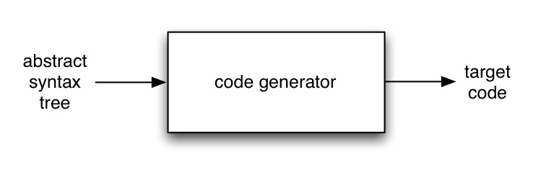
Why code generator
Code Generation is the process of transforming code from one representation to another.
yang -> python
Types
Active code generation
Passive code generation
http://codegeneration.net/
Advantage
You never know where a spark will come from to light an idea. Code Generation is about sharing, not about sitting passively through talk after talk. Our keynotes are the touch paper that sets your day off.
Notes:
Source: http://c2.com/cgi/wiki?CodeGeneration
Active Code generation: The process of generating code that will never require any human intervention for it to compile and function properly. Works best when the code is regenerated/refreshed as part of ContinuousIntegration.
Passive Code generation: The process of generating "skeleton" code that requires human intervention before it will compile or function properly.

Slide 6
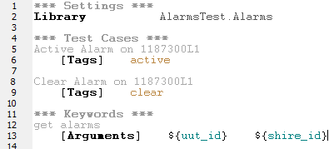
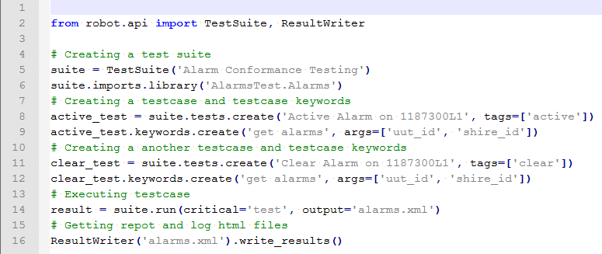
Code generator Example

Slide 7


What is pyang
PYANG
YANG validate and converter, written in Python.
pyang adtran-my-module.yang --ietf
Also convert one form into another form using plugin mechanism
Plugin
Customization of your inputs
Pyang in-built plugins are
To see more options for pyang use pyang --help

Slide 8
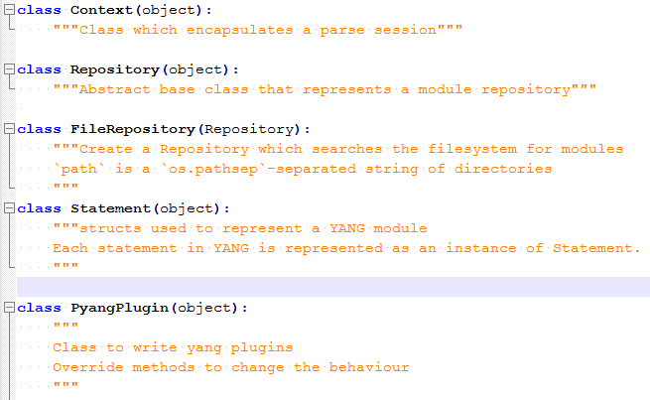
Important pyang classes

Slide 9
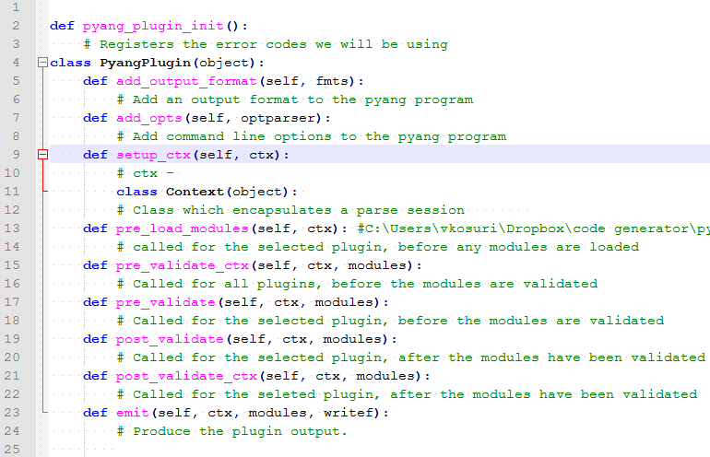
Writing a sample plugin
Plugin initialization
Plugin class (PyangPlugin class methods)
add_opts
--plugindir plugins -f cg_robo_gen -p models/models models/models/adtran-evcs.yang --sample_name "My Sample Option“
setup_fmt
https://tools.ietf.org/html/rfc6087
self.strict = False; self.repository = repository; self.errors = []; self.canonical = False; self.max_line_len = None; self.max_identifier_len = None; self.implicit_errors = True; self.lax_xpath_checks = False; self.deviation_modules = []; self.features = {} ; self.keep_comments = False
post_validate and pre_validate
Validate yang data tree before and after
Notes:
def pyang_plugin_init():
# Registers the error codes we will be using
class PyangPlugin(object):
def add_output_format(self, fmts):
# Add an output format to the pyang program
def add_opts(self, optparser):
# Add command line options to the pyang program
def setup_ctx(self, ctx):
# ctx -
class Context(object):
# Class which encapsulates a parse session
def pre_load_modules(self, ctx): #C:\Users\vkosuri\Dropbox\code generator\pyang-1.5\pyang\__init__.py
# called for the selected plugin, before any modules are loaded
def pre_validate_ctx(self, ctx, modules):
# Called for all plugins, before the modules are validated
def pre_validate(self, ctx, modules):
# Called for the selected plugin, before the modules are validated
def post_validate(self, ctx, modules):
# Called for the selected plugin, after the modules have been validated
def post_validate_ctx(self, ctx, modules):
# Called for the seleted plugin, after the modules have been validated
def emit(self, ctx, modules, writef):
# Produce the plugin output.

Slide 10
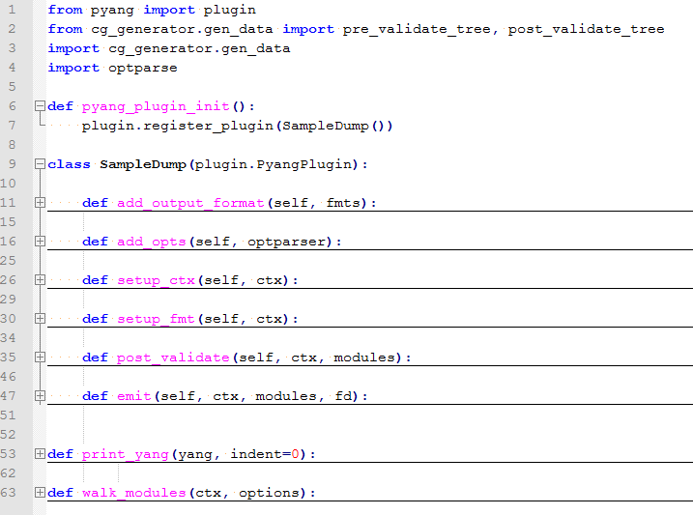
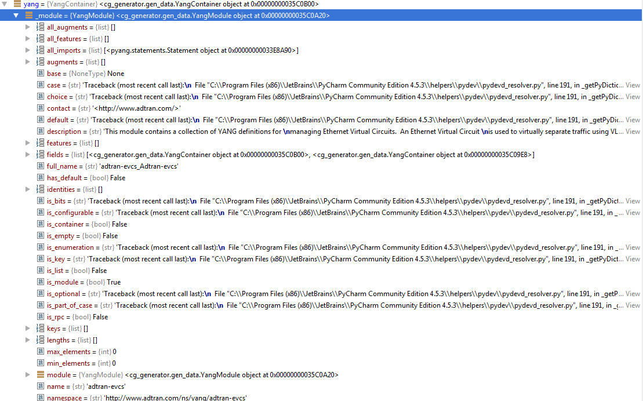
Writing a sample plugin (Conti…)
YANG module
Notes:
from pyang import plugin
from cg_generator.gen_data import pre_validate_tree, post_validate_tree
import cg_generator.gen_data
import optparse
def pyang_plugin_init():
plugin.register_plugin(SampleDump())
class SampleDump(plugin.PyangPlugin):
def add_output_format(self, fmts):
"""Called by Pyang to register the output format"""
self.multiple_modules = True
fmts["sample"] = self
def add_opts(self, optparser):
optlist = [
optparse.make_option("--sample_name",
type="string",
dest="sample_name",
help="just a sample property"),
]
g = optparser.add_option_group("Sample Plug-in Options")
g.add_options(optlist)
def setup_ctx(self, ctx):
"""Part of the Pyang plug-in interface."""
pass
def setup_fmt(self, ctx):
"""Part of the Pyang plug-in interface."""
ctx.implicit_errors = False
pass
def post_validate(self, ctx, modules):
"""Part of the Pyang plug-in interface. Used here to build up a structure to hold the parsed YANG model."""
class GenContext:
pass
self.my_context = GenContext()
self.my_context.modules = modules
self.my_context.all_modules = ctx.modules.values()
self.my_context.ctx = ctx
self.my_context.parse_tree = None
self.my_context.ctx.opts.skip_adtran_checks = True
cg_generator.gen_data.pre_validate_tree(self.my_context, False)
def emit(self, ctx, modules, fd):
post_validate_tree(self.my_context, False)
walk_modules(self.my_context, ctx.opts)
def print_yang(yang, indent=0):
""" Print the tree node and it's children"""
indentStr = ' ' * indent
print indentStr, "%s - %s (%s, %s)" % (yang.name, yang.description.replace("\n", ""), yang.__class__.__name__, yang.yang_type)
# Do we have any fields?
if hasattr(yang, 'fields'):
for child in yang.fields:
print_yang(child, indent + 2)
def walk_modules(ctx, options):
print "Sample Name: %s" % options.sample_name
for module in ctx.parse_tree:
print_yang(module)

Slide 11
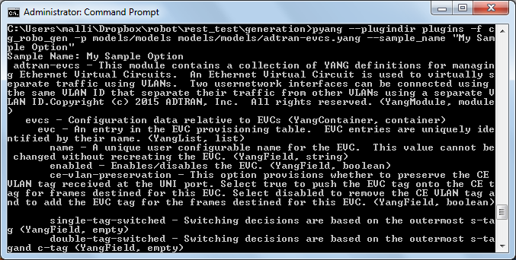
Writing a sample plugin (Conti…)
Notes:
pyang --plugindir plugins -f cg_robo_gen -p models/models models/models/adtran-evcs.yang --sample_name "My Sample Option"
Sample Name: My Sample Option
adtran-evcs - This module contains a collection of YANG definitions for managing Ethernet Virtual Circuits. An Ethernet Virtual Circuit is used to virtually separate traffic using VLANs. Two usernetwork interfaces can be connected using the same VLAN ID that separate their traffic from other VLANs using a separate VLAN ID.Copyright (c) 2015 ADTRAN, Inc. All rights reserved. (YangModule, module)
evcs - Configuration data relative to EVCs (YangContainer, container)
evc - An entry in the EVC provisioning table. EVC entries are uniquely identified by their name. (YangList, list)
name - A unique user configurable name for the EVC. This value cannot be changed without recreating the EVC. (YangField, string)
enabled - Enables/disables the EVC. (YangField, boolean)
ce-vlan-preservation - This option provisions whether to preserve the CEVLAN tag received at the UNI port. Select true to push the EVC tag onto the CE tag for frames destined for this EVC. Select disabled to remove the CE VLAN tag and to add the EVC tag for the frames destined for this EVC. (YangField, boolean)
single-tag-switched - Switching decisions are based on the outermost s-tag (YangField, empty)
double-tag-switched - Switching decisions are based on the outermost s-tagand c-tag (YangField, empty)
mac-switched - Switching decisions are based on the outermost s-tag and destination MAC address (YangField, empty)
double-tag-mac-switched - Switching decisions are based on the outermosts-tag, c-tag and destination MAC address (YangField, empty) men-ports - Metro Ethernet Network interface(s). (YangField, string[])
no-stag - If present, indicates no s-tag has been specified. (YangField,empty)
stag - Explicit VLAN ID that is being applied. (YangField, uint16)
evcs-state - State data associated with EVCs (YangContainer, container)
evc-state - State data for a specific EVC (YangList, list)
name - A unique name for an EVC (YangField, string)
admin-status - Represents the administrative status of the EVC (YangField, enumeration)
oper-status - The basic operational status of the EVC. (YangField, enumeration)
running-status - The detailed running status of the EVC (YangField, enumeration)
mac-address - The MAC address table associated with this EVC (YangList, list)
interface - The interface associated on which the MAC address waseither configured or learned. (YangField, string)
mac-address - A learned or configured MAC address (YangField, string)
interface-type - Identifies the type of interface in the end-to-endconnection (YangField, enumeration)
insert-method - Denotes how the MAC address was inserted into the table (YangField, enumeration)
C:\Users\malli\Dropbox\robot\rest_test\generation>

Slide 12

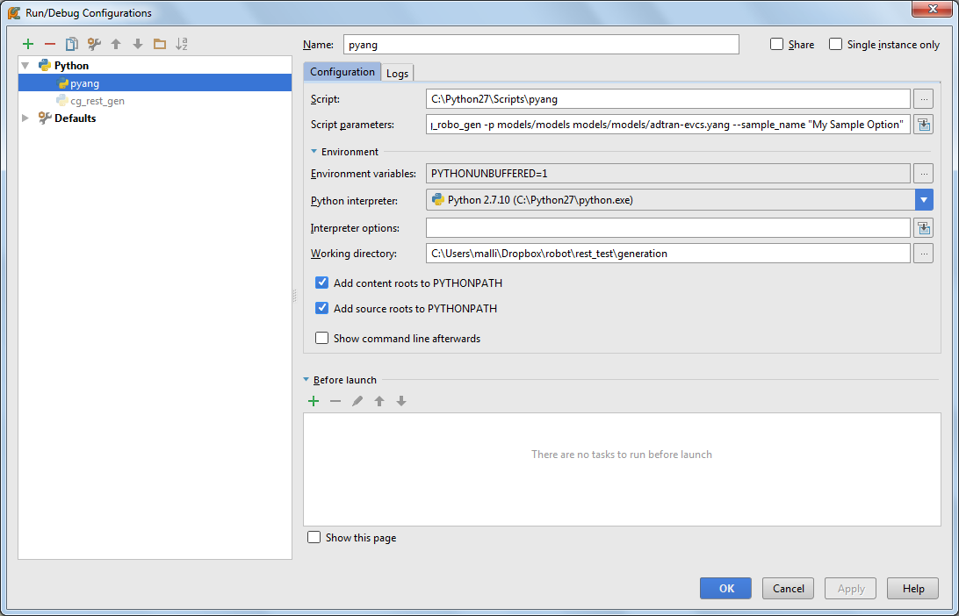
Pyang plugin debug
https://www.jetbrains.com/pycharm/
Open pyang file and configure required parameters and press Alt + Shift + 9
Default location of pyang file is C:\Python27\Scripts\pyang (on windows)
Script
C:\Python27\Scripts\pyang
Script params
--plugindir plugins -f cg_robo_gen -p models/models models/models/adtran-evcs.yang --sample_name "My Sample Option“
Working directory
C:\Users\malli\Dropbox\robot\rest_test\generation

Slide 13

Reference and Questions
http://yang.adtran.com/docs/yang/latest/
http://yang.adtran.com/docs/code_generation/latest/
http://www.yang-central.org/twiki/bin/view/Main/WebHome
https://github.com/mbj4668/pyang/wiki/Tutorial
http://www.tail-f.com/education/what-is-yang/
http://bba.adtran.com/syseng/YANGopaedia/Lists/YANG%20Data%20Model%20Change%20Request/AllItems.aspx

