Slide 1
HP ALM and REST
Mallikarjunarao K

Slide 2
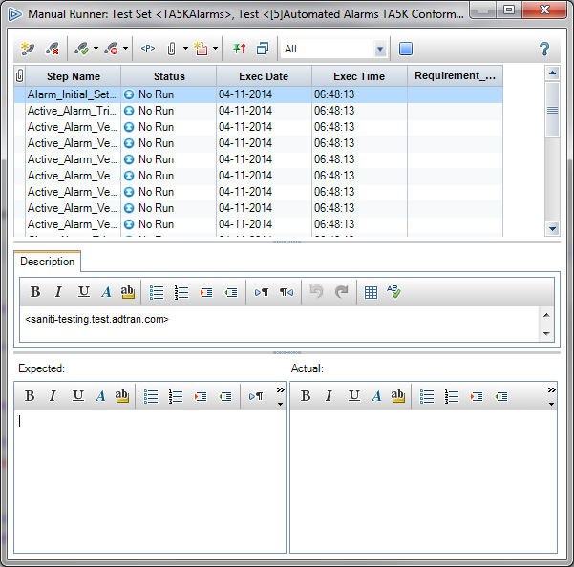
Theme
Missing Part
Even though we have been updating actual/expected results in HP ALM we don’t have logs for Manual Runs.
Theme
Convert actual design steps information into html report format.
Notes:
Representational state transfer http://en.wikipedia.org/wiki/Representational_state_transfer

Slide 3
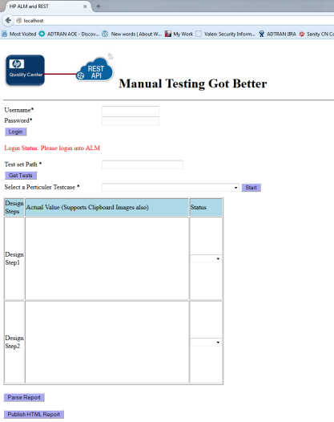
HP ALM and REST
http://172.20.14.21/
5 simple steps to accomplish this task.
Login into HP ALM
Provide testset path
Fetch testcase from testset.
Enter design steps. convert design steps into log using parse button.
Update test status and upload attachment to test instance.

Slide 4
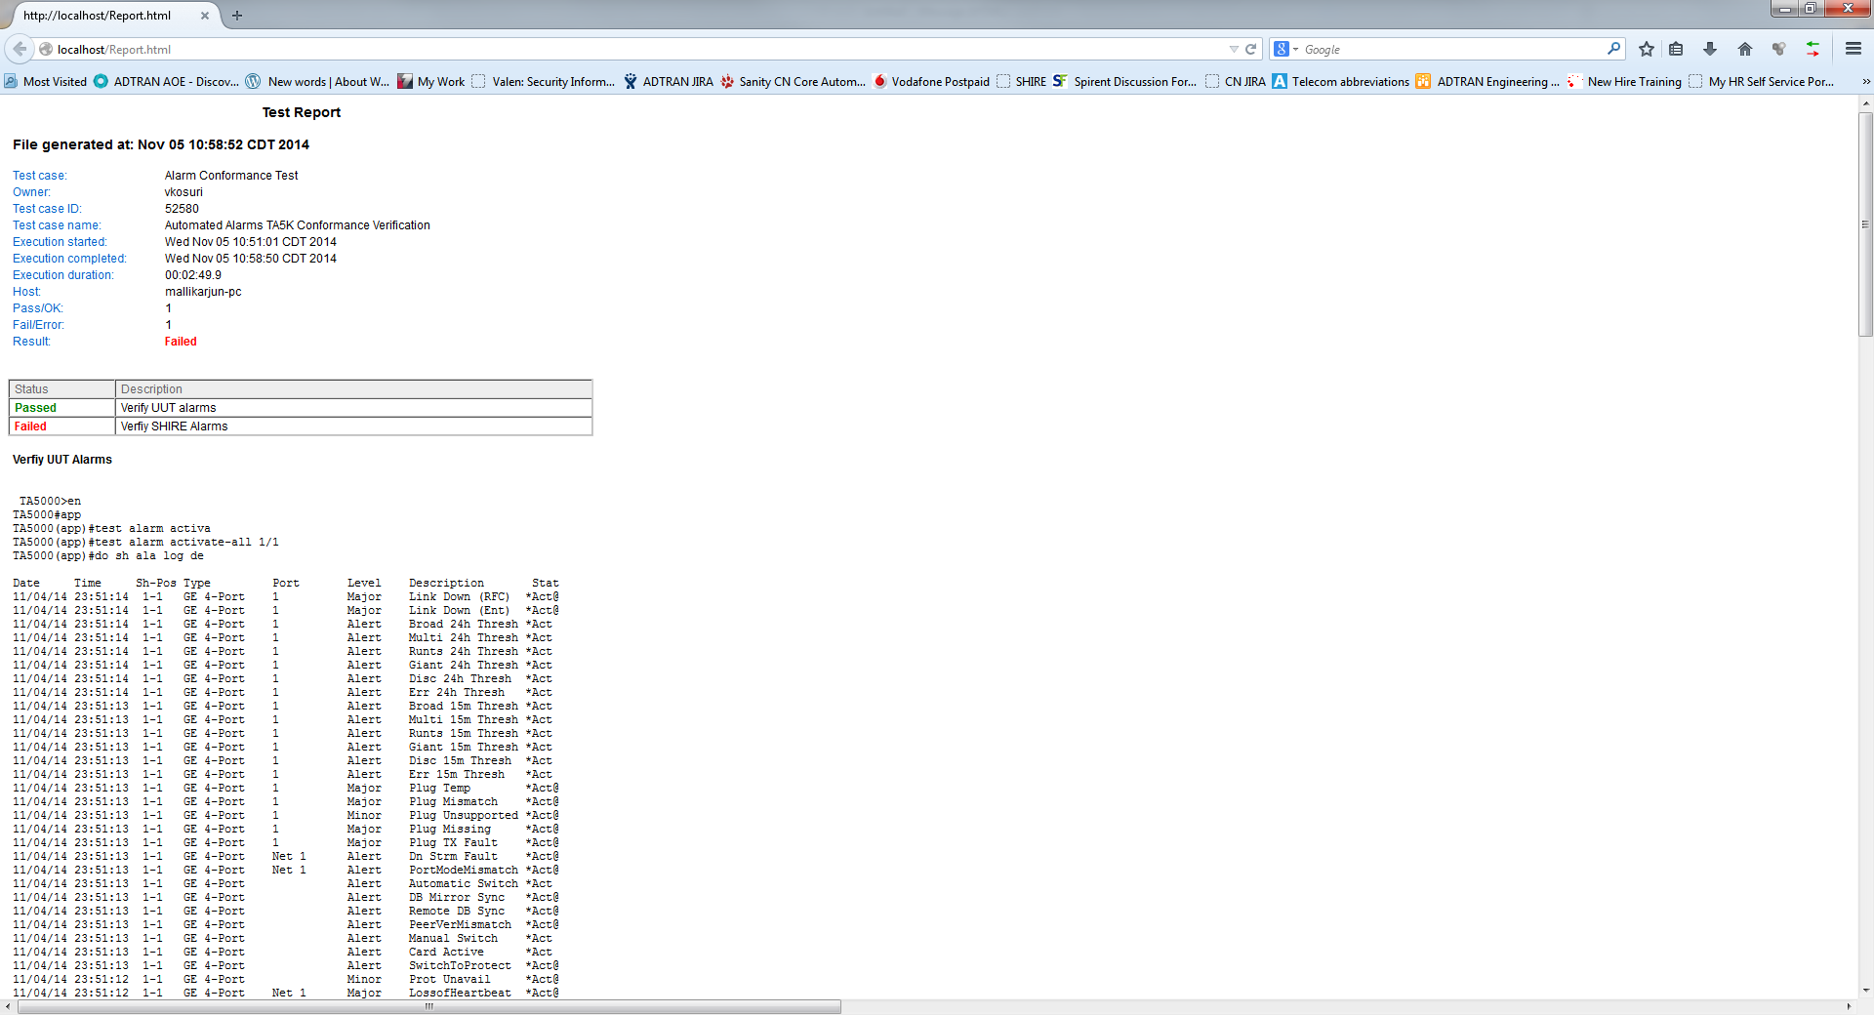
Report Format

Slide 5
Other Future Features
Attach test reporters to any given test instance using REST interface
From HP ALM copy and paste single test set doesn’t copy your reporter to destination, so this tool could do this.

Slide 6






Required Tools

Slide 7

Thanks

