Slide 1
Elmo Converters
Subbu, Sarada, Malli and Prasad
Special thanks to Paul Revy

Slide 2
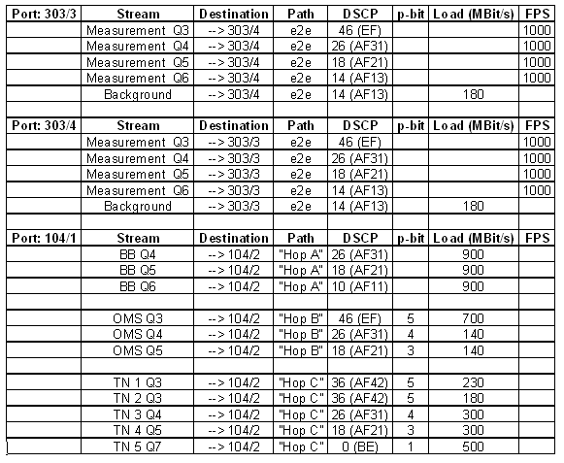
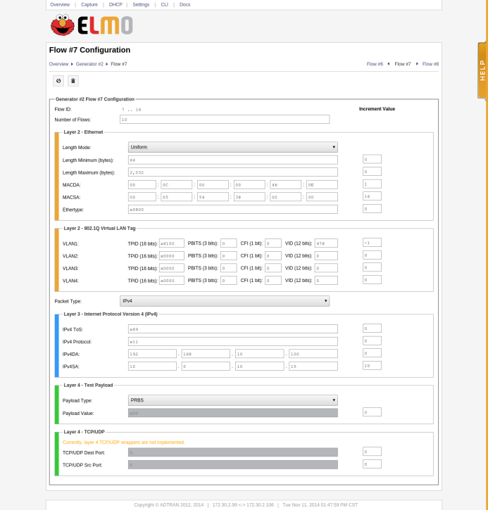
Big Problem
Open each stream in traffic generator
Note down each stream data
Create a new flow in elmo
Fill traffic data in each elmo flow
We have to do it this process for every stream

Slide 3

How we achieved
Python
Traffic gen XML --> XML Operations --> ELMO dict --> Elmo.esh

Slide 4
Demo

Slide 5
Exp. Traffic Gens
Traffic Generators | Quantity | Approximate costs we are spending
N2X | 2 Chassis 10 x 100M 64 x 1G 8 x 10G | No ongoing support costs
Ixia XM12 | 4 x 1G | No ongoing support costs
Shenick | 1 6 1 0 | 5500 (Legacy) No ongoing costs TVM-420 $25000 (4x 1G ports) Support Costs: $3750k p.a., per unit TVM-620 $37500 (4x 10G ports) Support Costs: $5536k p.a., per unit TVM-630 $66000 (8x 1G ports) Support Costs: $10000 p.a., per unit
Spirent |  | System test doesn’t any STC ports – the ones Hassan uses are owned by PQ

Slide 6
Any Questions?

