Slide 1
TRAP
Test Result Analysis Provider

Slide 2

Why we need TRAP?
In the Current Adtran Testing Process
Testing suites cannot be considered as fully automatic.
Manual intervention is required on one or more stages of the test cycle.
Analysis of test reports is tedious & time consuming.
Teams may require a separate tool for publishing test results.
Teams use different tools and frameworks.
All teams process their results manually.

Slide 3

What is TRAP?
TRAP is an all-round tool for consolidation of Test results across Adtran.
It provides a “Bird’s eye view” of the results.
It can work in conjunction with Jenkins to provide a truly automated “One-shot solution” for execution and analysis of test suites.
It highlights failures which can be quickly acted upon.
It is TCL based, has a small footprint & is blazing fast.
It can be made to work with any test environment.
(TCL, Python) or any framework (iTest, Robot etc..)
It can even publish reports to HP ALM.

Slide 4







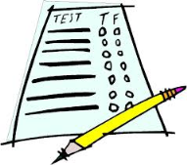
TRAP Flows
Test Server
DNS
DB
MIBS
Test Suite
TRAP Tool
(C++
Tcl
Phython
Tests)
Test Logs
Parsers (Tcl/iTest)
HTML (GUI)
CSV (Excel)

Slide 5
TRAP Functions
TRAP can parse test logs into HTML or CSV format.
HP ALM
Download all logs from given test set
XML
Formatted into single xml file
XSLT
Input XML file XSLT template
XSLT does magic and creates HTML consolidated log
HTML
Parser
Converts into XML file
HP ALM
Download all logs from given testset
CSV
Formatted into single CSV file
Parser
Converts into CSV file

Slide 6

TRAP Demo

Slide 7
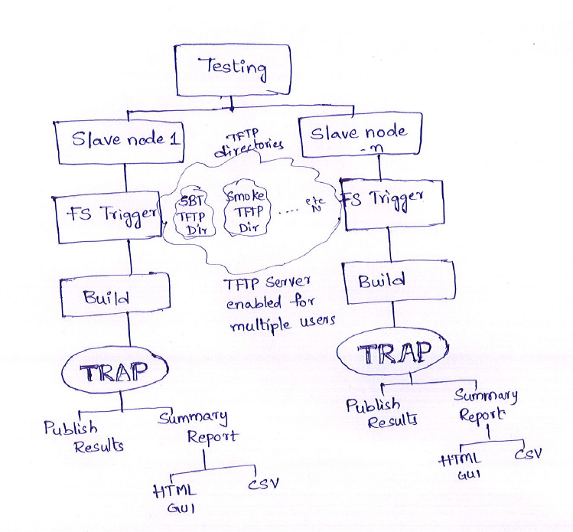
Future of TRAP
Still on Paper..

Slide 8

Questions

