Slide 1
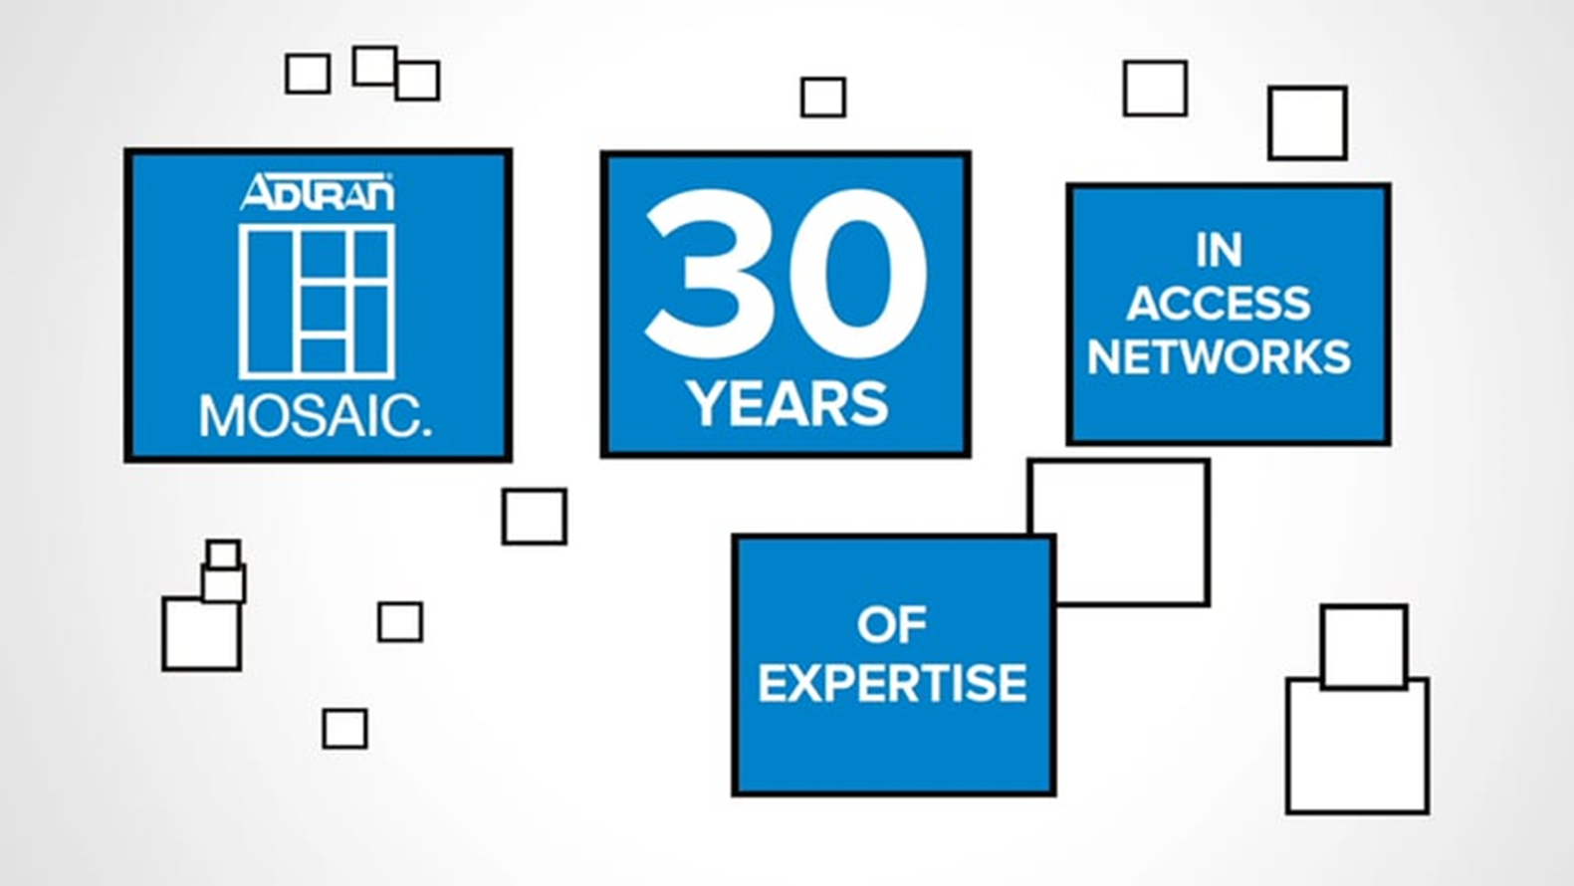
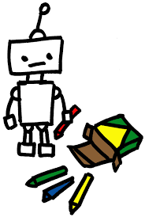
Murali, Surya, Malli

Slide 2
In brief

Slide 3
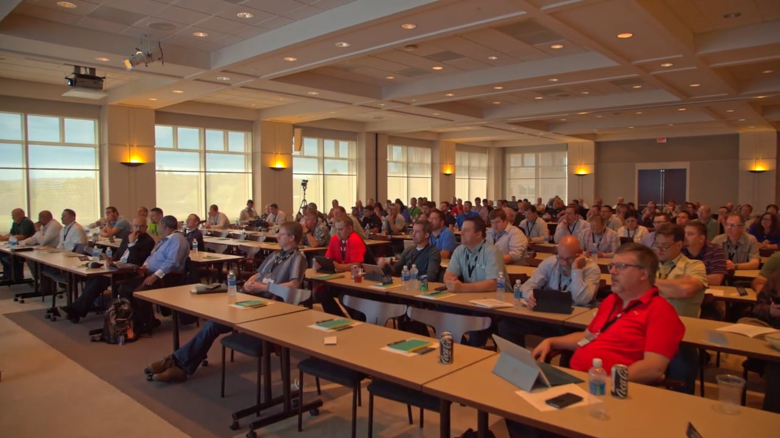
Through Processing
Human Process
Learn, Apply and Solve
Thought
Why can’t we use robots?

Slide 4
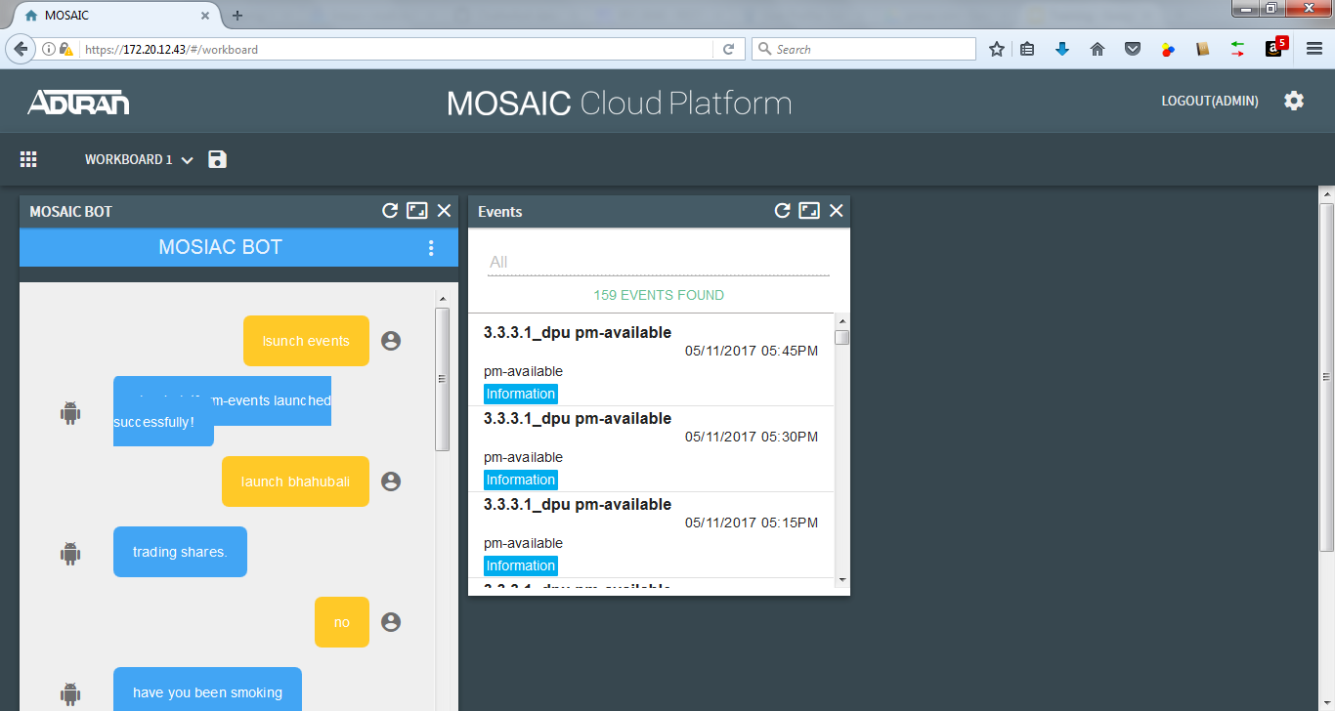
Development and learnings
Angular Material
Django and Django Admin Page
Natural Language processing with Python
AI Algorithms

Slide 5
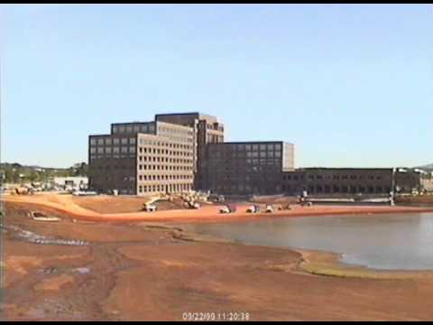
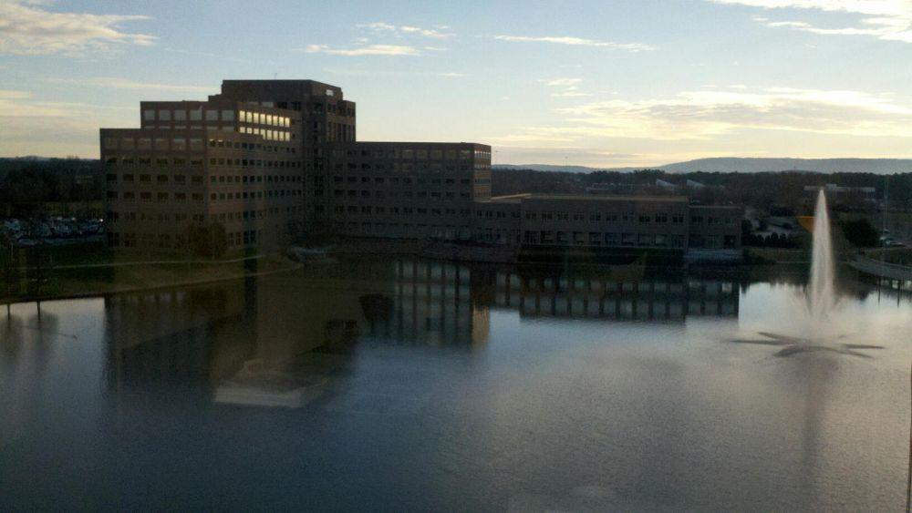
What we can improve
Suggestions
Input suggestions to user
Personas
Analyses user response and creating persons
UI changes
Customer Report issue
Customer
Found Issue
Sales
Read customer Issue
Redirect
Manager or PO
Redirect
Identity SME
Unable to find solution
Customer
Found Issue
MCP-BOT
Chat with bot
Creates
Unable to find solution
Find solution ☺
Issue reports automatically
SME
Respond to ticket/JIRA
This phase involves both Sales and PO

Slide 6

Showcase

Slide 7

Questions

