Slide 1
SHIRE CI
A good improvement with few headaches
MALLIKARJUNARAO KOSURI

Slide 2
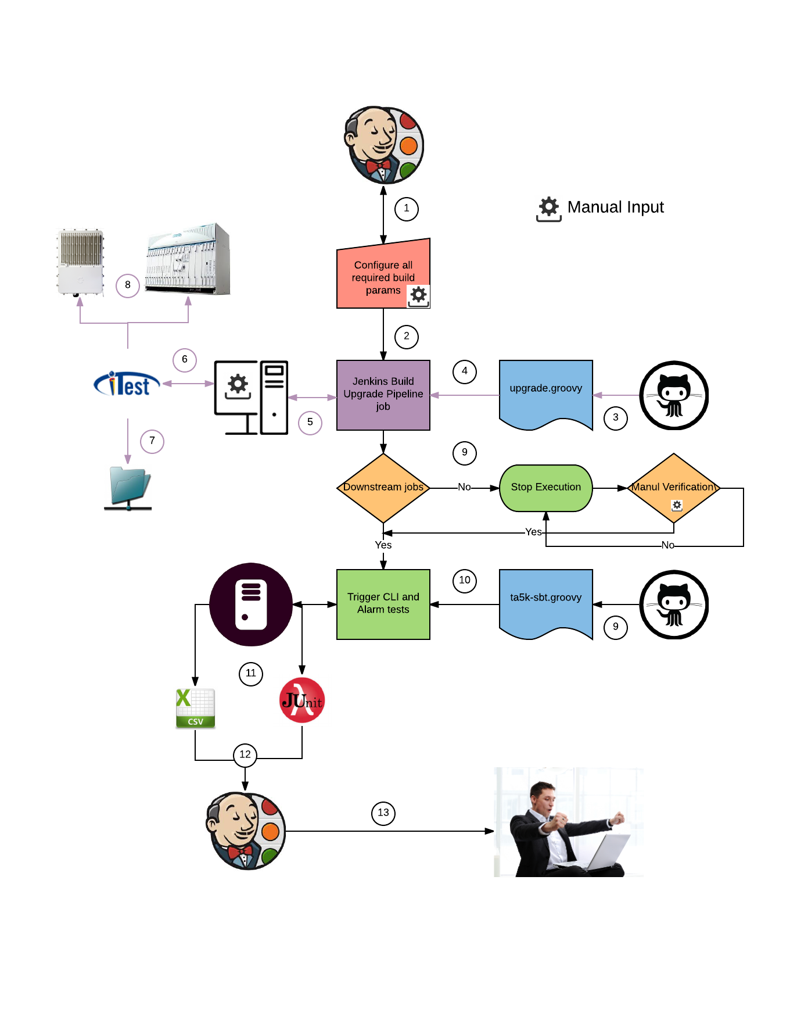
Block diagram

Slide 3
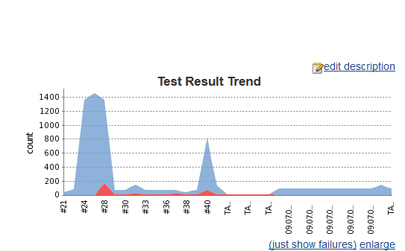
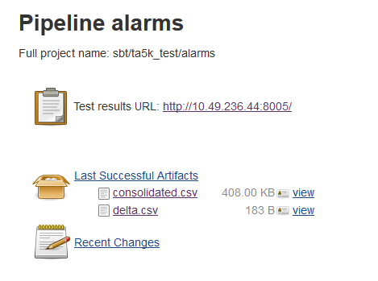
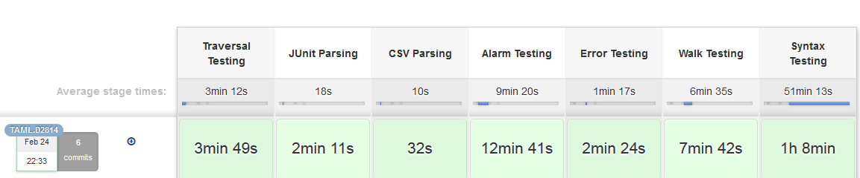
Features
Pipeline jobs
Junit Parser
CSV Parser
Web reports
Build copies through FTP
Trigger downstream jobs
HipChat notifications

Slide 4
Technical Advantages
Advantage | How it | What we achieved
Single user maintainer | With help consolidated repots, and confluence documentation | 2 users to 1 user
Reduces number of days regression | With pipeline triggering | 8 to 4 days
Make it downstream job other jobs | Using pipeline scripts | No manual intervention for builds

Slide 5






Technologies we have used

Slide 6
Limitations
SHARED devices
Retest
iTest

