Slide 1


EduChain – Proposal of Requirements and Architecture
EduChain Workshop, Zurich, June 7, 2019
Bruno Rodrigues, Muriel Franco, Eder Scheid, Christian Killer, Burkhard Stiller
Communication Systems Group CSG Department of Informatics IfI University of Zürich UZH, Switzerland
[rodrigues¦franco¦scheid¦killer¦stiller]@ifi.uzh.ch

Slide 2
Requirements
Private Environment
Issuers are responsible → Permissioned DLT
Certificate and individual data must be kept private
Certificate revocation process
Operation with legacy systems
Public Environment
Verifiers and recipients
Straightforward verification process
Availability of identifiers, i.e., certiticate hash
Data must be decentralized → Permissionless BC
2

Slide 3
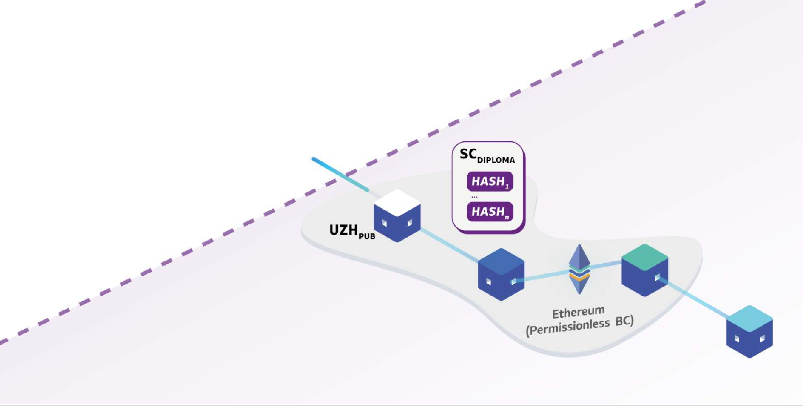
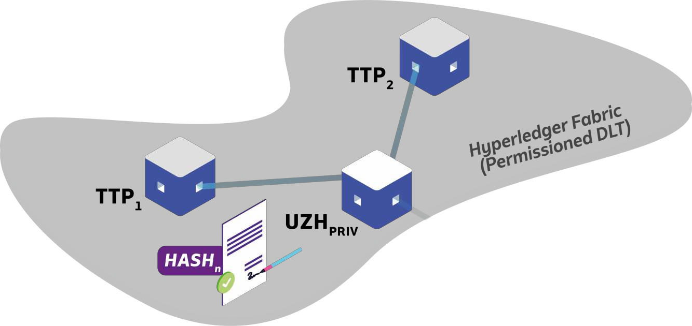
Example EduChain Architecture (1)
Create, sign, hash, and store document
Store hash

Slide 4

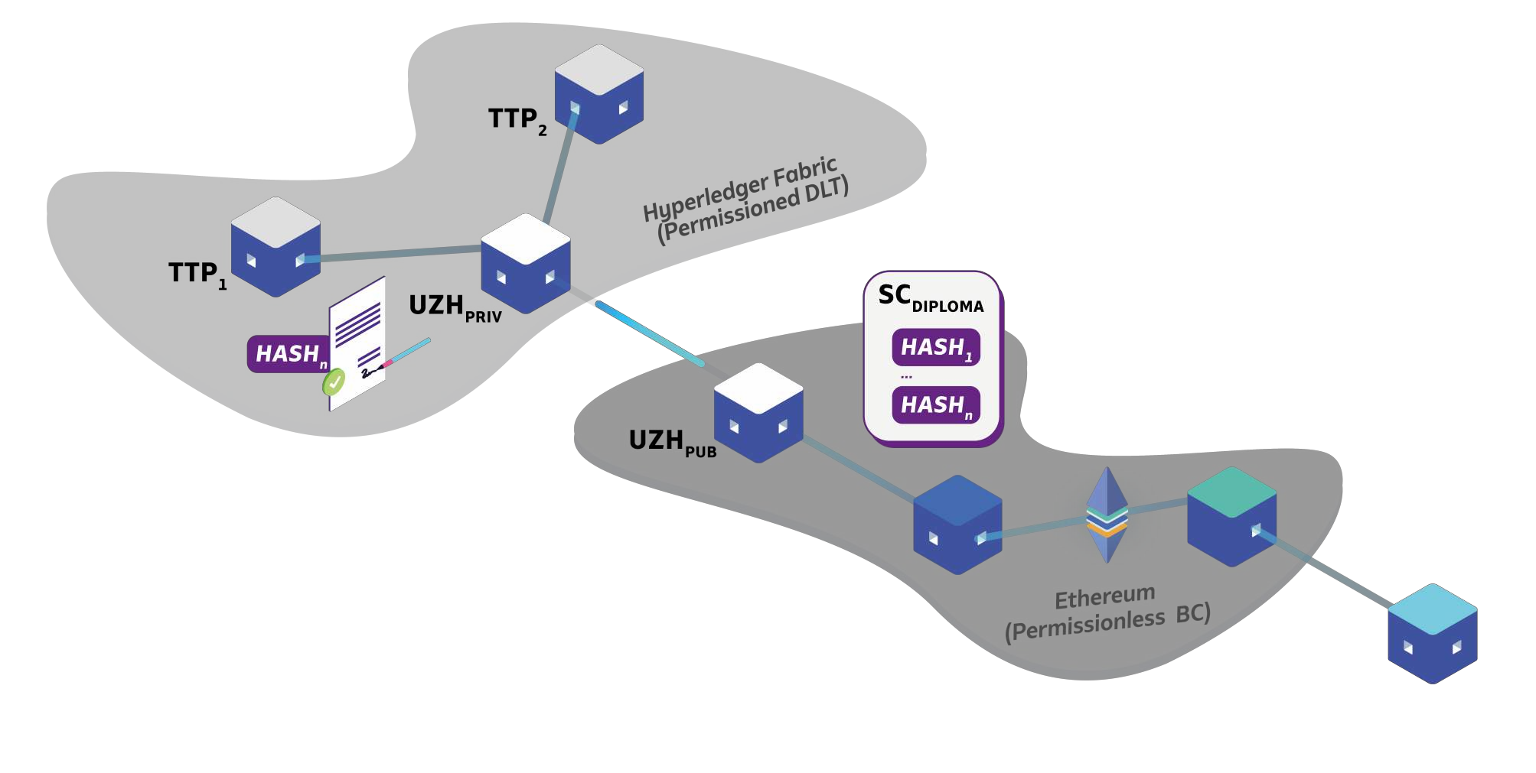
Example EduChain Architecture (2)
Development: (Front-End) Applications, “chaincode”
Infrastructure: Operations and deployment
Development: (Front-End) Applications, Solidity SC
Security: Node operations, key management

Slide 5

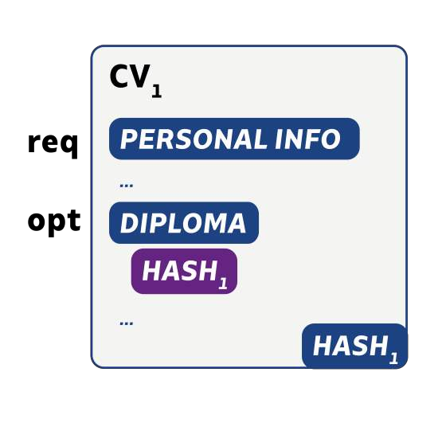

Extended EduChain Functionality to CVs
Add diploma hash to CV
Store hash

Slide 6
Extended CV Functionality: Data Types
Example Definition of required data structure
"basics": {
"first name": "John",
"lastname":"Doe",
"email": "john@gmail.com",
{
"gender": "Male",
"birthday": "01-01-1990", "location": {
"address": "Binzmühlestrasse 14", "countryCode": "CH", "postalCode": "8050",
"city": "Zurich",
"canton": "Zurich"
}
Personal
information
},
"work": [
{
"company": "Universitätsspital Zürich", "companyUID": "CHE-108.904.325",
"position": "System Administrator", "startDate": "2013-01-01",
"endDate": "2014-01-01",
"hash": "c84f2e7767be14b872b77056d28a1d0c[...]", "evidenceURL": "https://educhain.uzh.ch/verify/[...]"}
],
Work experience
"education": [
{
"institution": "University of Zurich", "department": "Department of Informatics", "degree": "Bachelor's Degree",
"startDate": "2011-01-01",
"endDate": "2013-01-01",
"finalGrade": "4.0",
"hash": "c84f2e7767be14b872b77056d28a1d0c[...]", "evidenceURL": "https://educhain.uzh.ch/[...]"}
Academic degrees

Slide 7
Possible Implementation Paths
Private Environment
Public Environment
Permissioned “Consortium”
 | XOR
Traditional Database
Ethereum SC
DLT
EduChain API
Web App

Slide 8
Technical Challenges and Decisions
Storage of Data (Diplomas, CVs)
On-chain vs. off-chain?
Private permissioned DLT vs. traditional database
Cost, privacy
Storage of certificate identifier (Hashes)
Public permissionless BC vs.
E.g., Ethereum Smart Contracts
Public permissioned BC
E.g., own instance of Proof-of-Authority (PoA) Ethereum
Determination of roles, access policies, IDs

Slide 9

Thank you for your attention.

