Slide 1


Overview on Blockchain-based Academic Certificate Handling
EduChain Workshop, Zurich, June 7, 2019
Bruno Rodrigues, Muriel Franco, Eder Scheid, Christian Killer, Burkhard Stiller
Communication Systems Group CSG Department of Informatics IfI University of Zürich UZH, Switzerland
[rodrigues¦franco¦scheid¦killer¦stiller]@ifi.uzh.ch

Slide 2
Blockchains in Education
Academic certificate handling
Creation (issuance), revocation, and verification
Interesting blockchain (BC) features
Data immutability, i.e., data cannot be changed
Data replication, i.e., availability, no single point-of-failure
Data trust, i.e., no need for a Trusted Third Party (TTP)
BC can act as a public and distributed ledger of academic certificates
Still necessary to trust the institutions that are issuing certificates are accredited
BC-based Smart Contracts (SC)
– Automated and immutable code execution
2

Slide 3
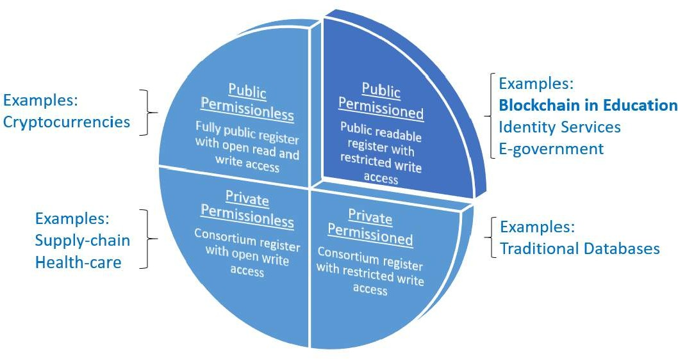
Blockchain Deployment Types
3

Slide 4
Public Permissioned
Public register with open read and restricted write access.
Public Permissionless
Fully public register with open read and write access.
Private Permissionless
Consortium register with open write access.
Private Permissioned
Consortium register with restricted write access.

Slide 5



Stakeholders and Roles
Issuers
Accredited education institutions, e.g., UZH or ETH
BC permissions: write and read
Recipients
Certificate owners, e.g., students
BC permissions: read
Verifiers
Interested parties, e.g., companies, universities
BC permissions: read
5

Slide 6
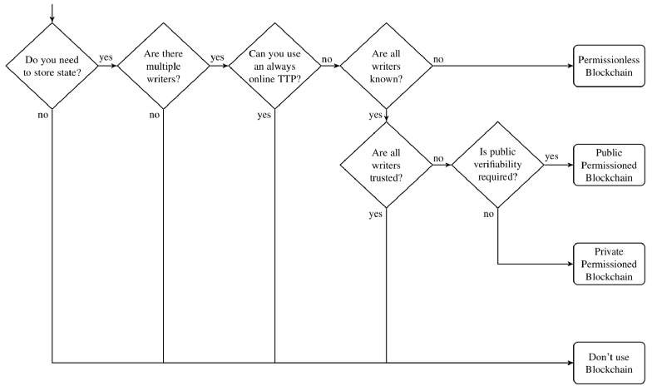
Mapping Stakeholder Permissions to BC
Based on
K. Wüst, A. Gervais
6

Slide 7
Landscape of Blockchain in Education
Work | BC Type | BC | Certificate Storage | Permissions to Issue Certificates
Blockcerts | Permissionless | Bitcoin, Ethereum | Traditional DB | Off-chain Overlay
Disciplina | Permissionless | Own Blockchain | Own Blockchain | Smart Contract
UZHBC | Permissionless | Ethereum | Traditional DB | Smart Contract
BCDiploma | Permissionless | Ethereum | Traditional DB | Smart Contract
Edgecoin | Permissionless | Ethereum | IPFS | Smart Contract
OS University | Permissionless | Ethereum | IPFS | Smart Contract
Gräter et al. | Permissionless | Ethereum | IPFS | Smart Contract
Sony Global Education | Permissioned | IBM HyperLedger | Traditional DB | Selected institutions
GRNET | Permissioned | Cardano | Traditional DB | Selected institutions
CredenceLedger | Permissioned | MultiChain | Traditional DB | Selected institutions
Based on: B. Rodrigues, M. Franco, E. Scheid, B. Stiller, S. Kanhere: A Technology-driven Overview on Blockchain-based Academic Certificate Handling.

Slide 8
Approaches for BC Certificate Handling
Proof of Existence
BC used as time-stamping solution, providing integrity
Vendor as Notary
Intermediator providing access to the information on the BC
Know your customer (KYC)
Allow recipients to demonstrate the ownership of their certificates
Vendor-dependent validation
Digital Self-Sovereign (Identity)
Individuals control the sharing of certificates
Vendor-independent

Slide 9
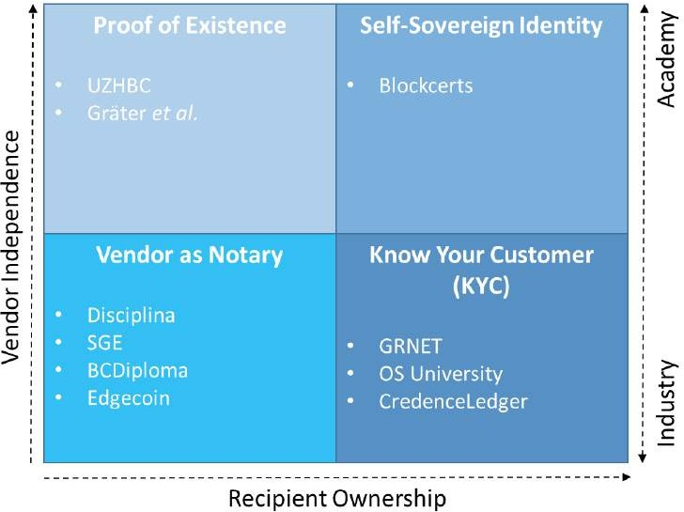
Classification of Work

Slide 10
Challenges
Privacy
Data in the BC (e.g., certificate hash) is personal data?
GDPR Compliance → cannot remove data from the BC
Integrity
Prevent certificates issued by recognized and accredited institutions from being modified
Access Control / Organizational
Prevent unrecognized and unaccredited institutions from issuing certificates
Novelty
Skepticism of BC adoption
– Price volatility

Slide 11
Opportunities
BC conceived to promote disintermediation
However, stakeholders operate in different BC networks that are closed in their own ecosystem
Standards → fundamental aspect to make these different isolated networks to communicate, i.e., interoperability
User-centric Data Control
Allow verifiable claims in Curriculum Vitae (CV) independently of a vendor or educational institution
Secure sharing of CV/certificate data (control of data access)

Slide 12

Thank you for your attention.

