Slide 1
IMAGE BENCH · LOCAL
Salad Studio
Build, validate and POST ComfyUI /prompt graphs to SaladCloud and vast.ai, from a local page.
Python server on 127.0.0.1 · Angular page · one container image pair
Features and numbers on every slide are read from the code at build time.
python -m salad_studio

Slide 2
What it is
Two halves: what you drive here, and what runs on the GPU.
ON THIS MACHINE
ON THE GPU
Profiles and credentials
Prompt authoring and editing
Import from Civitai and ComfyUI
The queue that owns the delay
History, ratings and the gallery
A ComfyUI image pair (Klein and SNOFS)
Weights fetched on first boot
Salad group or a vast.ai instance
The render itself, by /prompt
salad_klein/ holds the image; salad_studio/ holds the studio.

Slide 3
Architecture
One page, one local server, one thread that owns the state.
Angular page
Local server
Core thread
Stores
ui/src · AG Grid
11 pages, one shell
web/server.py
3 API routes + files
web/core.py
every handler in order
~/.config/salad
tokens, profiles, queue
Every action is one POST /api/action naming a page and an action; the reply carries that page's whole state.
Status, log lines, dialogs and action results stream back on GET /api/events.

Slide 4
Eleven pages, in the order you use them
01
Config
02
Prompt Settings
03
Tokens
04
Loras
Profiles, images, Salad group, vast.ai
Size, steps, seed, graph, LoRAs
Five provider keys, checked one by one
Catalog, extras, verified state
05
Prompt Editor
06
Prompt Assist
07
Prompt Catalog
08
Import
Request JSON and the graph it draws
DeepSeek or a local model rewrites prompts
Saved prompts with names
Civitai and ComfyUI paste to a request
09
Prompt History
10
Queue
11
Logs
Every request, rated, with its plate
Waiting, running, finished; retry and cancel
Container logs and redacted Studio events
read from web/registry.py PAGE_IDS

Slide 5
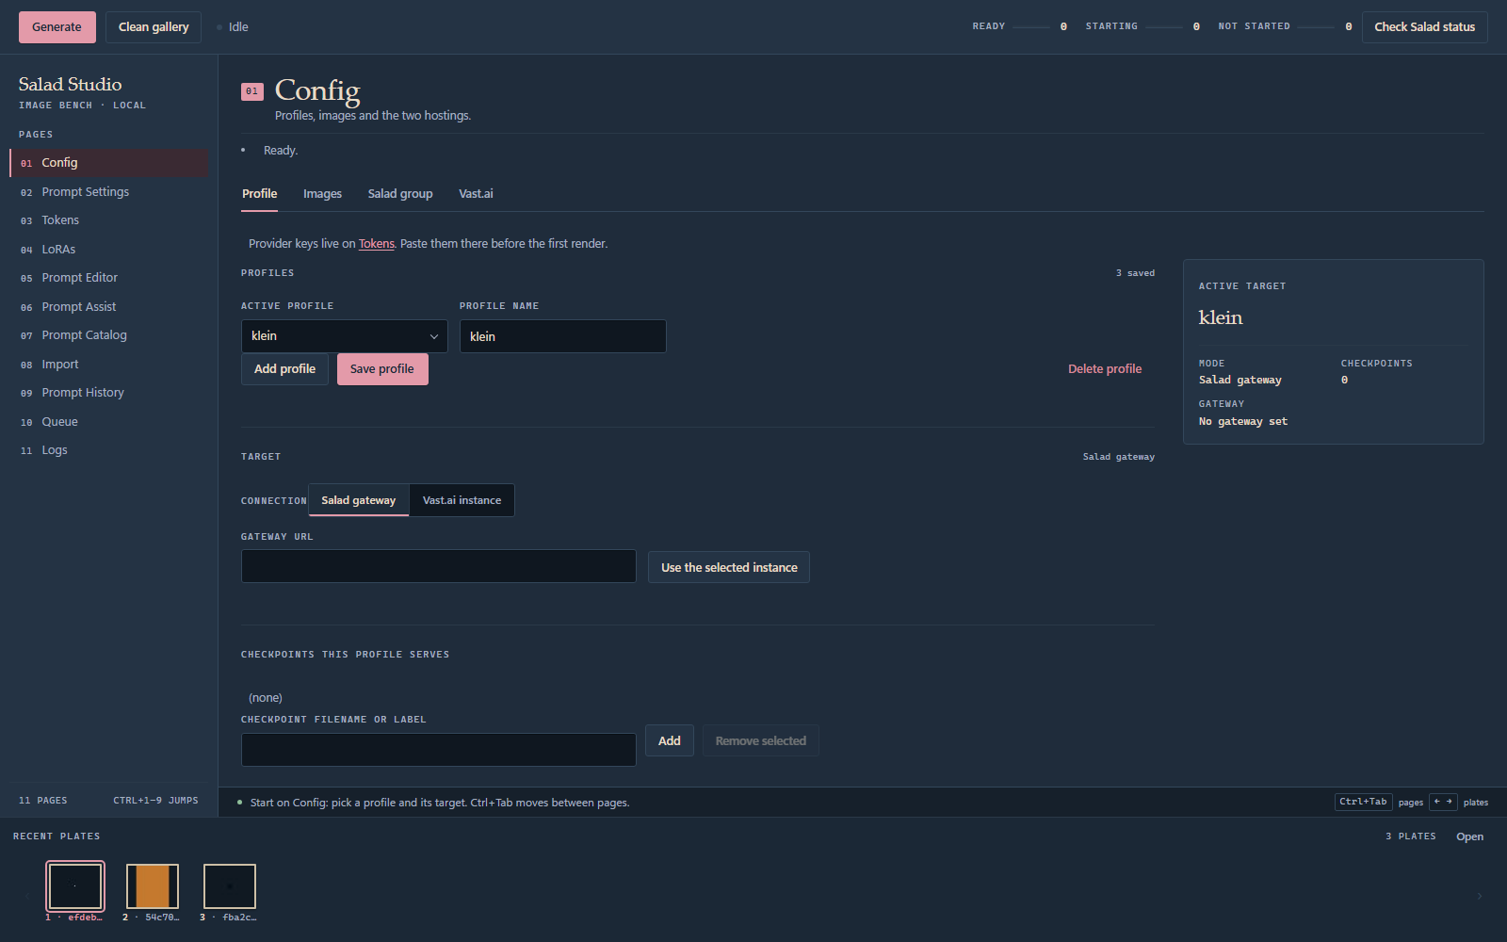
PAGE 01
01
Config
Where a render is pointed, and what it is allowed to use.
▪ Four sections Profile, Images, Salad group, Vast.ai. A save writes only its own section.
▪ Checkpoints route A listed checkpoint decides which family serves the request.
▪ Two targets Salad gateway or a vast.ai instance, chosen in the profile.
▪ One key per provider Keys live beside the profile, not inside it.

Slide 6
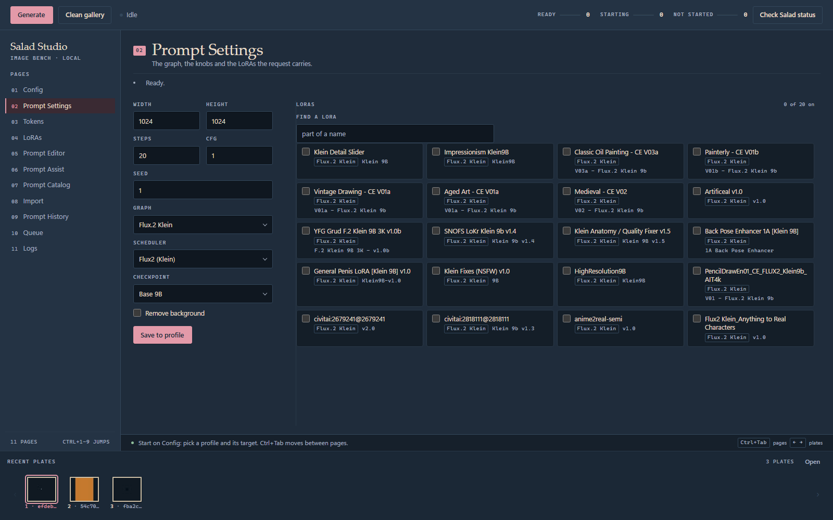
PAGE 02
02
Prompt Settings
The knobs every request is built from.
▪ The form is the graph Width, height, steps, CFG, seed, scheduler and checkpoint.
▪ LoRA checkboxes Selecting one rebuilds the LoraLoader chain in the editor.
▪ Save to profile Writes the form, not the box below.
▪ Remove background rembg u2net cuts each new plate to a PNG.

Slide 7
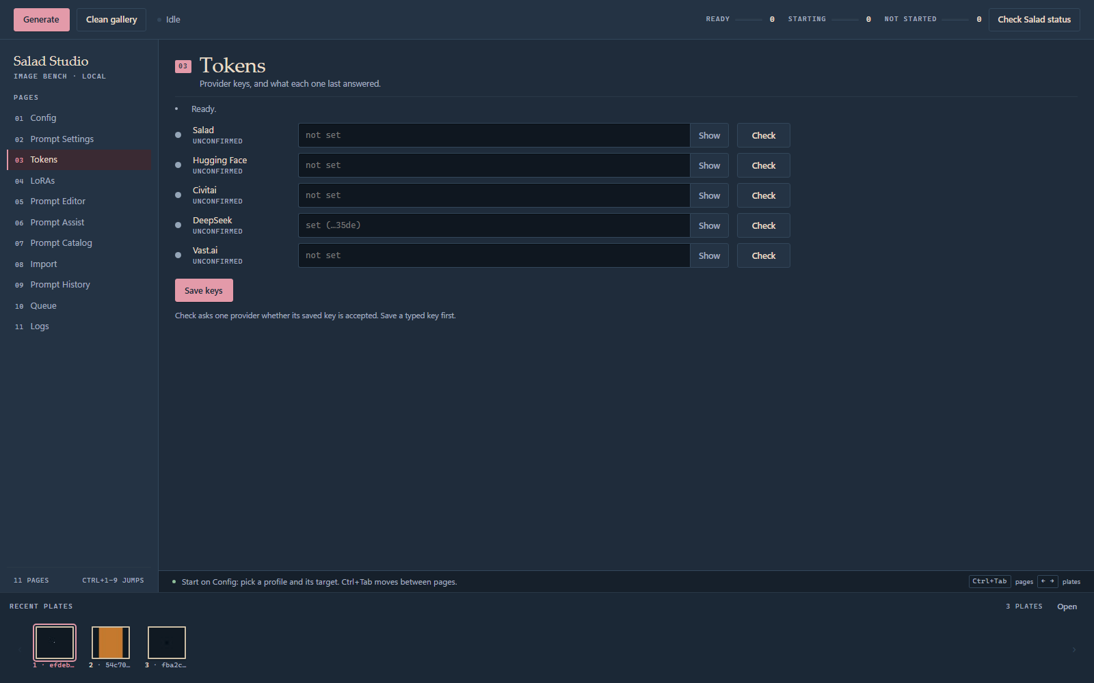
PAGE 03
03
Tokens
Five provider keys, each checked against its own provider.
▪ Green means accepted A dot turns green only on a real 200 from the provider.
▪ Check asks one provider One hanging provider cannot hold up the rest.
▪ Seeded, never guessed An empty slot copies from ~/.config; nothing is probed on open.
▪ Gitignored salad_studio/studio-tokens.json stays out of the repository.

Slide 8
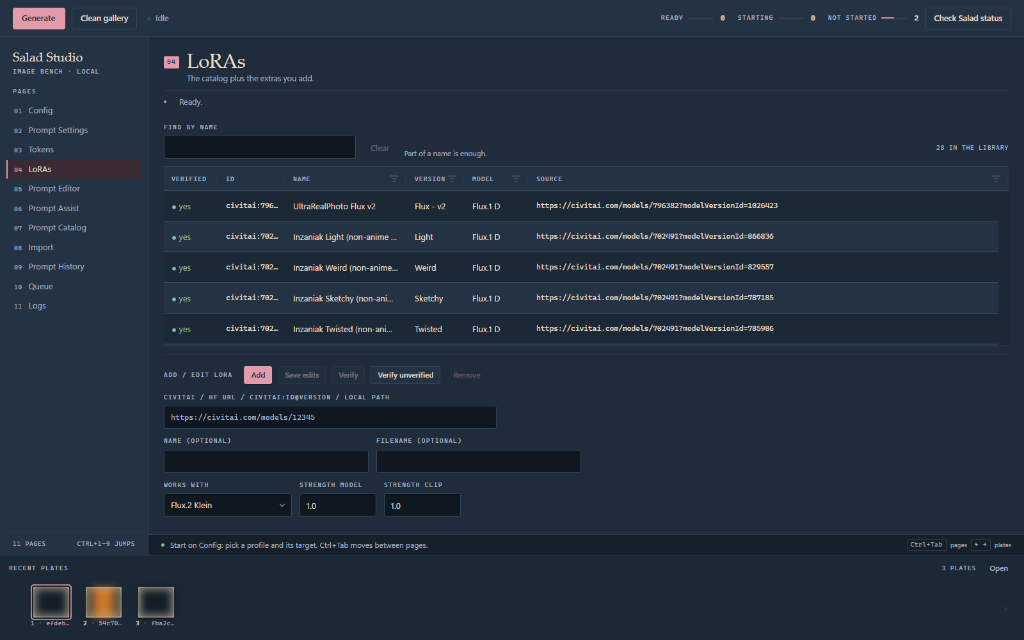
PAGE 04
04
LoRAs
A catalog you own, with a verification state per row.
▪ Any source Civitai page or id@version, Hugging Face URL, local file, or a download URL.
▪ Verified leads One dot per row; the column sorts like any other.
▪ Find by name Narrows the grid, and a narrowed grid still sorts.
▪ Families matter A LoRA from another family is flagged before it reaches a POST.

Slide 9
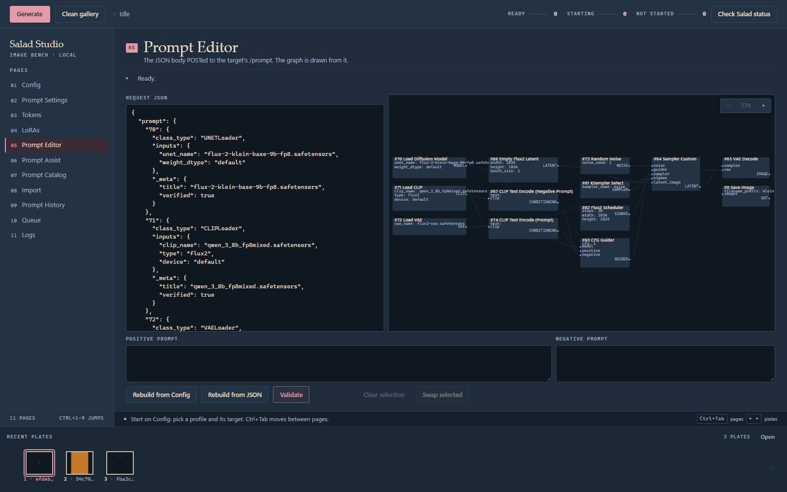
PAGE 05
05
Prompt Editor
The request JSON, and the graph drawn from it.
▪ Drawn from the request graph_model.py lays it out as data, not a second description.
▪ Validate is the real gate The same parse Generate runs, plus token and URL checks.
▪ Rebuild both ways From the config, or back out of the JSON.
▪ CLIP wiring follows the stack Native LoRAs encode after the last loader; foreign ones on the base.

Slide 10
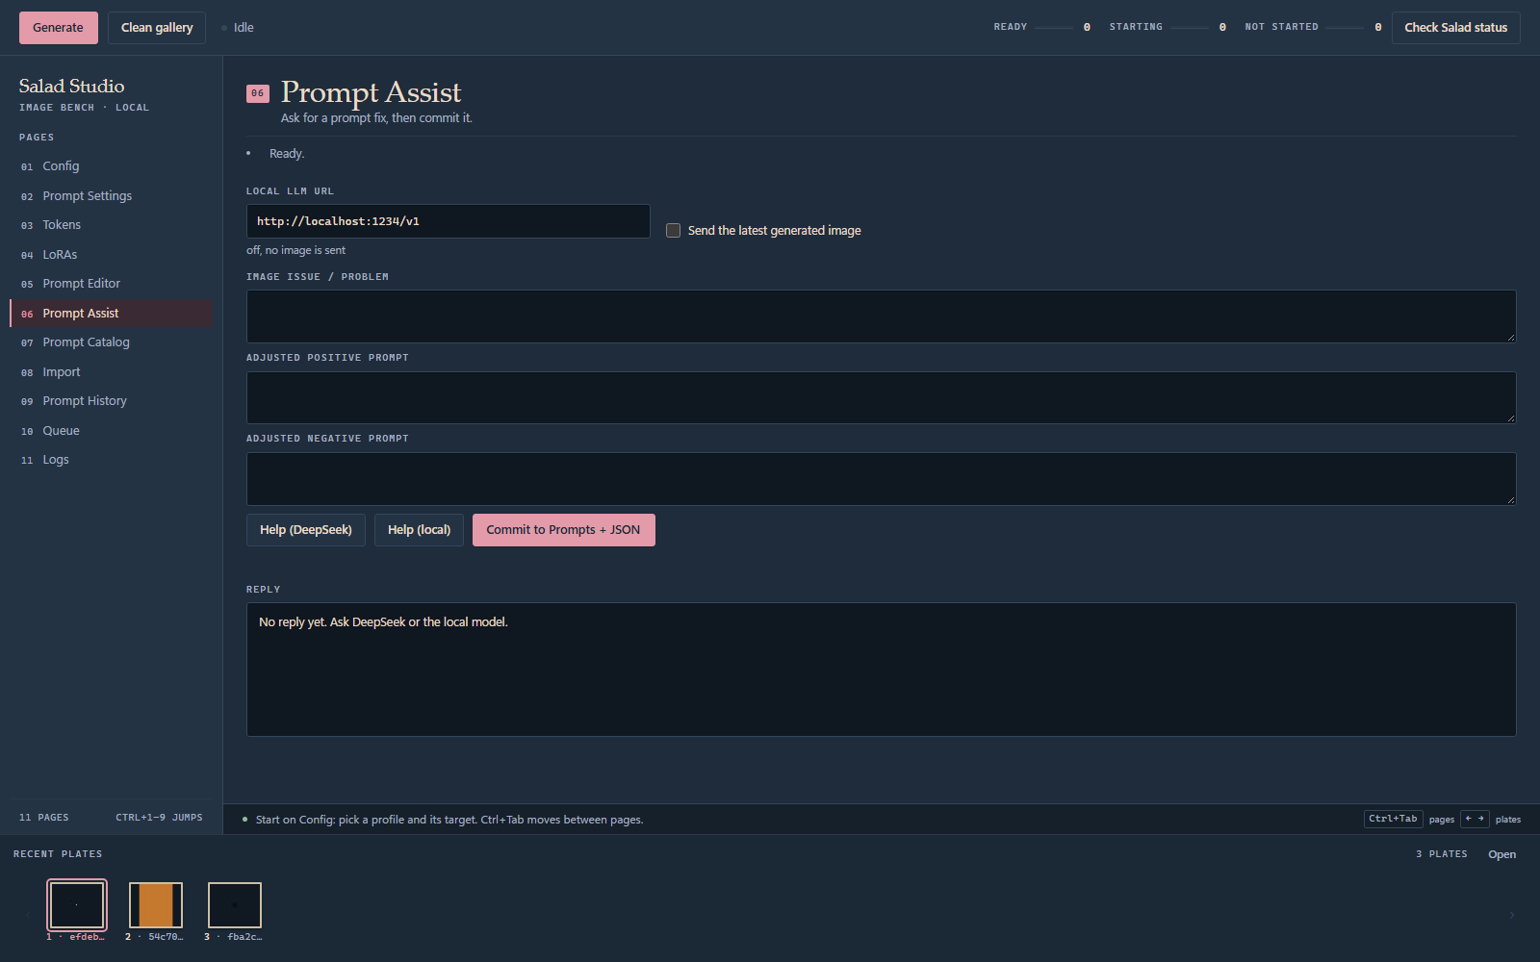
PAGE 06
06
Prompt Assist
Ask for a prompt fix, then commit it to the graph.
▪ Two engines deepseek-flash over the API, or an OpenAI-compatible local server such as LM Studio.
▪ The issue leads What went wrong with the last plate is the highest-priority instruction.
▪ Reply read as a whole The best complete JSON object wins; a truncated reply is continued.
▪ Commit once Fills both prompts and patches the CLIP text, or rebuilds and says so.

Slide 11
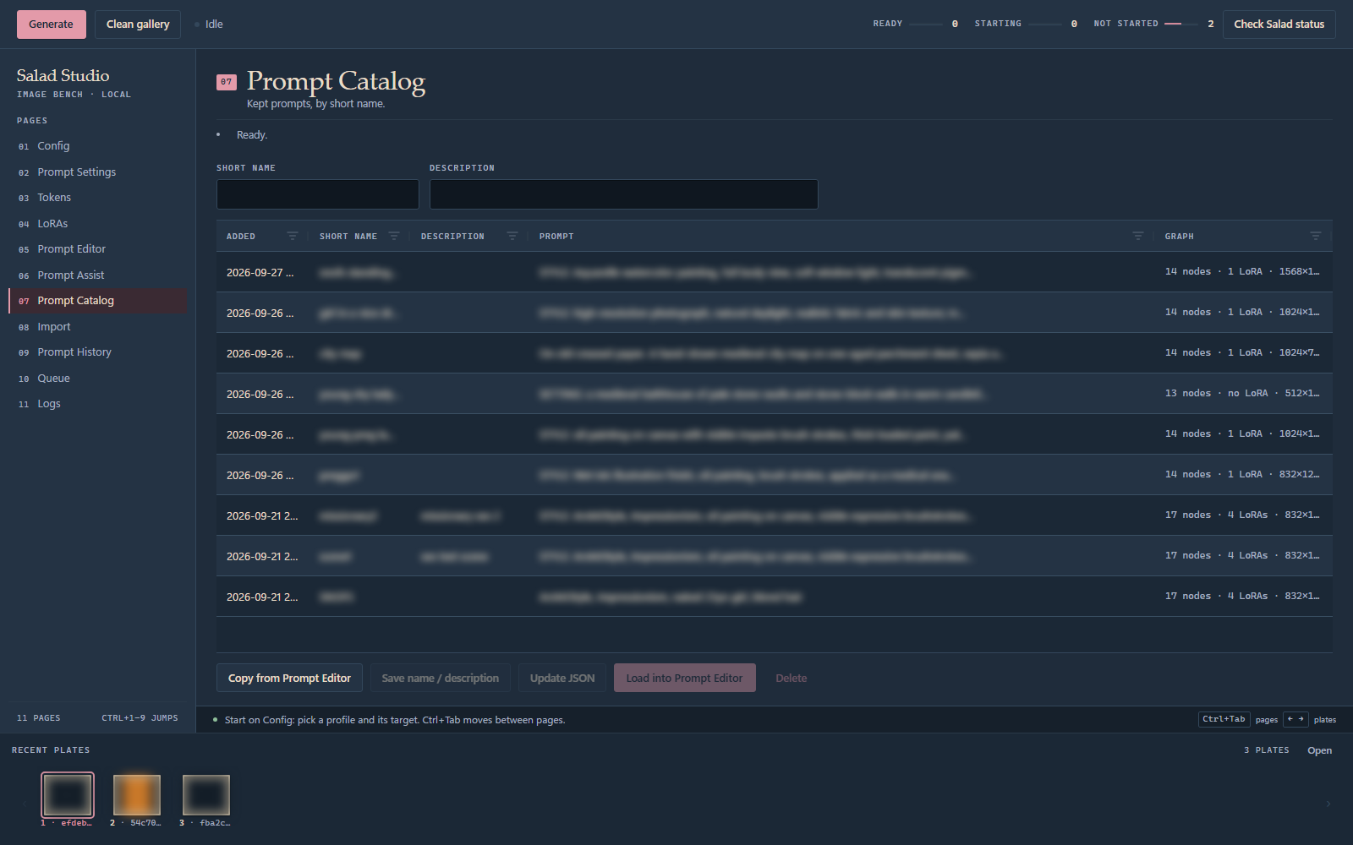
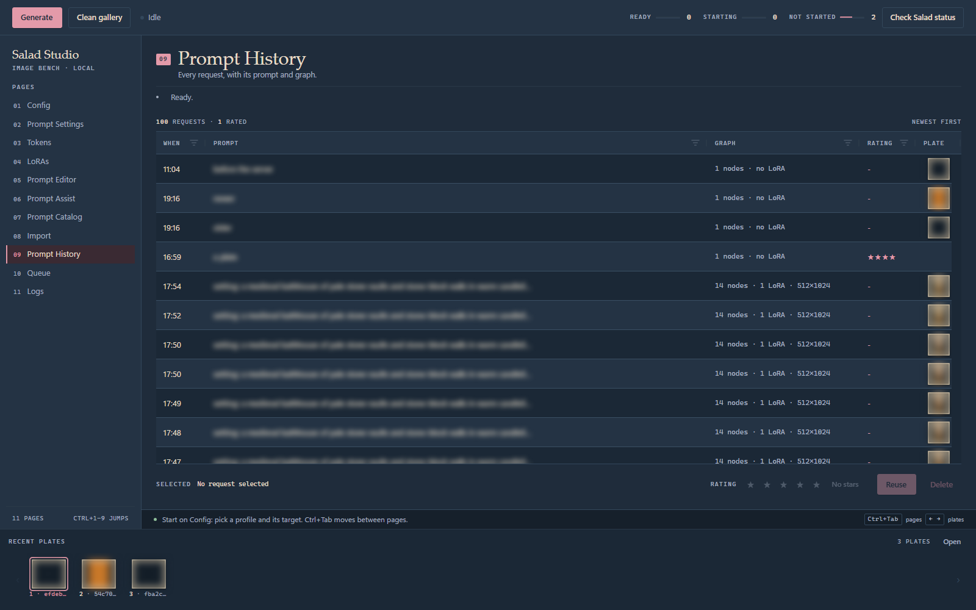
Prompts you kept, and every render you made
Prompt Catalog
Prompt History
Named prompts with a description, copied from the editor and loaded back into it.
One row per request, with its graph, a rating and its plate; Reuse restores the JSON.

Slide 12
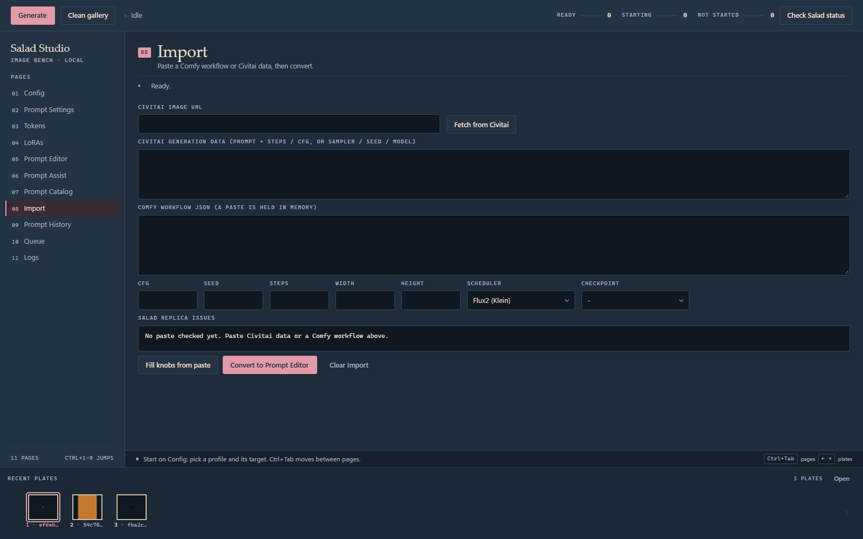
PAGE 08
08
Import
Paste what another tool gave you; get a request this house can run.
▪ Two paste kinds Civitai generation data, and ComfyUI nodes and links.
▪ Routed on shape Graph presence first, then tooling; a paste with no sampling path is rebuilt.
▪ Repaired for the replica Missing nodes dropped, rewired or replaced with their local equivalents.
▪ Warnings, not blocks A converted graph that would fail is reported and stripped at POST.

Slide 13
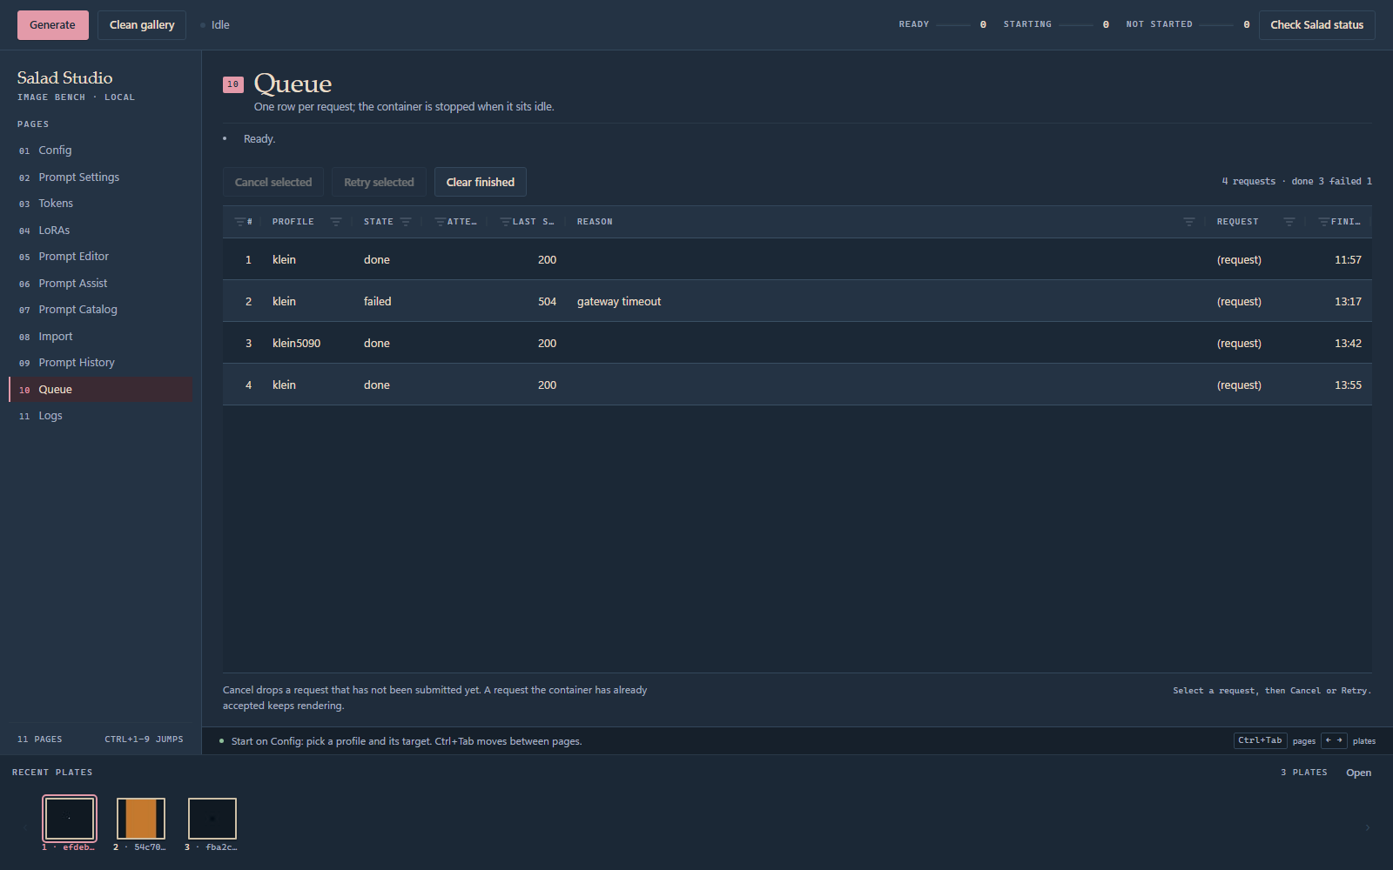
PAGE 10
10
Queue
The part that owns the delay between pressing Generate and getting a plate.
▪ One line per profile A request waits for its own container, not for every other render.
▪ Never a second POST An accepted request is never sent again, and cannot be retried.
▪ Finished rows stay 4 hours, then they turn over.
▪ Bounded retries 6 attempts, 8 s apart.
▪ Idle stop 60 minutes after the last render.

Slide 14
The queue's promise
Two invariants the code is tested against.
NEVER POSTED TWICE
NEVER STARTS A CONTAINER
A press repeating the request at the head adds nothing. An accepted request is never retried.
It stops what it started and follows what it owns. A hand-started container is left alone.
Both are checked as exhaustive state-machine runs by .claude/skills/queue-submission-safety/check.py.

Slide 15
Local by construction
Nothing here listens beyond this machine.
▪ Loopback only The socket binds 127.0.0.1.
▪ Origin check A request whose Origin names another site is refused before any action runs.
▪ Run token The URL carries a token minted per run; every API request must return it in a header.
▪ No UI toolkit in the server tests/test_layers.py fails if tkinter or flet is ever imported again.
▪ Keys stay home Provider keys live in gitignored local files and never enter the repository.

Slide 16
What runs on the GPU
One image family, two weight sets.
SNOFS
docker.io/vkozyrev0/eldermark-klein:comfy0.35-api1.19.2-prefetch6-snofs
Weights are fetched on first boot; the image carries none.
KLEIN
docker.io/vkozyrev0/eldermark-klein:comfy0.35-api1.19.2-prefetch6-klein
Weights are fetched on first boot; the image carries none.
salad_klein/Dockerfile builds on the Salad comfyui-api runtime; salad_klein/prefetch.py names the weights.

Slide 17
How this is checked
The suite is the feature map.
▪ 1,162 Python tests One module per area, plus the HTTP and page layers.
▪ The docs are a contract tests/test_docs_match.py fails when a manual drifts from the code.
▪ The page has its own tests Vitest under npx ng test, and audit.cjs checks bindings statically.
▪ The queue is proven, not sampled Exhaustive interleavings on the submission path.
▪ Layered tripwire No Python module may import a UI toolkit.

