Slide 1
Ratings Prediction
Submitted by:
VARSHA PATANKAR

Slide 2
INTRODUCTION
We have a client who has a website where people write different reviews for technical products. Now they are adding a new feature to their website i.e. The reviewer will have to add stars(rating) as well with the review.
The rating is out 5 stars and it only has 5 options available 1 star, 2 stars, 3 stars, 4 stars, 5 stars. Now they want to predict ratings for the reviews which were written in the past and they don’t have a rating. So, we have to build an application which can predict the rating by seeing the review.

Slide 3
Problem Statement
Objective of this project is to collect the data from different websites for various products to do the predictions based on reviews.

Slide 4
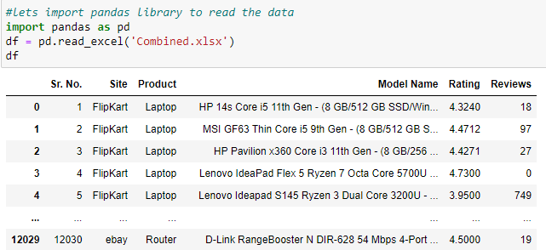
Data Sources
The data you found can be in any form i.e. csv file, excel file etc.
I have got the data in the form of excel file which we have to import that file using pandas library.

Slide 5
Data Pre-processing
Data Wrangling
Check if there are any null values are present in the dataset or not using
df.isnull(),sum()
Data summary
Check the summary of our dataset using
df.describe()

Slide 6
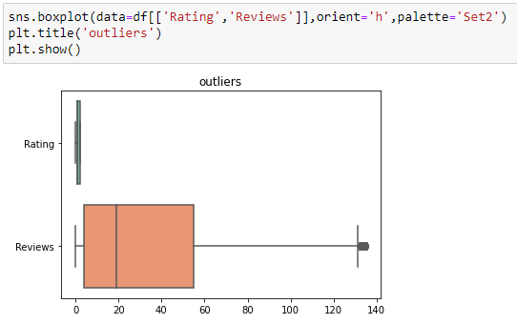
Checking Outliers
Our data is a raw data so we have to check whether any value is out of the box or not.

Slide 7
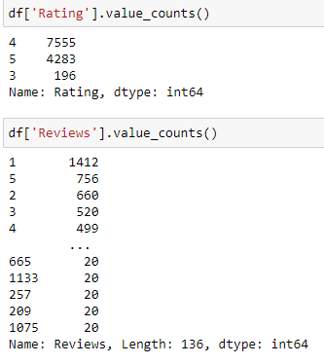
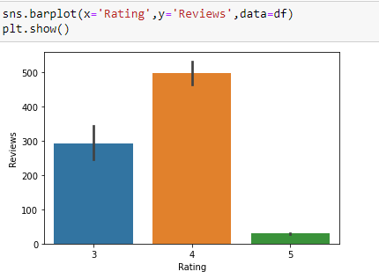
Data Analysis
Univariate
Bivariate

Slide 8
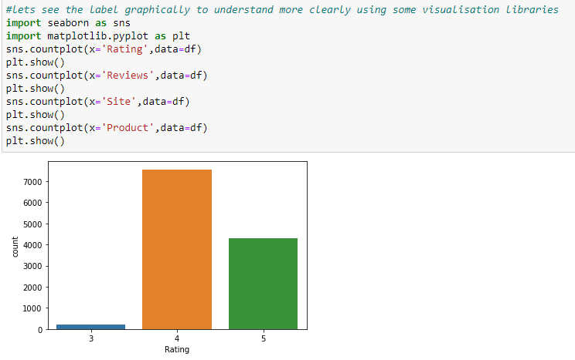
Data Visualization
Univariate
Bivariate

Slide 9
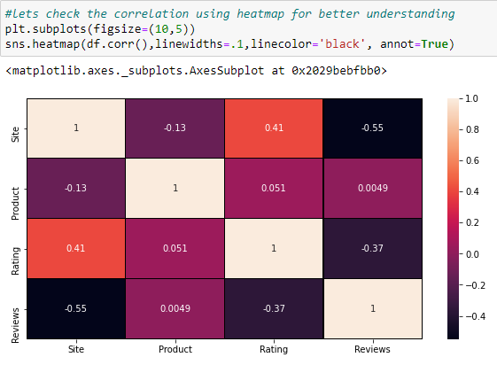
Correlation between columns
We have to find the correlation between all variables.
Heatmap method gives the graphical visualization from which we can easily understand the correlation.

Slide 10
Model/s Development and Evaluation
Machine learning algorithms help to create a new model using existing and historical data that we can use for the training and testing our model to predict the future outcome.
In this project we have used various machine learning algorithms to predict the proper outcome which gives as much as accuracy for our model.

Slide 11
Decision tree classifier
Decision tree is a powerful algorithm in machine learning which can used when working on the real world datasets.
Decision Tree Classifier is a simple and widely used classification technique.

Slide 12
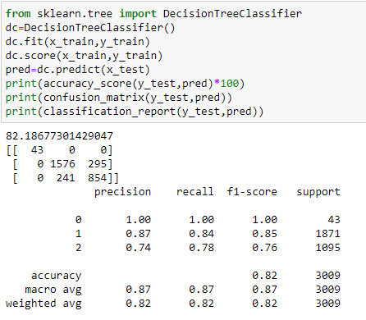
From above diagram we can say that decision tree method gives the accuracy above 82%.

Slide 13
Random forest classifier
The Random forest classifier creates a set of decision trees from a randomly selected subset of the training set. It is basically a set of decision trees (DT) from a randomly selected subset of the training set and then It collects the votes from different decision trees to decide the final prediction.

Slide 14
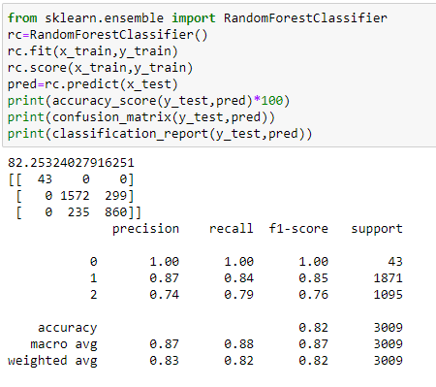
From above diagram we can say that decision tree method gives the accuracy above 82%.

Slide 15
Conclusion
In the experimentation different machine learning algorithms were employed for the proposed model development and their performances were evaluated on various parameters.
From all above process we can say that whatever algorithms or method we used for prediction of our model all process with visualization is very beneficial. Using any visualization library it is easy for us to understand the all data.
For this data Randomforest classifier and decision tree classifier proves the best and others we have used also has good result.

Slide 16
Thank You

