Slide 1
Malignant Comments Classification
Submitted by:
VARSHA PATANKAR

Slide 2
INTRODUCTION
The proliferation of social media enables people to express their opinions widely online. However, at the same time, this has resulted in the emergence of conflict and hate, making online environments uninviting for users. Although researchers have found that hate is a problem across multiple platforms, there is a lack of models for online hate detection.
Online hate, described as abusive language, aggression, cyberbullying, hatefulness and many others has been identified as a major threat on online social media platforms. Social media platforms are the most prominent grounds for such toxic behaviour.

Slide 3
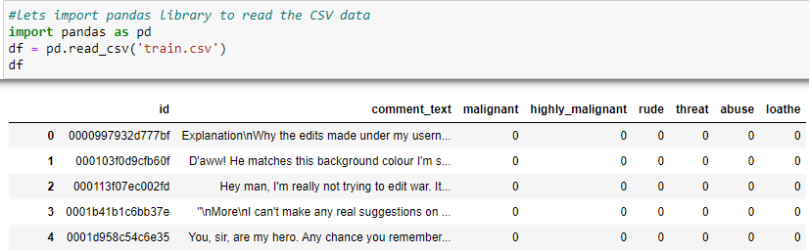
Data Sources and their formats
The data you found can be in any form i.e. csv file, excel file etc.

Slide 4
Problem Statement
Internet comments are bastions of hatred and vitriol. While online anonymity has provided a new outlet for aggression and hate speech, machine learning can be used to fight it. The problem we sought to solve was the tagging of internet comments that are aggressive towards other users. This means that insults to third parties such as celebrities will be tagged as unoffensive, but “u are an idiot” is clearly offensive.

Slide 5
Data Pre-processing
Data Wrangling
Check if there are any null values are present in the dataset or not using
df.isnull(),sum()
Data summary
Check the summary of our dataset using
df.describe()

Slide 6
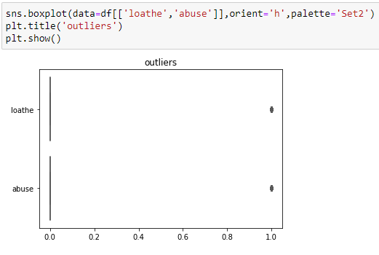
Checking Outliers
Our data is a raw data so we have to check whether any value is out of the box or not.

Slide 7
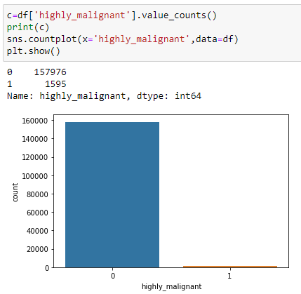
Data Analysis
Univariate

Slide 8
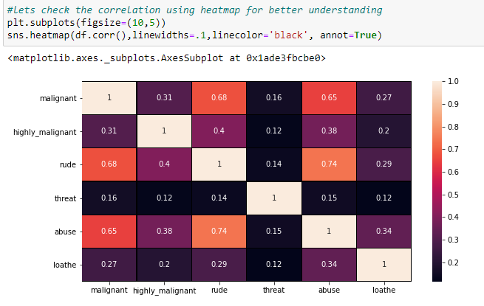
Correlation between columns
We have to find the correlation between all variables.
Heatmap method gives the graphical visualization from which we can easily understand the correlation.

Slide 9
Identified Approaches (Algorithms)
Logistic regression – Logistic Regression is a Machine Learning algorithm which is used for the classification problems, it is a predictive analysis algorithm and based on the concept of probability.

Slide 10
Decision tree classifier
Decision tree classifier – Decision tree is a powerful algorithm in machine learning which can used when working on the real world datasets.
Decision Tree Classifier is a simple and widely used classification technique. It applies a straightforward idea to solve the classification problem. Decision Tree Classifier poses a series of carefully crafted questions about the attributes of the test record. Each time it receives an answer, a follow-up question is asked until a conclusion about the class label of the record is reached.

Slide 11
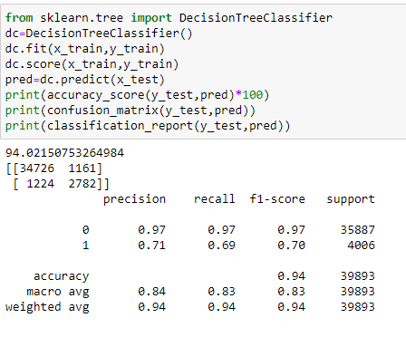
Decision tree also gives the good accuracy above 94%.

Slide 12
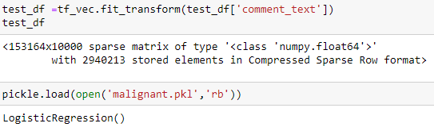
Interpretation of the Results
We have to interpret the result on test dataset.

Slide 13
Text Normalization
1.Removing Characters in between Text.
2.Removing Repeated Characters.
3.Converting data to lower-case.
4.Removing Punctuation.
5.Removing unnecessary white spaces in between words.
6.Removing “\n”.
7.Removing Non-English characters

Slide 14

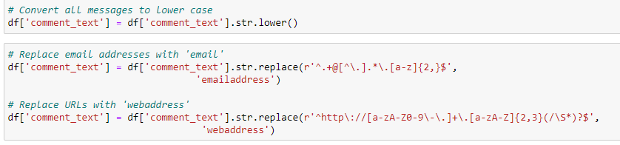

Slide 15
CONCLUSION
In the experimentation phase two different machine learning algorithms were employed for the proposed model development and their performances were evaluated on various parameters.
From all above process we can say that whatever algorithms or method we used for prediction of our model all process with visualization is very beneficial. Using any visualization library it is easy for us to understand the all data.
For this data Logistic regression proves the best and others we have used also has good result but while using Logistic regression with different random state, it also gives the more than 95% accuracy.

Slide 16
Thank You

