Slide 1

Sprocket Central Pty Ltd
Data analytics approach
Vishnu K

Slide 2
Agenda
Introduction
Data Exploration
Model Development
Interpretation

Slide 3
Introduction
Identify and Recommend new Customers to be targeted taking insights from old customer dataset
Outline of Problem
Sprocket Central Pty Ltd is a company that specialises in high-quality bikes and accessible cycling accessories to riders.
The marketing team is looking to boost business by analysing their existing customer dataset
To recommend which of these 1000 new customers should be targeted to drive the most value to the business
Approach for data analysis
Bike related purchase for past 3 years by gender
Job industry distributions
Wealth segmentation by age category
Number of cars owned and not-owned in each state
RFM analysis and customer classification
Targeting high value customers

Slide 4
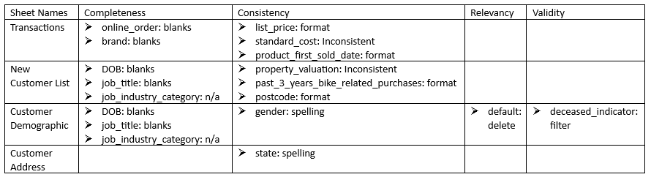
Data Exploration
Data Quality Assessment
Key Issues during data quality assessment

Slide 5
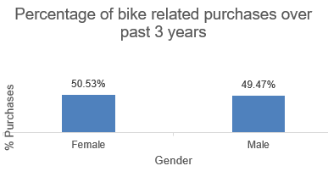
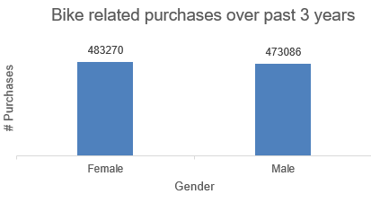
Data Exploration
Bike related purchase for past 3 years
by gender
Over the last 3 years about 50.53% of bike related purchases were made by females to 49.47% made by males.
Numerically, females purchased more than 10,000 more bikes than males.
Females make up majority of bike related sales.

Slide 6
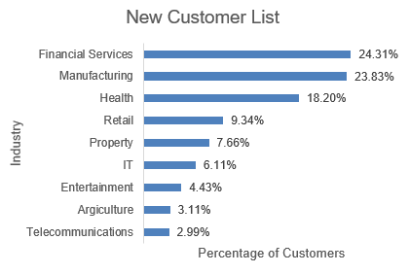
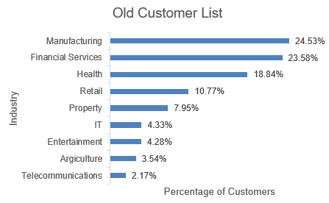
Data Exploration
Job industry distribution
Manufacturing, Financial services and Health have more than 66% of the total customers for ‘Old Customer List’.
Similar pattern is seen for the ‘New Customer List’ also.
We can concentrate of these industries for more sales.

Slide 7
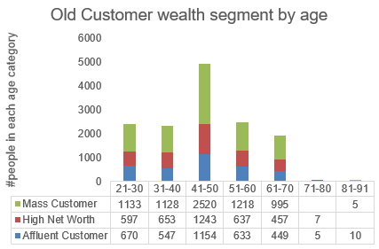
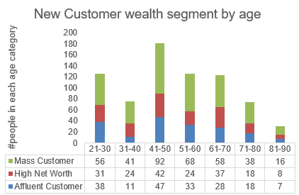
Data Exploration
Wealth segmentation by age category
Mass Customers have the highest customers in all age categories.
Customers in 41-50 range are likely to purchase more compared to other age groups.
Affluent Customers can outperform the high net worth customers in 41-50 age groups.

Slide 8
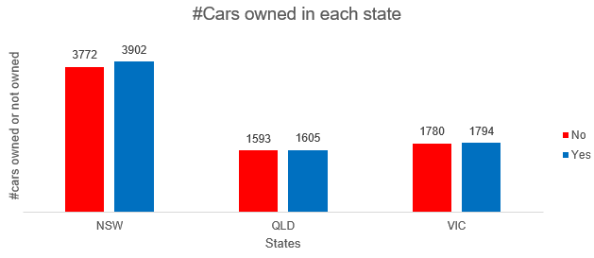
Data Exploration
Number of cars owned and not-owned in each state
NSW has largest amount of people that do not own a car. NSW seems to have higher number of people from which data was collected
VIC and QLD is split quite evenly. Both numbers are significantly lower than those of NSW.
All regions have relatively higher number of customers who own a car

Slide 9
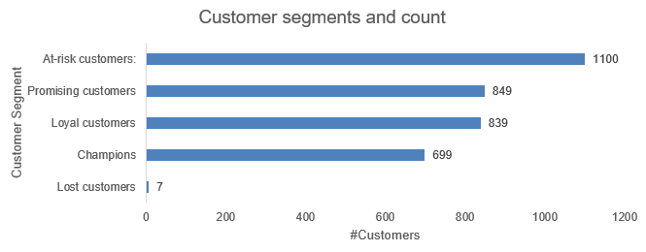
Model Development
RFM analysis and customer classification
RFM analysis is used to determine which customers a business should target to increase its revenue and value.
The RFM(Recency, Frequency, Monetary) model shows customers that have displayed high levels of engagement with the business in the 3 mentioned categories

Slide 10
Model Development
Targeting high value customers
These are the high value customers that should be targeted from the new list
Most of the high value customers will be females compared to males
Working in Manufacturing, Financial services and Health
Aged in the range of 41-50
More preference to people living in NSW.

Slide 11
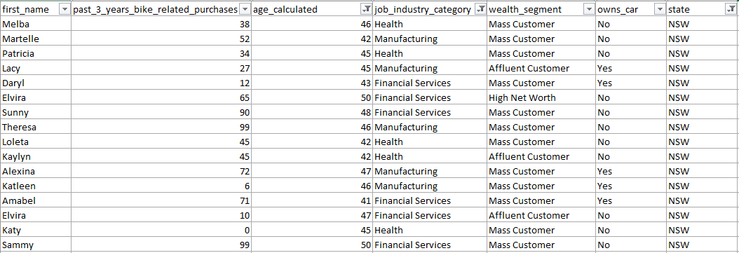
Interpretation
Summary table for high value customers
Here is a snapshot of a few customers that will come under the high value customers

Slide 12
Appendix

Slide 13
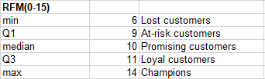
Appendix
RFM segmentation
Checking if RFM calculated value is less than or equal to each segment cutoff.

Slide 14
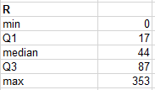
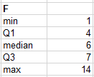
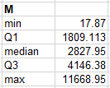
Appendix
Recency, Frequency and Monetary cutoffs
For R and F, checking if value is less than or equal to cut-off
For M checking greater than or equal to above cutoff

Slide 15
Thanks

