Slide 1
Presenting Analysis Report to CEO and CMO
Online Retail Analysis

Slide 2
Familiarize with data
The dataset includes
Description
UnitPrice
InvoiceNo
Invoice Date
StockCode
CustomerID
Quantity
Country

Slide 3
Revenue Calculated
Revenue = Quantity * Unit Price

Slide 4
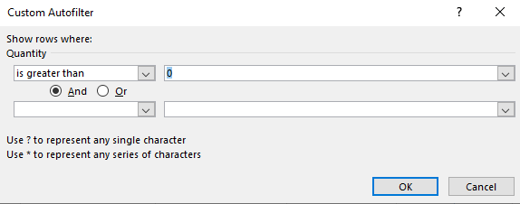
Data Cleaning process
Quantity had negative values. So Adding condition to check that quantity is greater than 0
Unit Price had negative values. Added a check that the Unit price should not be below $0

Slide 5

Data Ready For Visualization
Using Tableau for Visualization and Answering the Questions

Slide 6
Question-1
The CEO of the retail store is interested to view the time series of the revenue data for the year 2011 only. He would like to view granular data by looking into revenue for each month. The CEO is interested in viewing the seasonal trends and wants to dig deeper into why these trends occur. This analysis will be helpful for the CEO to forecast for the next year.

Slide 7
Answer-1
We are focusing only data for the year 2011
Plotting Time-series of the revenue data vs Invoice date
Displaying granular data for each month
September -November has seen a good growth
November has topped the revenue monthly chart
February and April has least revenue.

Slide 8
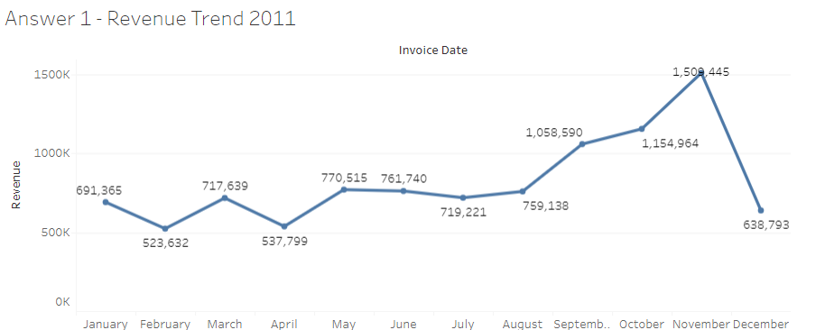
Revenue Trend 2011 Viz

Slide 9
Question-2
The CMO is interested in viewing the top 10 countries which are generating the highest revenue. Additionally, the CMO is also interested in viewing the quantity sold along with the revenue generated. The CMO does not want to have the United Kingdom in this visual

Slide 10
Answer-2
Top 10 countries with highest Revenue
Also Quantity sold across the Top 10 countries
We are excluding United Kingdom from this analysis
Netherland Tops the list
Revenue and Quantity are not strictly correlational

Slide 11
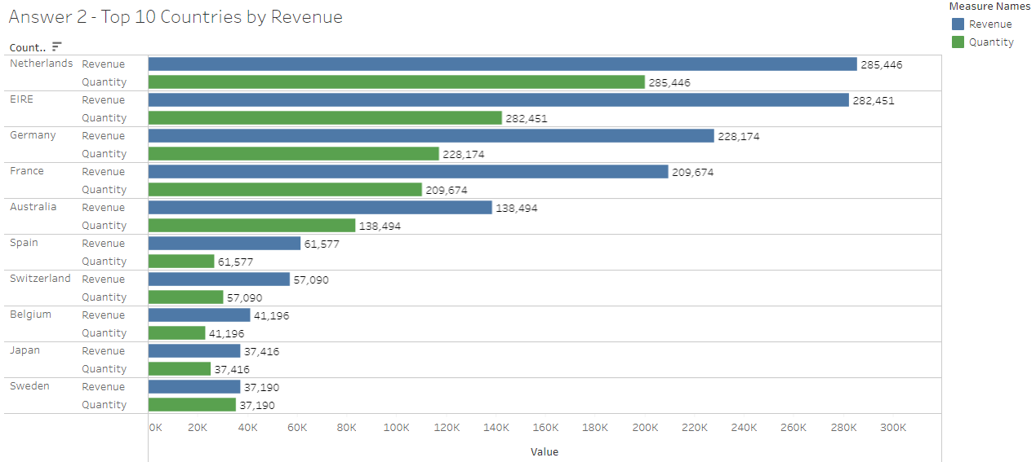
Top 10 Countries by Revenue Viz

Slide 12
Question-3
The CMO of the online retail store wants to view the information on the top 10 customers by revenue. He is interested in a visual that shows the greatest revenue generating customer at the start and gradually declines to the lower revenue generating customers. The CMO wants to target the higher revenue generating customers and ensure that they remain satisfied with their products.

Slide 13
Answer-3
Top 10 customers by revenue
Customer with id 14646 has provided the highest revenue
Followed by 18102
Top 2 Customers contribution is more than bottom 5 customers of the Top 10 list
We can focus more on these customers.

Slide 14
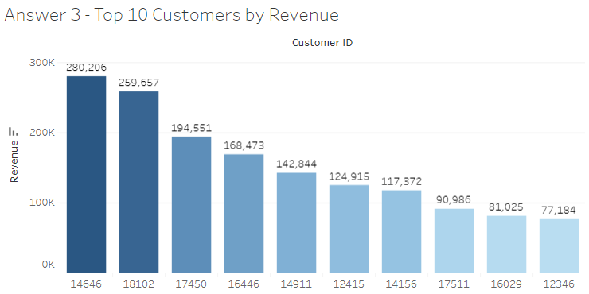
Top 10 Customers by Revenue Viz

Slide 15
Question-4
The CEO is looking to gain insights on the demand for their products. He wants to look at all countries and see which regions have the greatest demand for their products. Once the CEO gets an idea of the regions that have high demand, he will initiate an expansion strategy which will allow the company to target these areas and generate more business from these regions. He wants to view the entire data on a single view without the need to scroll or hover over the data points to identify the demand. There is no need to show data for the United Kingdom as the CEO is more interested in viewing the countries that have expansion opportunities.

Slide 16
Answer-4
Plotting products demand on a map chart
Excluding UK from this analysis
This is the map plot of Question-2 for better visualization
Countries around UK are having the most demand
US, Canada and Brazil have less demand compared to their area

Slide 17
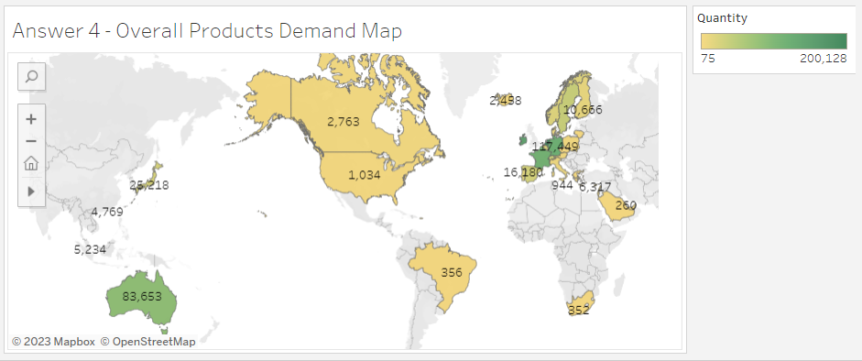
Overall Products Demand Map Viz

Slide 18
Questions?

Slide 19
Thank You

