Slide 1
Sprint 1 Review
Final Round
Ujjwal Sood
Vamshi Vavilla
Saad Khairullah
Christian Hernandez
Deep Avaiya
Abel Sanchez

Slide 2
Notes & Guidelines
All documentation has been completed
Next step is to begin with our initial build of the app, and to keep learning the technologies were going to use

Slide 3
Sprint Goal
Do a deep research on the amount of datasets available and zeroing on the models to choose as well as complete project charter

Slide 4
Product Backlog Items
Backlog Item | Estimate | Actual
Research on the amount of clean data available online | 24 Hours | 24 Hours
Project Charter | 48 Hours | 28 Hours
Figuring out basic architecture | 24 Hours | 16 Hours
Setting up accounts | 4 Hours | 4 Hours

Slide 5
Sprint Backlog for Research
Backlog Item | Estimate | Actual
Research about legal datasets | 10 Hours | 8 Hours
Research models | 5 Hours | 3 hours
Learning the basic LM tools | 9 Hours | 0 Hours
Research for scalable system architectures and automation | 9 Hours | 9 Hours
This is the document that we have included our research in:
PrepAI_Design_Document.docx

Slide 6
Sprint Backlog for Charter
Backlog Item | Estimate | Actual
Program methodology and value proposition milestones | 8 Hours | 4 Hours
Development Milestones background and related work | 8 Hours | 4 Hours
System overview, roles and responsibilities | 8 Hours | 4 Hours
Cost proposal, facilities and equipment | 8 Hours | 4 Hours
Assumptions, constraints and risks | 8 Hours | 4 Hours
Documentation and reporting | 8 Hours | 8 Hours

Slide 7
Sprint Backlog for Basic Architecture
Backlog Item | Estimate | Actual
Figuring out IPC | 6 Hours | 4 Hours
Figuring out languages and backend | 6 Hours | 4 Hours
System overview, roles and responsibilities | 6 Hours | 4 Hours
Brainstorming a timeline | 6 Hours | 4 Hours

Slide 8
Sprint Backlog for Setting up Accounts
Backlog Item | Estimate | Actual
Setting up jira | .5 hours | .5 hours
Discord | 1/12 Hours | 1/12 Hours
Github | 1/6 Hours | 1/6 Hours
Word | 1/12 hours | 1/12 hours
Overleaf | 1/6 Hours | 1/6 Hours

Slide 9
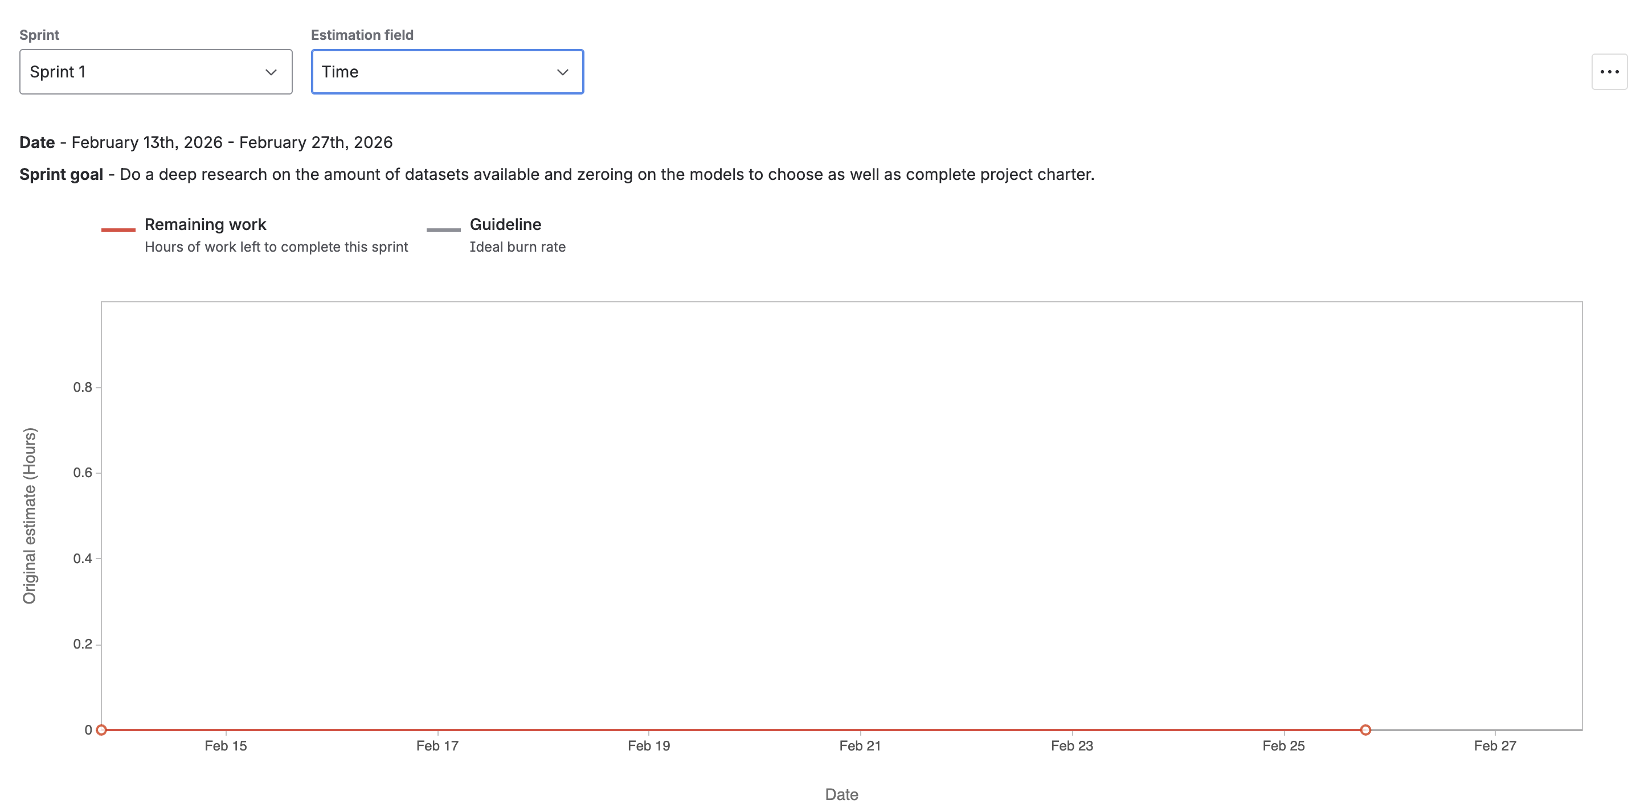
Sprint Burn Down Chart

Slide 10
Burndown Chart Summary
What it shows: Remaining sprint work items each day (Feb 16–Feb 23). Ideal = planned steady burn, Actual = real progress.
Deviation from plan: Yes. Progress happened in clusters instead of a smooth daily burn.
Days with no progress: Yes. Several days were flat (no items moved to Done), due to integration/review/dependencies.
Estimate accuracy: We tracked by item count (not story points), so overall delivery was strong, but pacing was harder to predict; next sprint use story points + smaller tickets for better accuracy.

Slide 11
Demo
Link_to

Slide 12
Questions?

