Slide 1
CS 6150 : Lecture 10 Graphs

Slide 2

Last class
Reductions between various problems
SAT ≤_{p} 3-SAT ≤_{p} Independent-Set ≤_{p} Vertex-Cover ≤_{p} Subset-Sum ≤_{p} Parallel-Scheduling
Encounter new problem -> related to something known?

Slide 3

“Coping” with NP hardness
Hard => hopeless?
Approximation algorithms (decision -> optimization)

Slide 4
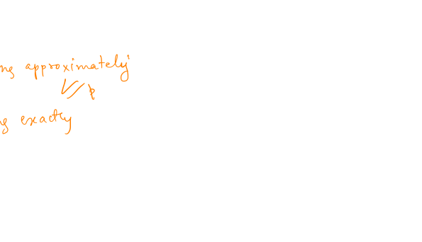
Can we always approximate well?
Can approximate well => P=NP
“Gap problems”: given G, tell between
max-independent-set has size > n^{(1/2)}
max-independent-set has size < n^{(1/3)}

Slide 5

Graphs
Way to model objects and their pairwise interactions
Set of nodes V, set of “edges” E (directed/undirected)

Slide 6
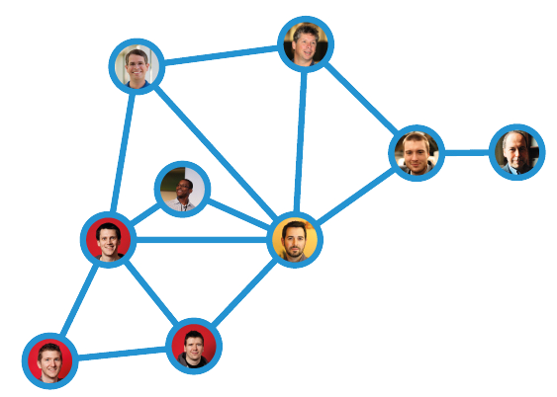
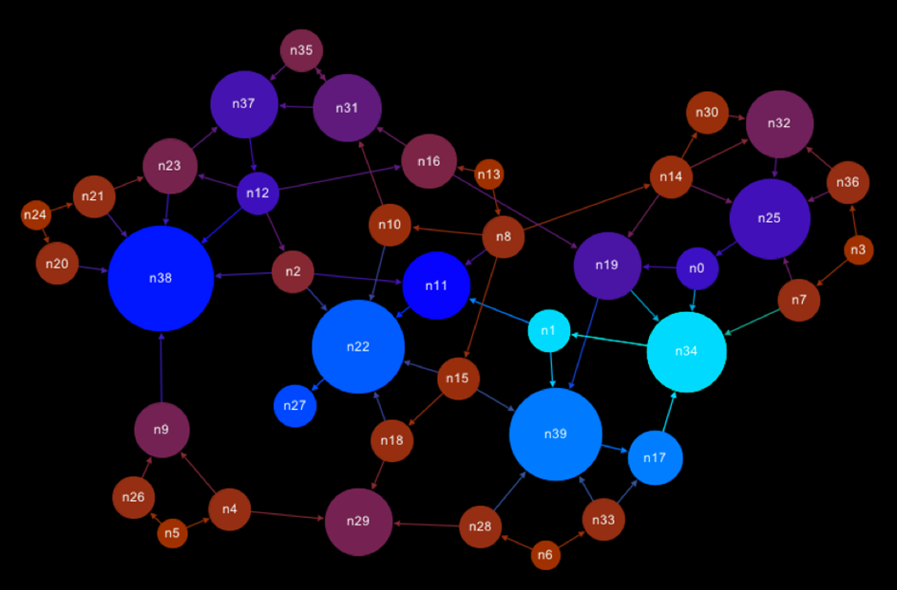
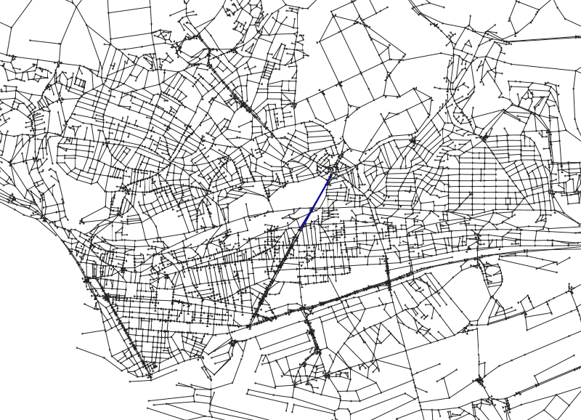
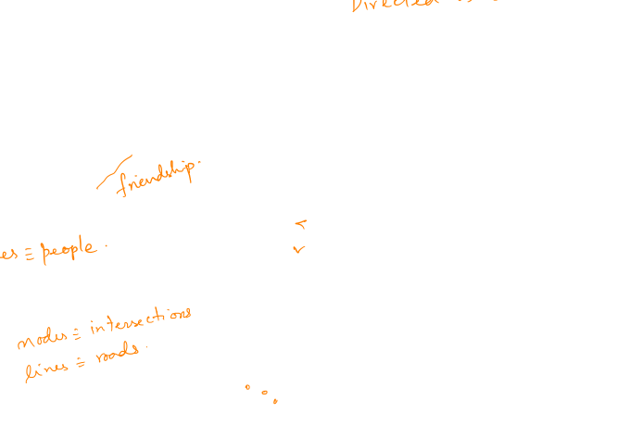

Slide 7
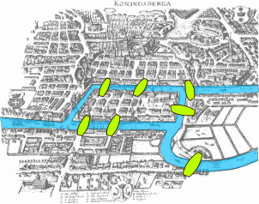

Leonhard Euler (1736)

Slide 8
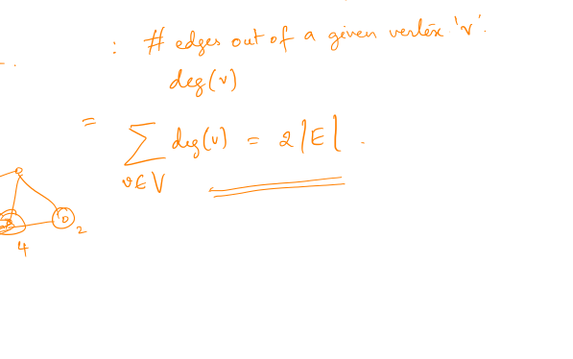
Basic parameters (undirected)
G = (V, E), possibly weights w : E -> R
Degree of a vertex
Sum of degrees

Slide 9
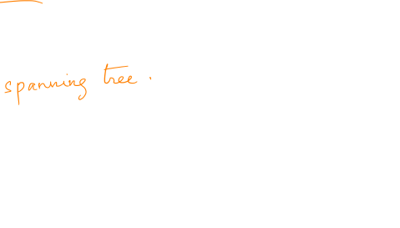
Basic questions
Which nodes are reachable from u?
Find short paths between vertices
Find subset of edges that connects all vertices

Slide 10
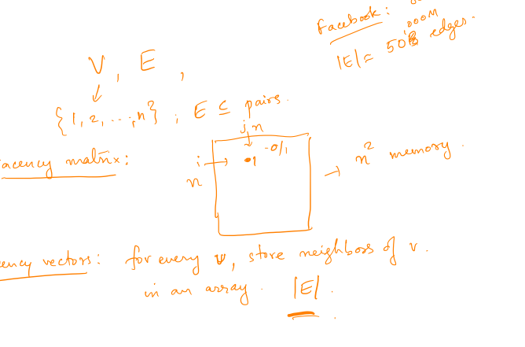
How to store graphs?

Slide 11
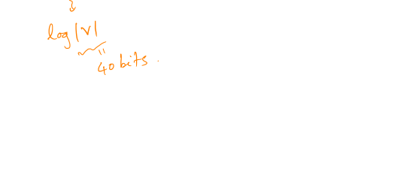
How to store large graphs?

Slide 12
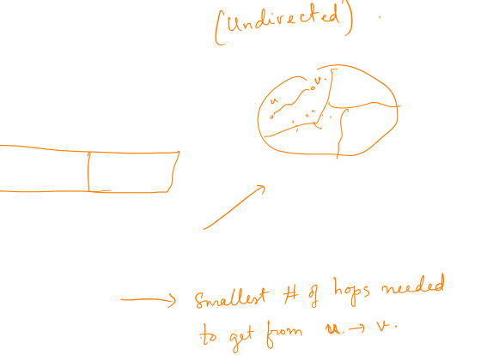
Basic algorithms
Reachability – “search”
Connected components
Shortest paths

Slide 13
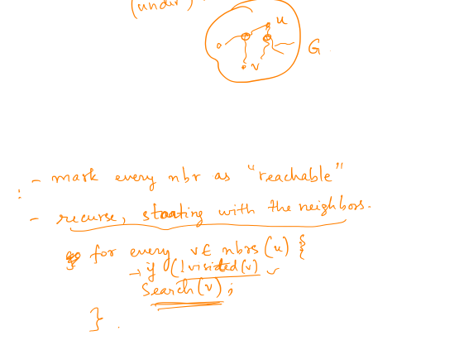
Search in graphs
Problem: find all vertices reachable from given u.

Slide 14
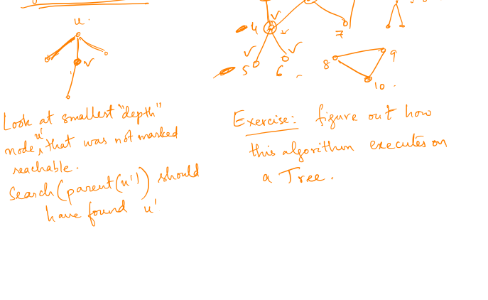
Depth first search – algorithm

Slide 15
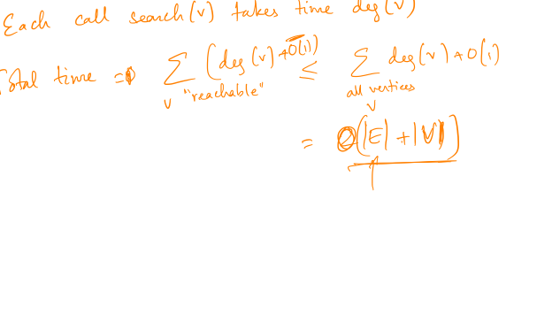
Depth first search – run time

Slide 16
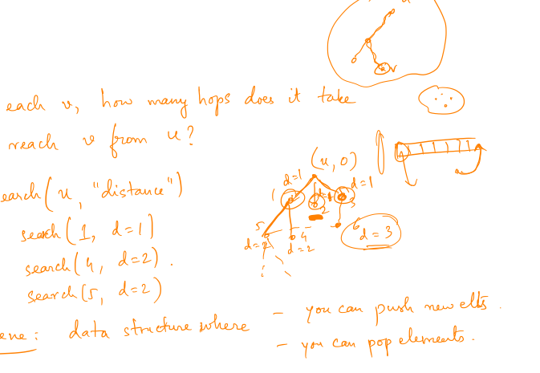
Breadth first search

Slide 17
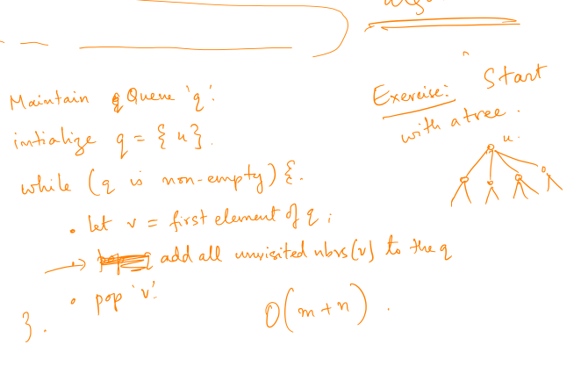
Breadth first search – run time

Slide 18
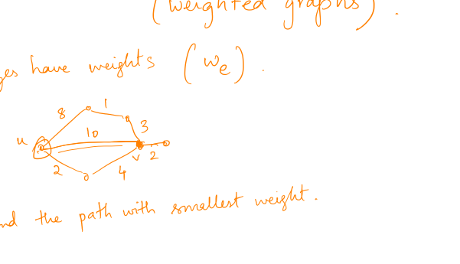
Shortest paths

Slide 19
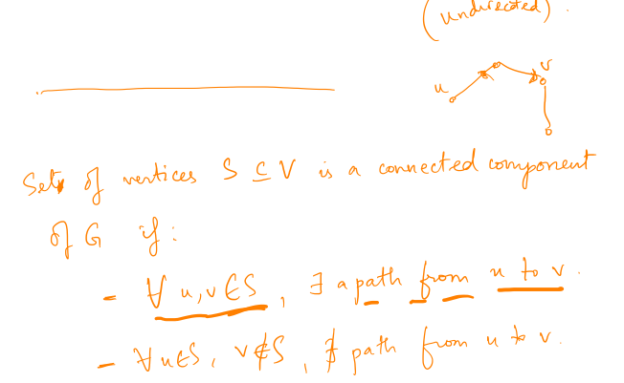
Connected components

Slide 20

Directed graphs
Reachability is asymmetric
Strongly connected components

Slide 21
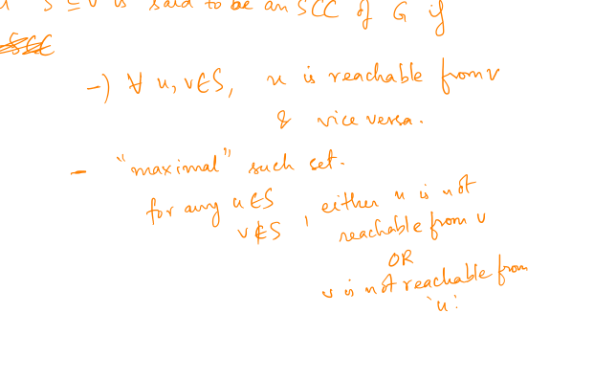
Strongly connected components

Slide 22
Dijkstra’s algorithm

Slide 23
Dijkstra’s algorithm

