Slide 1
CS 6150 : Lecture 11 Shortest paths

Slide 2

Last class
Introduction to graphs (weighted, unweighted, directed, undirected)
Adjacency matrix/lists
Connected components (and directed variant)
Depth first search, Breadth first search

Slide 3
Depth first search
Goal: given v, find all vertices reachable from ‘v’
initialize:
reachable[u] = false for all u;
reachable[v] = true;
dfs(v):
for w in nbrhood[v], do:
if (reachable[w] == false)
set reachable[w] = true;
dfs(w);
FYI : http://visualgo.net/dfsbfs

Slide 4
Breadth first search
Goal: given v, find all vertices reachable from v, while keeping track of distance from v.
source: wikimedia commons

Slide 5

Breadth first search
Goal: given v, find all vertices reachable from v, while keeping track of distance from v
initialize:
reachable[u] = false for all u;
reachable[v] = true;
queue q = [v];
while (q is non-empty)
set u = top element of q;
for neighbors w of u, do:
if (reachable[w] == false)
set reachable[w] = true;
add w to q;
pop q;

Slide 6
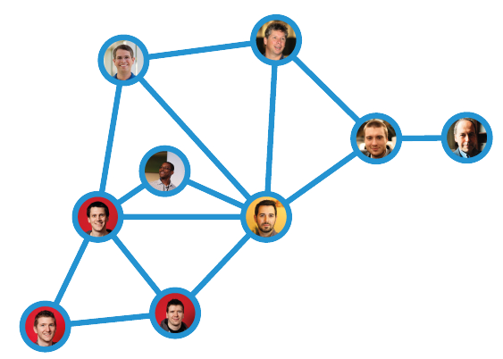
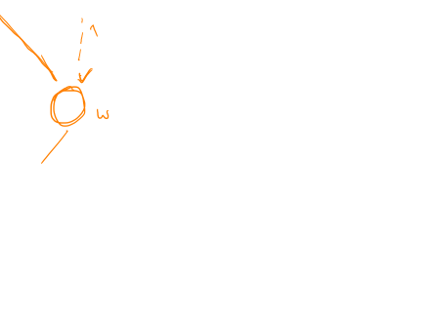
Weighted graphs? (>= 0)
4
5
3
more hops, but smaller total distance..
3
1
1

Slide 7
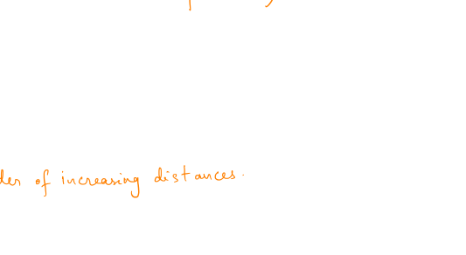
Dijkstra’s algorithm
Goal: given v, find shortest distances from v to all other vertices.
Can we mimic BFS? what order must we process neighbors?
Good to have q always “sorted by distance”?
Might find “better distance” to element already in q

Slide 8
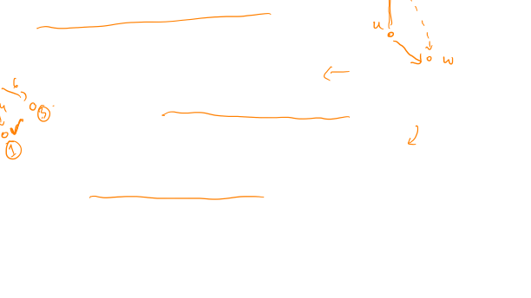
Dijkstra’s algorithm – try 1
initialize:
dist[u] = ∞ for all u;
dist[v] = 0;
queue q = [v];
while (q is non-empty)
set u = first element of q;
for neighbors w of u, do:
if ( dist[w] > dist[u]+wt(u,w) )
set dist[w] = dist[u]+wt(u,w);
add w to q; (if not present)
pop q;
sort q; (by dist values)

Slide 9

Correctness
Induction?
Claim: in every iteration of loop, the front of the q has the correct distance value.

Slide 10

Correctness
Sub-claim: as algorithm progresses, the dist value of the front of the q is non-decreasing.

Slide 11
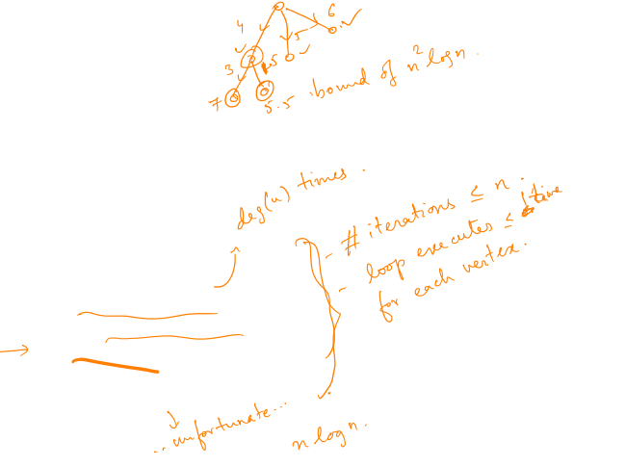
Running time
initialize:
dist[u] = ∞ for all u;
dist[v] = 0;
queue q = [v];
while (q is non-empty)
set u = first element of q;
for neighbors w of u, do:
if ( dist[w] > dist[u]+wt(u,w) )
set dist[w] = dist[u]+wt(u,w);
add w to q; (if not present)
pop q;
sort q; (by dist values)

Slide 12

Running time
initialize:
dist[u] = ∞ for all u;
dist[v] = 0;
queue q = [v];
while (q is non-empty)
set u = first element of q;
for neighbors w of u, do:
if ( dist[w] > dist[u]+wt(u,w) )
set dist[w] = dist[u]+wt(u,w);
add w to q; (if not present)
pop q;
sort q; (by dist values)

Slide 13
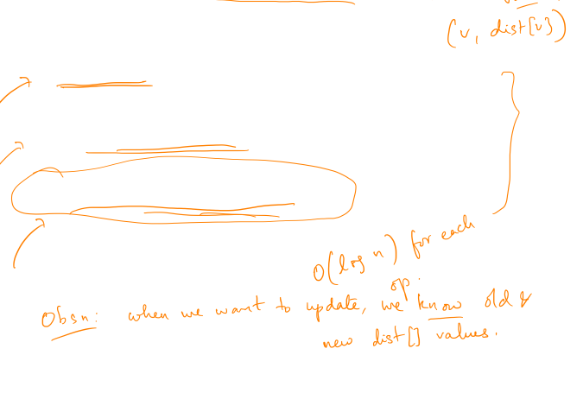
Better data structure?
Add vertices along with dist[] values
Update the dist[] value of vertex (if it exists)
Delete vertex of min dist[] value

Slide 14
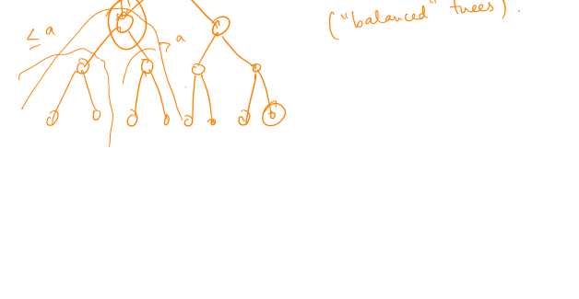
Aside: binary search trees
How to store a collection of integers, s.t. query, delete, add are all “fast”?

Slide 15
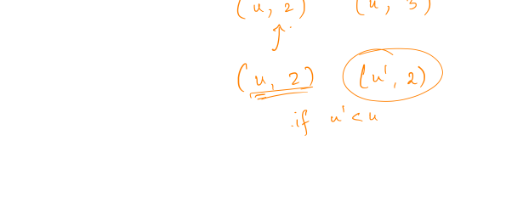
BST for our queue

Slide 16

Final running time

Slide 17

What if edges can be –ve?

Slide 18
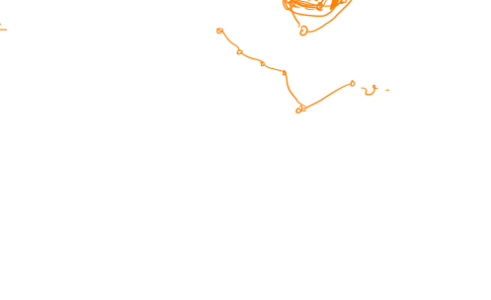
Negative edges
Assume no negative cycles.. Can we find shortest paths?
Observation: for any u,v, shortest path between u & v has length <= n
Bellman-Ford / Shimbel’s algorithm

Slide 19

Directed vs undirected
Will assume graphs are directed..

Slide 20
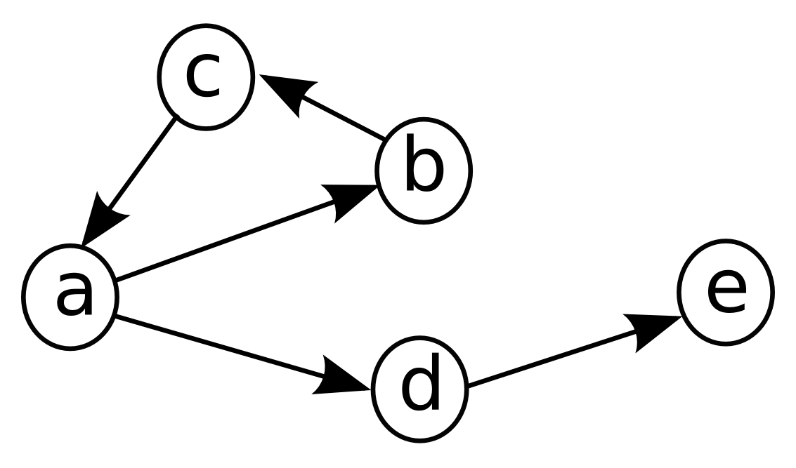
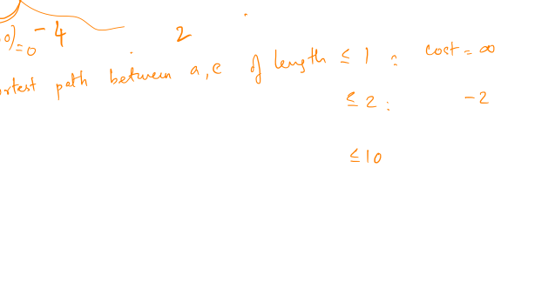
Shortest path of length <= k?

Slide 21
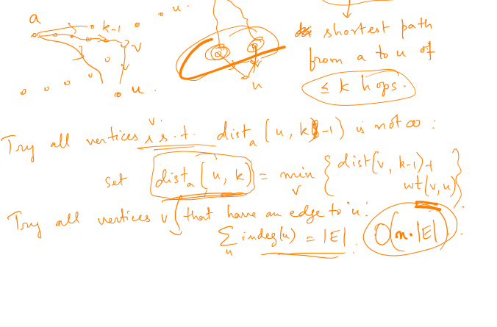
Shortest path of length <= k

Slide 22
Correctness and running time

Slide 23
Divide and conquer?

Slide 24
Even faster?

