Slide 1
CS 6150 : Lecture 12 Shortest paths

Slide 2
Announcements
HW1 grading questions:
Problem 1: Michael Matheny
Problems 2,3: Mohsen Abbasi
Problems 4,5: Waiming Tai

Slide 3
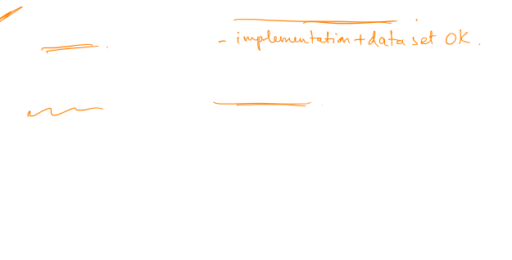
Announcements
Homework 2 due today!!
Scheduling of final
Tuesday, Dec 13, class time
Topics for project
list of papers + sample out next week (2pg max)
pairs OK
Homework 3 (Friday after fall break)

Slide 4

Last class – short paths
Graphs with all edge wts >= 0:
Undirected graphs == directed graphs
Dijkstra’s algorithm (priority queue)
Allow negative edges:
Negative cycles -> problems! (also undirected graphs)
No negative cycles -> “Bellman-Ford” algorithm

Slide 5
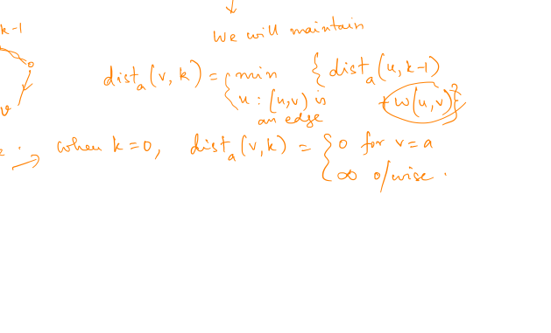
Recap – Bellman-Ford
Distances from vertex a
For all v: keep track of dist_{a}(v, k)
Update using Dyn programming!

Slide 6
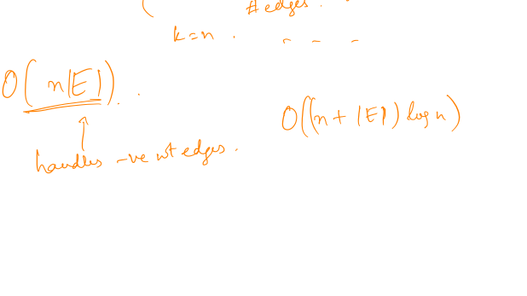
Correctness and running time

Slide 7
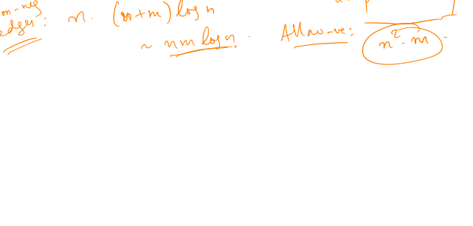
“All pairs” shortest paths
Goal: for every u, v, find shortest path length between u, v

Slide 8
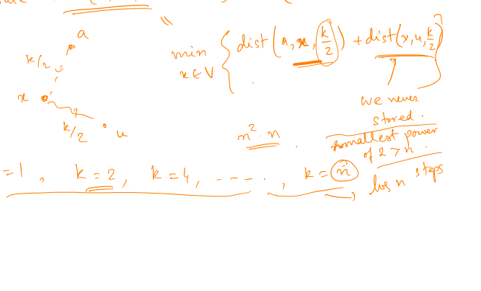
Divide and conquer?

Slide 9
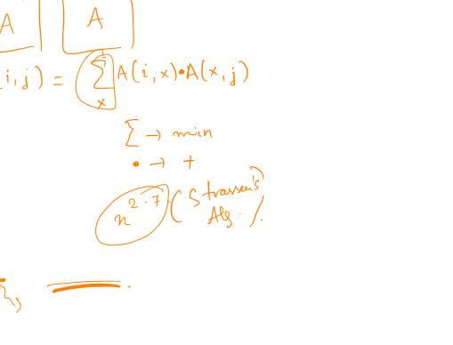
Comments
“Looks like” matrix multiplication
Not clear if “fast” algorithms can be used (not directly)
[Alon, Galil, Margalit] (early 90s), [Seidel 92] (simplified, for undirected)

Slide 10
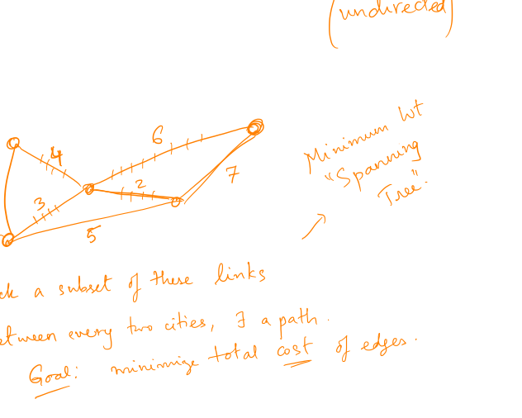
Communication backbones

Slide 11
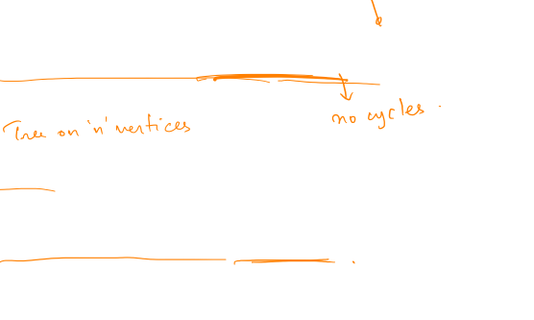
Trees
Defintion: A tree is a connected acyclic graph
Has n-1 edges
Every two vertices have precisely one path

Slide 12

Minimum spanning tree
Problem: Given a weighted undirected graph, find a connected subgraph with min total weight.

Slide 13
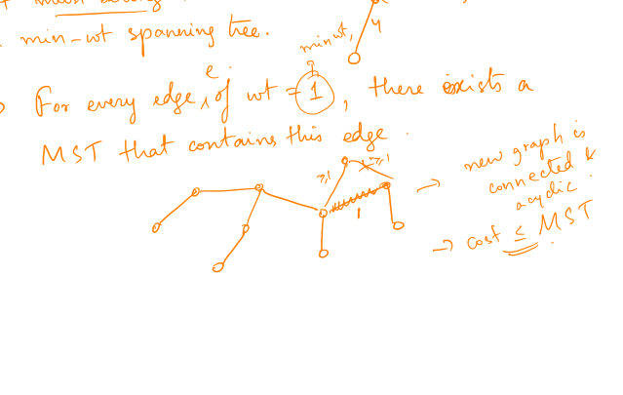
What edges to pick?

Slide 14
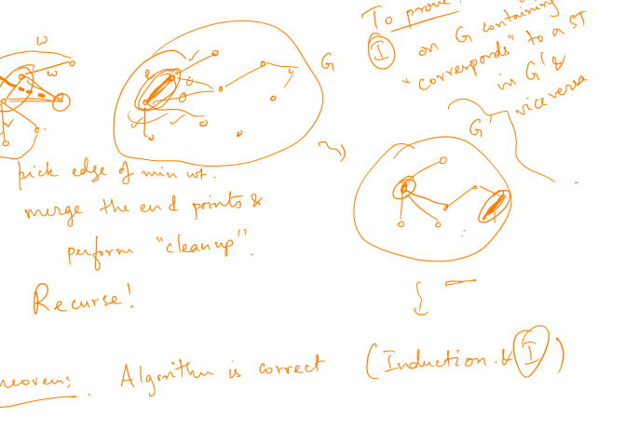
Kruskal’s algorithm

Slide 15
Correctness

Slide 16
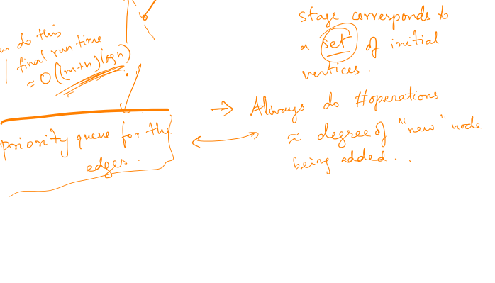
Implementing quickly

Slide 17
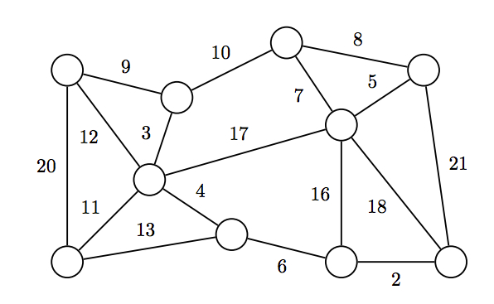

Simpler greedy (Prim)
Start with any vertex, add edges “greedily”

Slide 18
Correctness – “cut” property

Slide 19

Run time

Slide 20
Next class: “cuts” in graphs

