Slide 1
CS 6150 : Lecture 13 MST, Flows and Cuts

Slide 2
Announcements
HW1 grading questions:
Problem 1: Michael Matheny
Problems 2,3: Mohsen Abbasi
Problems 4,5: Waiming Tai
High level (ask me after class today)

Slide 3
Announcements
Scheduling of final
Friday, December 16, 2016 ---- 10:30 am – 12:30 pm ----
Homework 3 out (Friday after fall break – Oct 21)
sort out definitions questions early!

Slide 4

Last week
Shortest path
Undrected, directed graphs
Dijkstra’s algorithm (>=0 wts)
“Bellman-Ford” algorithm (no negative cycles)
Spanning tree problem
Kruskal’s algorithm – merge nodes recursively
“Prim’s algorithm”

Slide 5
Last week
Shortest path
Undrected, directed graphs
Dijkstra’s algorithm (>=0 wts) (priority queue)
“Bellman-Ford” algorithm (no negative cycles) (DP)
Spanning tree problem
Kruskal’s algorithm – merge nodes recursively
“Prim’s algorithm”

Slide 6
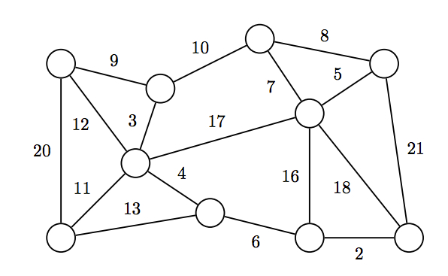
Minimum spanning tree
Problem: given a weighted, undirected graph, find a subset of edges of min total wt, connects all nodes.

Slide 7

Recap – Kruskal’s algorithm
Key Observation: let ‘e’ be an edge that has min wt. There exists a min spanning tree that contains ‘e’.
How to implement this in O(m+n)!?

Slide 8

Prim’s algorithm
“Easy” O((m+n)log n)!
Algorithm:
- start with any vertex and “grow” conn. comp.
- add the edge of least wt out of current set

Slide 9
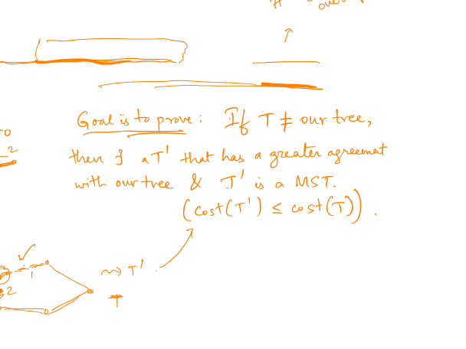
Correctness
Key: let T be a min spanning tree that “agrees the most” with our tree; consider first disagreement..

Slide 10

Correctness
Key: let T be a min spanning tree that “agrees the most” with our tree; consider first disagreement..

Slide 11
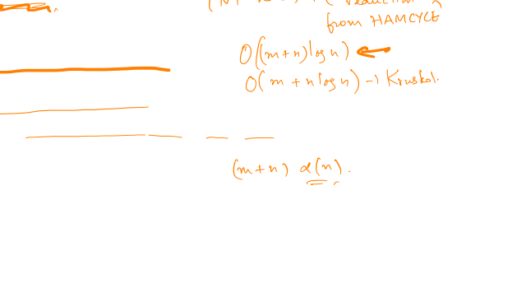
Comments – spanning trees
Directed Graphs
Quest for linear time algorithms
Randomized algorithm known
Not known if there exists a deterministic one!

Slide 12
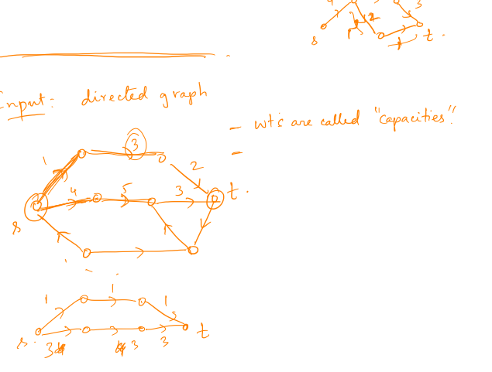
“Flows” in a network

Slide 13
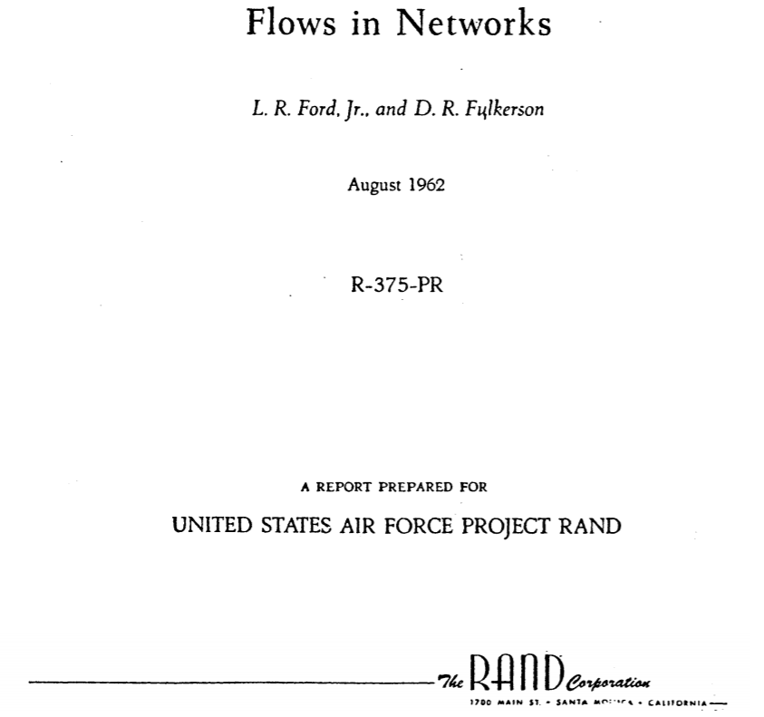

Slide 14

Maximum flow

Slide 15
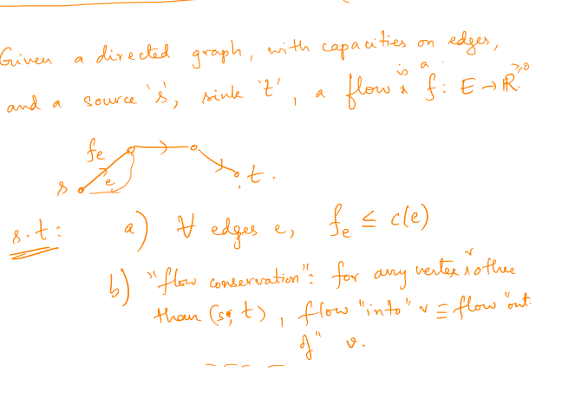
Formal definition: flow

Slide 16
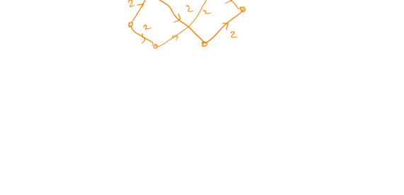
Greedy approach?
Algorithm: As long as there is a path of capacity > 0, “augment” flow

Slide 17
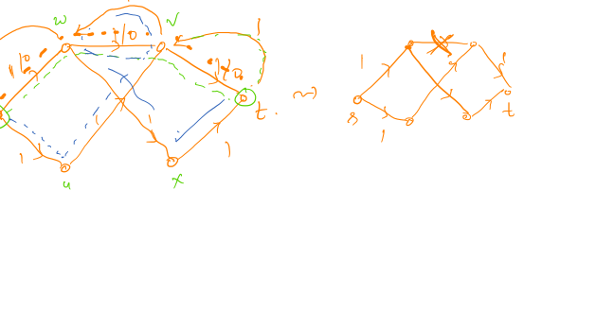
Greedy approach

Slide 18
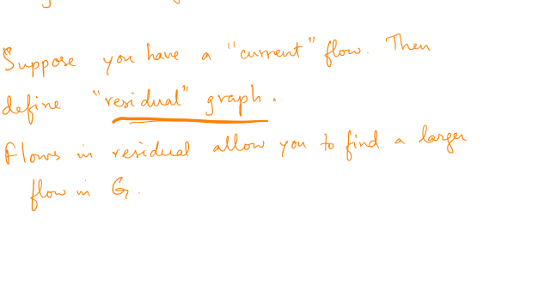
Can we “correct” for mistakes?

Slide 19
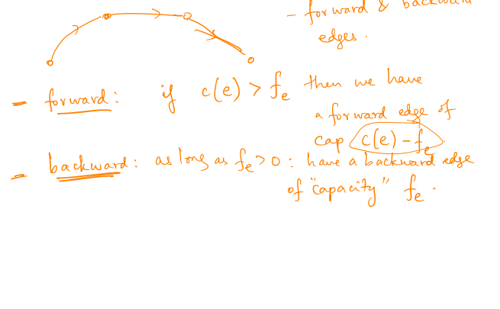
Residual graph

Slide 20
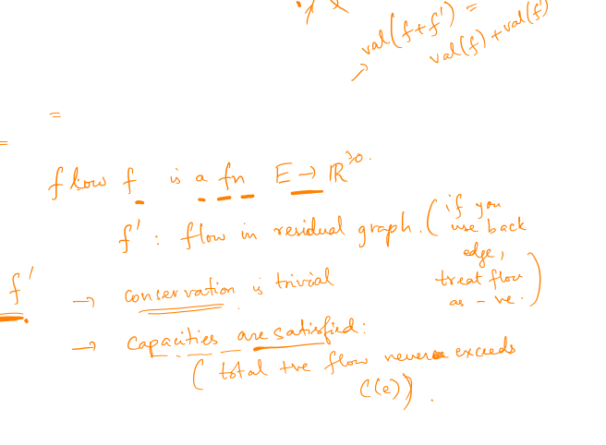
Residual graph
Claim: let G_{f} be the residual after flow f in G, and let f’ be a flow in G_{f}. Then f “+” f’ is a flow in G

Slide 21

Key observation
Claim: let f1, f2 be flows in G, and suppose val(f2) > val(f1). Then f2 “–” f1 is a valid flow in G_{f2}

Slide 22

Key observation
Claim: let f1, f2 be flows in G, and suppose val(f2) > val(f1). Then f2 “–” f1 is a valid flow in G_{f2}

Slide 23
Augmenting paths algorithm

Slide 24
Application: maximum matching

