Slide 1

CS 6150 : Lecture 14
Flows and Cuts
Mid semester Review

Slide 2

Announcements
Scheduling of final
  Friday, December 16, 2016
  ---- 10:30 am – 12:30 pm ----
Homework 3 due (Friday after fall break – Oct 21)

Slide 3

Last class
“Flows” in a graph/network
  directed graph with capacities on edges
  find “max” flow from source ‘s’ to sink ‘t’
  flow: a function f: E -> R_{>=0} that satisfies:
  (a) capacities and (b) flow conservation

Slide 4
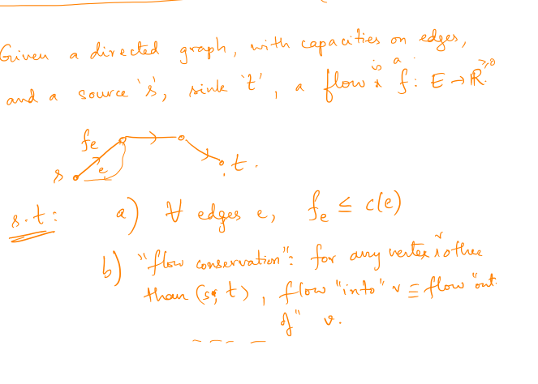
Formal definition: flow

Slide 5

Greedy gets stuck at non-opt
(all capacities = 1)
s
t

Slide 6

Key idea
[Ford, Fulkerson 1956]
Allow “correcting” for wrong choice
Maintain flow f at every step; define “residual” graph G_{f} for this flow
Property 1: for any flow f’ in G_{f}, (f + f’) is a valid flow in G, and it has value val(f) + val(f’)

Slide 7

Residual graph
Given G, valid s-t flow f, define G_{f} as graph with:
  “forward edges”: every e in G, if f(e) < c(e), new capacity of e is c(e) – f(e)
  “backward edges”: every e in G with f(e) > 0, add a back edge of capacity f(e)

Slide 8
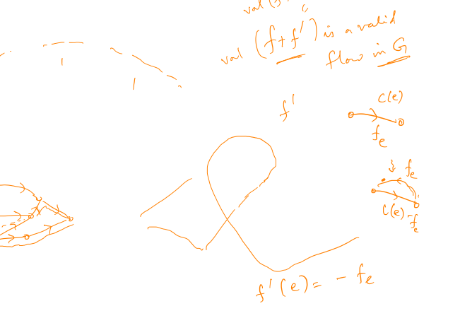
Residual graph
s
t
1
1
1
0
0
0
s
t
has an s-t flow of val = 1

Slide 9

Ford-Fulkerson algorithm
Property 1: for any flow f’ in G_{f}, (f + f’) is a valid flow in G, and it has value val(f) + val(f’)
Algorithm:
  start with f = 0
  while (there exists > 0 flow f’ in G_{f}), set f = f + f’
there is > 0 flow iff there is a > 0 path
“augmenting path”

Slide 10
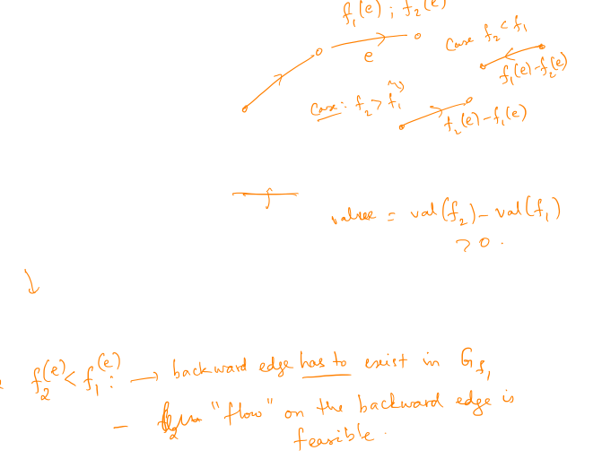
Correctness
Property 2: let f1, f2 be flows in G, and suppose val(f2) > val(f1). Then f2 “–” f1 is a valid flow in G_{f1}
Implication: unless f is the maximum flow, there is always an augmenting path in G_{f} !

Slide 11
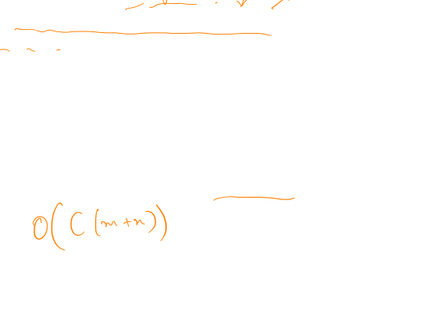
Running time
Algorithm:
  start with f = 0
  while (there exists augmenting path f’ in G_{f})
  set f = f + f’
Note: value of flow monotonically increases; how long is each iteration?
Suppose all capacities are integers, max flow = C..

Slide 12
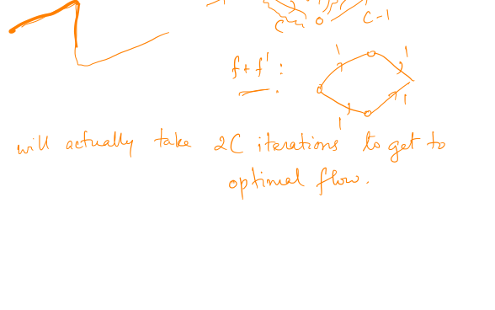
Could it really take so long?
“crisscross” example
C
C
s
1
t
C
C

Slide 13

“Strongly” poly time algorithms
C
C
Want: running time poly in the input size!
s
1
t
C
C
Two algorithms:
  pick augmenting path that leads to most flow
  pick augmenting path with fewest edges!

Slide 14
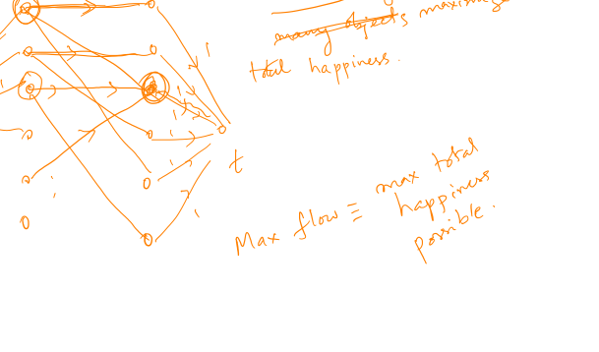
Application: maximum matching

Slide 15
Reduction to flow

Slide 16
Final project info

Slide 17
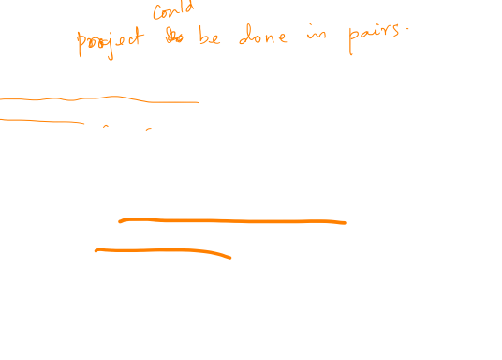
Final project info
Note: list of papers out!
Hints:
  can use other resources online (lecture notes, etc)
  discuss with partner – supposed to produce one report per group
Other projects: talk to instructor BEFORE Friday Oct 21, get permission

Slide 18
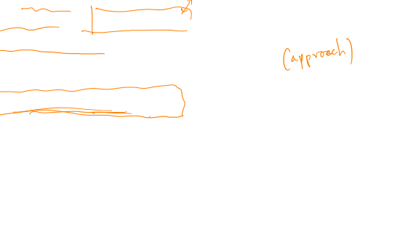
Report details
Two pages long
Should contain:
  Problem statement
  Background / importance / previous results (short summ)
  Why difficult? -- (tricky step)
  Main result (statement)
  Outline of algorithm (main steps, assuming subroutines)
  Outline of proof – “structure”

Slide 19

Outline of proof
Rough idea: intuitive
Main lemmas (restate)
Why they imply main result
Key: should be “self-sufficient” -- modulo proof details

