Slide 1

CS 6150 : Lecture 15 Flows and Cuts

Slide 2
Announcements
Homework 3 due (this Friday)
Project topic/partnering: this Friday (see assignments page)

Slide 3
Last few lectures
“Flows” in a graph/network
directed graph with capacities on edges
find “max” flow from source ‘s’ to sink ‘t’
flow: a function f: E -> R_{>=0} that satisfies:
(a) capacities and (b) flow conservation

Slide 4

Ford-Fulkerson algorithm
Algorithm:
start with f = 0
while (there exists augmenting path f’ in G_{f})
set f = f + f’
Run time: value of flow monotonically increases. So, if all capacities are integers, max flow = C, run time is O(C(m+n))

Slide 5
Residual graph
Given G, valid s-t flow f, define G_{f} as graph with:
“forward edges”: every e in G, if f(e) < c(e), new capacity of e is c(e) – f(e)
“backward edges”: every e in G with f(e) > 0, add a back edge of capacity f(e)

Slide 6
Residual graph
s
t
1
1
1
0
0
0
s
t
has an s-t flow of val = 1

Slide 7
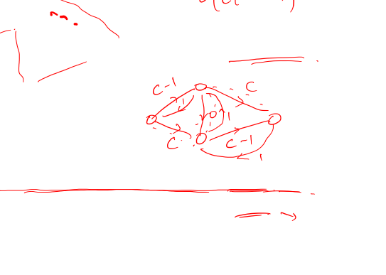
Poly time algorithms
C
C
Want: running time poly in the input size!
s
1
t
C
C
Two algorithms:
pick augmenting path that leads to most flow
pick augmenting path with fewest edges!

Slide 8
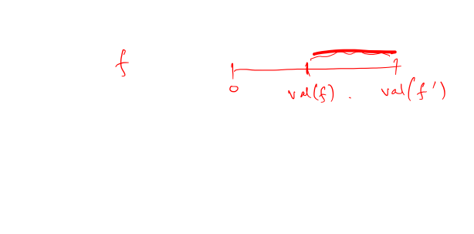
Recall proof of correctness
Lemma: Let f be current flow, and f’ be max flow. Then G_{f} has a flow of value val(f’) – val(f).
Claim: There is an augmenting path with all edges of capacity >= [val(f’) – val(f)]/2|E|.

Slide 9
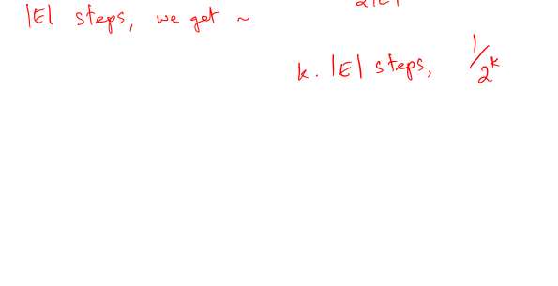
Why does this suffice?
Claim: There is an augmenting path with all edges of capacity >= [val(f’) – val(f)]/2|E|.

Slide 10
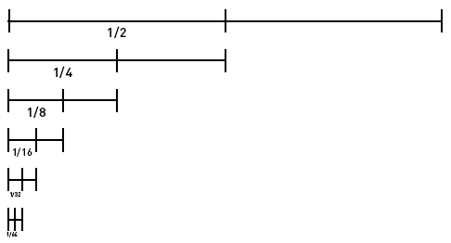
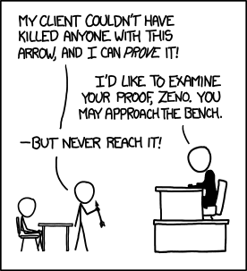
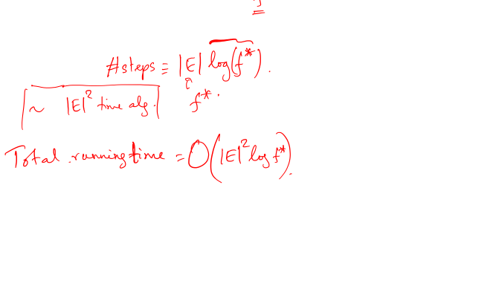
Why does this suffice?
Claim: There is an augmenting path with all edges of capacity >= [val(f’) – val(f)]/2|E|.

Slide 11
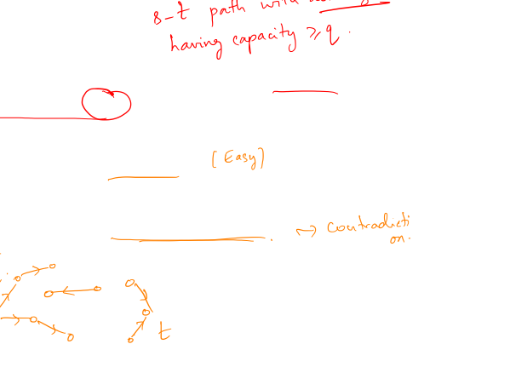
Proof of claim
Let q = [val(f’) – val(f)]/2|E|, and say we remove all edges in G_{f} of capacity < q
Say we had an s-t path. Then done!
Could it be, that we do not have an s-t path?

Slide 12
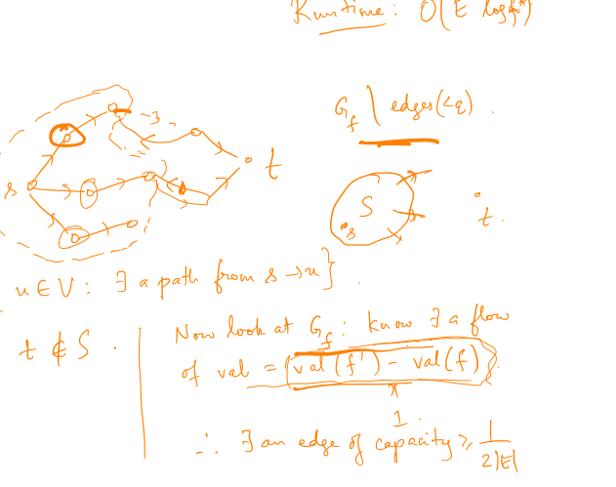
Proof of claim

Slide 13
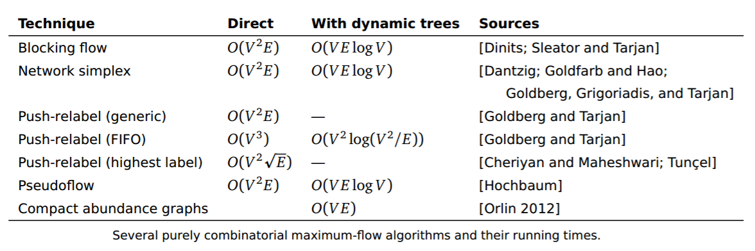

Max flow algorithms
Very different tools [Madry]: There is an algorithm with running time |E|^{10/7}! (better for sparse graphs)*

Slide 14

Alternate view of optimality
Earlier: Let f be current flow, and f’ be max flow. Then G_{f} has a flow of value val(f’) – val(f).
Corollary: for an optimum flow f, G_{f} has no augmenting path

Slide 15
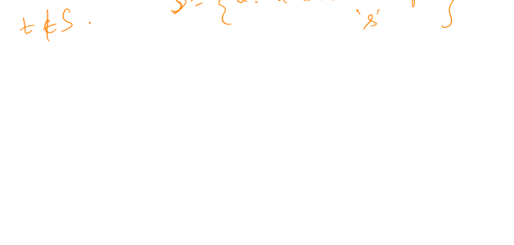
Closer look at optimality
For an optimum flow f, G_{f} has no augmenting path

Slide 16
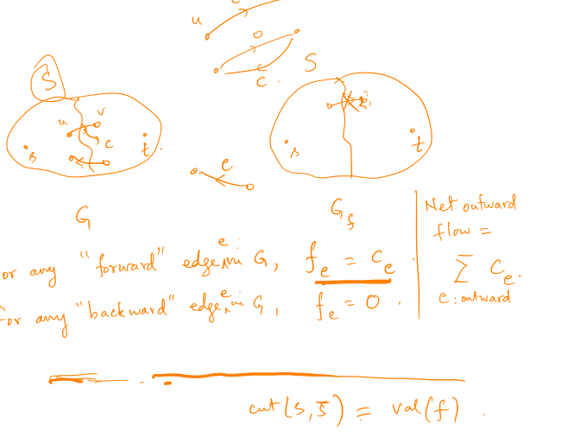
G and G_{f}
Claim: val(f) == total wt of outgoing edges out of S!

Slide 17
Proof

Slide 18
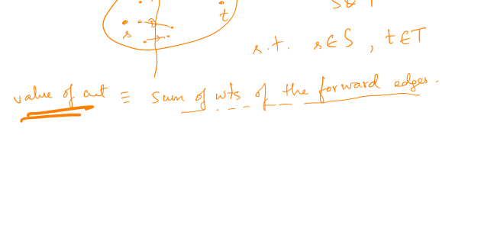
“Cuts” in a graph

Slide 19
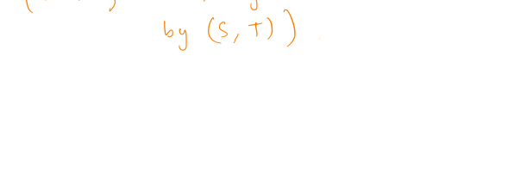
The min-cut problem

Slide 20
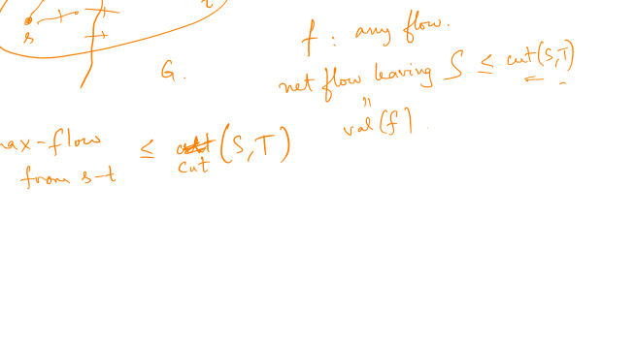
Connection – cuts and flows
Observation: Let (S, T) be any cut between s, t. There cannot be an s-t flow of val > cut(S, T).

Slide 21

Earlier proof…
We proved: If f is the max flow, there is an s-t cut in G of size = f!

Slide 22
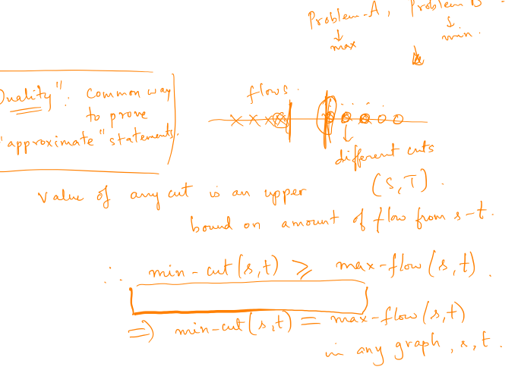
Cuts and flows
Max-flow = Min-cut
(part of a more general phenomenon, “duality”)

Slide 23
Next class: randomness
Can tossing coins help in designing faster algorithms?
How to formalize?

