Slide 1

CS 6150 : Lecture 16 Randomized algorithms

Slide 2
Last class
Max Flow Min Cut theorem
(first taste of “duality”)

Slide 3

Algorithms so far
Given input, output is “determined” (deterministic algorithms)
Question: can making random choices help in algorithm design?

Slide 4
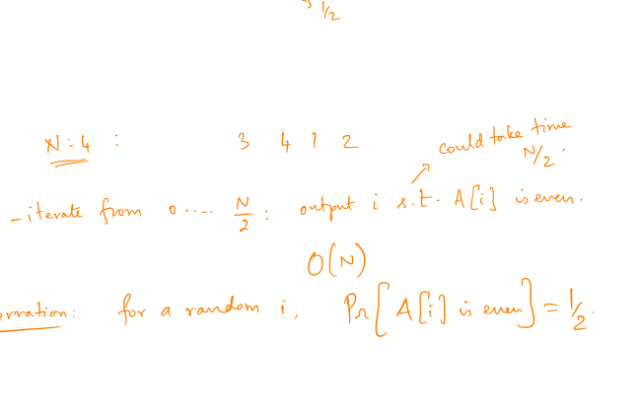
Toy example
Question: Given an array A[0, …, N-1], in which the numbers 1…N are written in some unknown order, find one index i for which A[i] is even.

Slide 5
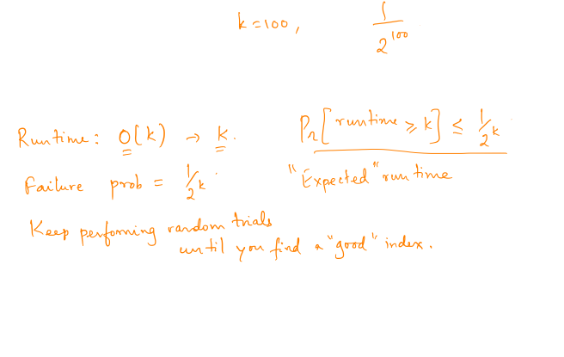
Toy example – random strategy
Claim: probability that all k “trials” fail is at most 1/2^{k}
Qn: what is the “expected” running time?

Slide 6

Analyzing randomized algs
Key technical point: input is “given” before algorithm starts executing

Slide 7

Philosophical questions
Where do random numbers come from?
Do we need randomness in algorithms?
Is it OK for an algorithm to give out diff outputs in diff runs?
What success probability is “good enough”? Is it ever satisfactory?

Slide 8

Analyzing randomized algs
Deterministic
Prove correctness
Bound running time
Probabilistic
Correct “with high probability”
“Expected” running time (can be stronger: run time small w.h.p.)

Slide 9

Early example
Primality test: given an N digit number, check if it is prime
20988936657440586486151264256610222593863921
Problem: can we find a poly(N) time algorithm to test primality?
(Note: we can add, multiply, gcd, … N digit #’s)

Slide 10
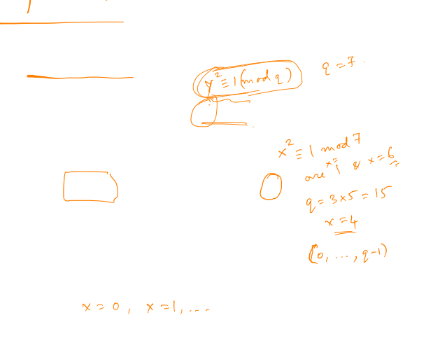
Miller-Rabin test
Input: odd integer ‘q’ (N digits)
Idea: “nontrivial” solutions to x² == 1 (mod q) is equivalent to ‘q’ being composite
“Fermat test” FT(x) – works by raising ‘x’ to some power, trying if we can find such square root
Key: if ‘q’ is prime, FT(x) fails for all x. If ‘q’ is composite, it succeeds for (1/2) the x’s in [0, q-1]

Slide 11

Miller-Rabin test -- guarantee
Input: odd integer ‘q’ (N digits)
Algorithm: perform FT(x) for k random x’s
[ run time = O(k poly(N)) ]
Claim 1: if q is prime, always answers PRIME
Claim 2: if q is composite, answers COMPOSITE w.p. at least 1- 2^{-k} (think k = 100)

Slide 12
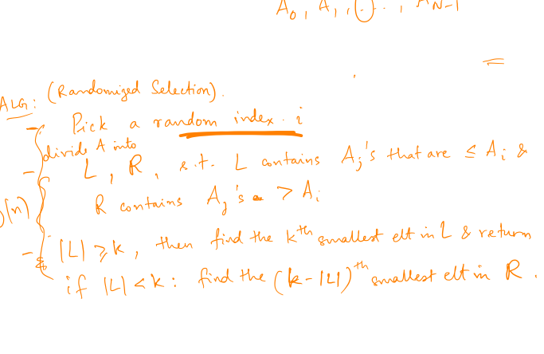
Median finding
k-Selection: given an array A[0,…, N-1], find the k’th smallest element

Slide 13
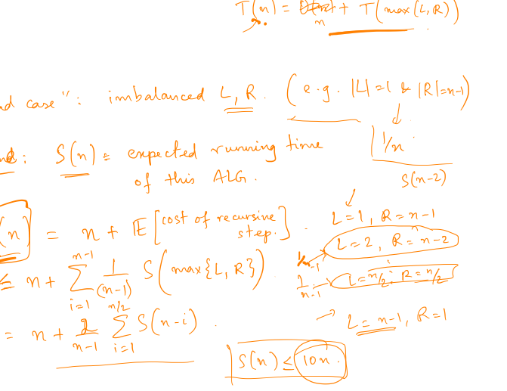
Median – analysis (probabilistic recurrences)

Slide 14

Expected good => good?
Have proved: expected run time = O(n). Could it be that run time is “usually” bad?

Slide 15
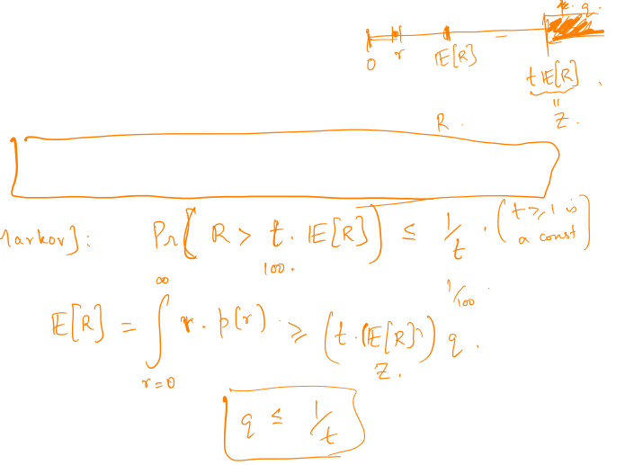
Markov’s inequality
Informal: A non-negative random variable is unlikely to be “much larger” than its expectation

Slide 16
Differences
Median finding: always correct, run time depends on random bits (“Las Vegas”)
Primality test: run time = k * poly(N), can return wrong answer with prob 1- 2^{-k} (“Monte Carlo”)

Slide 17

Related example
Quick sort: given an array A[0,…, N-1], pick random “pivot”, and sort recursively

