Slide 1
CS 6150 : Lecture 17 Randomized algorithms

Slide 2

Announcements
Project proposal!
HW4 due next Friday

Slide 3

Randomized algorithms
Question: can “randomness” be used in designing efficient algorithms?
“Meta” case: have search problem, but know there are “many” good choices in the space
Examples: finding odd number in array, number that passes FermatTest, finding “good split”, …

Slide 4

“Typical” uses
Sampling – estimation problems (what will be the result of an election?)
“Hashing”: have 100 strings of length 200 each. Can we create “short” hashes so that strings are still distinct? (MD4, … )
Make choices so everyone is “treated equally” (w.h.p.) (e.g.: load balancing, randomized rounding, …)

Slide 5
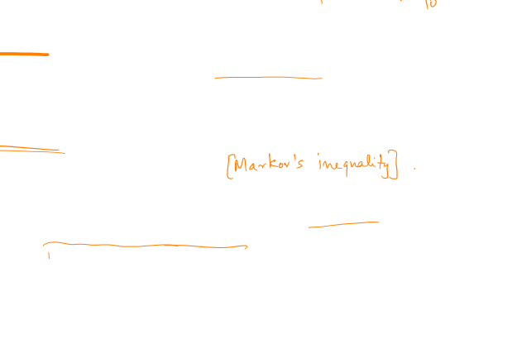
Analyzing randomized algs
Deterministic
Prove correctness
Bound running time
Probabilistic
Correct “with high probability” (Monte Carlo)
“Expected” running time (can be stronger: run time small w.h.p.)
Key assumption: random choices of algorithm NOT KNOWN to designer of input

Slide 6

Today’s goals
Hashing randomly – how to analyze properties
Random assignment – load balancing?
“Linearity of expectation”, “Concentration bounds”, …

Slide 7

Random hashing
Problem: have a collection of unknown “strings”; want to map them to significantly shorter strings, so that mapping is “roughly” one-one
e.g., test membership with low memory
(how to construct hash fn is a different problem!)

Slide 8
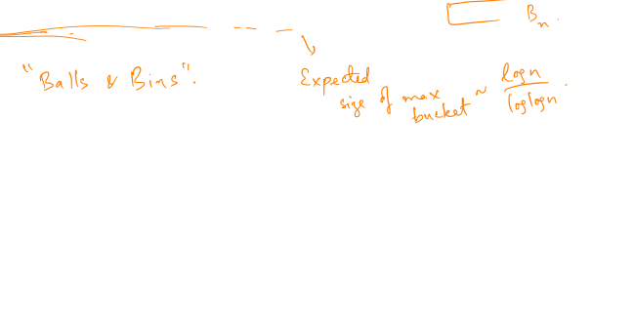
Random hashing – simple setting
Problem: collection of ‘n’ integers in the range [1,…, N]; say we build a hash table with n “buckets”
Questions:
- expected size of each bucket
is there a “collision”?
what is the size of the largest bucket?

Slide 9
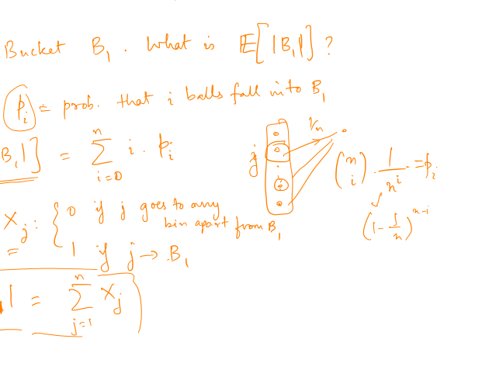
Expected size

Slide 10
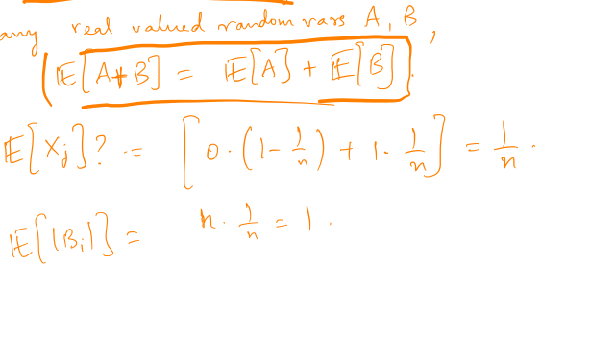
Linearity of expectation

Slide 11
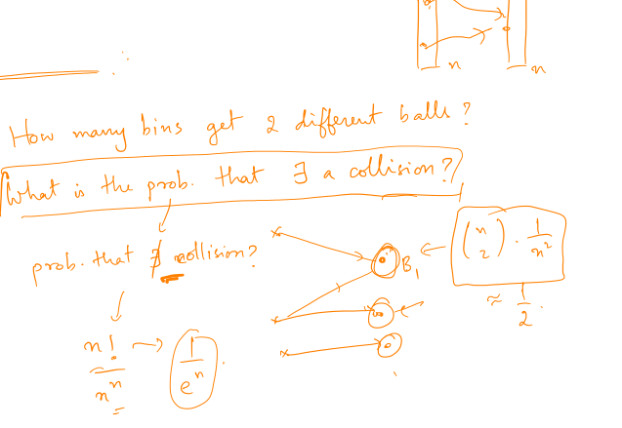
Collisions

Slide 12
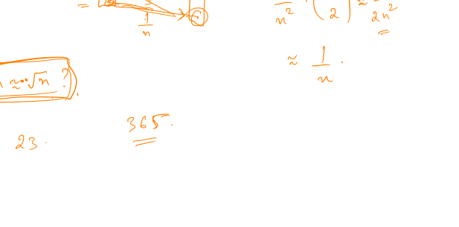
Birthday “paradox”

Slide 13
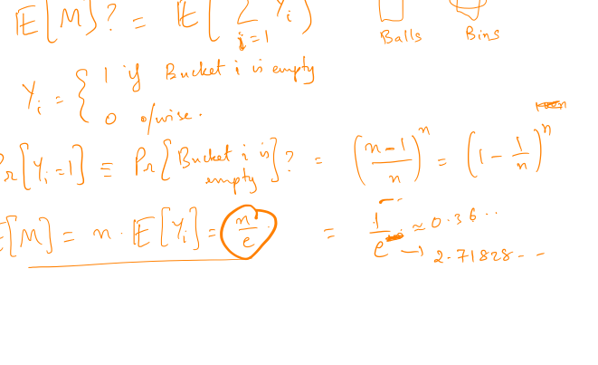
Number of empty buckets

Slide 14
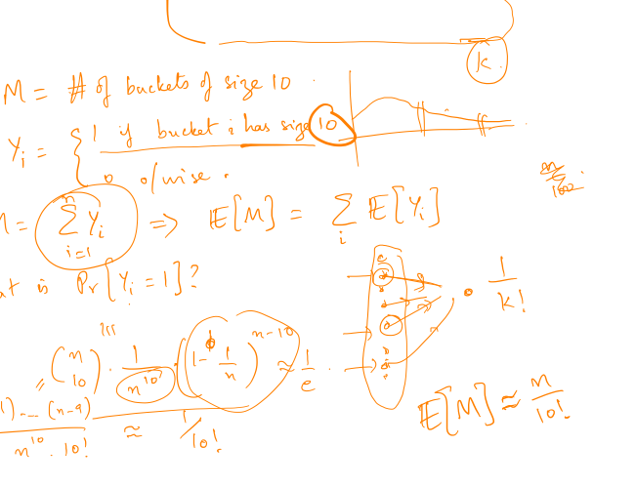
Number of buckets of size 10

Slide 15
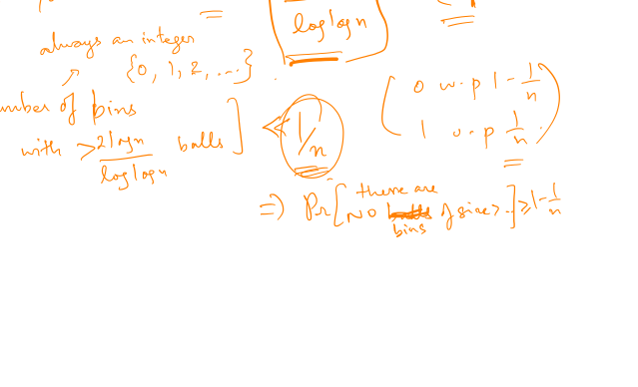
Number of buckets of size k

Slide 16

Max bucket size?

Slide 17
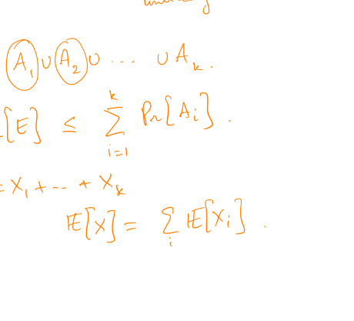
Union bound

Slide 18
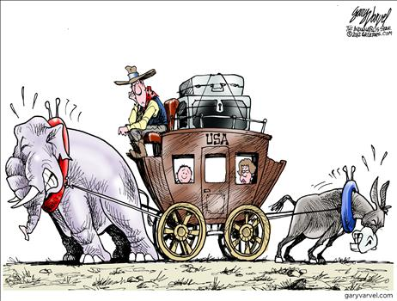
How good is sampling?
General question: have a random variable X (e.g., coin toss); how much does it deviate from expectation ?

Slide 19
Variance
Question: what is the “typical” deviation?

