Slide 1
CS 6150 : Lecture 18 Sampling and Estimation

Slide 2

Last lecture – random hashes
“Hashing”: have m balls, which we randomly assign to n bins..
Birthday paradox: even if m ~ sqrt(n), there will be “collisions”
If m = n, expected size of each bin = 1, but:
there are ~ n/e “empty” bins
there are ~ n/k! bins with k elements
max bin size is ~ (log n)/log log n

Slide 3
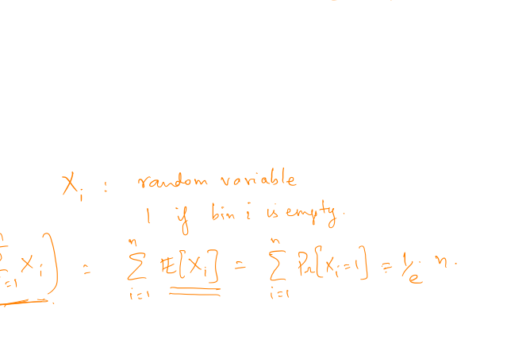
General argument
Compute probability that one bin has certain load
Use linearity of expectation to find expected # of bins of that load

Slide 4
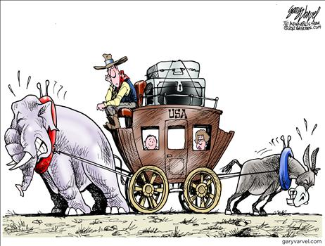
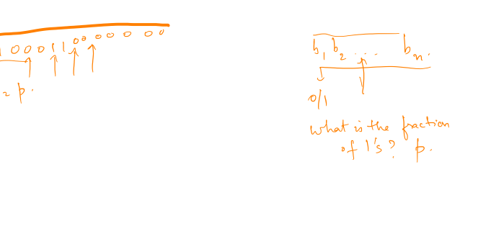
How good is sampling?
General question: have a random variable X (e.g., coin toss); how much does it deviate from expectation ?

Slide 5
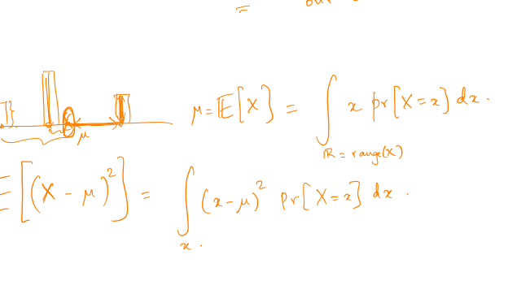
Variance
Question: what is the “typical” deviation?

Slide 6
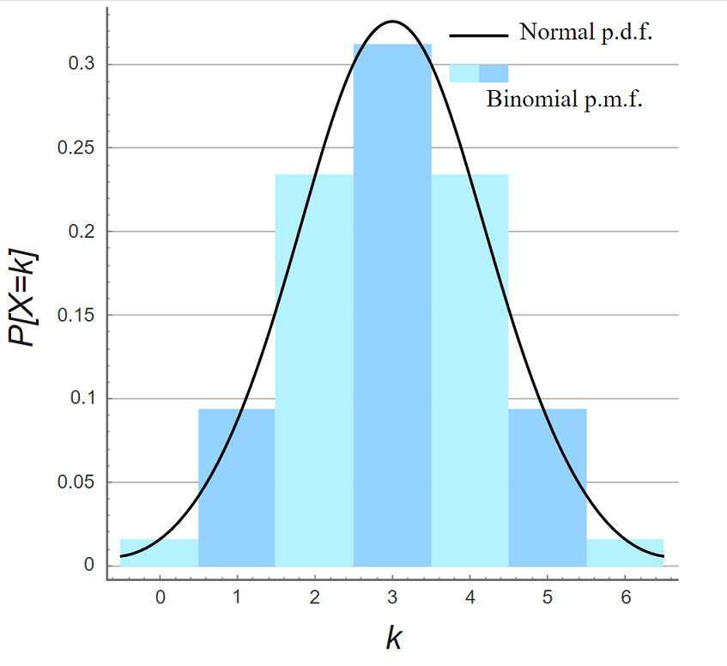

Coin tosses (Binomial distrib.)

Slide 7
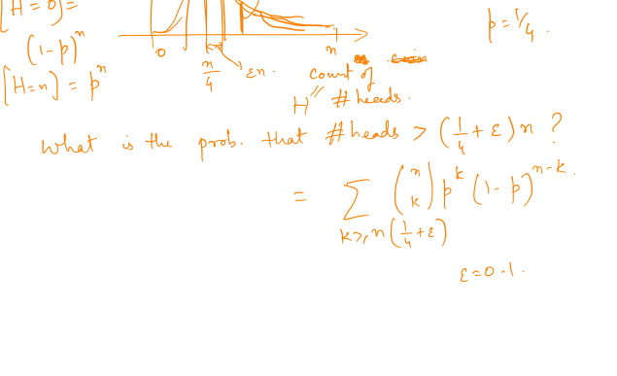
Coin tosses (Binomial distrib.)

Slide 8
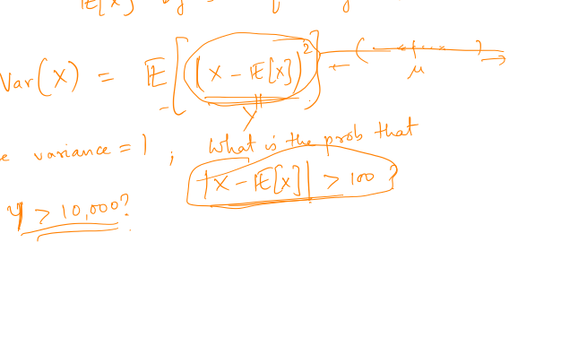
Large deviations

Slide 9
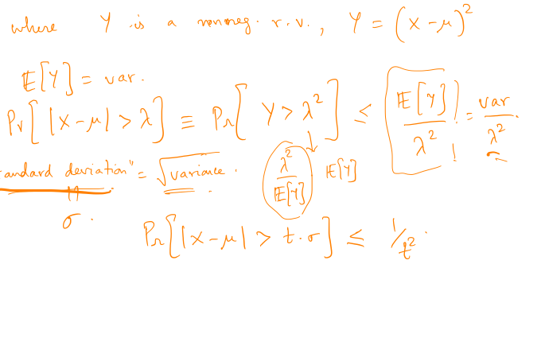
Large deviation -- Chebyshev

Slide 10
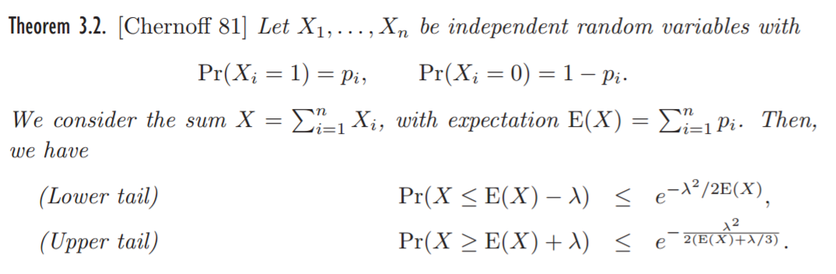
Chernoff bound (Bernoulli ver.)

Slide 11
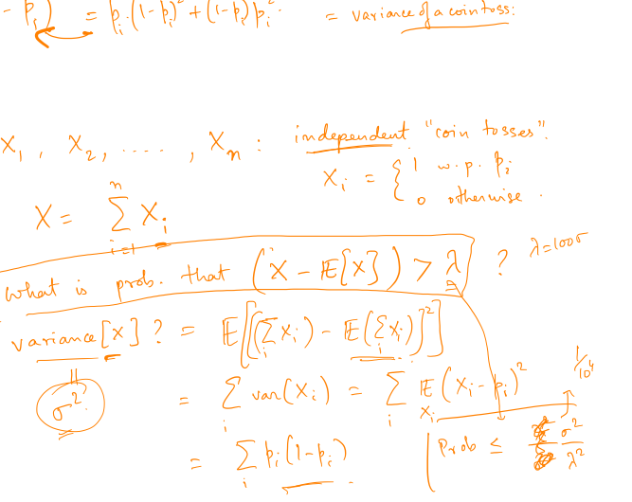
Chernoff bound (Bernoulli ver.)

Slide 12
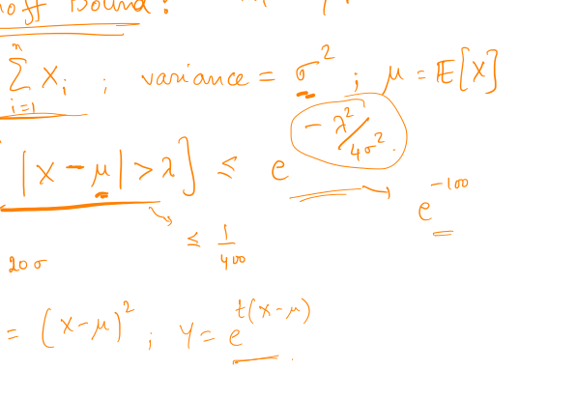

Slide 13
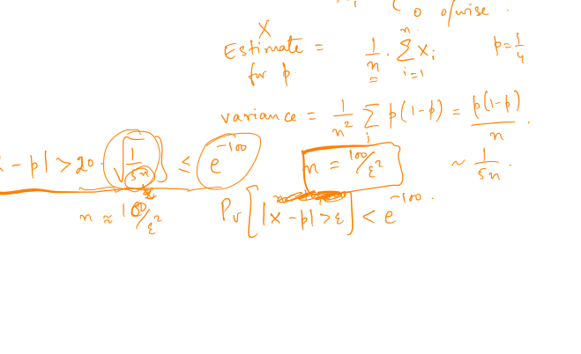
Confidence bounds in elections

Slide 14
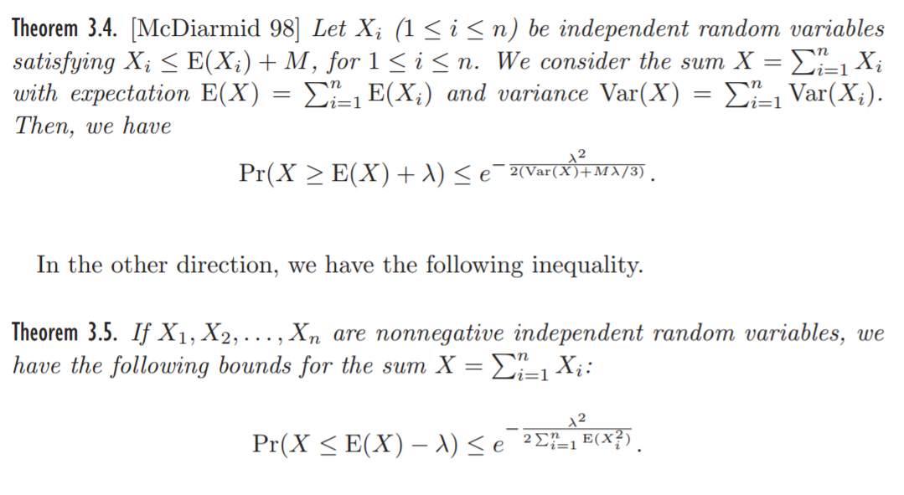
Chernoff bound (general)

Slide 15
Chernoff bound (general)

Slide 16
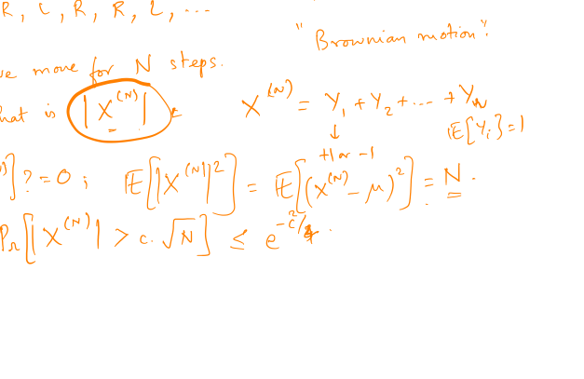
An application – line walk

Slide 17
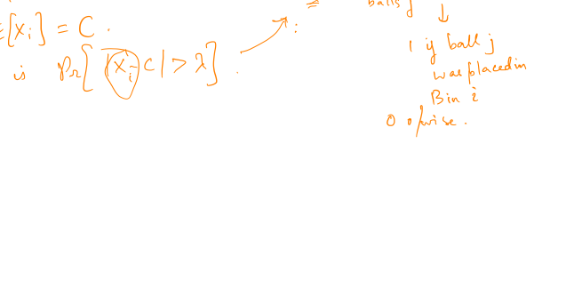
Another application
Balls and bins: have m balls, which we randomly assign to n bins.. m = C * n

Slide 18

A non-application
Balls and bins: have n balls, which we randomly assign to n bins.. Probability that (n/2) bins are empty?

Slide 19
Distinct elements problem
Problem: given an array A[] of size ‘n’, find the number of “distinct elements” it has.. (all elts in range 1 … n)

Slide 20
Distinct elements – easy case
Assume: A[] has ‘k’ distinct elements, all occurring roughly equally often

Slide 21
Distinct elements – easy case

Slide 22
Distinct elements in a “stream”
What if: you see the entire array, but you make precisely “one pass”

Slide 23
Distinct elements in a “stream”
What if: you see the entire array, but you make precisely “one pass”

Slide 24
Distinct elements in a “stream”

Slide 25

Bob Sedgewick Lecture!
Lecture: MOOCs – Monday Distinguished Lecture series (10AM)
Theory talk: 2 PM, Graphics Annex (next to data lab)

