Slide 1
CS 6150, Lecture #2 Divide & Conquer
Aditya Bhaskara
University of Utah

Slide 2
Agenda
Divide & Conquer – idea and examples
Analyzing run times – recursion
Homeworks and technicalities
Project

Slide 3
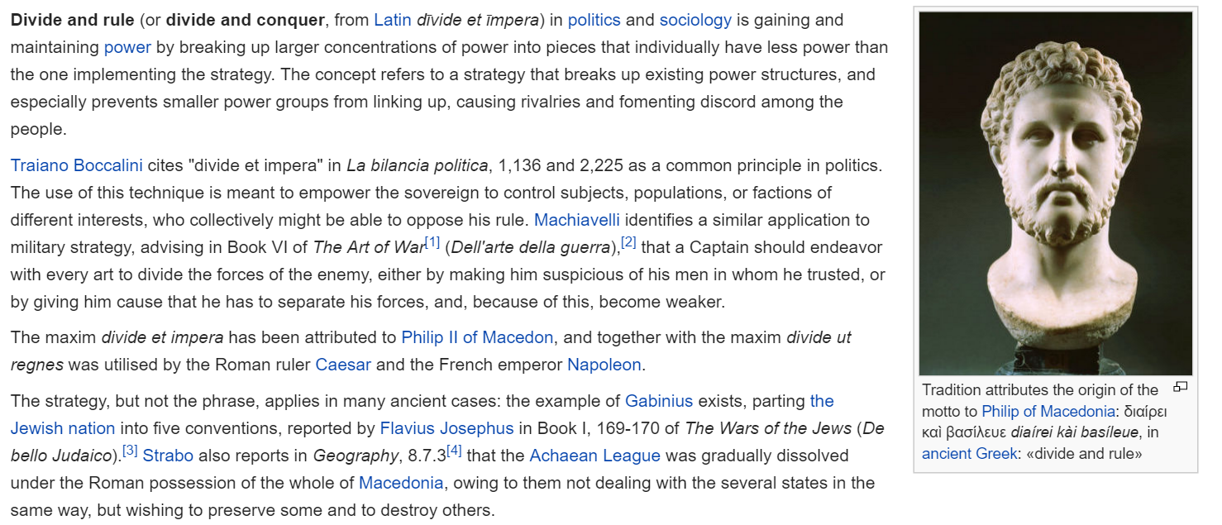
Julius Caesar
Machiavelli
Napoleon

Slide 4
problem
part1
part2
part3
soln1
soln2
soln3
Full solution

Slide 5
Steps
Illustrate how we argue
How to divide?
How to solve subproblem?
How to “conquer”?
Analyze running time

Slide 6
When and why?
Sub-problems “simpler” – easier to solve
Combining shouldn’t be too difficult
(easier to combine than solve from scratch!)

Slide 7
Three examples
Clearly divide-and-conquer
Plausible
What? Divide and conquer?

Slide 8
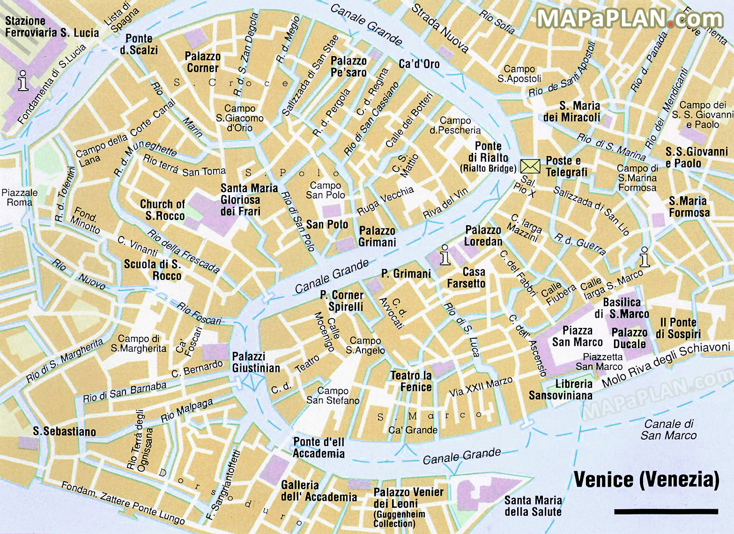

Slide 9
Merge sort
INPUT: array A[1…n] of n numbers
OUTPUT: array B[1…n], sorted form of A

Slide 10
Merge sort

Slide 11
Merging

Slide 12
Formal analysis – 3 sacred steps
1. State algorithm formally
2. Prove it works correctly
3. Analyze complexity (running time/space/etc)

Slide 13
The algorithm

Slide 14
Correctness proof

Slide 15
Proofs by induction
Prove some statement for all integers n>=1
e.g.: 1 + 2 + … + n = n(n+1)/2
e.g.: mergesort(A[1…n]) works correctly
BASE CASE: works for n = 1 (or up to some n)
IND STEP: prove for n, assuming truth for 1, … , n-1

Slide 16
Theorem: Procedure sort(A[1 … n]) returns an array that is sorted.
Proof: Induction.

Slide 17
Lemma: Whenever C, D are sorted, procedure merge(C, D), returns an array that is sorted.
Proof: examine the process..

Slide 18
Time complexity?
Key idea: do this also recursively..

Slide 19
Alternate dividing

Slide 20
Alternate dividing
“Merging” trivial
Any issues?

Slide 21
Multiplying n digit integers
Elementary school algorithm

Slide 22
Multiplying n digit integers
What’s the running time?

Slide 23
Can we do better?
“Forced” divide and conquer

Slide 24
Can we do better?
“Forced” divide and conquer

Slide 25
Algorithm

Slide 26
Running time?

Slide 27
Logistics
Homework 0: “Open grading” volunteers?
Project: read one of given list of papers, write 2 pg summary, or produce implementation (*)
(examples to be provided)

