Slide 1
CS 6150 : Lecture 20 Optimization

Slide 2
Announcements
Homework 4: due tomorrow!
Michael Matheny office hrs:
moved to tomorrow (Friday) 9-11AM (just this week)

Slide 3

Last couple of weeks
Randomization and how it (possibly) leads to algs
simpler (min cut, quick sort, ..)
faster in expectation
unexpected (streaming, primality testing)
Analysis challenges
expected run times, failure probability
linearity of expectation
“concentration” bounds – Markov’s ineq, Chernoff

Slide 4

Next:
Main course aim: how to approach a new problem?
recursive formulation
break up into smaller problems
cast as “flow”/matching problem
try showing it’s NP hard?
Powerful: cast as an optimization problem

Slide 5
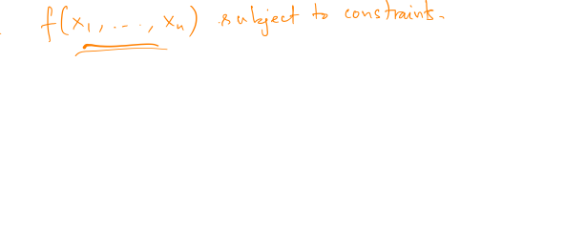
What is optimization?
Variables, constraints, “objective function”

Slide 6
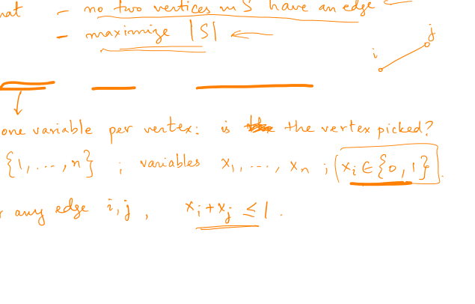
Example: max independent set
Variables, constraints, objective function

Slide 7
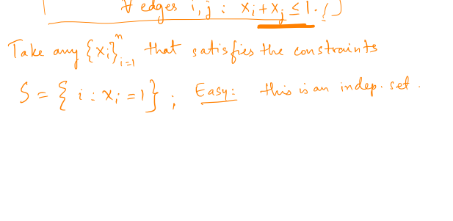
Example: max independent set

Slide 8
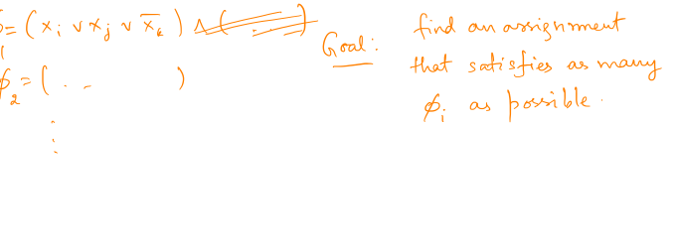
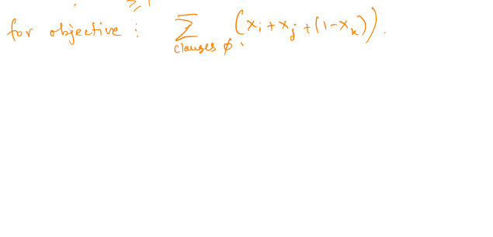
Example: max 3-SAT

Slide 9
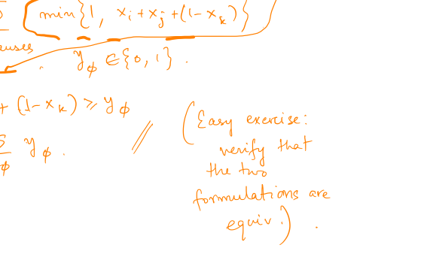

Slide 10
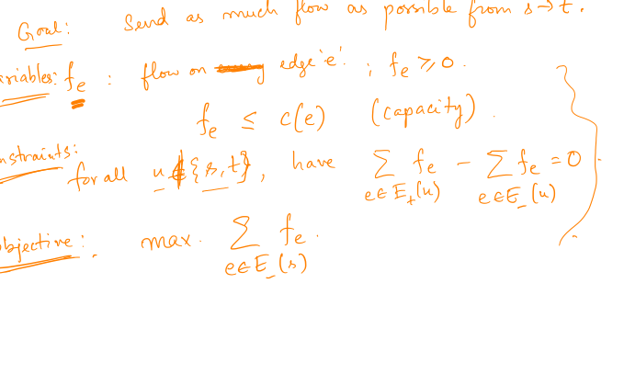
Example: max flow

Slide 11
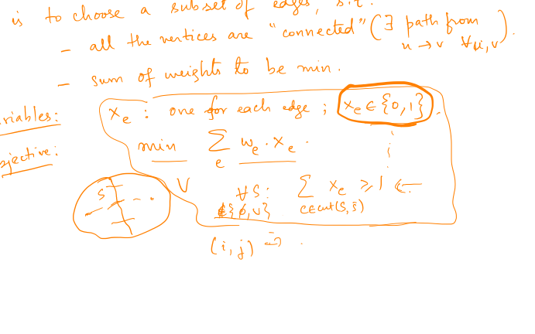
Example: minimum spanning tree

Slide 12
Example: minimum spanning tree

Slide 13
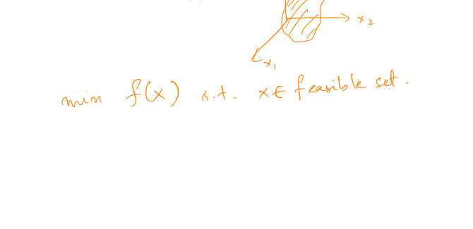
What is optimization?
Variables, constraints, “objective function”
min f(x) subject to
g₁(x) >= 0
g₂(x) >= 0
…
“Geometric” viewpoint

Slide 14
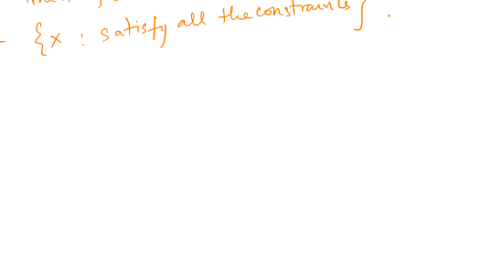
Efficient solutions?
Question: what kinds of optimization problems can be solved “efficiently”? (poly time)
convex (objective convex, feasible set convex)

Slide 15
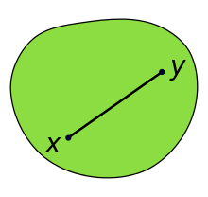
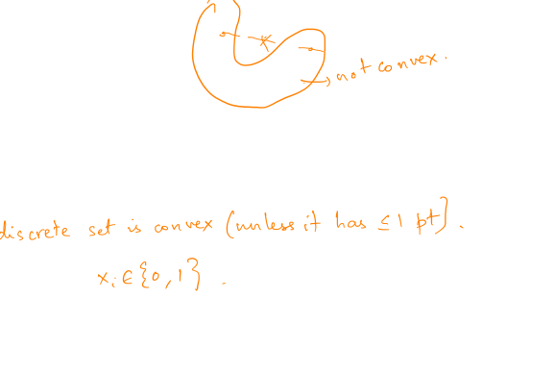
Convex set
For any x, y in S, the entire line segment joining x-y is in S

Slide 16
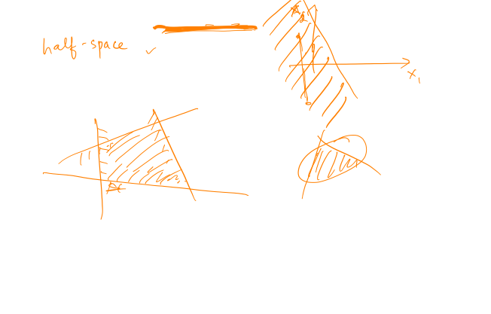
Convex set -- examples
x₁² + x₂² + … + x_{n}² <= 1
Linear constraints 2x₁ + 3x₂ <= 2
Intersection of convex sets

Slide 17
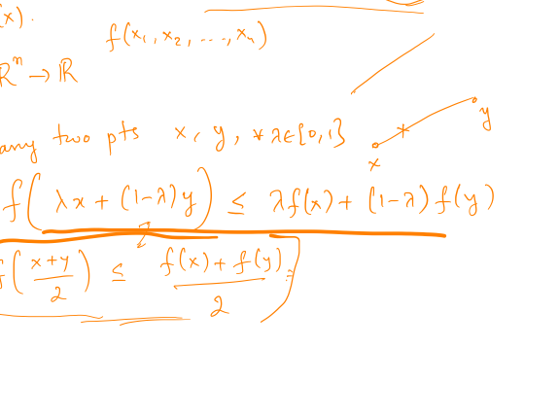
Convex function

Slide 18
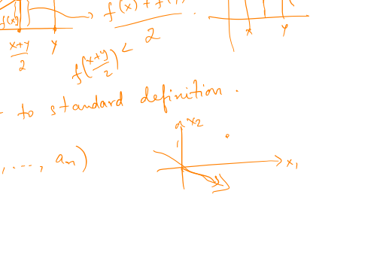
Convex function

Slide 19
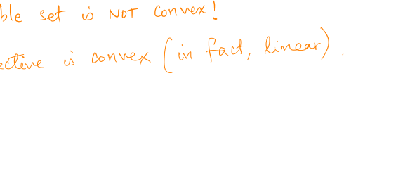
Back to eg: max independent set

Slide 20
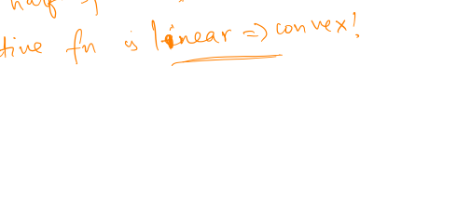
Back to eg: max flow

Slide 21

Linear obj, linear constraints

