Slide 1
CS 6150 : Lecture 21 Linear Programming

Slide 2

Announcements
Homework 5 out (randomized algorithms) [6 total]
Get started on projects!

Slide 3


Slide 4

Optimization view of problems
Way to approach a new problem
define appropriate variables
maximize/minimize an “objective function”
subject to some constraints
Examples
max independent set (needed “integrality” constraints)
maximum flow (linear constraints)
minimum spanning tree (was tricky to write!)

Slide 5

What is optimization?
Variables, constraints, “objective function”
x = (x₁, x₂, …., x_{n})
min f(x) subject to
g₁(x) >= 0
g₂(x) >= 0
…
“Geometric” viewpoint

Slide 6
Efficient solutions?
Question: what kinds of optimization problems can be solved “efficiently”? (poly time)
convex opt -- minimize convex objective function over a convex feasible set

Slide 7
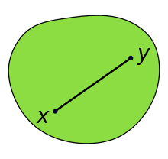

Convex set
For any x, y in S, the entire line segment joining x-y is in S

Slide 8
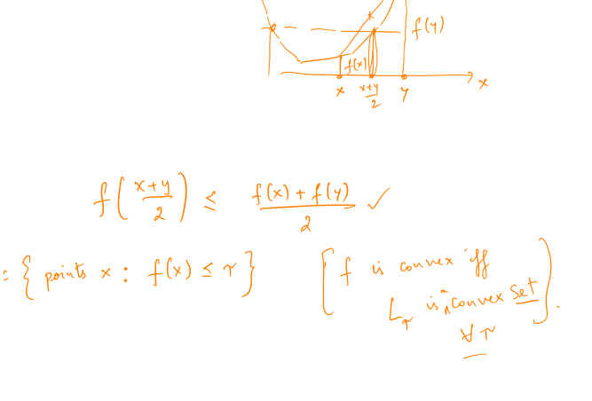
Convex function
Convex function on “domain” S: for any x, y in S,
f((1-λ)x + λy) ≤ (1- λ) f(x) + λ f(y)

Slide 9
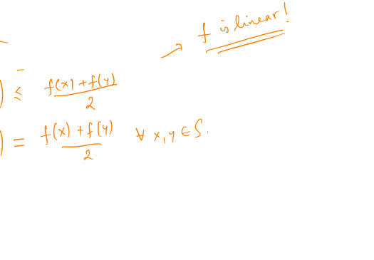
Convex optimization
Goal: minimize f(x) over a feasible set S
[“typically” easy]
not “maximize”!
when are f and “-f” both convex?

Slide 10
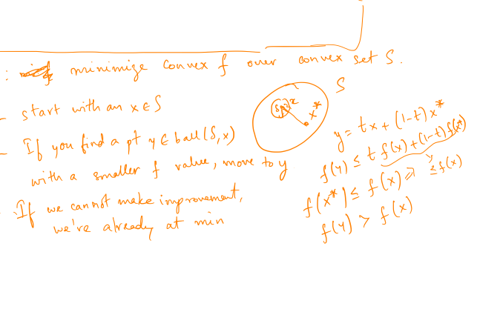
“Generic” alg – local search!
Key observation: any local optimum is a global optimum!

Slide 11

Gradient descent
Algorithm:
start with any point x in S
if grad(f) at x is zero, stop
update x = x – c. grad(f), for small ‘c’

Slide 12
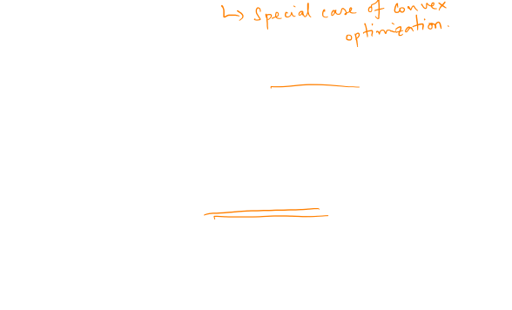
Linear programming
Optimization with a linear objective, and linear contraints.
Earliest version to be studied – Dantzig (1950’s)
Operations research
Big question of 50s-70s: can LP be solved in time polynomial in input? (Yes! Khachiyan ’79 “sputnik”)

Slide 13
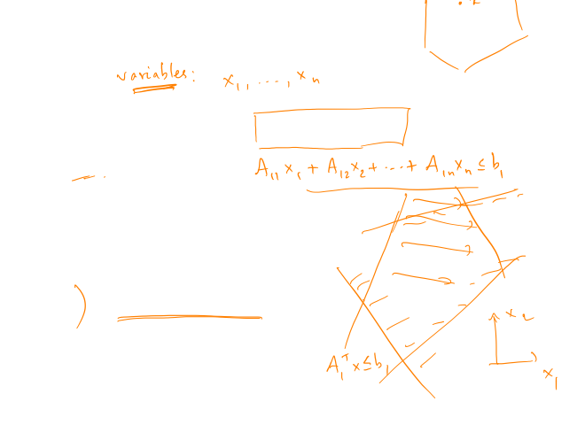
Linear programming
Geometric view: minimize c₁x₁ + … + c_{n} x_{n}, subject to
A₁^{T}x <= b₁
A₂^{T}x <= b₂
…
“polytope” – int of half-spaces

Slide 14
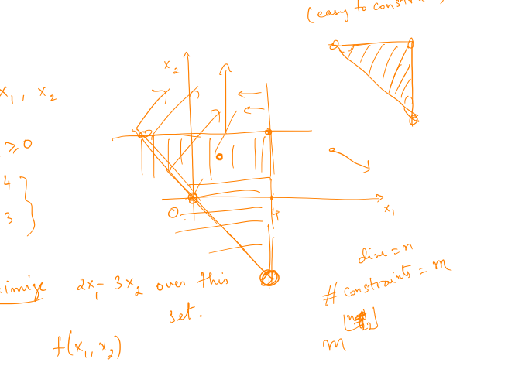
Polytope in 2D

Slide 15


Key observation
Claim: point x that attains the minimum is always a “corner point” of the polytope.

Slide 16
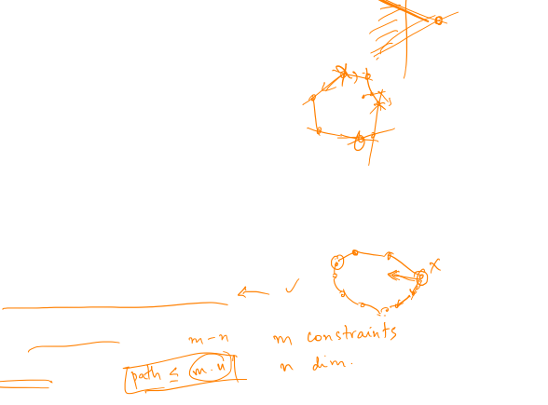
Simplex algorithm – idea
Rough algorithm: move from vertex to “neighboring” vertex, until no “local” improvement in objective is possible.. (why?)
how to find the starting vertex?
many possibilities to move!
Hirsch conjecture
Not known if it can be made poly!

Slide 17

Simplex algorithm – “proof”

Slide 18

Applications of LP
Flow problems
Network optimization (transportation, etc.)
Resource allocation
Problems with “continuous” parameters that need optimization
[Dantzig survey]

Slide 19
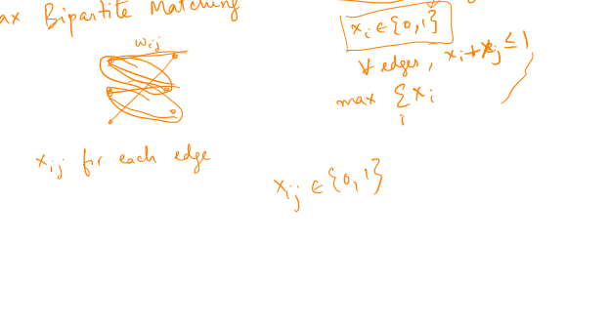
LP for “discrete” problems?

Slide 20
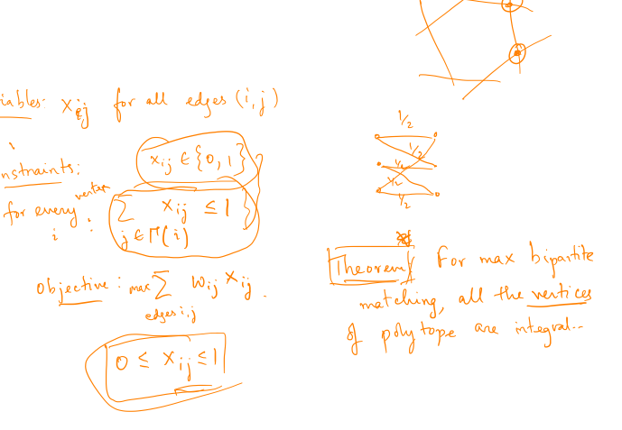
Maximum matching

Slide 21
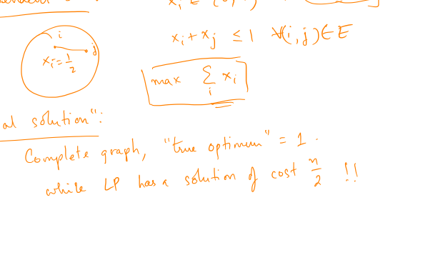
“Rounding” solutions

Slide 22
Approximation – vertex cover

Slide 23
“Randomized” rounding
“Congestion minimization” problem:

