Slide 1
CS 6150: Lecture 22 Linear Programming II:
Approximations

Slide 2
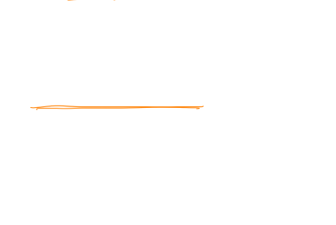
Last couple of lectures
Phrase problems as optimization
maximize f(x) subject to …..
“rule of thumb”: minimizing a convex function over a convex set is easy
general algorithm: local search / gradient descent
LOCAL OPT = GLOBAL OPT!!

Slide 3
Convex function
Convex function on “domain” S: for any x, y in S,
f(x/2 + y/2) ≤ (1/2) f(x) + (1/2) f(y)

Slide 4
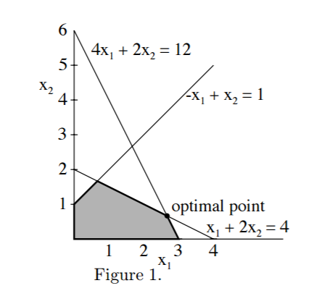
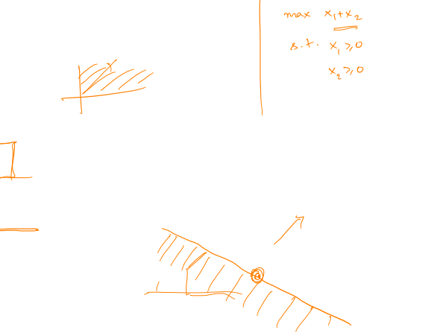
Linear programming – 2D
max x₁ + x₂, subject to
x₁ + 2x₂ ≤ 4
4x₁ + 2x₂ ≤ 12
-x₁ + x₂ ≤ 1
0 ≤ x₁, x₂

Slide 5
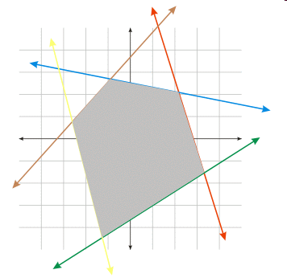
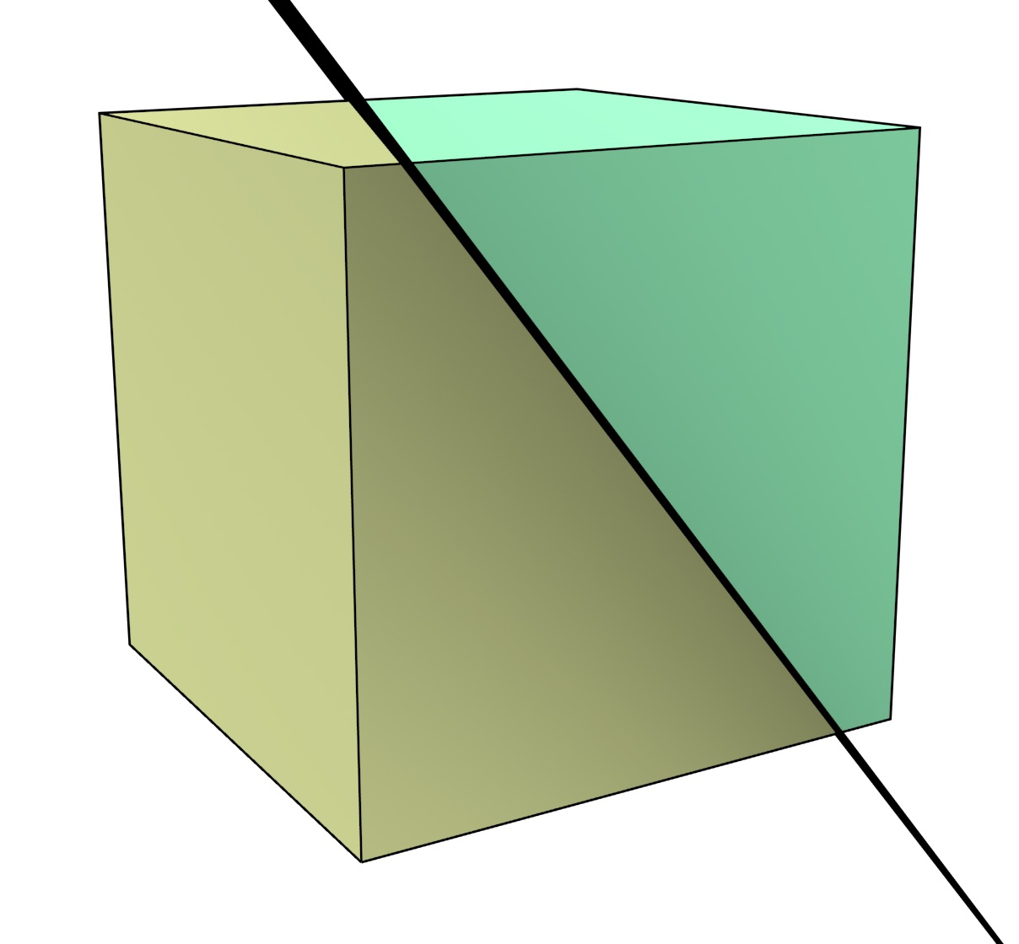
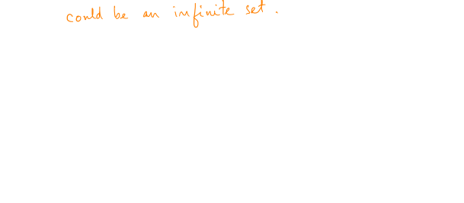
Linear programming (LP)
Geometric view: minimize c₁x₁ + … + c_{n} x_{n}, subject to
A₁^{T}x <= b₁
A₂^{T}x <= b₂
…
“polytope” – int of half-spaces

Slide 6
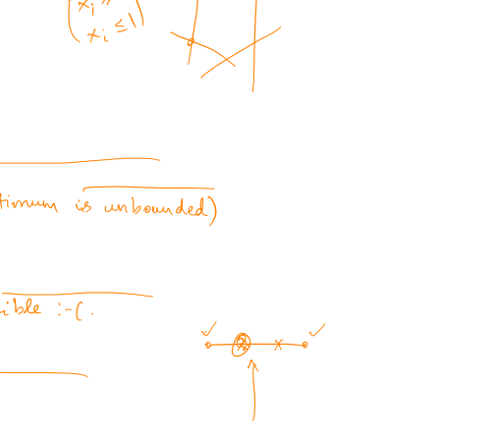
Key observation
Claim: for any linear function, the point x that attains the minimum is always a “corner point” of the polytope.
Idea for maximizing: check all corner point vals!
** Basis for the “simplex” algorithm

Slide 7

Simplex algorithm – idea
Rough algorithm: move from vertex to “neighboring” vertex, until no “local” improvement in objective is possible.. (why?)
how to find the starting vertex?
many possibilities to move!
Hirsch conjecture
Not known if it can be made poly!

Slide 8
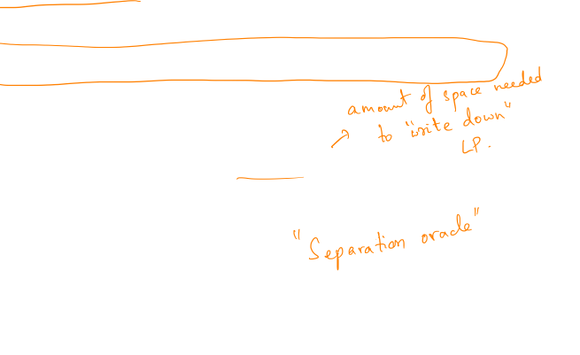
Polynomial time: ellipsoid algo
[Khachiyan – 1979]
Lecture notes link: on course page (Michel Goemans)
Bottomline:
LP’s can be solved in time poly(“size”)
Sometimes, can solve LP’s with n vars, exp(n) constraints, in time poly(n)!

Slide 9
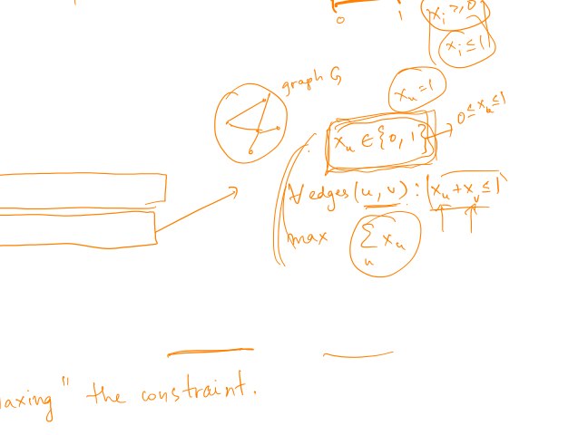
LP for “discrete” problems?
Min spanning tree
Max weight matching
Max independent set
Vertex cover
What if we replace x \in {0,1} with 0 <= x <= 1

Slide 10

Polytope has 0/1 vertices
Min spanning tree
Max weight bipartite matching
Max independent set
Vertex cover

Slide 11
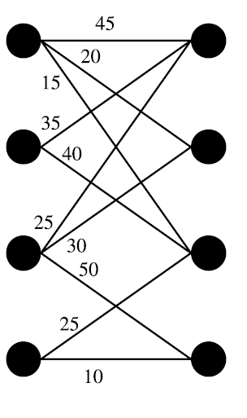
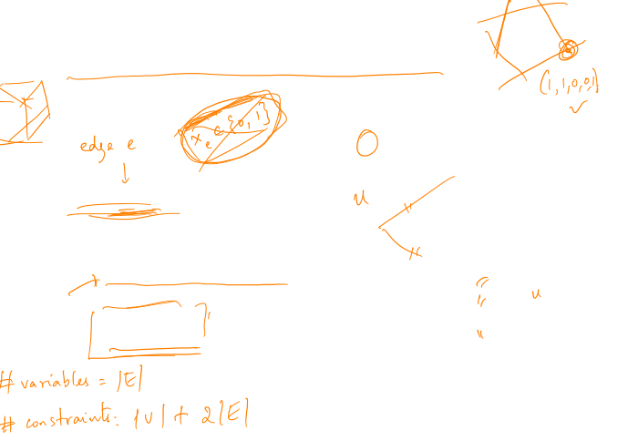

Weighted bipartite matching
max $\sum_{e}{w_{e} x_{e}}$ subject to
for all u: $\sum_{\left\{e∈Γ\left(u\right)\right\}}{x_{e}}≤1$ , and
$$0≤x_{e}≤1$$

Slide 12
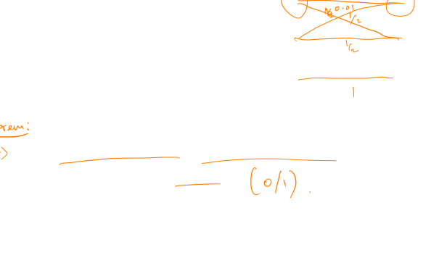
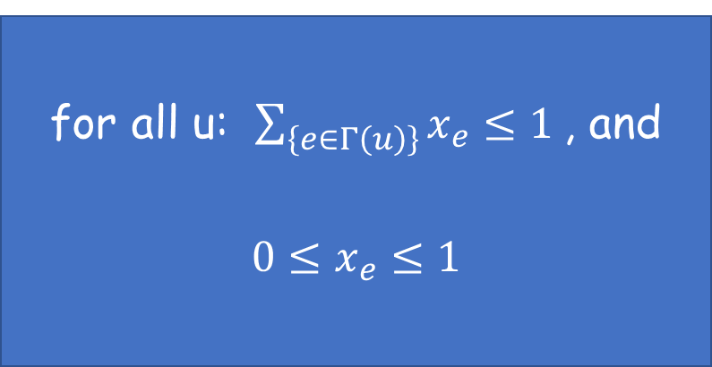
Bipartite matching polytope
for all u: $\sum_{\left\{e∈Γ\left(u\right)\right\}}{x_{e}}≤1$ , and
$$0≤x_{e}≤1$$
All “corners” of this polytope turn out to be “integral”

Slide 13
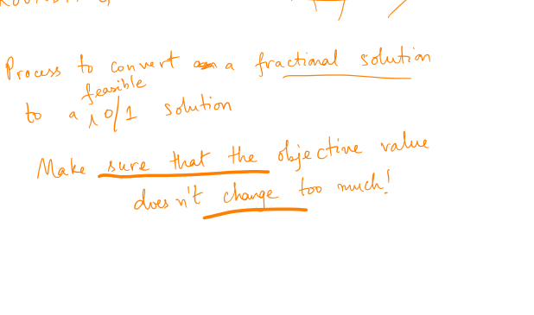
What if corners aren’t integral?

Slide 14
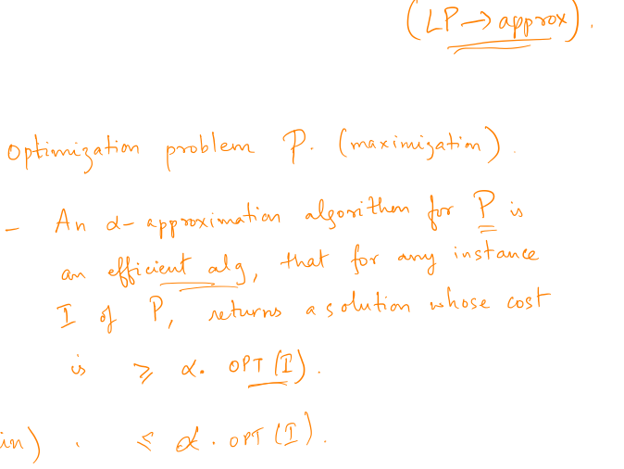
Approximation algorithms

Slide 15
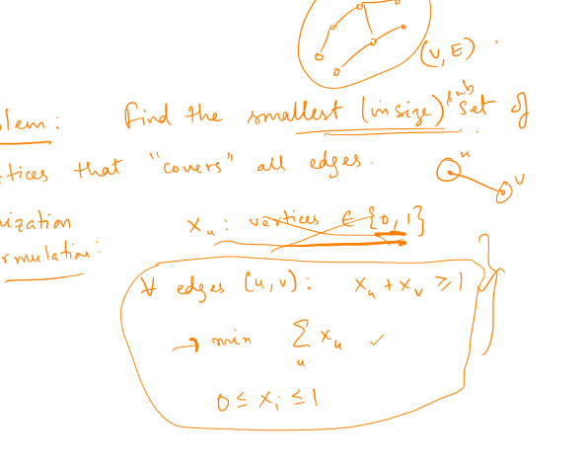
Vertex cover

Slide 16
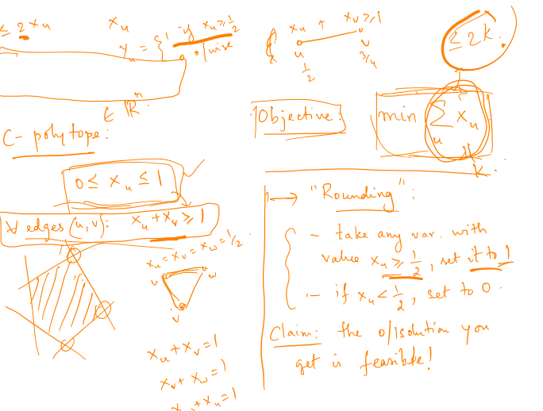
Vertex cover

Slide 17
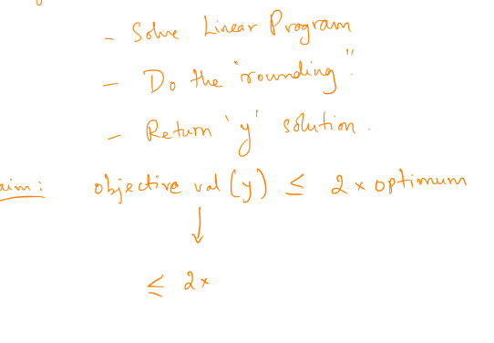
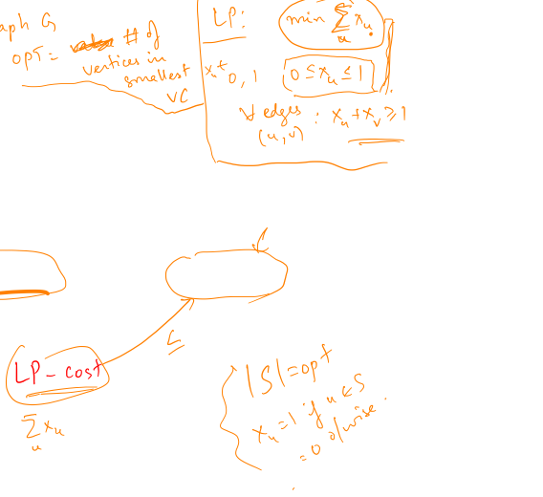

Slide 18
Congestion minimization
Problem: given (s₁, t₁), (s₂, t₂), …., (s_{k}, t_{k}), find paths from s_{i} to t_{i} for all i, so as to minimize the “max congestion” over edges

Slide 19
“Flow” intuition

Slide 20
Linear program

Slide 21
“Rounding”

Slide 22
Randomized rounding

