Slide 1
CS 6150: Lecture 23 Linear Programming:
“Rounding”, Intro to duality

Slide 2
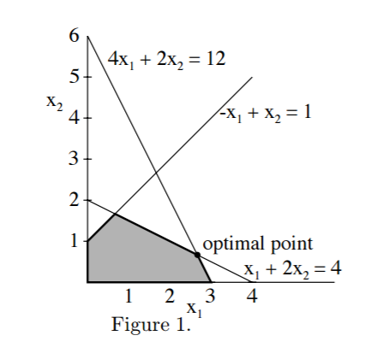

Linear programming – 2D
max x₁ + x₂, subject to
x₁ + 2x₂ ≤ 4
4x₁ + 2x₂ ≤ 12
-x₁ + x₂ ≤ 1
0 ≤ x₁, x₂

Slide 3

LP review
[Khachiyan – 1979]
LP’s can be solved in time poly(“size”)
Special case of convex optimization
Linear ineqs define “polytope”, max/min attained at a corner point

Slide 4

LP for discrete problems
Examples: Max bipartite matching, min vertex cover
max x₁ + x₂ + … + x_{n}, subject to
x_{i} + x_{j} >= 1 for all edges (i,j)
x_{i} either 0 or 1 for all i
“relaxing”: replace $x_{i}∈\left\{0,1\right\}$with 0 <= x_{i} <= 1

Slide 5
LP for discrete problems
Bipartite matching: relaxing does not change polytope! (all corners integral to start with)
Vertex cover: relaxing can “create” spurious corners

Slide 6
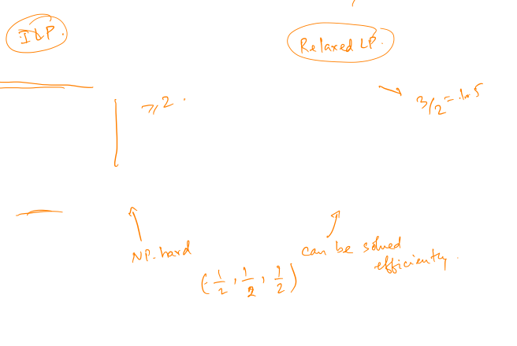

Integer LP vs LP
min x₁ + x₂ +x₃, subject to
x₁ + x₂ >= 1
x₂ + x₃ >= 1
x₃ + x₁ >= 1
$x_{i}∈\{0,1\}$
min x₁ + x₂ +x₃, subject to
x₁ + x₂ >= 1
x₂ + x₃ >= 1
x₃ + x₁ >= 1
0 <= x_{i} <= 1

Slide 7

ILP vs LP
Objective val (LP) <= Objective val (ILP)
[min problem]
ILP is often NP hard to solve, while LP is in P
“Relax and round” paradigm: to solve ILP, first solve LP, and if opt solution is fractional, “round” it
powerful way to get “approx. algorithms”

Slide 8

“Rounding” corner points
Example: factor 2 approximation for “vertex cover”
Rounding very simple: fractional x -> integral y
if x_{u} >= 1/2, round up to 1 (i.e., set y_{u} = 1)
else, round down to 0 (i.e., set y_{u} = 0)
Claim: y is a feasible solution to ILP

Slide 9
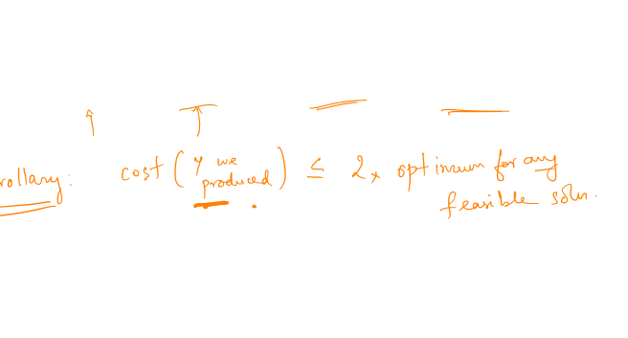
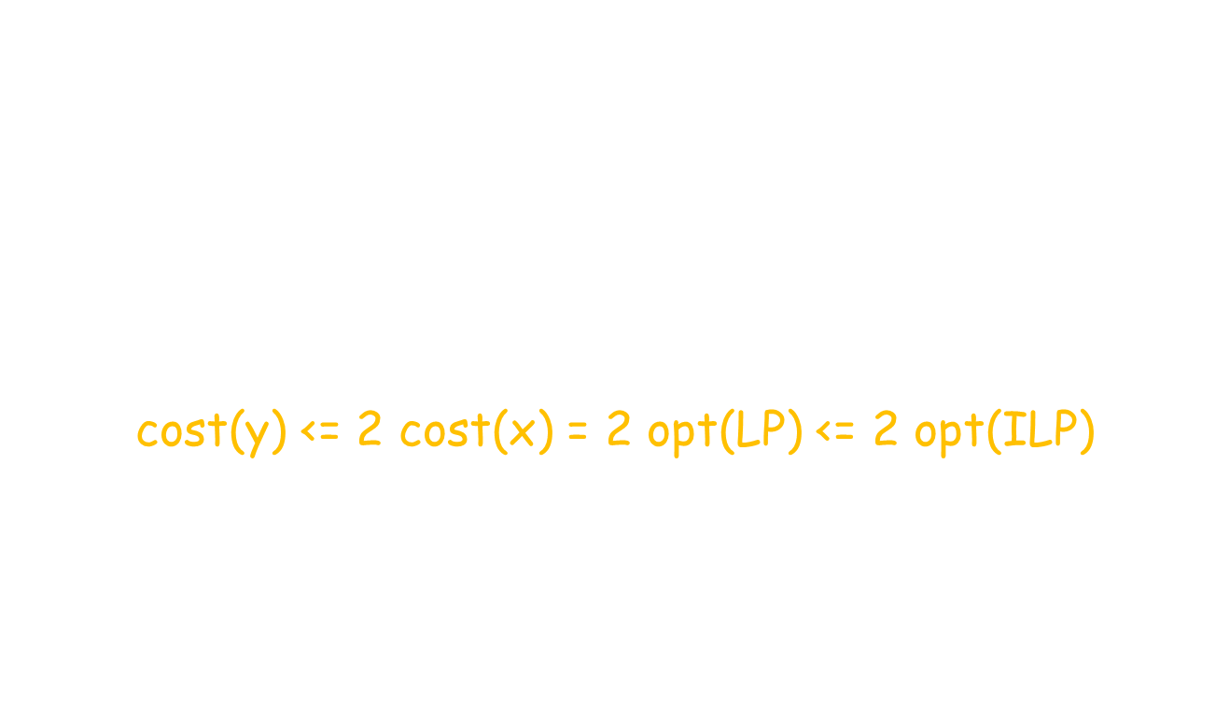
“Rounding” corner points
Claim 2: $\sum_{i}{y_{i}≤2 \sum_{i}{x_{i}}}$
“Chain” of ineqs:
cost(y) <= 2 cost(x) = 2 opt(LP) <= 2 opt(ILP)

Slide 10
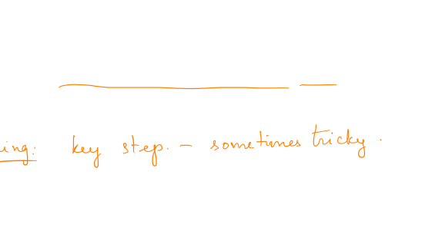
Relax and round
Key: new way to obtain approximation algorithms, and novel “proof” of correctness
Useful for many problems – clustering, scheduling, graph problems, covering, flows, etc.

Slide 11
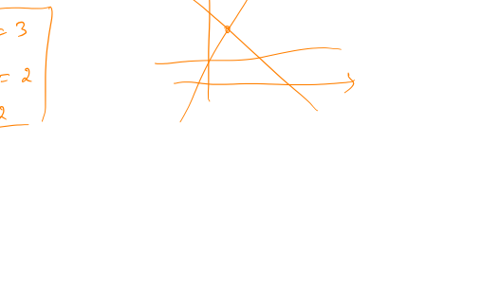
More on LPs : infeasibility
Simpler question: when is a set of linear equalities infeasible?
Example in 2D

Slide 12
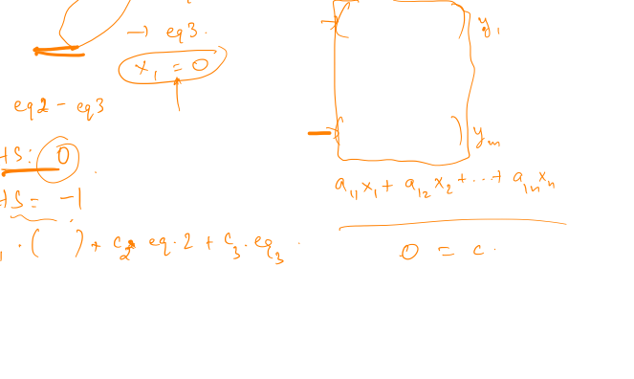
Infeasibility – algebraic view
x₁ + x₂ + x₃ = 2
x₂ + x₃ = 1
x₁ = 2
A₁^{T} x = b₁
A₂^{T}x = b₂
…
A_{m}^{T} x = b_{m}

Slide 13
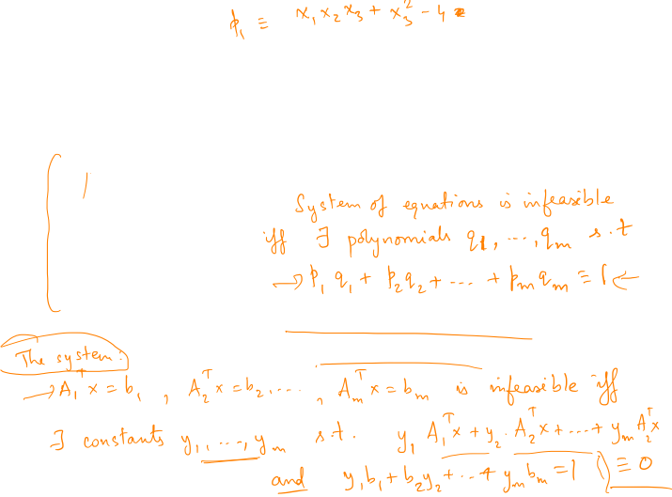
Infeasibility – algebraic view
p₁ (x) = 0
p₂ (x) = 0
p₃ (x) = 0
…
p_{m} (x) = 0
Very general theory: “Hilbert’s Nullstellensatz”
Linear systems – can be proved via basic linear algebra:

Slide 14
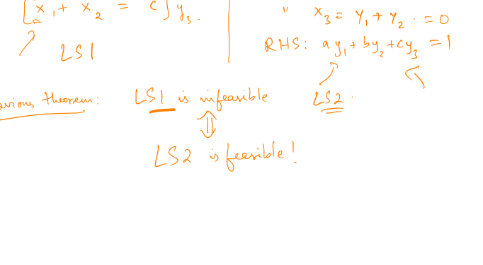
How to check infeasibility?

Slide 15
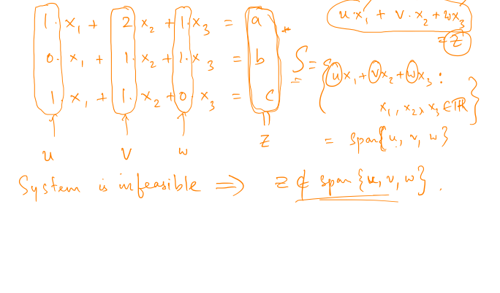
Idea of proof

Slide 16
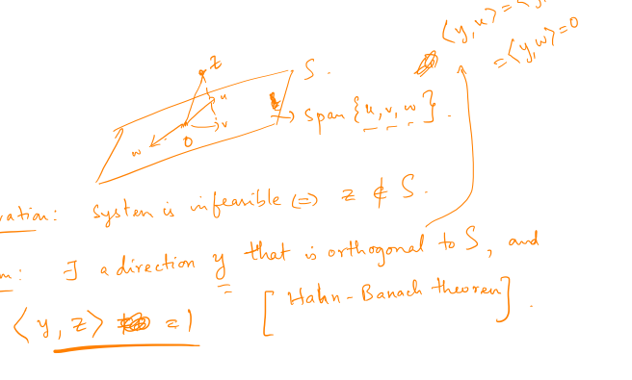
Idea of proof

Slide 17
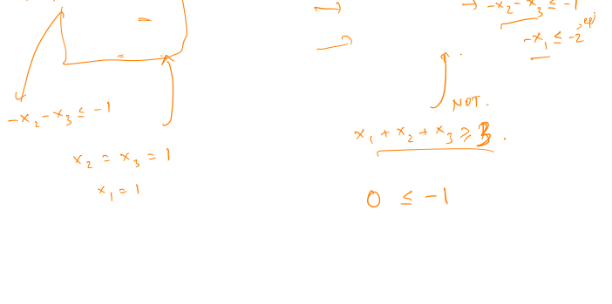
What about inequalities?
x₁ + x₂ + x₃ >= 2
x₂ + x₃ >= 1
x₁ <= 2
x₁ + x₂ + x₃ <= 2
x₂ + x₃ >= 1
x₁ >= 2

Slide 18
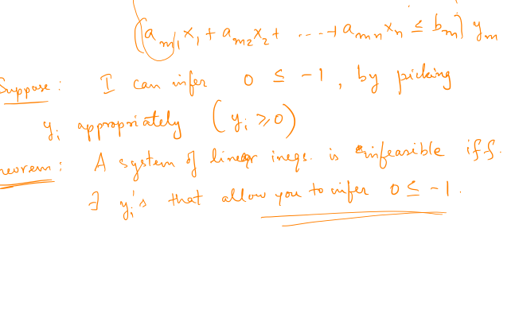
More on LPs : infeasibility

