Slide 1
CS 6150: Lecture 24 Linear Programming:
Duality

Slide 2
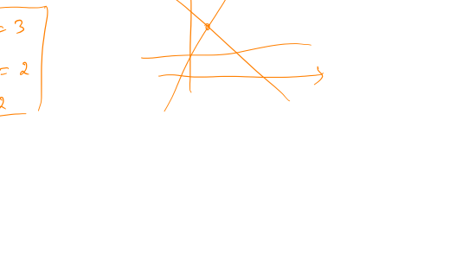

Linear equalities – infeasibility
Simpler question: when is a set of linear equalities infeasible?
Example in 2D

Slide 3
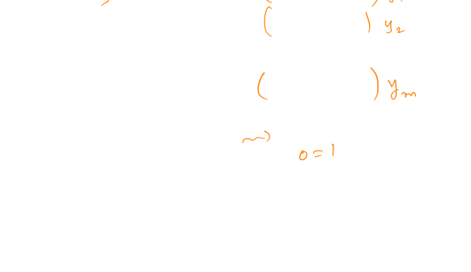
Proving infeasibility
x₁ + x₂ + x₃ = 2
x₂ + x₃ = 1
x₁ = 2
A₁^{T} x = b₁
A₂^{T}x = b₂
…
A_{m}^{T} x = b_{m}
General meth: “manipulate” ineqs until you get 0 = 1
y₁ (eq1) + y₂ (eq2) + … + y_{m} (eqm)

Slide 4
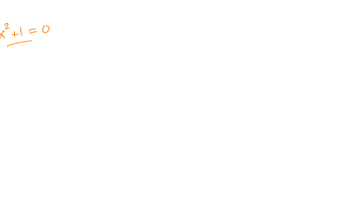
General theory
p₁ (x) = 0
p₂ (x) = 0
p₃ (x) = 0
…
p_{m} (x) = 0
Polynomial equations: “Hilbert’s Nullstellensatz”
infeasible iff there exist q₁, .., q_{m}
s.t. p₁q₁ + p₂q₂ + .. + p_{m}q_{m} = 1
Our focus: linear systems

Slide 5

How to check infeasibility?
Key obs: infeasibility test is itself a linear system!
x₁ + x₂ + x₃ = 2
x₂ + x₃ = 1
x₁ = 2

Slide 6
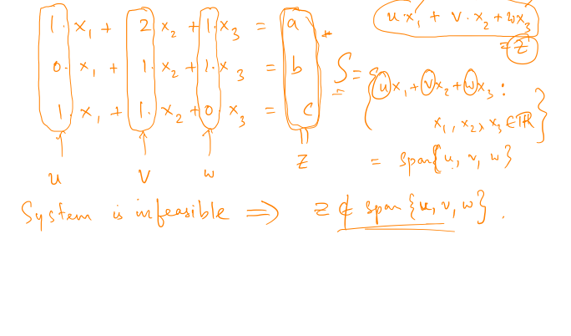
Idea of proof

Slide 7
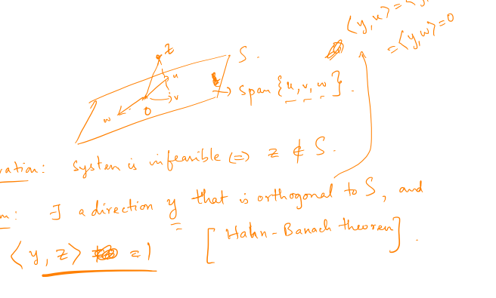

Idea of proof

Slide 8
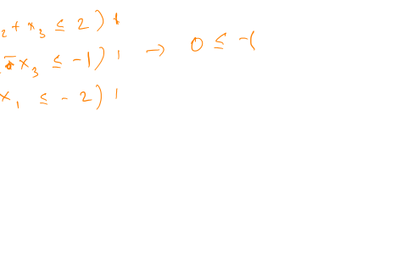
What about inequalities?
x₁ + x₂ + x₃ >= 2
x₂ + x₃ >= 1
x₁ <= 2
x₁ + x₂ + x₃ <= 2
x₂ + x₃ >= 1
x₁ >= 2

Slide 9
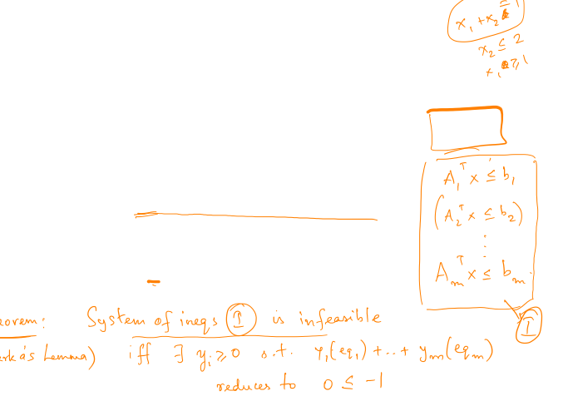
More on LPs : infeasibility
General meth: “manipulate” ineqs until you get 0 <= -1
y₁ (eq1) + y₂ (eq2) + … + y_{m} (eqm)
key difference: y_{i} are non-negative!

Slide 10
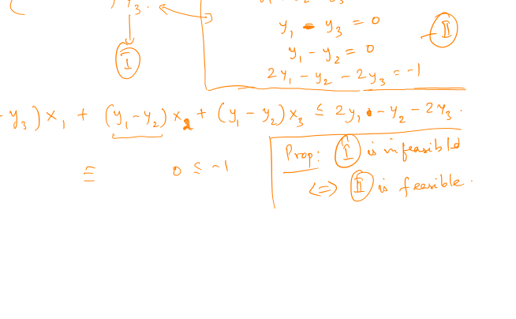
Infeasibility as another system
x₁ + x₂ + x₃ <= 2
- x₂ - x₃ <= -1
- x₁ <= -2

Slide 11
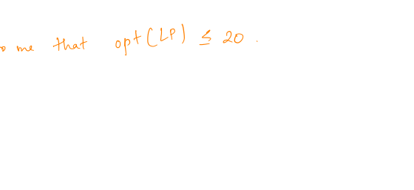
Back to linear programs
max x₁ + x₃
x₁ + x₂ + x₃ <= 2
x₂ + x₃ >= 1
x₃ <= 2

Slide 12
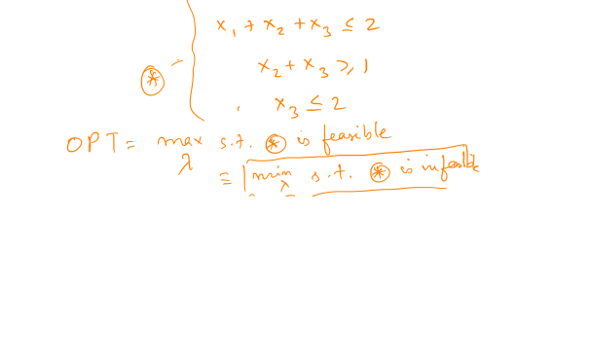
Objective fn as constraint?
max x₁ + x₃
x₁ + x₂ + x₃ <= 2
x₂ + x₃ >= 1
x₃ <= 2

Slide 13
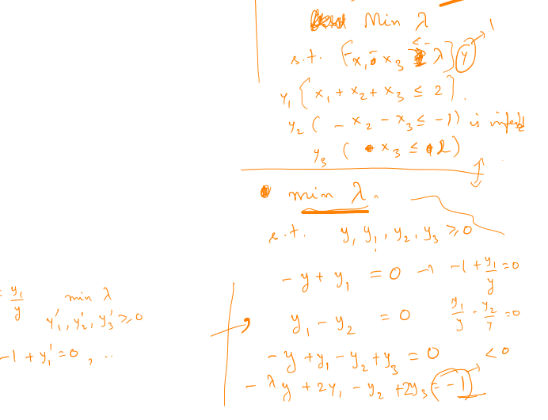
The dual problem
max x₁ + x₃
x₁ + x₂ + x₃ <= 2
x₂ + x₃ >= 1
x₃ <= 2

Slide 14
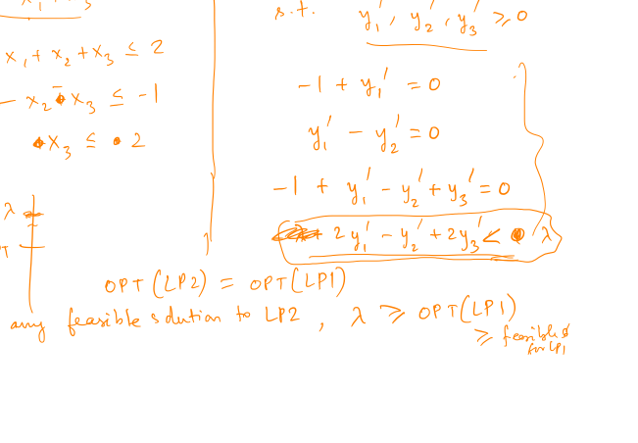
More general example

Slide 15
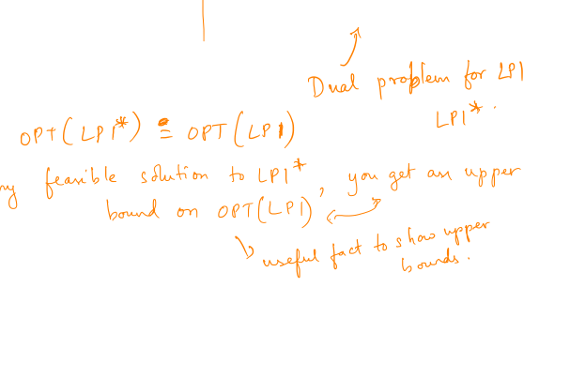
Duality theorem

Slide 16
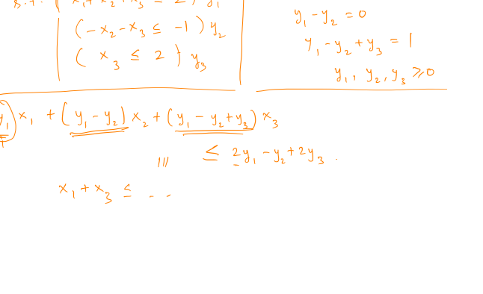
Other “forms”

Slide 17
Application: max flow LP

Slide 18
The dual

Slide 19
Integral solutions to the dual

