Slide 1
CS 6150: Lecture 25 Duality and Applications

Slide 2

Announcements
No HW6! (grading delays, end of sem blues, …)
“Makeup” HW out on Wed (submit in 2 weeks)

Slide 3

Proving infeasibility
A₁^{T} x = b₁
A₂^{T}x = b₂
…
A_{m}^{T} x = b_{m}
General way: “manipulate” ineqs until you get 0 = 1
y₁ (eq1) + y₂ (eq2) + … + y_{m} (eqm)

Slide 4

What about lin inequalities?
x₁ + x₂ + x₃ <= 2
- x₂ - x₃ <= -1
-x₁ <= -2
General way: “manipulate” ineqs until you get 0 <= -1
y_{i} >=0, s.t. y₁ (eq1) + y₂ (eq2) + … + y_{m} (eqm)

Slide 5

Infeasibility as another system
system I
system II
x₁ + x₂ + x₃ <= 2
- x₂ - x₃ <= -1
- x₁ <= -2
y₁ – y₃ = 0
y₁ – y₂ = 0
2y₁ – y₂ – 2y₃ = -1
y₁, y₂, y₃ >= 0
Theorem: there exists a feasible solution to I iff there is no feasible solution to II

Slide 6
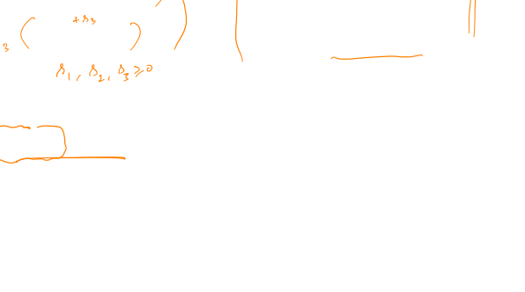
Linear programs
max x₁ + x₃
x₁ + x₂ + x₃ <= 2
- x₂ - x₃ <= -1
x₃ <= 2
min 2y₁ – y₂ + 2y₃
y₁ = 1
y₁ – y₂ = 0
y₁ – y₂ + y₃ = 1
y₁, y₂, y₃ >= 0
Idea: try to manipulate constraints, and obtain x₁ + x₃ <= Z, for smallest possible Z

Slide 7
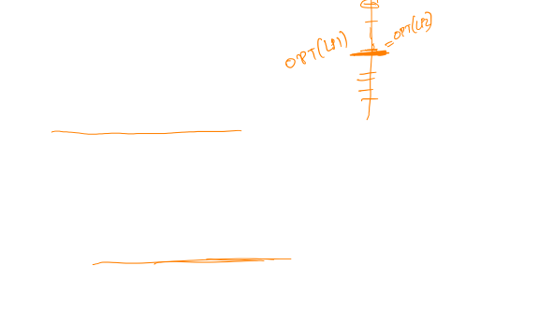
Duality theorem
Theorem: suppose LP1 (primal) is feasible, and opt is bounded; then there is a feasible soln to LP2 (dual), and opt(LP1) = opt(LP2).
Any feasible soln to dual gives “upper bound” on primal opt.

Slide 8
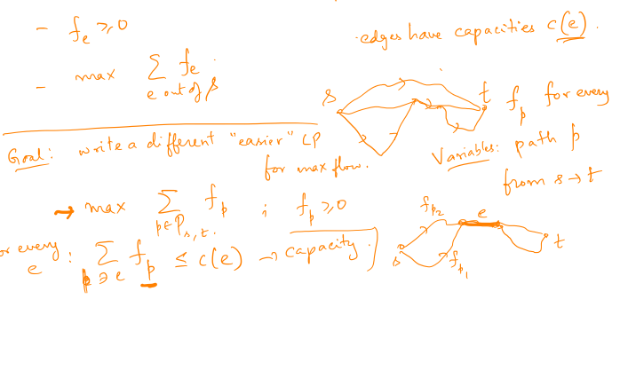
Application: max flow LP

Slide 9
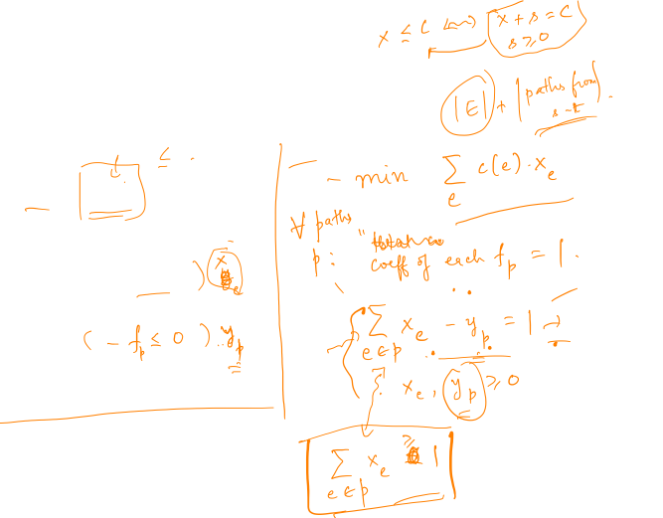

Writing the dual
max $\sum_{p}{f_{p}}$
$$∀e: \sum_{p ∋ e}{f_{p}≤c(e)}$$
$$f_{p}≥0$$

Slide 10
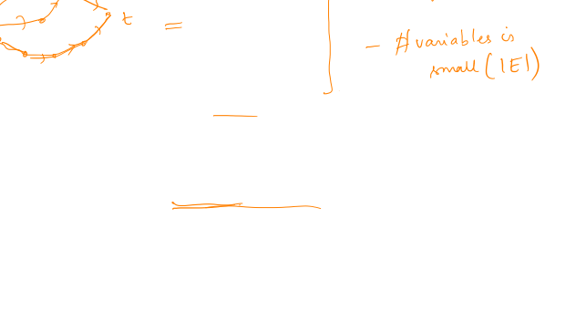

The dual
min $\sum_{e}{c\left(e\right){ x}_{e}}$
$$∀p: \sum_{e ∈ p}{x_{e}≥1}$$
$$x_{e}≥0$$
Interpretation: “length” for every edge

Slide 11
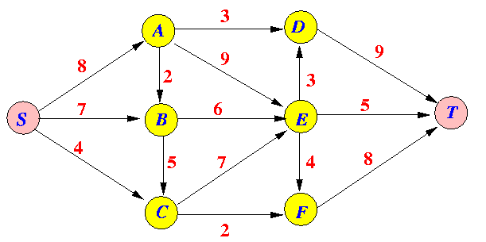
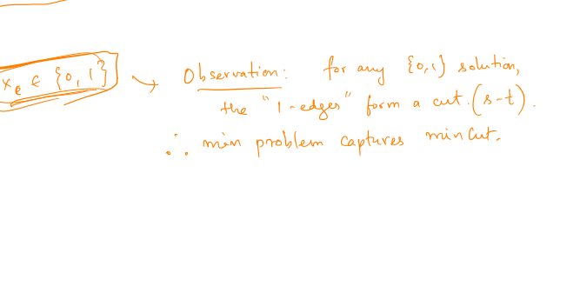

Integral solutions to the dual
min $\sum_{e}{c\left(e\right){ x}_{e}}$
$$∀p: \sum_{e ∈ p}{x_{e}≥1}$$
$$x_{e}≥0$$

Slide 12
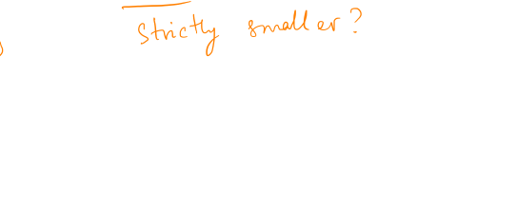

The dual and min cut?
min $\sum_{e}{c\left(e\right){ x}_{e}}$
$$∀p: \sum_{e ∈ p}{x_{e}≥1}$$
$$x_{e}≥0$$
Claim: OPT(dual) <= val of min cut between s and t.

Slide 13
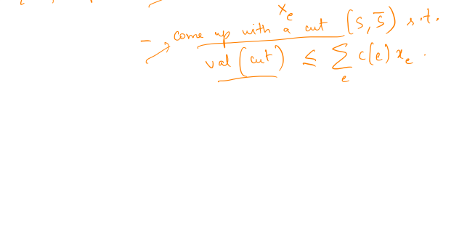
Can there be smaller frac soln?
min $\sum_{e}{c\left(e\right){ x}_{e}}$
$$∀p: \sum_{e ∈ p}{x_{e}≥1}$$
$$x_{e}≥0$$
Theorem: OPT(dual) = val of min cut between s and t.

Slide 14
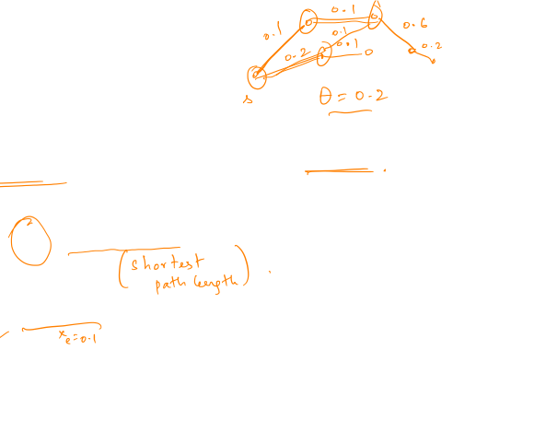

Proof of equality
Key idea: “distance cuts”
For any θ, define S_{θ} as vertices at distance <= θ from source
min $\sum_{e}{c\left(e\right){ x}_{e}}$
$$∀p: \sum_{e ∈ p}{x_{e}≥1}$$
$$x_{e}≥0$$

Slide 15
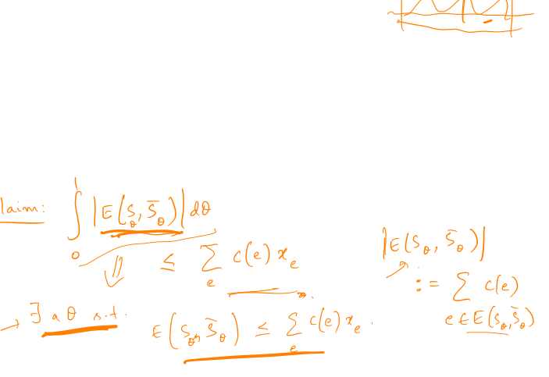
“Average” distance cut
For any θ, define S_{θ} as vertices at distance <= θ from source

Slide 16
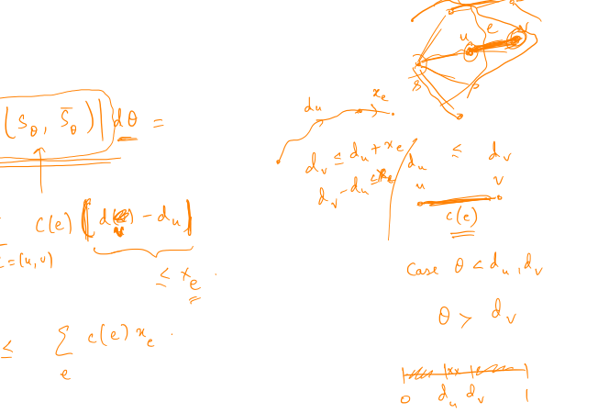
Analyzing a single edge

Slide 17
Alt proof: Max flow = Min cut
Theorem: OPT(dual) = val of min cut between s and t.
Combine with duality [OPT(primal) = OPT(dual)]

Slide 18

Recap of LP
Useful to capture cont. opt problems (flows, …)
Useful even for discrete opt, need to do “rounding”
Duality – allows bounding OPT value for an LP
Other applications – game theory, economics, …

Slide 19

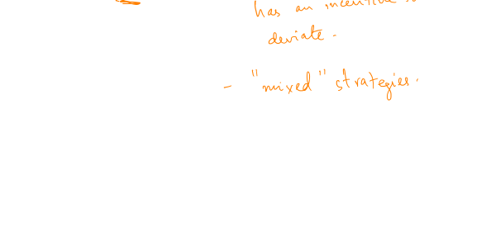
Basic ideas of 2-player games
“Equilibrium”?

Slide 20
Zero sum games

Slide 21
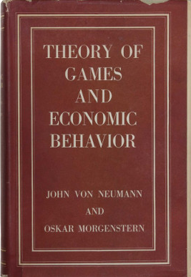
Von Neumann’s theorem

Slide 22
Final project info

Slide 23
Final project info
Hints:
can use other resources online (lecture notes, etc)
discuss with partner – supposed to produce one report per group

Slide 24

Report details
Two pages long
Should contain:
Problem statement
Background / importance / previous results (short summ)
Why difficult? -- (tricky step)
Main result (statement)
Outline of algorithm (main steps, assuming subroutines)
Outline of proof – “structure”

Slide 25
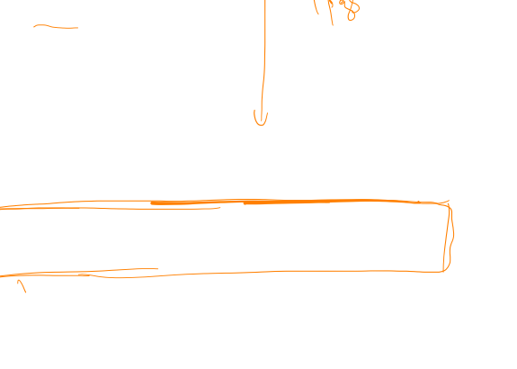
Outline of proof
Rough idea: intuitive
Main lemmas (restate)
Why they imply main result
Key: should be “self-sufficient” -- modulo proof details

