Slide 1
CS 6150: Lecture 26 “Online” algorithms

Slide 2
Announcements
Make-up HW out (submit Sunday after Project)
See project template
HW solutions trickling in; please see TA’s for immediate questions

Slide 3
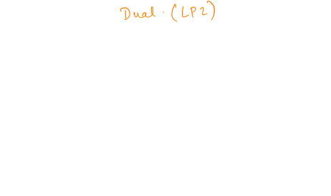
Last few weeks
Linear programs – how to write problems as LP
Duality: checking feasibility can be formulated as another linear system!
min b^{T}y subject to
y^{T}A = c
y >= 0
max c^{T}x subject to
Ax <= b

Slide 4
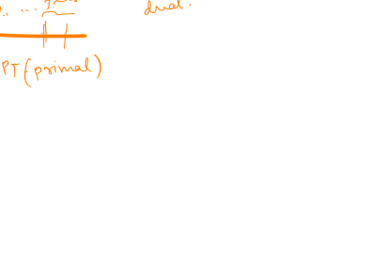
Duality theorem
Theorem: suppose LP1 (primal) is feasible, and opt is bounded; then there is a feasible soln to LP2 (dual), and opt(LP1) = opt(LP2).
Any feasible soln to dual gives “upper bound” on primal opt.

Slide 5

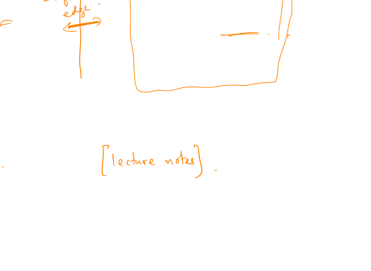

Application: max-flow/min-cut
max $\sum_{p}{f_{p}}$
$$∀e: \sum_{p ∋ e}{f_{p}≤c(e)}$$
$$f_{p}≥0$$
min $\sum_{e}{c\left(e\right){ x}_{e}}$
$$∀p: \sum_{e ∈ p}{x_{e}≥1}$$
$$x_{e}≥0$$
Dual can be interpreted as “lengths”
“Distance cuts”

Slide 6
Alt proof: Max flow = Min cut
Easy: OPT(primal) = val of max flow between s and t.
Theorem: OPT(dual) = val of min cut between s and t.
Combine with duality [OPT(primal) = OPT(dual)]

Slide 7

Algorithms under uncertainty
So far: well-defined problems, all input given
Often in practice: “vague” problem, e.g., cluster some data, predict some quantity

Slide 8
Decision making
To be or not to be?
Should I stay or should I go?

Slide 9

Decision making
What pages will a surfer visit next? (browser cache problem)
“Paging” in memory management – what pages will be accessed next?
Maintaining “portfolio” of stocks – which to buy/sell?
Hiring secretaries (or selling houses)

Slide 10

Types of guarantees
Compare with “offline” optimum (best in hindsight)
Weaker, problem-specific notions..
Coming up with “reasonable” assumptions

Slide 11
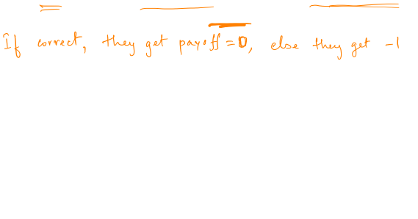
E.g.: a simple prediction game
Setting: n “experts”, each makes prediction each day
Goal: make prediction each day, maximize total payoff

Slide 12

E.g.: a simple prediction game
Setting: n “experts”, each makes prediction each day

Slide 13


What guarantee to expect?
Max possible payoff?
Impossible – adversary can always play against you..
Goal: compete with the “best expert in hindsight”

Slide 14
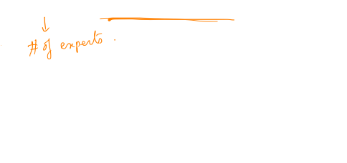
Surprising fact
Theorem: for any c>0, can always ensure that the number of “mistakes” made <= (1+c) (#mistakes by best expert) + O(log n). [Irrespective of T!]

Slide 15

Simpler case
Suppose there is an expert who is always right.. (i.e., # mistakes = 0)

Slide 16
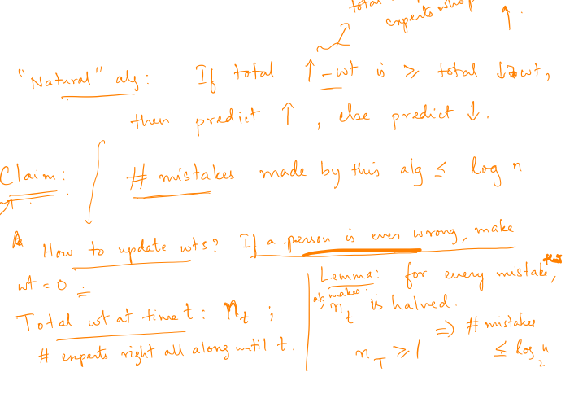
Simpler case
Suppose there is an expert who is always right.. (i.e., # mistakes = 0)

Slide 17
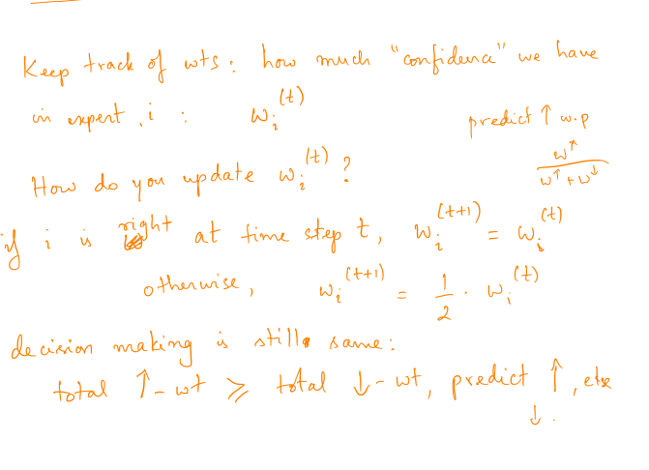

Slide 18
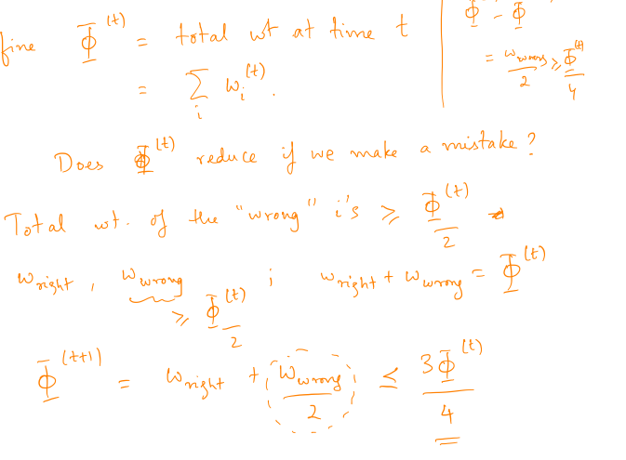

Slide 19
