Slide 1
CS 6150 – Lecture 3 Divide & Conquer

Slide 2
Last class
Divide and Conquer – Merge Sort + Correctness
Running time: T(N) = 2 T(N/2) + O(N)
Jeff Erickson’s lecture notes (UIUC)

Slide 3
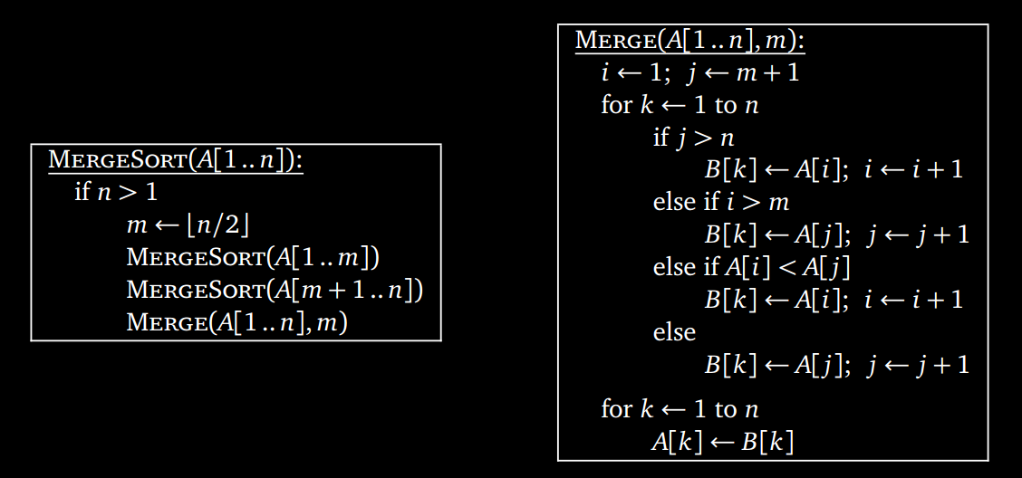
Merge Sort

Slide 4
Today
How to obtain “closed form” solutions to recurrences
Another example: divide & conquer can be tricky: multiplying two N digit numbers

Slide 5
Recurrence relation
Relation that bounds a function “recursively” or inductively
Examples:
f(N) = f(N-1) + 2
f(N) = f(N-1) + f(N-2)
f(N) = 2 f(N/2)
f(N) <= 3 f(N/2) + 41
f(N) = g(N/2) + f(3N/4); g(N) = 1 + g(N/2) + f(N/2)

Slide 6
How to “solve”?
No general method – a la integration
‘Master’ theorem
Heuristic calculation -> guess answer -> prove by induction!

Slide 7
The “recursion tree”
Example: f(N) = f(N-1) + 2
How many layers? Steps in each layer?

Slide 8
Depth of tree?
N → N/c → N/c^2 → N/c^3 → …
How many steps to reach constant? (c>1)
c = 2
c = 20
c = 0.999 (1-ε)

Slide 9
Summing geometric series
What is: 1 + x + x^2 + x^3 + … + x^k ?
Answer very simple in big-oh notation!

Slide 10
Another example
Example: f(N) = 3 f(N/2) + 41
How many layers? Steps in each layer?

Slide 11
f(N) = 3 f(N/2) + 41
What is depth?
Depth ‘k’ : 3^k copies of f(N / 2^k) + 3^(k-1) * 41
Total value? Say f(1) = 5

Slide 12
f(N) = 3 f(N/2) + 41

Slide 13
Merge sort – f(N)=2f(N/2)+N

Slide 14
Multiplying two N-digit integers
Elementary school
5 6 4 9 3
x 2 1 2 3 4
------------------------
2 2 5 9 7 2
1 6 9 4 7 9
1 1 2 9 8 6
5 6 4 9 3
1 1 2 9 8 6
-------------------------

Slide 15
Divide and conquer
x₁ x₂ x₃ x₄ …. x_{N} * y₁ y₂ y₃ y₄ …. y_{N}

Slide 16
Divide and conquer
Suppose we find A*C, A*D, B*C, B*D, can find X*Y in
additional O(n) time..
T(N) = 4 T(N/2) + O(N)

Slide 17
Doing better
We don’t really need all 4 terms…
X * Y = (AC) 10^{N} + (AD+BC) 10^{N/2} + BD
Knowing AC and BD, can we find AD+BC faster?

Slide 18
Karatsuba’s algorithm
Multiply(X, Y):
- divide X, Y into blocks of size N/2 (A,B,C,D)
- Multiply(A, C)
- Multiply(B, D)
- Multiply(A-B, C-D)
- find AD + BC, return answer
T(N) = 3 T(N/2) + O(N)

Slide 19
Running time
T(N) = 3 T(N/2) + O(N)

Slide 20
Musings on lower bounds
Are there faster algorithms for multiplying two N-digit numbers?
Are there even faster algorithms? Can we prove there are none?

Slide 21
Finding the median of N no.s
Median = N/2’th smallest number
trivial : O(N log N)
Solve a harder problem – find k’th smallest number, for any k in time O(N)

Slide 22
Next class
Recursion++ : dynamic programming

