Slide 1
CS 6150 : Lecture 4 Divide & Conquer, DP

Slide 2

Last class
How to solve recurrences (recursion tree)
No single method (guess + induction works best)
Counting “cost at each level” in tree gives intuition
“Fast” integer multiplication -- O(n^{1.59})
HW1 out tonight! Due in two weeks.
(Hint: start early)

Slide 3
Today
How to find median of N numbers
Dynamic programming

Slide 4

Finding the median
Problem: given an array A[0 … N-1], find the N/2’th smallest element
Unlikely recipe: solve problem X, solve more general version of X, use to solve X
“Selection” problem: given an array A[0 … N-1] and k, find the k’th smallest element

Slide 5

Selection
Problem: given an array A[0 … N-1] and k, find the k’th smallest element
O(N log N)?
Eternal question: can we do better?

Slide 6
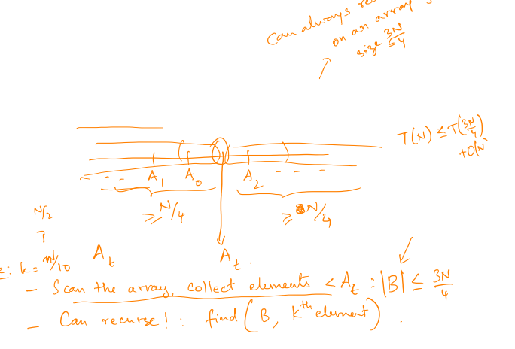
What if…
I tell you r^{th} smallest number for some r in the range (N/4, 3N/4)? (roughly in the middle)

Slide 7
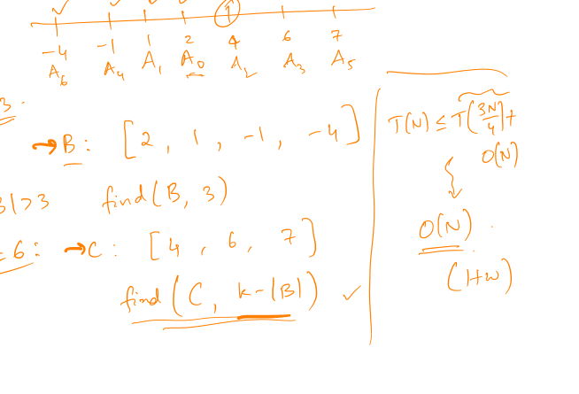

Slide 8
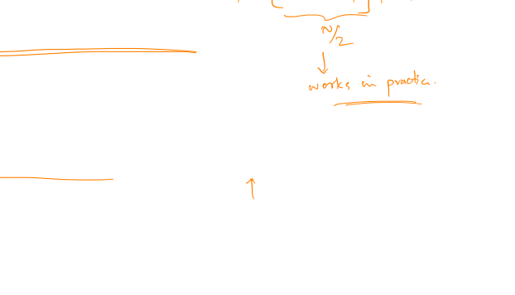
How can we find it?
Pick a number at random?
Can we do this “deterministically”?
Goal: given an array, find a number that is
“roughly in the middle” (r’th smallest, r in [N/4, 3N/4])

Slide 9
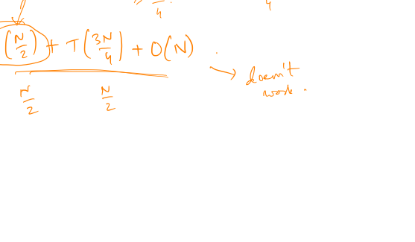
Idea 1
Pick N/2 arbitrary numbers, find their median

Slide 10


The trick
Divide into groups of large const size (>= 5)
Median of medians

Slide 11
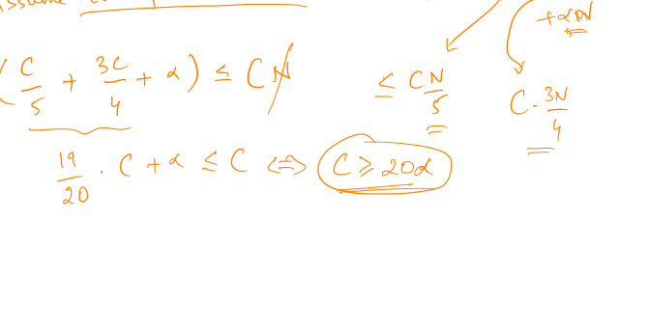
Pro tip
How to guess and prove by induction

Slide 12
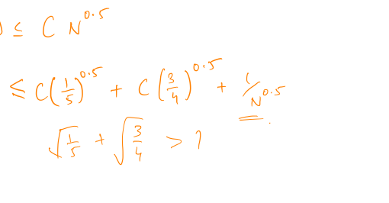

Slide 13
Dynamic Programming
Recursion ++

Slide 14
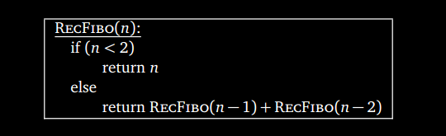
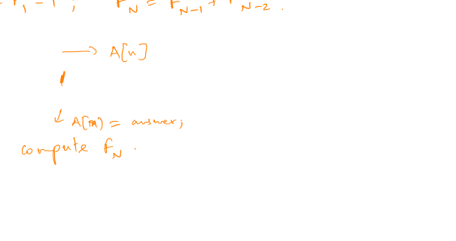
Recursive algorithm for F_{n}

Slide 15
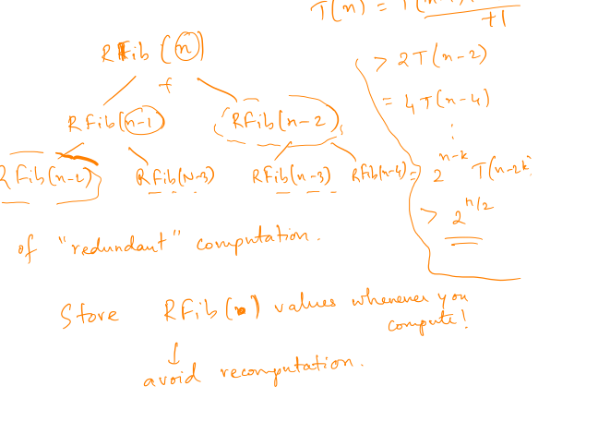
Running time?

Slide 16

Algorithm with memorization

Slide 17
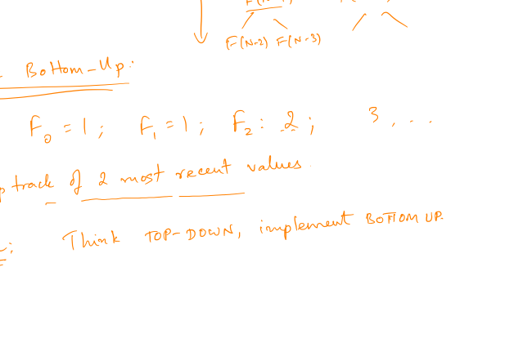
Wasting memory?

Slide 18

General views of DP
Recursion done “right”
Think top-down, implement bottom-up
Come up with recursive alg, “Ah, I can reuse computation”, remember answers..
Be aware of memory!

Slide 19

Eg 2: longest inc subsequence
Problem (LIS): given an array A[0 … N-1], find “sub-array” of largest size that is in increasing order.
45 | 9 | 16 | 5 | 13 | 7 | -1 | 21 | 32 | 4

Slide 20
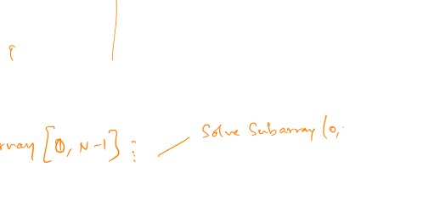
LIS
45 | 9 | 16 | 5 | 13 | 7 | -1 | 21 | 32 | 4
What is the longest seq starting at 9?

Slide 21
LIS – Algorithm
45 | 9 | 16 | 5 | 13 | 7 | -1 | 21 | 32 | 4

Slide 22
LIS – Proof
45 | 9 | 16 | 5 | 13 | 7 | -1 | 21 | 32 | 4

Slide 23
LIS – Can we do faster?
45 | 9 | 16 | 5 | 13 | 7 | -1 | 21 | 32 | 4
Subroutine: in a sub-array, find the index ‘i’ such that (a) A[i] > x, and (b) has max value of LIS[.]
A clever data structure?

